Slide 1

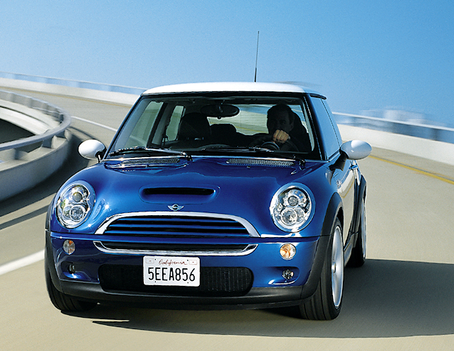
MINI- market success niche model.
MINI -brand belonging to BMW concern, achieves success on the whole world. Undoubted influence on this success has a perfect suspension. This suspension uses front and rear modules, supplying by Delphi. In front module was applied twin-tube strut, rear suspension uses twin-tube shock absorber. Delphi technology which was apply, secures perfect control for car dynamics and great road parameters.

