Slide 1

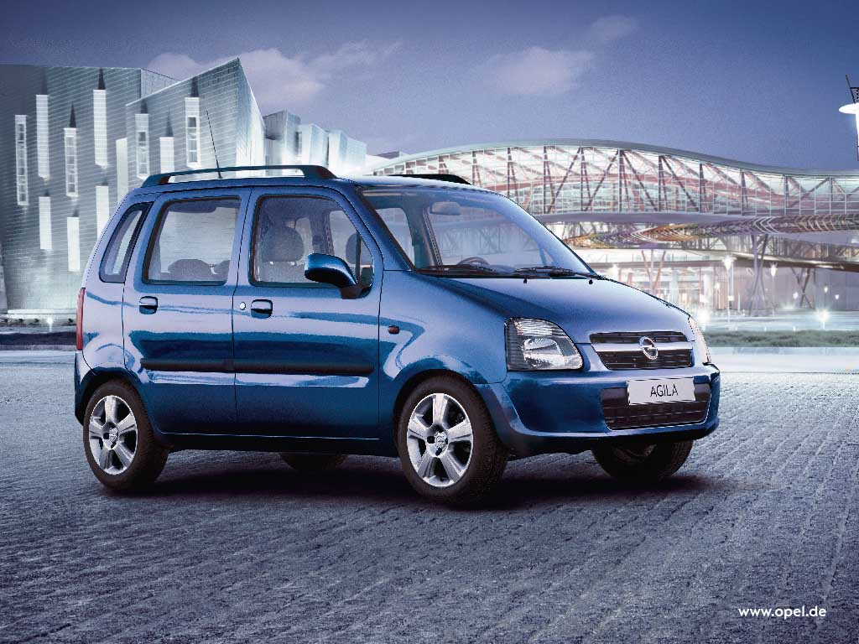
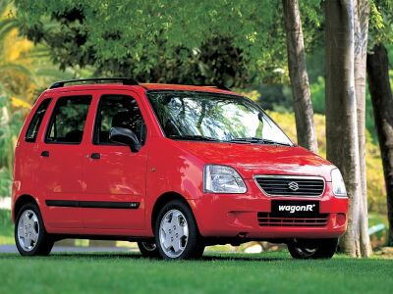
Opel Agila/ Suzuki Wagon R+ -
small car, high quality
    Public opinion pulls confirm that small Opel / Suzuki model is top of the quality scope. Delphi has a reason for great satisfaction because worked out and supply suspension shock absorbers. In the front suspension works twin-tube strut and rear suspensions uses twin-tube shock absorber. For over 5 years they have been made in Delphi plant in Krosno. These perfect opinions build the trust for Delphi products and gives hope on expanding cooperation.

