Slide 1
AutoGluon Assistant
Presenter: Boran Han
Other members: Anirudh Dagar, Haoyang Fang, Cuixiong (Tony) Hu, Caner Türkmen, YUAN TIAN, Huibin Shen, Nick Erickson, Yuyang (Bernie) Wang

Slide 2

Outline
Overview
Performance
Installation/Tutorials
Demo

Slide 3
Outline
Overview
Performance
Installation/Tutorials
Demo

Slide 4
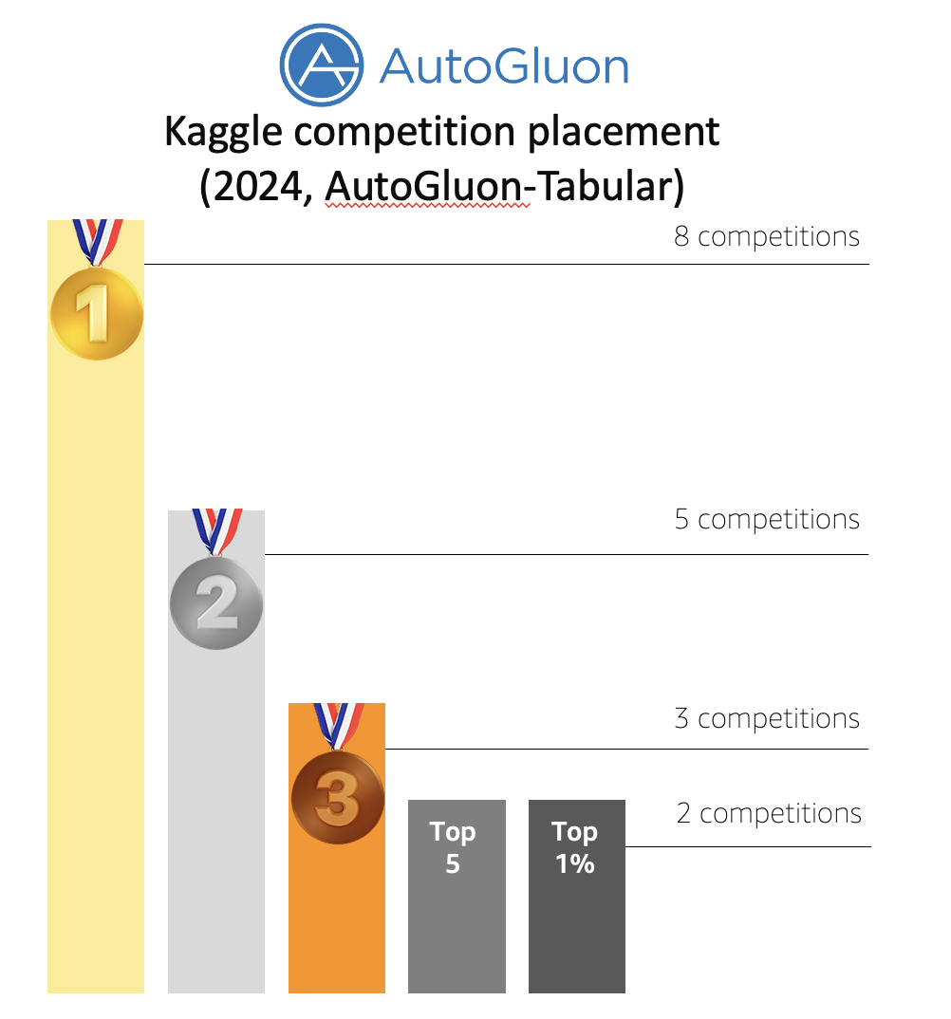
Assistant
AutoGluon is now the ML community’s go to tool for competitions.
Require three line of codes
from autogluon.tabular import TabularPredictor
predictor = TabularPredictor(label="class")
predictor.fit("train.csv", time_limit=600, presets="best")
predictions = predictor.predict("test.csv")

Slide 5
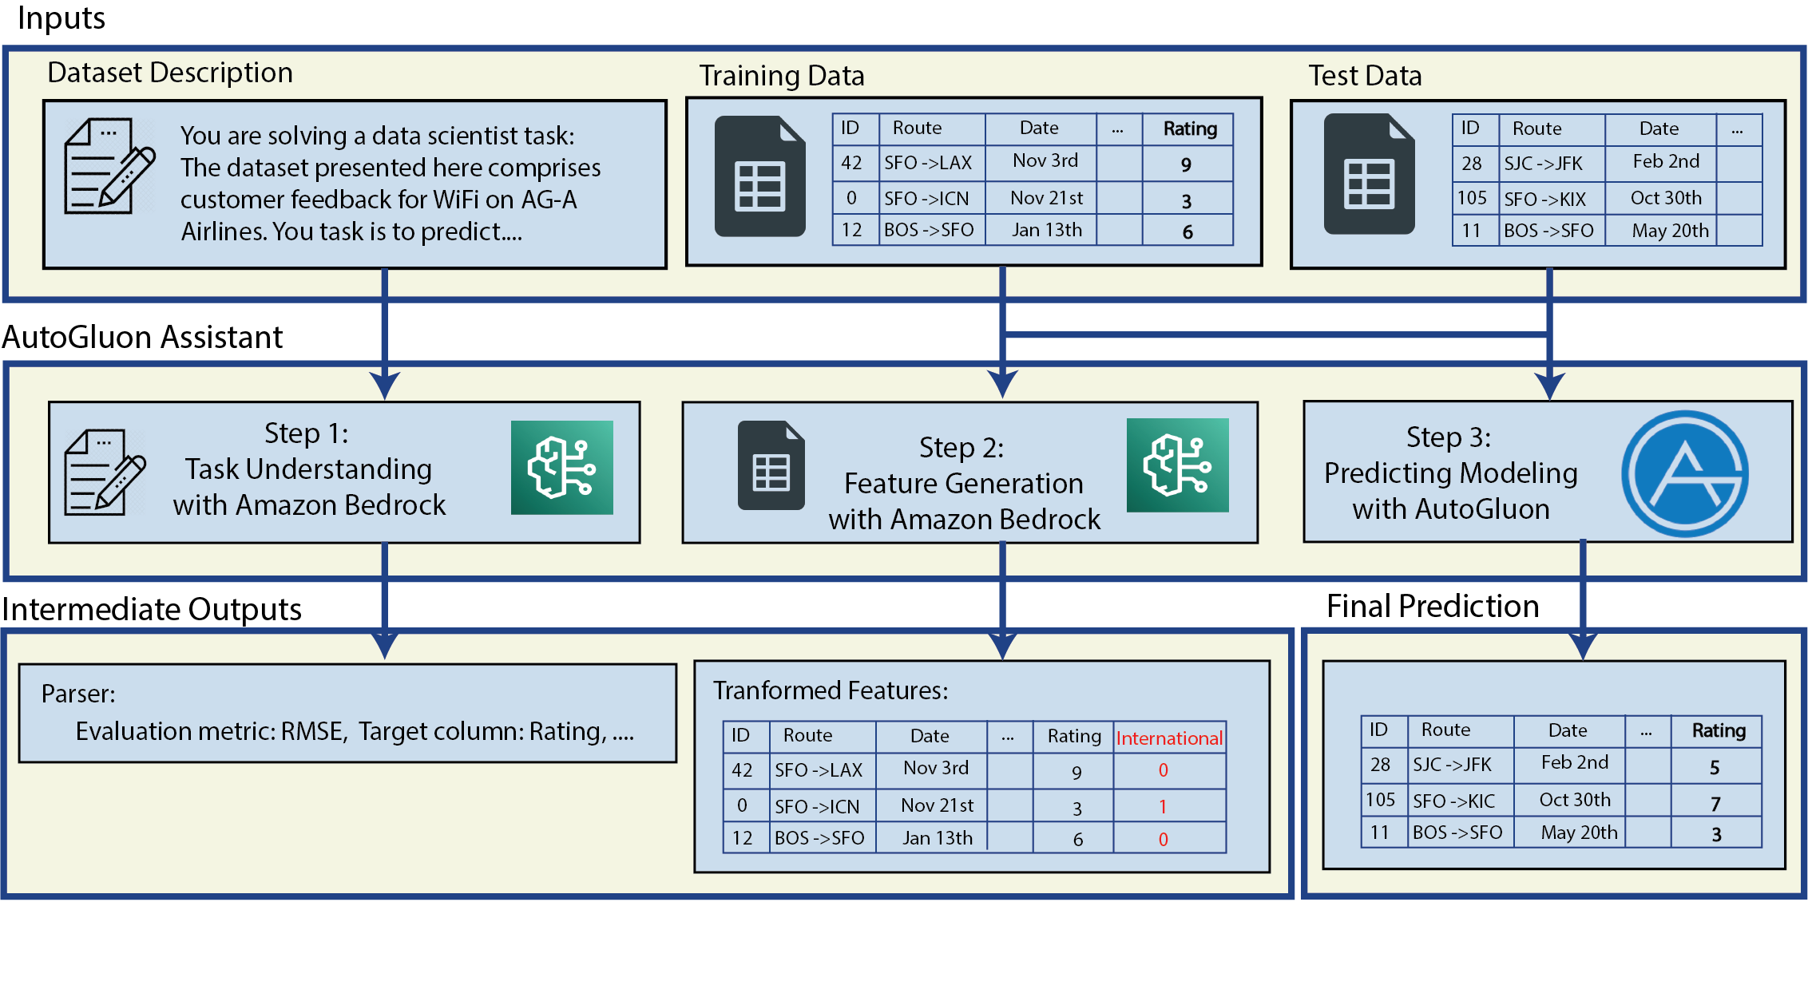


Assistant
We introduce AutoGluon Assistant (AG-A)!
LLM interface to solve tabular machine learning problems using only natural language descriptions
Zero lines of code with our simple user interfaces (UI, CLI, python API)

Slide 6
Overview
*
* Beta features

Slide 7
Outline
Overview
Performance
Installation/Tutorials
Demo

Slide 8
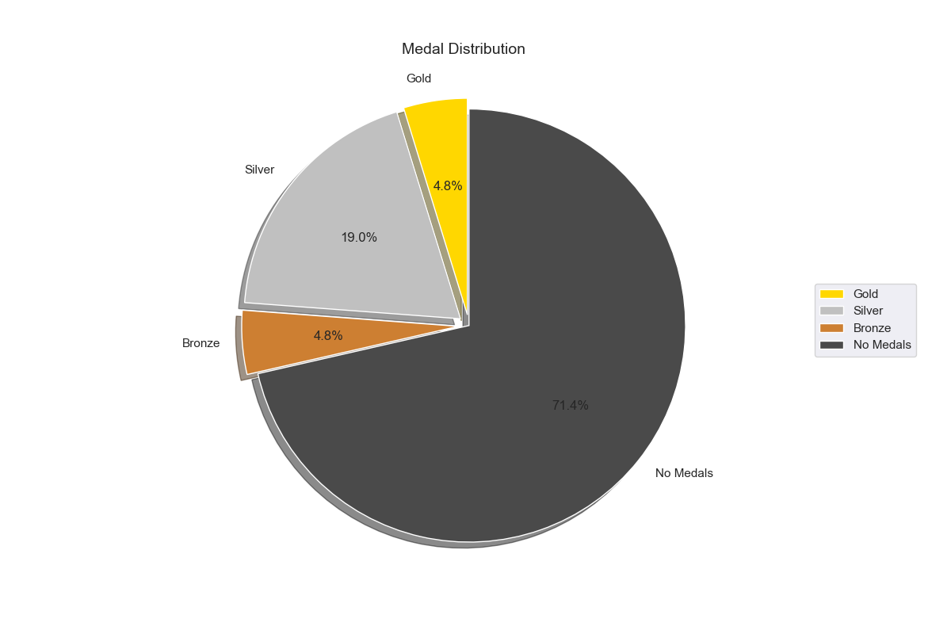
Results
The AutoGluon-Assistant (AG-A) benchmark setup features 40+ Kaggle competitions, with diverse problem types, input data, and evaluation criteria.
With only 4hrs of run time, AG-A achieves a medal on 28% of Kaggle competitions, according to the final leaderboard
100% successful run rate on tabular Kaggle competitions

Slide 9
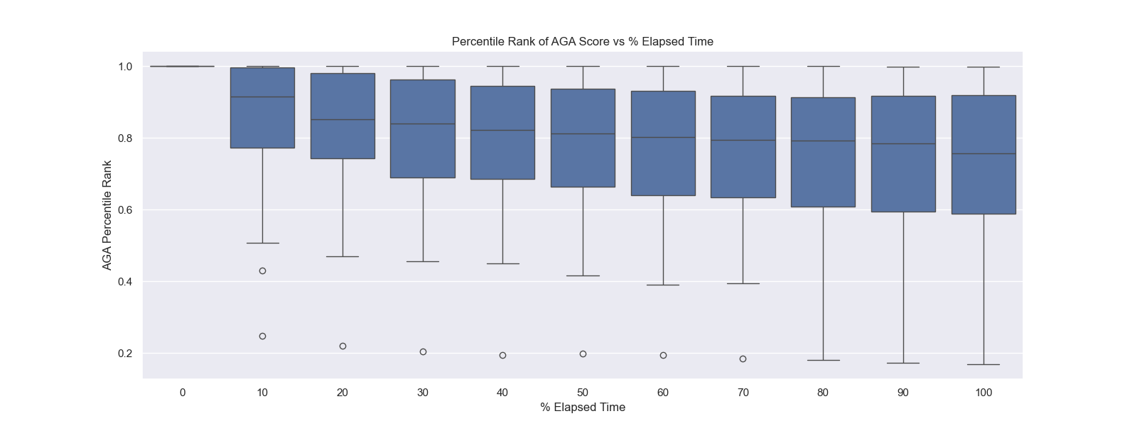
Results
AG-A Performance (over competition duration)
Beats 80% of human competitors on average in the first half of a competition
Beats 74% of human competitors on average at the end of the competition

Slide 10
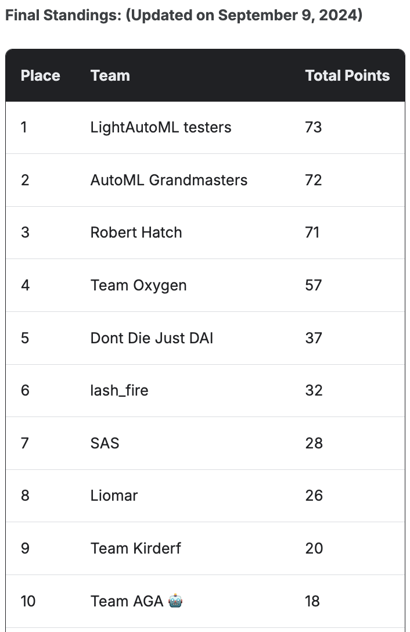
Kaggle AutoML Grand Prix 2024
Kaggle AutoML Grand Prix [1] is a 5-competition series where entries are ranked on their performance in the first 24 hours
The Grand Prix attracted over 500 teams, and most popular AutoML solutions (AutoGluon, H2O DAI, LAMA) were featured
Team AGA 🤖 (our No-HITL team) uses AG-Assistant to make the best submission with no human intervention
Team AGA 🤖 finished in 10th on the overall leaderboard, placing second in one of the five competitions.
Notably, AutoML Grandmasters (our HITL team) using AutoGluon Tabular finished 2nd overall, and all top 4 teams used AutoGluon.
[1] https://www.kaggle.com/automl-grand-prix

Slide 11
Outline
Overview
Performance
Installation/Tutorials
Demo
Q&A

Slide 12
Use AG-A: Getting Started
Installation
LLM Configuration
Three Ways to Use AG-A
Command Line Interface (CLI)
Python API
Web UI

Slide 13
Use AG-A: Installation
Supported Platforms:
Linux / MacOS / Windows
Python Version Support:
Python 3.9 ~ Python 3.12
Installation Methods:
Via pip: `pip install autogluon.assistant`
From source: Clone GitHub repository
MacOS Note: Additional dependency: libomp required

Slide 14
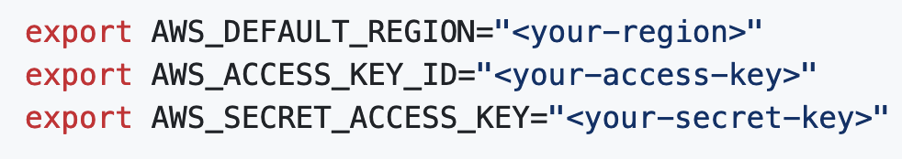
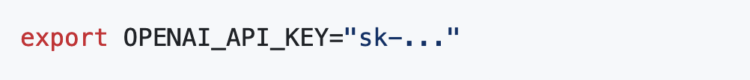
Use AG-A: LLM Configuration
AWS Bedrock (Default Option)
Set AWS credentials
Configure AWS region
OpenAI (Alternative Option)
Set OpenAI API key
Paid API recommended

Slide 15
Three Ways to Use AG-A
Command Line Interface (CLI)
Python API
Web UI

Slide 16
Use AG-A: Command Line Interface (CLI)
Basic Usage:
aga run [data_directory]
Quality Presets:
medium_quality / high_quality / best_quality
aga run ./toy_data --presets medium_quality
Output:
Predictions saved as CSV
Automatic naming with timestamps
AutoGluon compatible models

Slide 17
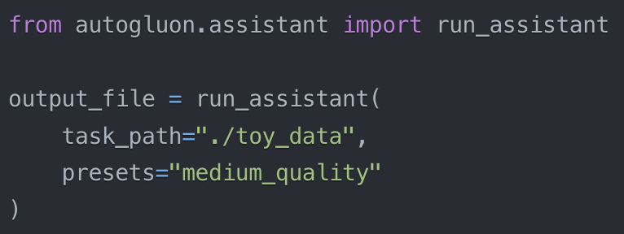
Use AG-A: Python API
Basics:

Slide 18
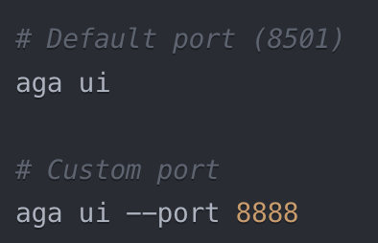
Use AG-A: Web UI
Launch Web Interface:

Slide 19
Outline
Overview
Performance
Installation/Tutorials
Demo

Slide 20
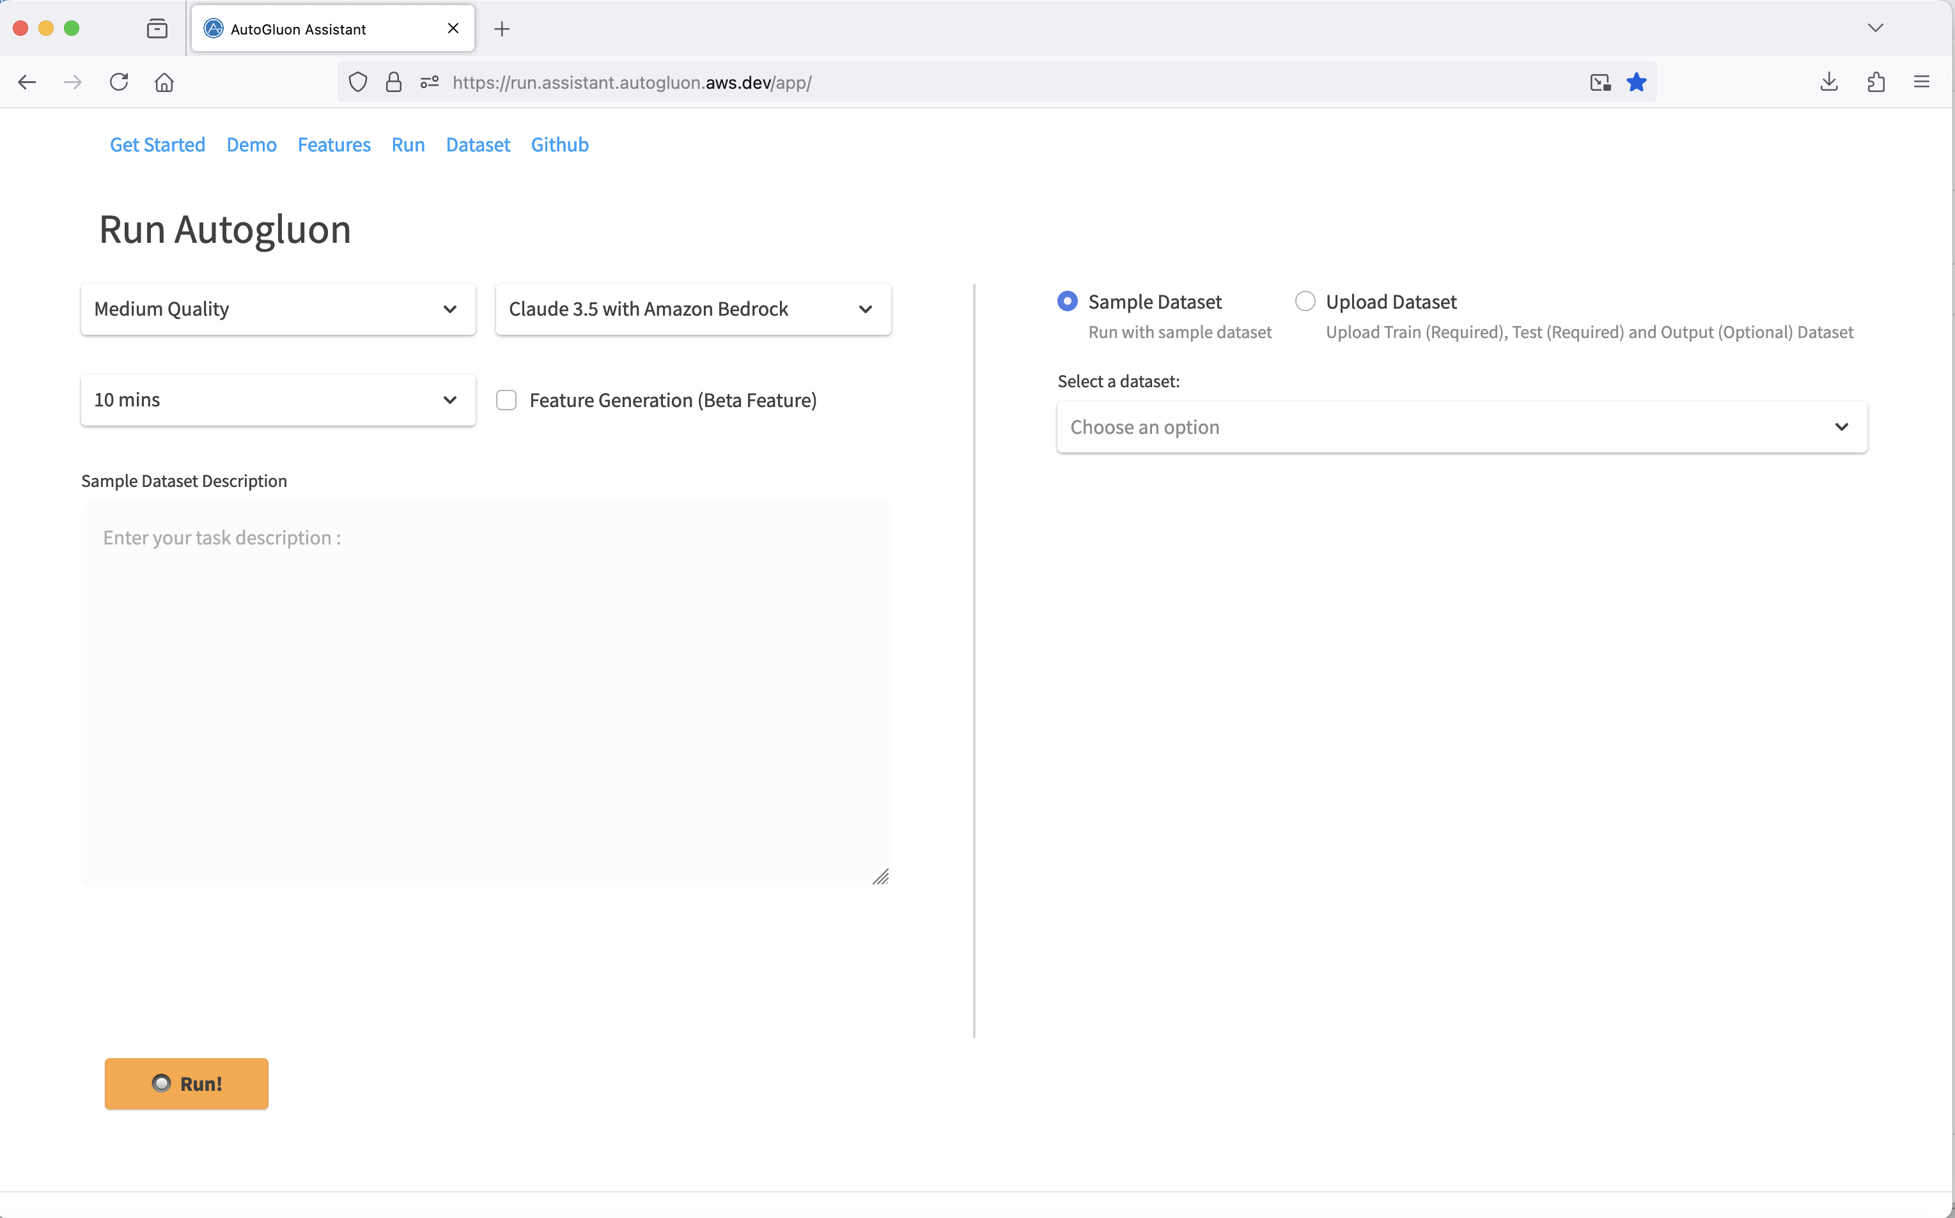
Use AG-A: Web UI Demo

Slide 21
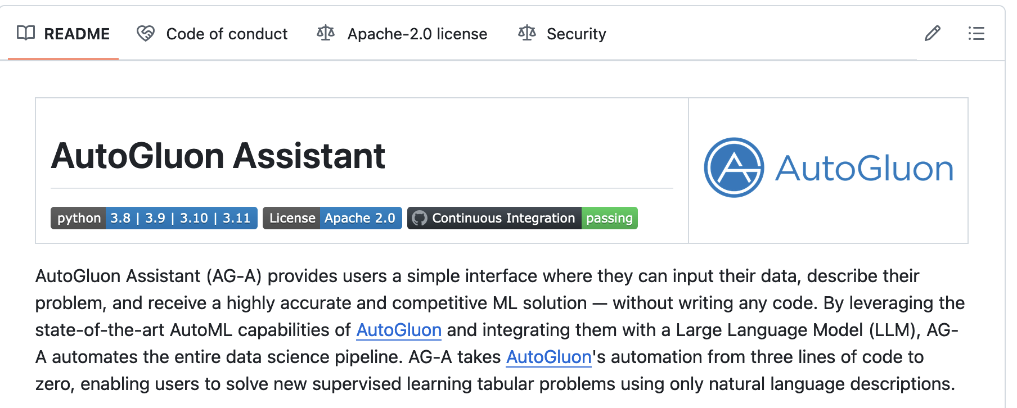
Thanks!
Get started with `pip install autogluon.assistant`
GitHub: github.com/autogluon/autogluon-assistant (Star us on GitHub if you like it ☺)
Open-source project. Welcome to contribute!

