Slide 1

Standards

Slide 2
Standards Organizations
International
International Organization for
Standardization (ISO)
International Electrotechnical Commission (IEC)
International Telecommunications
Union (ITU) (United Nations)
Universal Postal Union
(UPU) (United Nations)
TC 122
Packaging
ISO/IEC Joint Technical Committee 1
(JTC 1)
TC 104
Freight Containers
SC 31
Automatic Data Capture
SC 17
IC Cards
ITU-T (fka CCITT)
Telecommunications
WG 1 - Symbology
TC 122/104 JWG
SC Apps RFID
WG 2 - Data Content
ITU-R (fka CCIR & IFBR)
Radio-frequency Issues
WG 3 - Conformance
TC 8
Ships & Marine Tech
WG 4 - RFID
ITU-D (fka BDT)
Telecommunications
Development
WG 5 - RTLS
Regional
Comité Européen Normalisation
(CEN)
ODETTE
ECMA
Comité Européen Normalisation
Electrotechnique (CENELEC)
Comité Européen Postal &
Telegraph (CEPT)
National
Standards Australia
(SAA)
British Standards
Institution (BSI)
AFNOR
ANSI
Deutches Institut
fur Normung (DIN)
JISC
MHI
AIM
UCC
EIA
IEEE
INCITS
Other
T6
B10
Industry
DoD
ATA
EIA
AIA
HIBCC
AIAG
UCC
Other
VDA

Slide 3
AIDC Focused ISO Standards
International Organization for
Standardization (ISO)
International Electrotechnical
Commission (IEC)
Technical Committee (TC)
122 (Packaging)
ISO/IEC Joint Technical
Committee 1 (JTC 1) - IT
WG 4
(Transport Labels)
WG 7
(Package Labels)
ISO/IEC JTC 1
Subcommittee 31
Secretariat
Uniform Code Council (UCC)
National Body (NB)
Technical Advisory Groups (TAG)
WG 1
Data Carrier
WG 2
Data Structure
WG 3
Conformance
WG 4
RF Tags
WG 5
RTLS
U.S. TAG Administrator
MHI
Convener
S. Ackley (US)
Convener
T. Yoshioka (JP)
Convener
C. Biss (US)
Convener
H. Barthel
Convener
M. Harmon
Shipping Labels
Code 39
DAI
Linear Print Quality
Air Interface
API
ITF
Data Syntax
2D Print Quality
Unique RF Tag ID
2450 MHz
Product Package Marking
MaxiCode
Unique ID
Printing Specs
Defs. Logical Mem Map
433 MHz
Data Matrix
Test Specs BC Printers
Application Interface
GLS
EAN/U.P.C.
Test Specs BC Readers
Encoding Rules
Near Field
Dimensions & Layout
Code 128
Test Specs BC Verifiers
Symbology Use (Linear & 2D)
PDF417
RFID Performance
QR Code
RFID Conformance
Print Quality Level
Symbology Identifiers
Label Materials
License Plate Recommendations
Database / EDI Issues
JWG - Supply Chain
Applications of RFID
Technical Committee (TC) 104
(Freight Containers)

Slide 4

Types of Standards
Technology
  Symbology, RFID, I.C. Card
Data Content
  Semantics (DIs or AIs), Syntax
Conformance
  Print Quality, Test Specifications,
  Conformance to Air Interface
Application Standards
  Freight container, RTI, Ship Label,
  Product Package, Product Mark/Tag,
  eSeal
Notes:
Most industrial and commercial manufacturers have catalog or part numbers already assigned to their products. They often question the need for an additional number, thinking that their distributors and/or end customers should use their supplier assigned catalog or part numbers. Following are some of the reasons why UPC numbers are needed:
UCC.QED.I.10

Slide 5
ISO TC 122
(Packaging)

Slide 6
ISO TC 122 project status
ISO 15394, Packaging — Bar code and two-dimensional symbols for shipping, transport and receiving labels
  IS Approved 2000-04-01
  Periodic review to commence in 2005
ISO 22742, Packaging - Linear bar code and two-dimensional symbols for product packaging
  IS Approved 2004-12-05
ISO 21067, Packaging - Vocabulary
  DIS closed 2005-05-02

Slide 7
ISO TC 104
(Freight containers)

Slide 8
ISO TC 104 project status
ISO 830, Freight containers — Vocabulary
  CD Ballot 2005-07-31
  Revision of ISO 830:1999, ISO 830:1999/Cor 1:2001
ISO 17712, Freight containers — Mechanical seals
  FDIS Ballot 2005-05-11
  Previously approved as PAS
ISO 18185, Freight containers - Electronic seals
  Part 1, Communication protocol
  Part 2, Application requirements
  Part 3, Environmental characteristics
  Part 7, Physical layer
    Parts 1, 2, 3, and 7 CD ballot closed 2005-03-10
  Part 4, Data protection
  Part 6, Messages sets for transfer between seal reader and host computer
    Parts 4 and 6 CD ballot closes 2005-07-30
  Part 5, Sensor interface
    Withdrawn - 18185 is a read-only tag

Slide 9
ISO TC 122/104
Joint Working Group (JWG)
(Supply chain applications of RFID)

Slide 10
The Layers of Logistic Units
(Optically Readable Media)
Layer 5
ISO TC 204 (None)
AIAG B-15
Movement Vehicle
(truck, airplane, ship, train)
Layer 4
ISO TC 104 (None)
Container
(e.g., 40 foot Sea Container)
Layer 3
ISO TC 122/WG 4 (15394)
ANS MH10.8.1
AIAG B-10/14
EIA 556-B
Gen EAN.UCC Spec
Unit Load
“Pallet”
Unit Load
“Pallet”
Layer 2
ISO TC 122/WG 4 (15394)
ANS MH10.8.1
AIAG B-10/14
EIA 556-B
Gen EAN.UCC Spec
Transport
Unit
Transport
Unit
Transport
Unit
Transport
Unit
Layer 1
ISO TC 122/WG 7 (22742) ANS MH10.8.6
AIAG B-4
EIA 621/624 & IEC 62090 Gen EAN.UCC Spec
Pkg
Pkg
Pkg
Pkg
Pkg
Pkg
Pkg
Pkg
Layer 0
ISO TC 122 (TBD)
ANS MH10.8.7
AIAG B-4
EIA SP-3497
Gen EAN.UCC Spec
Item
Item
Item
Item
Item
Item
Item
Item
Item
Item
Item
Item
Item
Item
Item
Item

Slide 11
The Layers of Logistic Units
(Radio Frequency Identification - RFID)
Layer 5
Movement Vehicle
(truck, airplane, ship, train)
Layer 4 (433 MHz)
ISO 17363
Container
(e.g., 40 foot Sea Container)
Layer 3 (860-960 MHz)
(433 MHz with TPA)
ISO 17364
Unit Load
“Pallet”
Unit Load
“Pallet”
Layer 2 (860-960 MHz)
ISO 17365
Transport
Unit
Transport
Unit
Transport
Unit
Transport
Unit
Layer 1 (860-960 MHz) ISO 17366
Pkg
Pkg
Pkg
Pkg
Pkg
Pkg
Pkg
Pkg
Layer 0 (860-960 MHz)
(13.56 MHz with TPA)
ISO 17367
Item
Item
Item
Item
Item
Item
Item
Item
Item
Item
Item
Item
Item
Item
Item
Item
“TPA” - Trading Partner Agreement

Slide 12
ISO TC 122/104 JWG project status
ISO 10374.2, Freight containers — RF automatic identification
  IS Issued 1991, Amd 1 1995
  CD expected 2005-04-30
ISO 17363 - Supply chain applications of RFID -
Freight containers
  CD sent for ballot 2005-02-25
ISO 17364 - Supply chain applications of RFID - Returnable transport items
  CD sent for ballot 2005-04-30
ISO 17365 - Supply chain applications of RFID -
Transport units
  CD sent for ballot 2005-04-30
ISO 17366 - Supply chain applications of RFID -
Product packaging
  CD sent for ballot 2005-04-30
ISO 17367 - Supply chain applications of RFID -
Product tagging
  CD sent for ballot 2005-02-25

Slide 13
Working Group (WG) 4
RFID for Item Management
ISO/IEC JTC 1/SC 31
Automatic Identification and
Data Capture Techniques

Slide 14
ISO/IEC JTC 1/SC 31
  Charted to work on technical specifications
  “JTC 1 was established in 1987 for 'standardization in the field of information technology systems ... and equipment ...(with the exclusion of) information technology for specific applications….” [jtc16778]
  JTC 1 is comprised of both ISO and IEC
  SC 31 is chartered to work on automatic data capture technical specifications

Slide 15
Technology Standards
Radio Frequency Identification Open Standards
ISO/IEC 18000 - RFID for Item Management
  Part 2 - 125 - 150 kHz
  Part 3 - 13.56 MHz
  Part 4 - 2450 MHz
  Part 6 - 860 - 960 MHz
  Part 7 - 433.92 MHz (active)
Data Standards
ISO/IEC 15418 - Application Identifiers & Data Identifiers
ISO/IEC 15434 - Syntax
ISO/IEC 15459 - Unique Item Identification
ISO/IEC 15961 - Data Protocol: Application Interface
ISO/IEC 15962 - Data Protocol: Data Encoding Rules and
Logical Memory Functions
ISO/IEC 15963 - Unique Identification for RF Tags
Conformance Standards
ISO/IEC 18047 - RFID device conformance test methods (at)
  Part 2 - 125 - 150 kHz
  Part 3 - 13.56 MHz
  Part 4 - 2450 MHz
  Part 6 - 860 - 960 MHz
  Part 7 - 433.92 MHz (active)

Slide 16
Application Standards
Radio Frequency Identification - Open Standards
ISO 10374 - Freight containers — Automatic identification
ISO 18185 - Freight Containers - Radio-frequency communication protocol for electronic seal
ISO 11785 - Radio-frequency identification of animals — Technical concept
ANSI MH10.8.4 - RFID for Returnable Containers
AIAG B-11 - Tire & Wheel Identification Standard
ISO 122/104 JWG - Supply Chain Applications of RFID
  ISO 17363 - Freight containers
  ISO 17364 - Returnable transport items
  ISO 17365 - Transport units
  ISO 17366 - Product packaging
  ISO 17367 - Product tagging

Slide 17
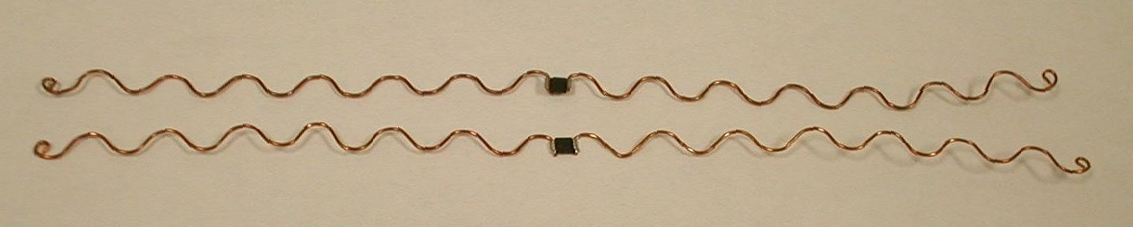
AIAG B-11 Tire Tag
ANSI INCITS 256 (T6) and ISO/IEC 18000, Part 4 & Part 6 compliant
  902 - 928 MHz for U.S. / 869 MHz for Europe
  2450 MHz for Japan
Molded into tire, applied with adhesive, or label
1024 bits
ISO 15418/MH10.8.2 Data Identifiers
Successfully demonstrated in the U.S. & the E.U.

Slide 18

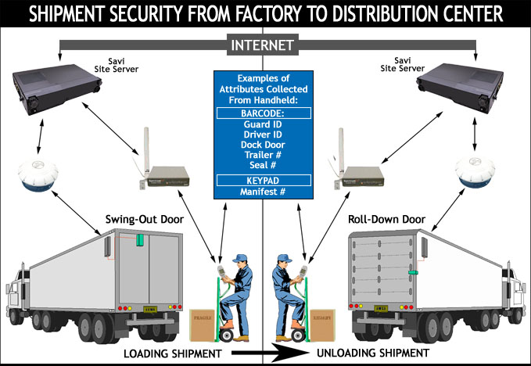
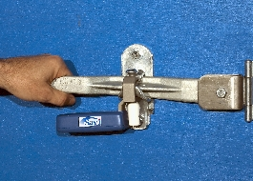
Sealing and anti-tamper capability
Bolt Seal Security Tag
Electronically secures ocean containers, air cargo ULD containers, trailers,
Monitors presence and integrity of bolt seal, generates alarm upon bolt removal or breakage
Re-usable tag
Reduces manual inspections
Minimizes theft, loss and tampering

Slide 19

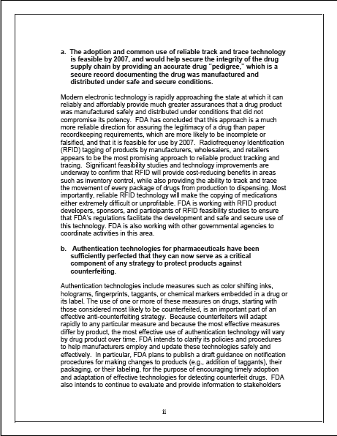
Item Identification versus
Anti-Counterfeiting

Slide 20
Data Content Standards
ISO/IEC JTC 1/SC 31/WG 2 & WG 4/SG 1
ISO/IEC 15424 - Data Carrier/Symbology Identifiers
ISO/IEC 15418 - EAN.UCC Application Identifiers and ASC MH 10 Data Identifiers
ISO/IEC 15434 - Syntax for High Capacity ADC Media
ISO/IEC 15459 - Unique identification - Part 1: Transport units; Part 2: Registration procedures; Part 3: Common rules; Part 4: Unique Item identification for supply chain management
ISO/IEC 15961 - Data protocol: Application interface
ISO/IEC 15962 - Protocol: Data encoding rules and logical memory functions
ISO/IEC 15963 - Unique ID of RF Tag

Slide 21
Technical Standards
Radio Frequency Identification (RFID)
ISO/IEC JTC 1/SC 31/WG 4/SG 3
RFID for Item Management Air Interface (ISO 18000)
ISO/IEC 18000-1 - Generic parameters - Air interface
ISO/IEC 18000-2 - Parameters for air interface below
135 kHz
ISO/IEC 18000-3 - Parameters for air interface at 13.56 MHz
ISO/IEC 18000-4 - Parameters for air interface at 2.45 GHz
ISO/IEC 18000-6 - Parameters for air interface at
860-960 MHz
ISO/IEC 18000-7 - Parameters for active air interface
at 433.92 MHz

Slide 22
Conformance Standards
Radio Frequency Identification (RFID)
ISO/IEC JTC 1/SC 31/WG 3/SG 1
ISO/IEC 18046 - RFID Device Performance Test Methods
ISO/IEC 18047 - RFID Device Conformance Test Methods
  Part 2 - <135 kHz
  Part 3 - 13.56 MHz
  Part 4 - 2.45 GHz
  Part 6 - 860-960 MHz
  Part 7 - 433 MHz

Slide 23
SC 31/WG 4 (RFID) Technology Projects
ISO Designation | Title | Status
ISO/IEC 18000, Part 1 | Information technology - AIDC techniques - RFID for item management - Part 1 - Definition of parameters to be standardized | Published 2004-08-06 AMD 1 in process
ISO/IEC 18000, Part 2 Mode A - ISO 11785 based Mode B - Yoshikawa RF | Information technology AIDC techniques - RFID for item management - Part 2 - Parameters for air interface communications below 135 kHz | Published 2004-07-30 AMD 1 in process
ISO/IEC 18000, Part 3 Mode A - ISO/IEC 15693 based Mode B - Magellan based | Information technology AIDC techniques - RFID for item management - Part 3 - Parameters for air interface communications at 13.56 MHz | Published 2004-08-06 AMD 1 in process
ISO/IEC 18000, Part 4 Mode A - Intermec based Mode B - Siemens/NEDAP based | Information technology AIDC techniques - RFID for item management - Part 4 - Parameters for air interface communications at 2.45 GHz | Published 2004-05-31 AMD 1 in process
ISO/IEC 18000, Part 6 Type A - BTG based Type B - Intermec/Philips based Type C - UHFGen2 (v1.0.9) based | Information technology AIDC techniques - RFID for item management - Part 6 - Parameters for air interface communications at 860-960 MHz | Published 2004-08-15 AMD 1 in process
ISO/IEC 18000, Part 7 Savi based | Information technology AIDC techniques - RFID for item management - Part 7 - Parameters for active air interface communications at 433 MHz | Published 2004-05-31 AMD 1 in process
ISO/IEC 15961 | RFID for Item Management – Data protocol: Application interface | Published 2004-10-15
ISO/IEC 15962 | RFID for Item Management – Protocol: Data encoding rules and logical memory functions | Published 2004-10-15
ISO/IEC 15963 | RFID for Item Management – Unique Identification of RF Tag | Published 2004-09-01

Slide 24
ISO Standards
ISO has published air interface, data structure, and conformance standards
ISO (JTC 1/SC 31) has 28 countries that actively participate in standards development including China, Korea, and Japan
ISO (JTC 1/SC 31) has 28 other regional and international organizations with which it cooperates in liaison
ISO follows established rules and engages all member countries in voting and comments to developing standards
ISO is open

Slide 25
RFID Experts Group (REG)

Slide 26
RFID Experts Group
Formed in February 2004 to assist DoD with RFID implementation
Under the AIM Global umbrella in July 2004
Reaching out for international cooperation
  Europe
  Japan
  Korea
  China

Slide 27
REG Terms of Reference (ToRs)
ToR: Reader System Implementation & Operations
ToR: Enabled Labels & Packaging
ToR: Recyclability
ToR: Tag Quality
ToR: Education & Certification
ToR: Global Operation
ToR: Privacy
ToR: Safety
ToR: Security
ToR: Sensors and Transducers
ToR: Technology Selection

Slide 28
ISO/IEC Implementation TRs
ISO/IEC 24729-1, Information technology — Radio frequency identification for item management — Implementation guidelines – Part 1: RFID-enabled labels
ISO/IEC 24729-2, Information technology — Radio frequency identification for item management — Implementation guidelines – Part 2: Recyclability of RF tags
ISO/IEC 24729-3, Information technology — Radio frequency identification for item management — Implementation guidelines – Part 3: RFID interrogator/antenna installation

Slide 29
???

Slide 30
Thank
You!!!

