Slide 1
AIM TSC
DPM Ad Hoc
A Revised Quality Measurement Method for DPM
Presentation to MH10.8
26 May 2005

Slide 2
Agenda
Background: what was the problem
Approach
Summary of new verification techniques
Grading Nomenclature
Application Group Decisions needed

Slide 3
Background: the problem
Good DPM marks got failing grades under today’s ISO/IEC 15415 method
  “Good” as determined by visual inspection and reader performance
Typical failure modes:
  Symbol Contrast
  Unconnected Dots in the ‘L’
  Sub-optimal illumination

Slide 4
Philosophy we’re following
Goal: revise the verification method to better assess those characteristics of the mark that impact readability.
Method:
  We collected read rate data on a variety of sample parts, to create a “yardstick” that correlates verifier grade to readability
  We’ve identified specific areas within the 15415 method that required modification to better correlate to readability

Slide 5
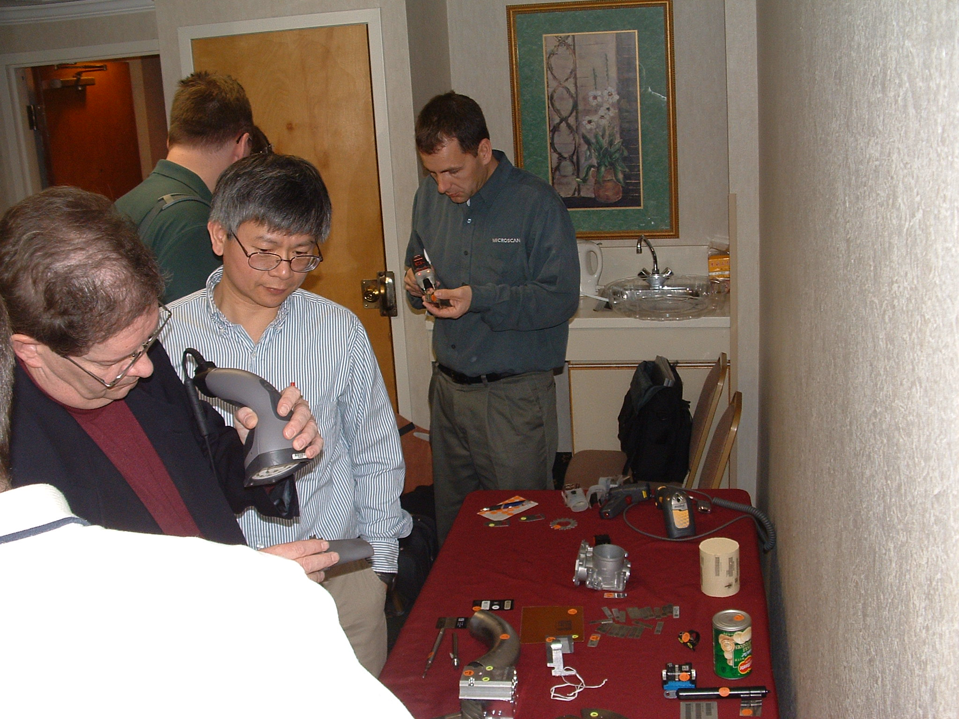
Data Collection
Tests were performed using readers from various suppliers and a large number of DPM parts…

Slide 6
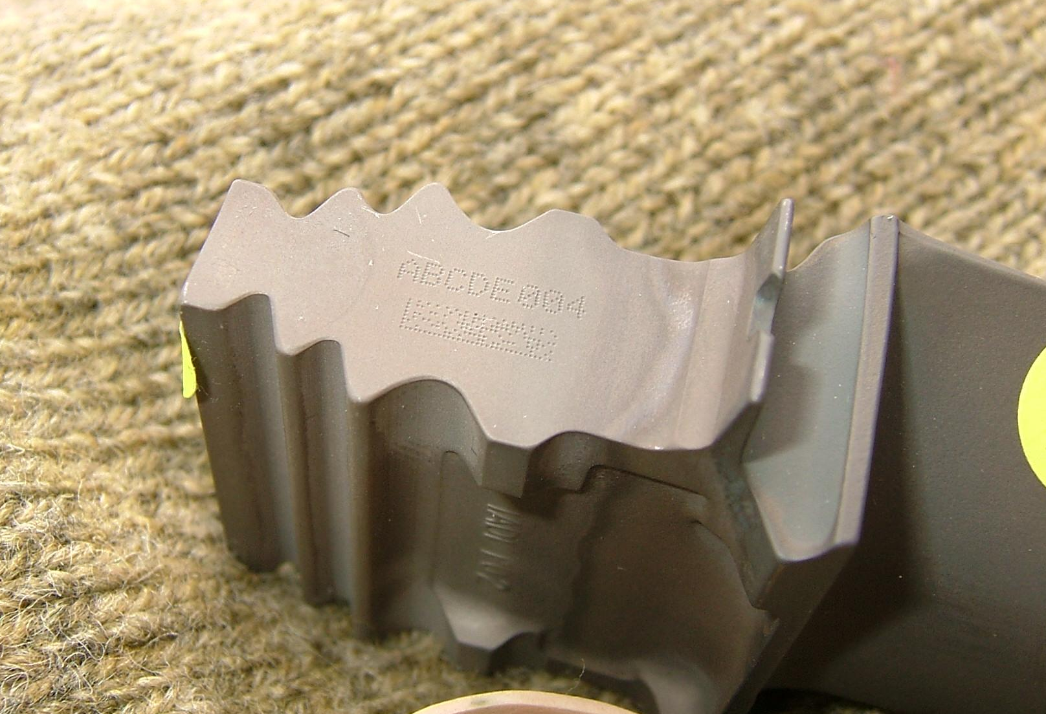
Analysis
…to understand what features in the 2D Data Matrix marks affected read rates in a positive or negative manner.

Slide 7
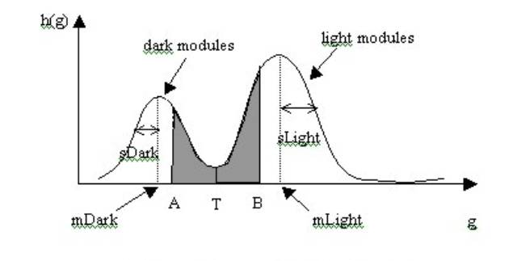
Algorithm modifications
Verifier software was modified to grade those parameters that had the greatest effect on the readability of the marks.

Slide 8
Summary of new DPM Measurement Solutions
Specified suitable illumination choices
  Diffuse Overhead (90 degree specular)
  Low-angle at North/South (from top and bottom of mark) and at East/West
  TBD: minimizing the needed options, including optimal angle recommendations
Add algorithm to “connect the dots” for finding a dot-peened ‘L’
  Current 15415 method does not work with dot diameters < 80% of cell size
DPM SC redefined for specular lighting
Other parameters modified (e.g., GT)

Slide 9
DPM Grading Nomenclature
There are changes in the format of the reported grade
Application specs can now specify combinations of allowed lighting
Example: DPM3.0/05/640/(30|90)/(V|H)
  Allows lighting at 30 or 90 degrees
  Lighting can be from N/S or E/W
Other options supported, such as ‘Q’ for lighting from all four sides

Slide 10
Application Group Decisions
Define Reading Situation
  Specialized DPM scanners, for all operators and work stations?
  Untrained Operators?
    Trained operators willing to orient scanner for directionally-sensitive parts
  What about paper labels?
What minimum Grade level?
Orientation-insensitive parts (V&H)?

Slide 11
Application Decisions II
Are there subcategories of part use/scanning that affect grading? E.G.:
Class 1: small internal parts, need fixed cameras and specialized lighting angle
Class 2: parts to be scanned in Field service using Hand-held DPM scanners
Class 3: Package Labels, that non-specialized readers need to read

Slide 12
Conclusions
The DPM verification technology issues have been addressed
Applications/Usage questions remain
Draft of an AIM spec on DPM quality being prepared for public review

Slide 13
AIM TSC
DPM Ad Hoc
A Revised Quality Measurement Method for DPM
Presentation to MH10.8
26 May 2005

