Slide 1
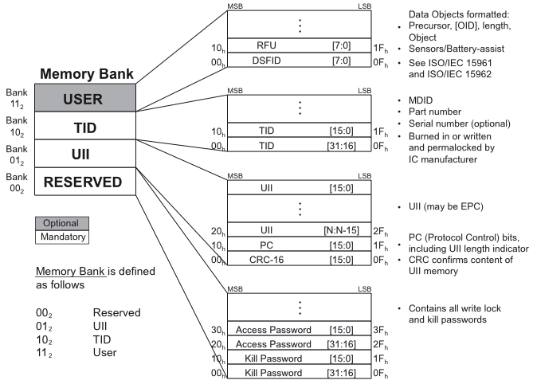
18000 - 6c
Tag Memory

Slide 2
Proposal - continued
x10
x15
x17
x20
x00
x0F
x14
x16
x18
x1F
Reserved
/AFI
UII Tag
Encoding
Zero fill
to the
word
boundary
CRC
Length
PC
always zero for EPC
Toggle - always zero for EPC
NSI
RFU
MB 11 is present

Slide 3
18000 - 6c Memory Banks “01” and “11”
UII Memory
User Memory
MB01
MB11
LSB
MSB
LSB
MSB
PC
Bits
(incl AFI)
UII
(incl
EPC)
Storage Format
RFU
CRC16
Object
Object
Object
UII
ISO/IEC 15961/15962
Data construction according to EPC proposal
Data construction according to ISO/IEC 15961/15962 standards
NEEDED: Within MB01, use bit 15 to indicate that MB11 is, or is not, used.

Slide 4
Proposal - continued
MB11 User Memory Construction
Memory Location
(Byte Number)
Meaning
1
Storage Format;
Made up of two sub-elements;
Access Method – Bits 7 & 8
Data Format – Bits 1 through 6
2
Reserved for Future Use; assignment by WG4 SG1; potentially battery-assisted, sensor-enabled / sensor data, etc.
3 and following
Object-based User Data;
Follows ISO/IEC 15961, and ISO/IEC 15962 data standards

Slide 5
End User examples
MB01 17 MB01 15 | 0 | 1
0 | Yes EPC No User Data (Would be appropriate for an exclusive retail tire) | No EPC No User Data
1 | Yes EPC Yes User Data (B-11 will state that all tires use this method) | No EPC Yes User Data (Would be appropriate for automotive OEM)

