Slide 1



EPCglobal….a global overview of progress across the community

Slide 2




GS1: a diversified portfolio
GS1 has a full portfolio of products and solutions
Global standards for automatic identification
Rapid and accurate item, asset or location identification
Global standards for electronic business messaging
Rapid, efficient & accurate business data exchange
The environment for global data synchronisation
Standardised, reliable data for effective business transactions
Global standards for RFID-based identification
More accurate, immediate and cost effective visibility of information

Slide 3
EPCglobal Core Purpose
Take a global leadership role in developing and promoting multi-industry, user driven standards for collaborative commerce utilising the EPC
To deliver added value to our customers and stakeholders through our activities
Drive the global, multi-industry adoption of EPC via the GS1 Member Organizations

Slide 4
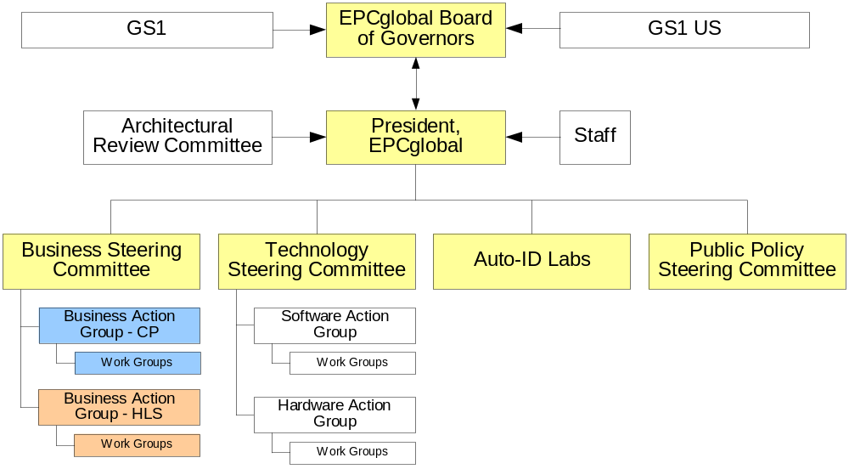
EPCglobal Organization
Virtual organization > 1500 people
Adoption programs – Europe, Asia
New action groups – Aerospace , Automotive, Apparel
Business Action
Group - TLS
Work Groups

Slide 5
EPCglobal Board of Governors
EPCglobal Board
of Governors
CPG Mftg and Retail (4)
President, EPCglobal (1)
Gillette (Board Chairman)
Metro
Procter & Gamble
Wal*Mart
Member Organizations (3)
Latin America
Europe
Far East
Trans/Logistics (1)
DHL
Healthcare (2)
J&J
Novartis
MIT (1)
Consumer Electronics (1)
Sony
Technology (2)
HP
Cisco
Aerospace (1)
Lockheed Martin
Public Sector (1)
DoD

Slide 6

EPCglobal research partners – Auto ID Labs
Cambridge - UK
MIT – USA
Adelaide - Australia
St. Gallen – Switzerland
Fudan – China
Keio – Japan
ICU – South Korea
Widening scope to include other research organizations globally.
Academic Convocation, Cambridge (MIT) January 2006

Slide 7
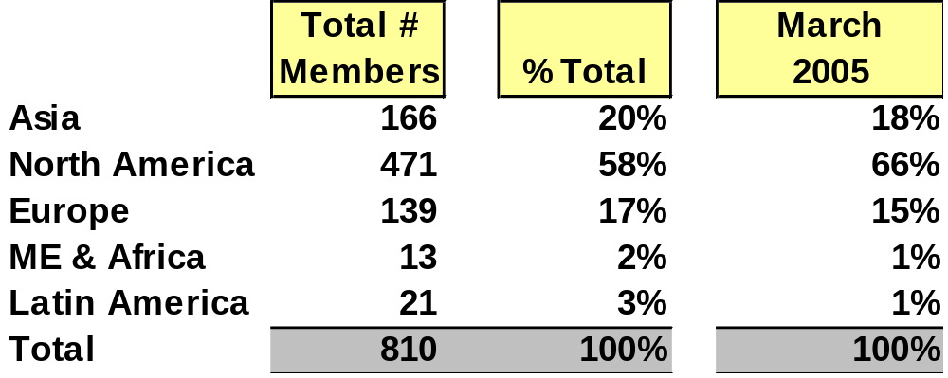
Global Membership (March 2006)
Each member joins once in the location of the head office

Slide 8
Membership expanding globally (March 2006)
Each member joins once in the location of the head office

Slide 9
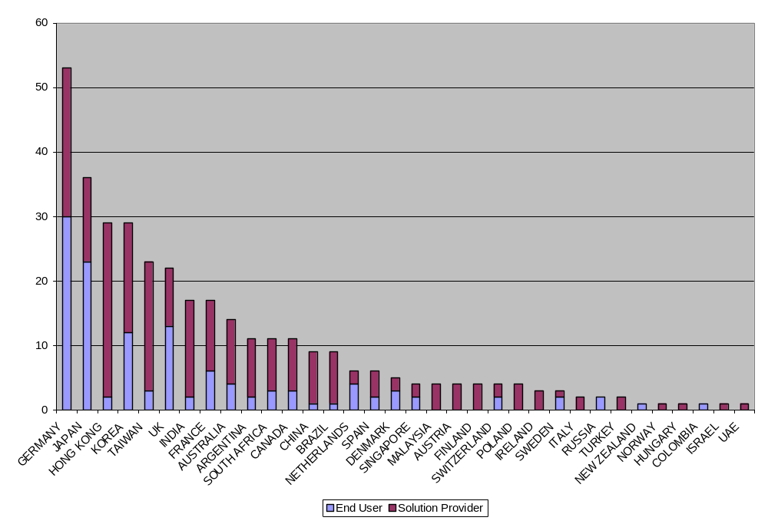
35 countries and growing fast!
USA (Membership = 460)
End Users 309
Solution Providers 151

Slide 10
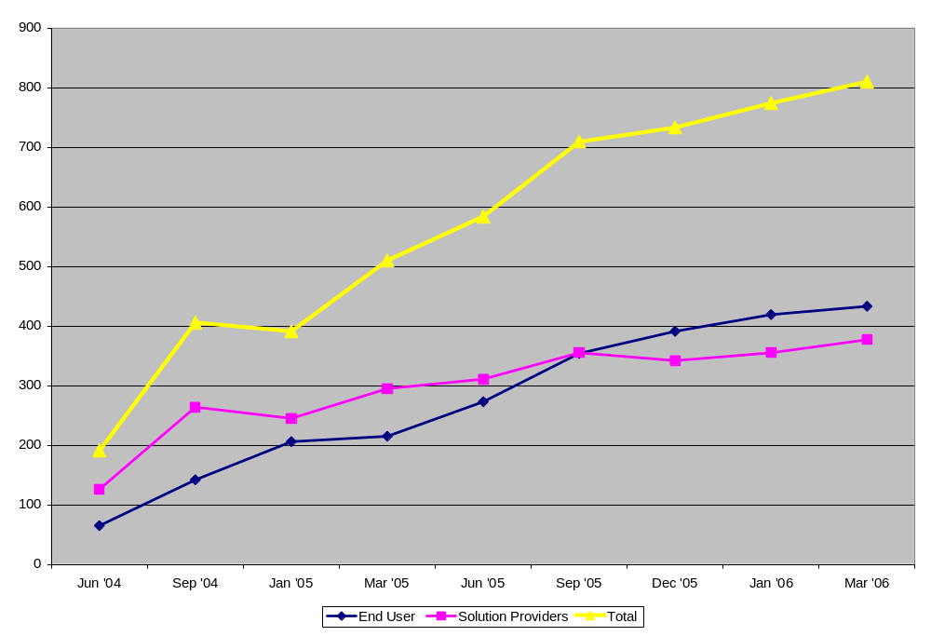
End users now 54% of total membership

Slide 11
Why are global standards important?
Reduce complexity
  Within organizations
  Between organizations
  For H/W and S/W production and purchase decisions
Reduce cost
  Implementation
  H/W, S/W and Integration
Facilitate trading partner collaboration
Allow organizations to focus more on how to use the information than how to get information

Slide 12
Standards in Progress, March 2006
Business
Requirements
Business/
Technical
Approval
Board
Ratification
Development
Prototyping
Certification
Data
Exchange
(Supports Track
& Trace)
Track & Trace
 ONS 1.0
EPCIS 1.0
FMCG Data Exchange
Drug Pedigree
Security X.509
 ALE 1.0
Internal
Systems
(Supports
Inventory Mgmt,
Shipping,
Receiving)
 Tag Data Translation 1.0
Reader Management 1.0
Reader Operations (Protocol 1.2 & ALE 1.1)
Reader Protocol 1.1
TDS & TDT
 Tag Data Standard v1.1
Object
Exchange
(Tags /Readers)
Item Level Tagging
 Tag Data Standard v1.3
Applied Tag Performance
 - Gen2
 - GEN2 Tags
& Readers
Industry Alignment
Reduced Complexity
Lower Cost

Slide 13
Item Level Tag Update
Now referred to Air Interface WG
Technology Demonstrations were not conclusive
Leadership of HLS BAG have requested that a HF WG be created
HF WG and UHF WG have been established based on the business scenarios created in the AIWG but will work collaboratively
Linkage between Work Groups must be consistent
Marketplace will decide

Slide 14
Compliance Testing Implemented
Allows confident, low cost technology buying decisions
Allows marketplace to thrive
Types of testing
  Conformance (certification by Met Labs and EPCglobal)
  Interoperability (test reports)
  Performance (conducted by accredited test labs)

Slide 15
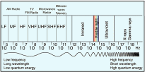
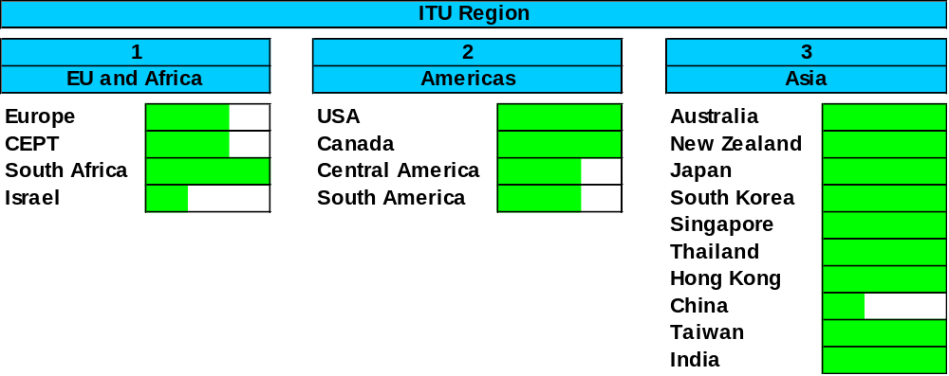
Regulatory infrastructure (UHF)
Spectrum allocation to allow use of Gen2
UHF spectrum (860-960 MHz) and power regulations (2w erp/4w eirp)
Significant progress made:

Slide 16
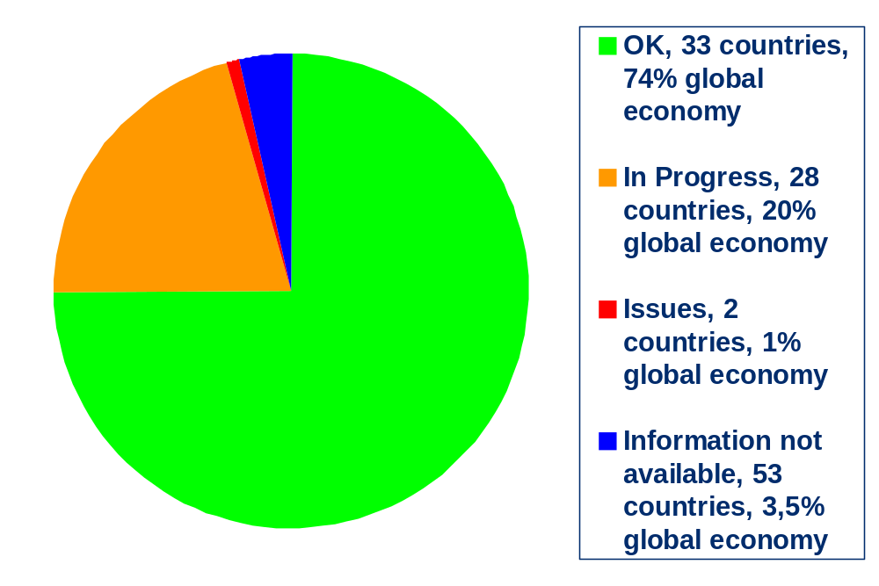
Global status regulations UHF

Slide 17
Current Business Action Groups
FMCG
  Implementations underway
  Focus migrating to item level tagging
Healthcare & Life Sciences
  Focus on patient safety and pedigree
  Pilots will be in US
Transportation & Logistics
  BAG formed late last year
  Workgroup structure in place
  Includes Customs, Logistics, IATA

Slide 18
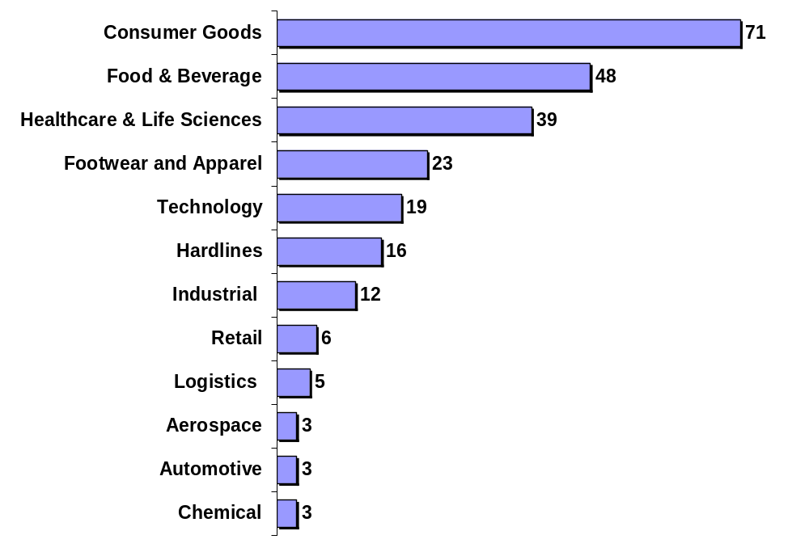
Membership growth in all sectors
US example
Momentum is developing rapidly in new sectors
Example shows split of EPCglobal US end user membership

Slide 19
New Industries Outlook
New industries likely to become BAGs during 2006
  Automotive
  Aerospace
  Apparel, Footwear and Fashion
Other key industries currently at early discussion stage
  Defense
  Food and Beverage
  High Tech
  Chemical
Structured process for “on-boarding”
Increasing use of common work groups where appropriate

Slide 20
EPCglobal Planning Tools
Strategic Plan 2006-2008
  Finalized and distributed Q3 2005
Annual work plan 2006
  100+ actions and deadlines
  Covers whole EPCglobal community
Joint Steering and Planning Group established
  Lead strategic planning
  Consolidate and prioritize work plan items
Peloton
  Linking milestones to benefit realization
  FMCG (North American and Europe versions), HLS, TLS tbd

Slide 21
Strategic Objectives
Develop user-driven EPC technology standards that support multiple industries globally
Enable supply chain transformation through standardized data exchange using the EPCglobal Network standards and protocols
Ensure that an effective environment and organization is in place to successfully support EPCglobal standards and technology implementation globally

Slide 22
Strategies 2005-2008
1) Standards Development
2) Technology
3) Public Policy
4) EPCglobal Organization and Process
5) Marketing/Communication
6) Intellectual Property
7) Adoption

Slide 23
Supply chain visibility
Potential to transform business process
The power of event related information
  Improved patient safety
  Reduced counterfeit
  Improved customer availability
  Demand driven supply chain
  Reduced inventory
  Improved ability to track and trace
  Shrinkage
  Returnable Assets
Transformation of commercial relationships

Slide 24
In summary…
EPCglobal ..from hope to hype to implementation.
  2005 - incredible progress made
  Global standards infrastructure is developing quickly
  The EPCglobal community grows stronger every day
  Life is becoming more complex…. but this is a good sign!
  Physics and standards challenges are being overcome
  Prices are going down
  The benefits of “visibility” are starting to be realized
  The community has started to move decisively from preparation to implementation

Slide 25

EPCglobal - where technology meets business needs

