Slide 1
Convenor’s report to SC31 Moscow Plenary, June 2006
Chuck Biss
Convenor
SC31/WG3

Slide 2
Topics …
Organization / Participation
Meetings
Work progress
  Bar code work items
  RFID work items
  New work item
Decisions required

Slide 3
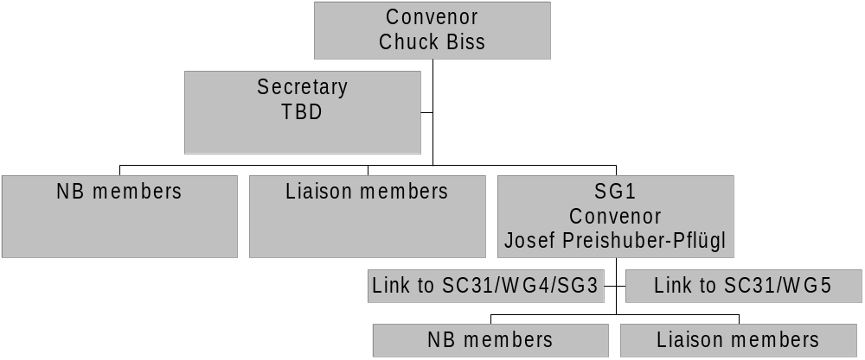
WG3 organisation

Slide 4
Participation
National bodies
  Australia
  Austria
  Canada
  France
  Germany
  Republic of Korea
  Korea
  Japan
  Russia
  Singapore
  South Africa
  UK
  USA

Slide 5
Meetings since Singapore Plenary
WG3
  June 2005, Singapore (# 28)
  August 2005, Toulouse, France (# 29)
  January 2006, Ft. Lauderdale, FL USA (#30)
  March 2006, Kyoto, Japan (#30)
WG3/SG1
  June 2005, Singapore (# 15)
  September 2005, Colorado Springs, CO USA (# 16)
  November 2005, Klagenfurt, Austria (#17)
  March 2006, Kyoto, Japan (#18)

Slide 6
Future meetings
WG3
  August 2006, Paris FR
  January 2007, Sydney AUS
  June 2007, South Africa (tentative)
WG3/SG1
  August 2006, Paris FR
  January 2007, Sydney AUS
  March 2007, Berlin D
  June 2007, South Africa (tentative)
Dates and venues of further meetings to be arranged, dependent on progress of work programme

Slide 7
Progress overview
Many of our WG3 documents (from a total of 20 standards & technical reports) are into or starting the review process
There are numerous TR’s in final ballot or publication stages
Work continues on the DPM (Direct Marked Parts) print quality measurement analysis being done by the AIM Global Technical Symbology Committee at the request of WG3 and in conjunction with ANSI MH10.8

Slide 8
Progress overview
We have additional new work items in WG3 SG1 in both RFID and RTLS subject areas
Please see the 2006 Moscow Plenary WG3 Convenor’s Report for more details

Slide 9
Current work items activity
IS 15415 published in 2004
IS 15416 in final 5 year review stages
IS 15419 in 5 year review
IS 15421 in 5 year review
IS 15423-1 combined in 15423 & withdrawn
IS 15423 published in 2004
IS 15426-1 in 5 year review
IS 15426-2 published 2004

Slide 10
Current work items activity
TR 18047-2 in publication process
TR 18047-3 published in 2004
TR 18047-4 published in 2004
TR 18047-6 in publication process
TR 18047-7 published in 2005
TR 18046 in review and transfer to IS
IS 18046-1 in NWIP ballot
IS 18046-2 in NWIP ballot

Slide 11
Current work items activity
IS 18046-3 in NWIP ballot
TR 19782 final approval / publication
TR 24720 final approval / publication
TR 24769 NWIP ballot passed successfully
TR 24770 NWIP ballot passed successfully

Slide 12
Factors affecting WIP
Project Editors – Due to various reasons (job changes, retirement, etc.) we continue to need Project Editors for existing and new committee work
WG3 Secretary – Due to the retirement of our existing Secretary a new Secretary is needed
In both cases we urge each National Body to assist by offering candidates

Slide 13
SC31 actions requested
Approval of fourteen (14) Project Editor appointments
Confirmation of the new WG3 SG1 Secretary
Issue of a National Body call for a new Secretary for WG3

Slide 14
And finally ...
Thanks to:
  Retiring Secretary Harry Clark
  All members of WG3 and WG3/SG1
  WG3/SG1 Convenor Josef Preishuber-Pflügl
  The SC31 Secretariat (Frank Sharkey and James Chronowski and their supporting staff)
  Alan Haberman
  …without all of whose continuing support & patience we could not have achieved all that we have

Slide 15



Any questions?
Thank you
Danke Schön
  Gracias
Grazie
Merci
Dank u

