Slide 1
Unique Digital Identification
by: Craig K. Harmon, Q.E.D. Systems

Slide 2
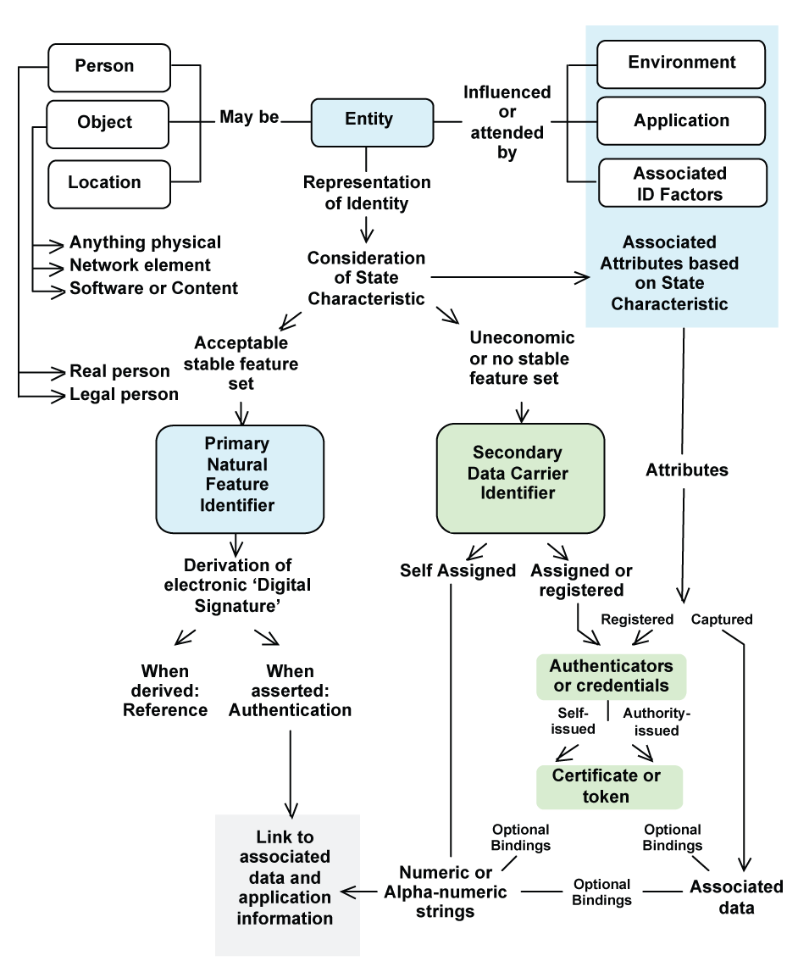
The Ontology of Identity
Notes:
The seven basic elements of any transaction are Who, What, When, Where, Why, Which, and How. While When is often a time-stamp, Why is the result of inputs including prior processes, and How is the specific procedures at hand; it is the Who, What, Where, and Which that require unique identity as described in this Ontology.
<I see no reason to go through the Ontology since it is hopefully self-explanatory and everyone should have a copy>

Slide 3
Item Numbering for
the 21st Century
• Unique Item Code
• Supplier Item Code
• Digital Item Code
• Serialized Item Code
• Non-significant Item Code
• Defined Length Item Code
• Item Code Includes Unique Identity of Manufacturer
Notes:
UCC.QED.I.18
So in summary the future looking numbering will be a unique, digital, serialized, non-significant, defined length supplier item code including the identity of the manufacturer.

Slide 4
Unique Numbering for ODETTE
IAC of “OD”
One of 35 IACs (as of 2008-03-04)
Company Identification Number (CIN) is defined as 4 an (providing over 1.6 million unique company coding structures)
Notes:
Each of the presentations (Odette, JAMA/JAPIA, Daimler, VW, and AIAG make an implication though not stated of a supplier product/RTI code as opposed to a customer part number/RTI code. Our proposal is simply more direct making use of established systems, forward looking systems, and systems to take advantage of the the size of a 96 bit tag.
Let us review what we have before us, however. First of all we have the Odette issuing agency code (IAC) of “OD”.

Slide 5
Issuing Agency Codes (IACs) as of 2008-03-04
IAC | Issuing Agency | IAC | Issuing Agency
0 thru 9 | GS1 | NL | Koninklijke TNT POST
D | NATO AC/135 | OD | ODETTE EUROPE
J | Universal Postal Union | QC | CEFIC
KNO | NorStella | RG | Xifrat Daten A.G.
KKR | Korea Institute of Distribution and Logistics (KIDL) | SI | SIEMENS
LA | JIPDEC/CII | ST | EUROFER
LB | Telcordia Technologies, Inc. | UN | Dun & Bradstreet
LD | DOD-DLIS | VEC | ECRI
LE | EDIFICE | VGL | van Gend & Loos
LF | FIATA | VGT | G.T.F.
LH | EHIBCC | VIB | IBM
LM | Telefonaktiebolaget LM Ericsson | VTD | Teikoku Databank Ltd.
ND | DHL Freight GmbH
Notes:
Odette’s is but one of 35 (ascribing 10 to GS1) IACs and but one of 28 (ascribing 10 to GS1) codes that are one or two digits in length.

Slide 6
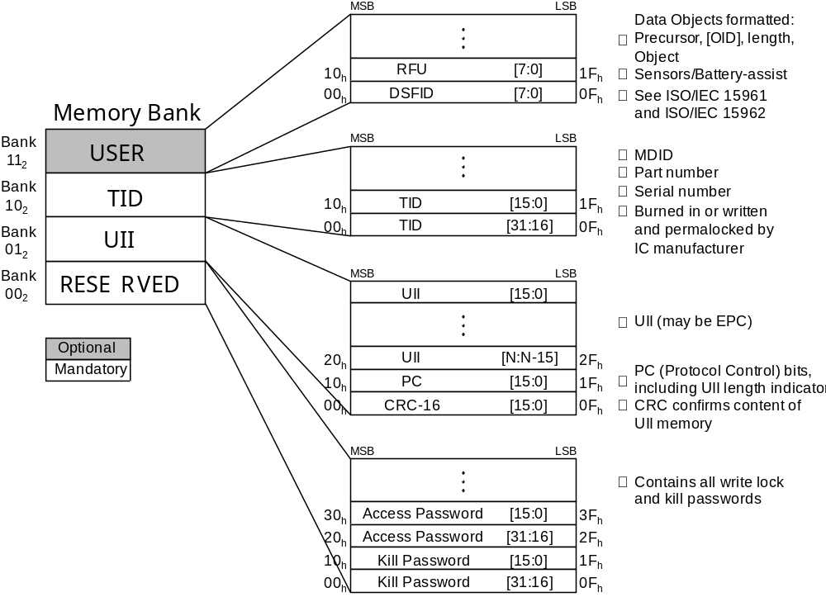
ISO/IEC 18000-6C & 3m3 Memory
Notes:
Both the ODETTE and the JAMA/JAPIA suggestions have implied that this Unique Item Identification (UII) for the automotive industry be housed in Memory Bank “11” basically surrendering the 96-bits in Memory Bank “01” to someone external. This proposal reclaims those 96 bits for JAIF use (and the use by others) while not conflicting with existing EPCglobal structures.

Slide 7
Headers
Header Value (binary) | Header Value (hex) | Encoding Length (Bits) | Encoding scheme | Header Value (binary) | Header Value (hex) | Encoding Length (Bits) | Encoding scheme
0000 0000 | 00 | NA | Unprogrammed tag | 0011 0100 | 34 | 96 | GIAI-96
0000 0001 | 01 | NA | RFU | 0011 0101 | 35 | 96 | GID-96
0000 001x | 02, 03 | NA | RFU | 0011 0110 | 36 | 198 | SGTIN-198
0000 01xx | 04, 05, 06, 07 | NA | RFU | 0011 0111 | 37 | 170 | GRAI-170
0000 1000 - 0000 1111 | 08 - 0F | NA | Available after 2009-07-01 | 0011 1000 | 38 | 202 | GIAI-202
0001 0000 - 0010 1011 | 10 - 2B | NA | RFU | 0011 1001 | 39 | 195 | SGLN-195
0010 1100 | 2C | 96 | GDTI-96 | 0011 1010 | 3A | 113 | GDTI-113
0010 1101 | 2D | 96 | GSRN-96 | 0011 1011 - 0011 1111 | 3B - 3F | NA | RFU
0010 1110 | 2E | 96 | RFU | 0100 0000 - 0111 1111 | 40 - 7F | NA | Available after 2009-07-01
0010 1111 | 2F | 96 | DoD-96 | 1000 0000 - 1011 1111 | 80 - BF | NA | Available after 2009-07-01
0011 0000 | 30 | 96 | SGTIN-96 | 1100 0000 - 1100 1101 | C0 - CD | NA | Available after 2009-07-01
0011 0001 | 31 | 96 | SSCC-96 | 1100 1110 | CE | NA | Available after 2009-07-01
0011 0010 | 32 | 96 | SGLN-96 | 1100 1111 - 1111 1110 | CF - FE | NA | Available after 2009-07-01
0011 0011 | 33 | 96 | GRAI-96 | 1111 1111 | FF | NA | RFU for headers longer than 8 bits
Notes:
Presently, EPCglobal uses 14 of the 256 headers available in an eight bit encoding. These 14 header, the Header for Unprogrammed Tag (00₁₆) and the Header to afford extensibility (FF₁₆) are shaded in the this table. The 240 remaining are unassigned (Note: The shaded area vs. non-shaded area in this table does not well represent the total population of available headers compared to the assigned headers, insofar as the shaded cells are individual headers while the non-shaded headers are by and large substantial ranges of headers.) It is recommended that EPCglobal be assigned the 14 previously assigned plus 18 more for a total of 32. The remaining 222 headers (00₁₆ and FF₁₆ would keep their same value) is proposed to be assumed either by ISO or by ITU. If EPCglobal needs more than the allocated 32, they may apply to the ISO/ITU registration authority. While under ISO/IEC 15459 GS1/EPC was allocated all of the leading numeric Issuing Agency Codes, they cannot claim that they should be allocated all of the bits.

Slide 8
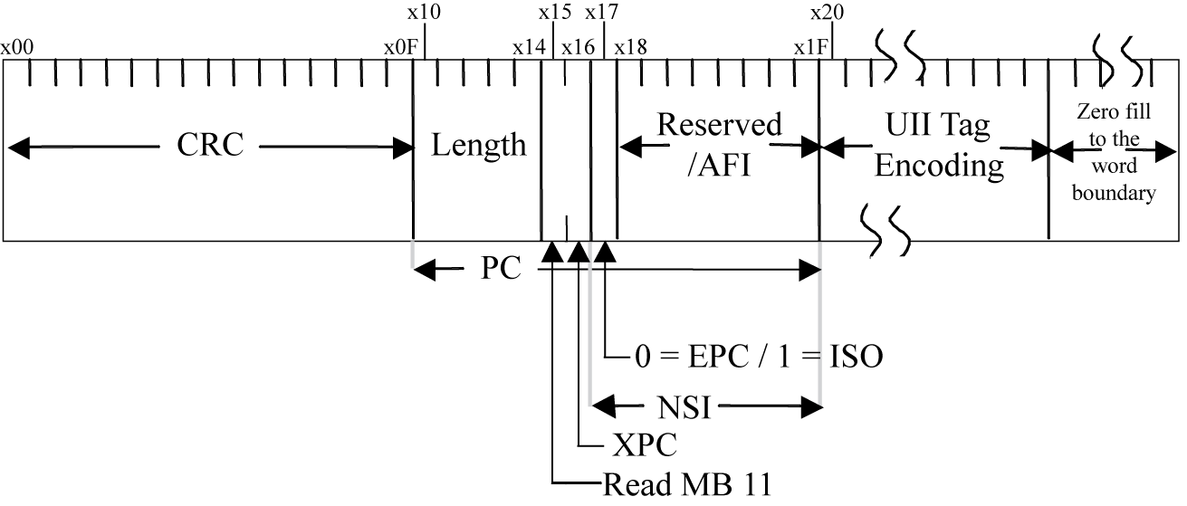
18000-6C & 3m3 Memory Bank 01₂
Notes:
For if the rest of the industry, including the automotive industry, do not promote the use of MB 01 for the efficient encoding of digital data, they will be condemned to:
1. Two read cycles – The first for MB 01, detecting Bit 15, and the second for MB 11, resulting in longer read times of non-EPC data
2. Larger than necessary (or available) memory sizes for RFID applications
This technique takes advantage of the most widely available and lowest cost tags; namely 96 bits. This technique also provides for something not available in EPC and that is a simple encodation that can be used by multiple media, providing intuitive key-entry and bar code back-up for RF tags.

Slide 9
RFID AFIs
Organization / Standard | AFI byte
ISO/IEC 17367: Supply chain applications of RFID – Product tagging [Separate MB01₂ and MB 11₂ with DIs] | A1
ISO/IEC 17365: Supply chain applications of RFID – Transport unit [Separate MB01₂ and MB 11₂ with DIs] | A2
ISO/IEC 17364: Supply chain applications of RFID – Returnable transport item [Separate MB01₂ and MB 11₂ with DIs] | A3
ISO/IEC 17367: Supply chain applications of RFID – Product tagging [Separate MB01₂ and MB 11₂ with DIs] - HazMat | A4
ISO/IEC 17366: Supply chain applications of RFID – Product packaging [Separate MB01₂ and MB 11₂ with DIs] | A5
ISO/IEC 17366: Supply chain applications of RFID – Product packaging [Separate MB01₂ and MB 11₂ with DIs] - HazMat | A6
ISO/IEC 17365: Supply chain applications of RFID – Transport unit [Separate MB01₂ and MB 11₂ with DIs] - HazMat | A7
ISO/IEC 17364: Supply chain applications of RFID – Returnable transport item [Separate MB01₂ and MB 11₂ with DIs] - HazMat | A8
ISO/IEC 17363: Supply chain applications of RFID – Freight containers [Separate MB01₂ and MB 11₂ with DIs] | A9
ISO/IEC 17363: Supply chain applications of RFID – Freight containers [Separate MB01₂ and MB 11₂ with DIs] - HazMat | AA
IATA: baggage handling [separate UII memory] | C1
EDItEUR: library items | C2
ISBT item level blood products ⁷ | C3
Notes:
It is true that we already have a set of AFIs that could be used to uniquely identify the item, but the cost of this usage will be higher priced tags due to larger memory, as can be seen in the other proposed structures.

Slide 10
Building on an EPC structure
 | Header | Filter Value | Partition | Company Prefix | Asset Type | Serial Number
17363-96 | 8 | 3 | 3 | 20-40 | 24-4 | 38
Freight container | 1000 0001 (Binary value) | (Refer to Table xx for values) | (Refer to Table xx for values) | 999,999 – 999,999,999,999 (Max. decimal range) | 999,999 – 0 (Max. decimal range) | 274,877,906,943 (Max. decimal value)
 | Header | Filter Value | Partition | Company Prefix | Asset Type | Serial Number
17364-96 | 8 | 3 | 3 | 20-40 | 24-4 | 38
RTI | 1000 0010 (Binary value) | (Refer to Table xx for values) | (Refer to Table xx for values) | 999,999 – 999,999,999,999 (Max. decimal range) | 999,999 – 0 (Max. decimal range) | 274,877,906,943 (Max. decimal value)
 | Header | Filter Value | Partition | Company Prefix | Serial Reference | Unallocated
17365-96 | 8 | 3 | 3 | 20-40 | 38-18 | 24
Transport unit | 1000 0011 (Binary value) | (Refer to Table xx for values) | (Refer to Table xx for values) | 999,999 – 999,999,999,999 (Max. decimal range) | 99,999,999,999 – 99,999 (Max. decimal range) | [Not Used]
 | Header | Filter Value | Partition | Company Prefix | Item Reference | Serial Number
17366-96 | 8 | 3 | 3 | 20-40 | 24-4 | 38
Product package | 1000 0100 (Binary value) | (Refer to Table xx for values) | (Refer to Table xx for values) | 999,999 – 999,999,999,999 (Max. decimal range) | 9,999,999 – 9 (Max. decimal range) | 274,877,906,943 (Max. decimal value)
 | Header | Filter Value | Partition | Company Prefix | Item Reference | Serial Number
17367-96 | 8 | 3 | 3 | 20-40 | 24-4 | 38
Product | 1000 0101 (Binary value) | (Refer to Table xx for values) | (Refer to Table xx for values) | 999,999 – 999,999,999,999 (Max. decimal range) | 9,999,999 – 9 (Max. decimal range) | 274,877,906,943 (Max. decimal value)
Notes:
Looking first at the existing EPCglobal formats, it would be relatively easy to assign specific headers for the the ISO supply chain layers. While it is recognized that the document at hand is addressing RTI Numbering, we may wish to take this opportunity to address all layers of the supply chain. This table and the associated text that would go with it requires more work to flesh in the specific attributes of each 96-bit tag. All values to the right and including the Company Prefix are those contained in the current EPC Tag Data Standard. The next slide shows how we might better assign the values in 17364-94.

Slide 11
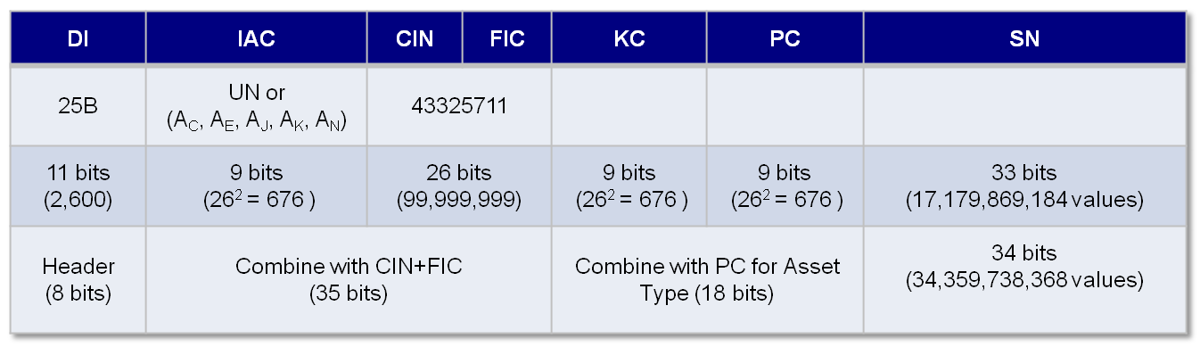
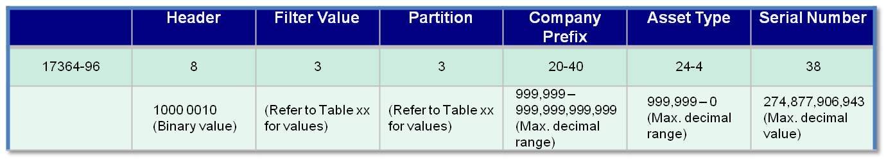
RTI - Encoding in 96 bits
Notes:
Data Identifier (DI), Issuing Agency Code (IAC), Company Identification Number (CIN), Factory Identification Code (FIC), Kind Code (KC), Partition Code (PC), Serial Number (SN)
As can be seen in this slide, it is proposed that each Header have an associated Data Identifier and in the case of 17364 that DI is “25B”. To encode any DI from A to Ann could be accomplished in 2,600 possible values which would require 11 bits. Presuming 1 or 2 character IACs (the truly international ones) 676 possible values could be encoded in 9 bits. The company and factory identification affords 100 million possible values IN EACH COUNTRY/REGION. The kind code/product code affords 676 different types of RTI and 676 different partition configurations within each different type. And within each factory/kind combination 34 billion unique serial numbers are possible. Of course it would be possible to adjust any of these fields as long as we retain the 96 bit length.

Slide 12
Identification of Items
System implies use of supplier part numbers and the establishment of an alias in existing databases
Industries agree to sunset the use of customer part numbers by 2010
All part numbers are 96 bits in length
Binary value is able to be easily translated to back to human-readable characters for key-entry and bar code encodation
Between 2008 and 2010, industries begin the process of crossing referencing customer part numbers to supplier part numbers and supplier part numbers to binary values
  UN/EDIFACT “PRICAT”/“ORDRSP”
  ASC X12 “832”/“855”
  Industry database
Notes:
Finally for the identification of products we encourage planning for the following:
- Automotive industry begins to phase in the use of supplier part numbers
- Automotive industry agrees to sunset the use of customer part numbers by 2010
- All part numbers are 96 bits in length
- Binary value is able to be easily translated to back to human-readable characters for key-entry and bar code encodation
- Between 2008 and 2010, automotive industry begins the process of crossing referencing customer part numbers to supplier part numbers

Slide 13
Benefits
Compatible with EPC
Codes can be easily converted back to ASCII values for key-entry and bar code back-up
Permits use of readily available, low cost RFID tags
Unique ID can be read on the first read
Uses industry established IACs

Slide 14
Next Steps
Establish an MH 10/TC 122 PINS/NP for Unique Digital Identification (UDI)
Develop initial text within SC 8 Ad Hoc
Submit to either SC 31/WG 2 or to TC 122

Slide 15
???

Slide 16
Thank You!

