Slide 1

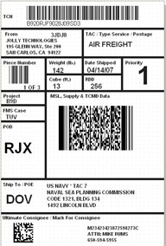


ISO TC 122/WG 4, 122/WG 5, 122/WG 7, & 122/104 JWG Report to ISO TC 122
by: Craig K. Harmon, Convener WGs 4, 7, & 9
2008-10-10
Notes:
Good morning ladies and gentlemen. I would first like to thank you this unusual presentation style. A set of issues developed where travel to Japan was not feasible. I am hopeful that you will find this technique not only acceptable but in some ways preferable, Next, this technique will include video where you would see a “talking head” speaking in English and the translator speaking in Japanese to the audience. Ultimately, I believe that the power of the internet will deliver real-time on-line translated voice communication, permitting collaboration at levels yet unheard of.
My presentation today is a report from the United States on the status of the Work Items of TC 122/Working Group 4, TC 122/Working Group 5, TC 122/Working Group 7, and TC 122/Working Group 9,
2008-10-08
(E): craig.harmon@qed.org (V): +1 319/364-0212
Craig K. Harmon Presentation - JPI

Slide 2

Craig K. Harmon • President & CEO
Q.E.D. Systems
Chair, ISO TC 122/104 JWG - Supply Chain Applications of RFID
Chair, RFID Experts Group (REG)
Founder, JTC 1/SC 31
Chair, ISO TC 122/WG 4 (Shipping Labels) & ISO TC 122/WG 7 (Product Packaging)
Vice-chair, ASC MH 10 and U.S. TAG to ISO TC 122 (Packaging)
Chair, JTC 1/SC 31/WG 6 - Mobile Item Identification and Management
Senior Project Editor ISO/IEC JTC 1/SC 31/WG 4 (RFID)
Project Editor, ISO 18185-5 (Electronic Container Seal - Physical Layer)
Joint Automotive Industry Forum (JAIF) JAMA/JAPIA/AIAG/ODETTE) – Returnable Transport Items
AIAG Bar Code, Applications, 2D, Tire, Returnables, & RFID Committees
Member, EPCglobal HAG (UHFGen2), FMCG BAG, HLS BAG, SAG, TLS, TDS, AIWG, SBAC
JTC 1 & TC 104 Liaison Officer to the International Telecommunications Union (ITU-R & ITU-T)
ISO TC 104 & 122 (Freight Containers / Packaging) Liaison Officer to JTC 1/SC 31
Past Chair, U.S. TAG to ISO/IEC JTC 1/SC 31/WG 4 (RFID)
Past Chair, ASC INCITS T6 (RFID) - ANS INCITS 256:1999, 2001
Advisor and Member of USPS Strategic Technology Council
Chairman & Project Editor, ANS MH10.8.2 (Data Application Identifiers)
Original Project Editor, NATO STANAG 2233 (RFID for NATO Asset Tracking)
Vocabulary Rapporteur to ISO/IEC JTC 1/SC 31, ISO/IEC 19762 - Harmonized vocabulary
CompTIA RFID Subject Matter Expert and RFID Certified Professional (CRCP) - RFID+
Recipient of the 2004 Richard Dilling Award
This presentation posted at: http://www.autoid.org/presentations/presentations.htm
Notes:
2008-10-08
(E): craig.harmon@qed.org (V): +1 319/364-0212
Craig K. Harmon Presentation - JPI
The most important part of this slide is at the bottom of the page where you can download a copy of this presentation in its native MS PowerPoint. Feel free to download and use the slides for your own internal purposes. Personally, I believe that plagiarism is the highest form of flattery, so please use. A word of credit every know and then would be appreciated.
I have the privilege of leading some of the efforts where there is an intersection between the RFID and the packaging industry. The work of the TC 122/104 JWG brings RFID to all levels of packaging consumer and industrial. The RFID Experts Group has addressed or is in the process of addressing most, if not all, of the topics of this presentation. JTC 1/SC 31 has written or is writing the technology, data, and conformance standards for RFID, bar codes, and two-dimensional symbols. WG 4 and WG 7 of TC 122 have written the bar code and 2D symbol application standards for the packaging industry. And in WG 6 we are looking at the standardization of a convergence of portable terminals, computing technology, mobile telephony, and automatic identification technologies. Each of these will have an impact on the packaging industry.

Slide 3
The Layers of Logistic Units
(Optically Readable Media - ORM)
Layer 5
ISO TC 204 (None)
ISO TC 8 (None)
AIAG B-15
Movement Vehicle
(truck, airplane, ship, train)
Layer 4
ISO 6346 (OCR)
(Freight containers)
Container
(e.g., 40 foot Sea Container)
Layer 3
ISO 15394
(Returnable transport items)
ANS MH10.8.1
GS1 Gen Spec (GRAI)
Unit Load
“Pallet”
Unit Load
“Pallet”
Layer 2
ISO 15394
(Transport units)
ANS MH10.8.1
GS1 Gen Spec (SSCC)
Transport
Unit
Transport
Unit
Transport
Unit
Transport
Unit
Layer 1
ISO 22742
(Product packaging)
ANS MH10.8.6
GS1 Gen Spec (GTIN)
Pkg
Pkg
Pkg
Pkg
Pkg
Pkg
Pkg
Pkg
Layer 0
ISO 28219
(Product tagging)
ANS MH10.8.7
GS1 Gen Spec (GTIN)
Item
Item
Item
Item
Item
Item
Item
Item
Item
Item
Item
Item
Item
Item
Item
Item
Notes:
First let me speak to the humble bar code and two dimensional symbols. The supply chain can have many (consumer goods) or few (automotive) links between trading partners. Consequently, it is necessary for supply chain and life cycle management to have standards for optically readable media at the product, product package, transport unit, returnable transport item, and freight container levels. I am happy to report that TC 122 has completed its work in the development of optically readable media standards for all levels of the supply chain. There appears to be a bit of confusion at ISO, but the work has been completed.
2008-10-08
(E): craig.harmon@qed.org (V): +1 319/364-0212
Craig K. Harmon Presentation - JPI

Slide 4
ISO TC 122/WG 4
Bar code symbols on unit loads and transport packages
Notes:
Let me first speak to WG 4, Bar code symbols on unit loads and transport packages
2008-10-08
(E): craig.harmon@qed.org (V): +1 319/364-0212
Craig K. Harmon Presentation - JPI

Slide 5
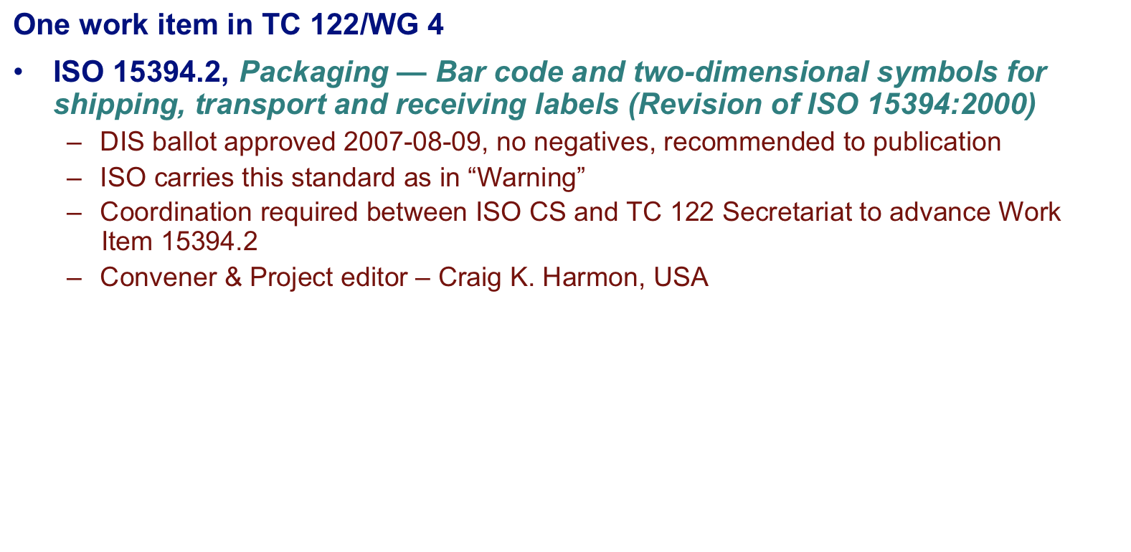
ISO TC 122/WG 4
Project Status
Notes:
WG 4 has one work item, ISO 15394, which was originally published on 2000 and has been prepared for its first revision (ISO 15394.2). The DIS ballot was approved with no negatives and under ISO rules, it can then progress to publication. The TC 122 Secretariat recommended that it move to publication but no action has been forthcoming from the ISO Central Secretariat. Not only has there been no action, but the ISO Project Portal caries this standard as in warning. It is apparent that we need some additional coordination between ISO CS and TC 122 Secretariat to advance Work Item 15384.2.
I serve as the Work Item project editor and WG convener.
2008-10-08
(E): craig.harmon@qed.org (V): +1 319/364-0212
Craig K. Harmon Presentation - JPI

Slide 6
ISO TC 122/WG 5
Vocabulary
Notes:
The convener of WG 5 (Elmer Kuhlman) asked that I present this brief report on TC 122 Vocabulary.
2008-10-08
(E): craig.harmon@qed.org (V): +1 319/364-0212
Craig K. Harmon Presentation - JPI

Slide 7
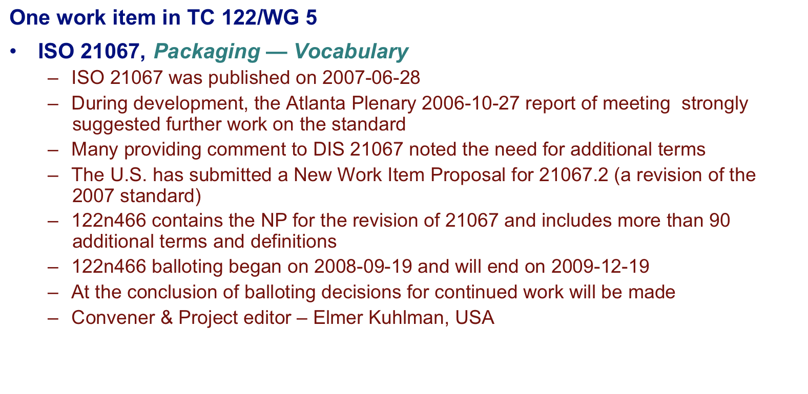
ISO TC 122/WG 5
Project Status
Notes:
The TC 122 Vocabulary (ISO 21067) was published on 2007-06-28. The Atlanta Plenary 2006-10-27 Report of Meeting strongly suggested further work on the standard. Many providing comment to DIS 21067 noted the need for additional terms. The U.S. has submitted a New Work Item Proposal for 21067.2 (a revision of the 2007 standard). 122n466 contains the NP for the revision of 21067 and includes more than 90 additional terms and definitions.
122n466 balloting began on 2008-09-19 and will end on 2009-12-19. At the conclusion of balloting decisions for continued work will be made
2008-10-08
(E): craig.harmon@qed.org (V): +1 319/364-0212
Craig K. Harmon Presentation - JPI

Slide 8
ISO TC 122/WG 7
Linear bar code and two dimensional symbols for product packaging
Notes:
Next, we have WG 7, which is responsible for Linear bar code and two dimensional symbols for product packaging
2008-10-08
(E): craig.harmon@qed.org (V): +1 319/364-0212
Craig K. Harmon Presentation - JPI

Slide 9
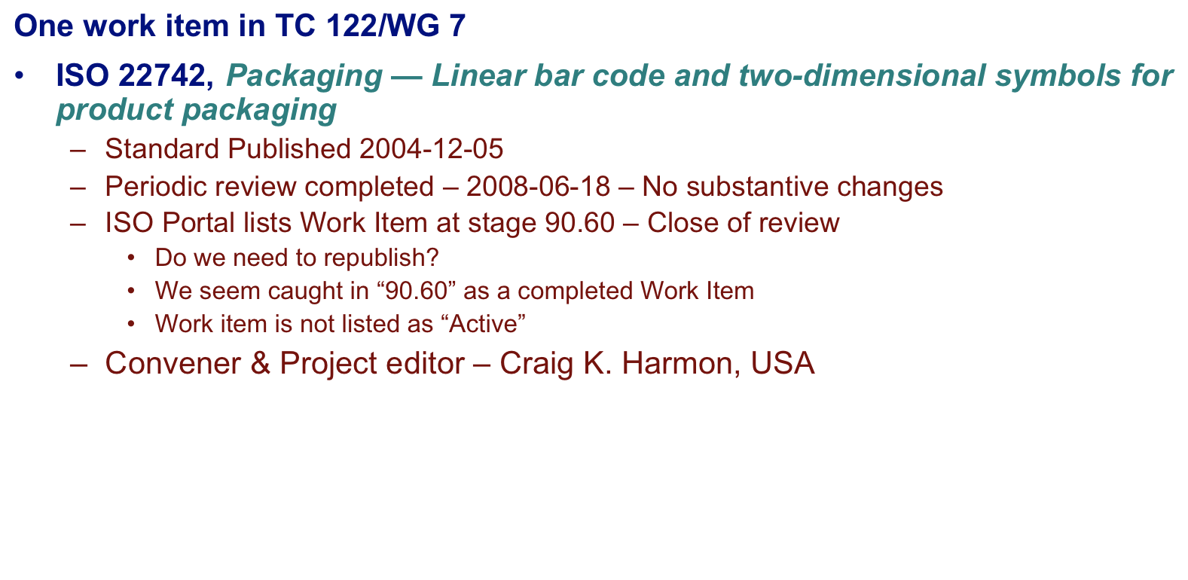
ISO TC 122/WG 7
Project Status
Notes:
WG 7 also has one work item, ISO 22742, which was originally published on 2004 and completed a periodic review in June, 2008. There were no substantive changes to the document. The question is that the Work Item appears “stuck” at stage 90.60. Close of review. Do we need to republish the document? Further, the document is not listed as “Active”. We clarification from ISO as to what happens next.
I serve as the Work Item project editor and WG convener.
2008-10-08
(E): craig.harmon@qed.org (V): +1 319/364-0212
Craig K. Harmon Presentation - JPI

Slide 10
ISO TC 122 – No assigned WG
Packaging -- Labelling and direct product marking with linear bar code and two-dimensional symbols
Notes:
We have completed the work of ISO 28219, Packaging -- Labelling and direct product marking with linear bar code and two-dimensional symbols. This effort had no assigned WG and could be considered as a Work Item of TC 122 (without a WG).
2008-10-08
(E): craig.harmon@qed.org (V): +1 319/364-0212
Craig K. Harmon Presentation - JPI

Slide 11
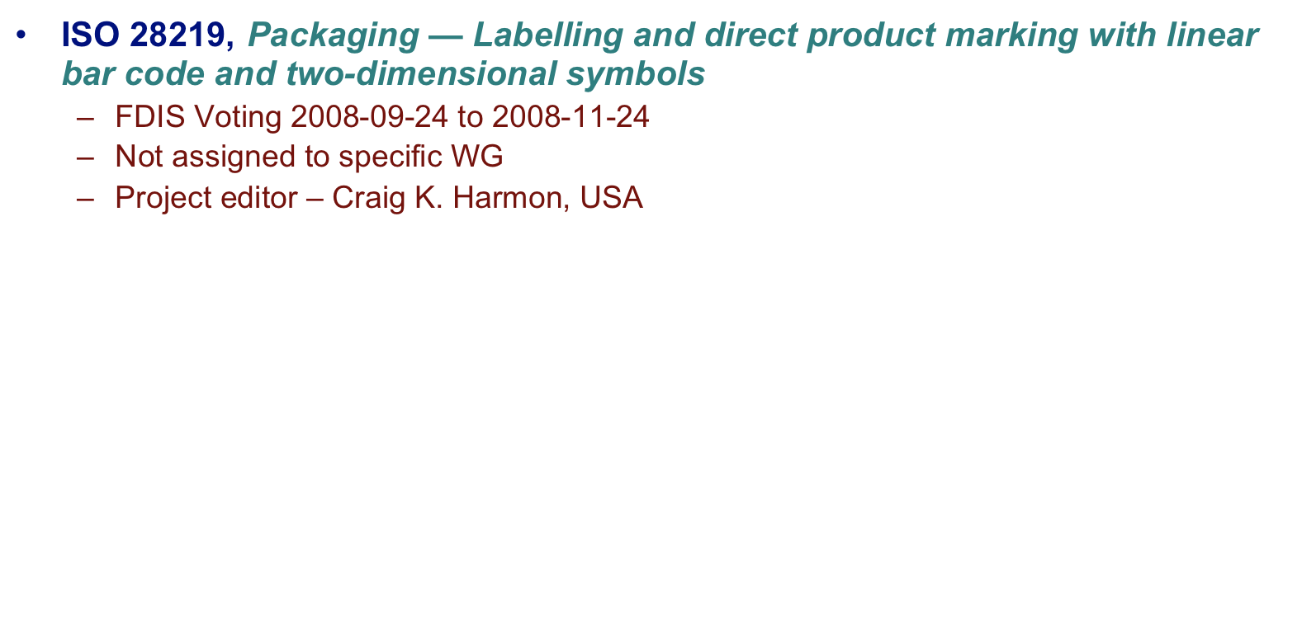
ISO TC 122/WI 28219
Project Status
Notes:
ISO 28219 addressing labeling and direct product marking is currently in its last round of balloting and is expected to be approved in November, 2008. I serve as the project editor.
2008-10-08
(E): craig.harmon@qed.org (V): +1 319/364-0212
Craig K. Harmon Presentation - JPI

Slide 12
ISO TC 122/104
Joint Working Group (JWG)
(Supply chain applications of RFID)
Notes:
When TC 122 began considering RFID we needed to bring together the standards of ISO/IEC JTC 1/SC 31, the optically readable media standards of TC 122, the pallet standards of ISO TC 51, and the freight container standards of ISO TC 104. This gave rise to the creation of the ISO TC 122/104 Joint Working Group (JWG).
2008-10-08
(E): craig.harmon@qed.org (V): +1 319/364-0212
Craig K. Harmon Presentation - JPI

Slide 13
The Layers of Logistic Units
(Radio Frequency Identification
Layer 5
Movement Vehicle
(truck, airplane, ship, train)
Layer 4 (433 MHz)
ISO 17363
(Freight containers)
Container
(e.g., 40 foot Sea Container)
Layer 3 (860-960 MHz)
(Other 18000 with TPA)
ISO 17364
(Returnable transport items)
Unit Load
“Pallet”
Unit Load
“Pallet”
Layer 2 (860-960 MHz)
(Other 18000 with TPA)
ISO 17365
(Transport units)
Transport
Unit
Transport
Unit
Transport
Unit
Transport
Unit
Layer 1
(860-960 MHz with TPA)
(13.56 MHz with TPA)
ISO 17366
(Product packaging)
Pkg
Pkg
Pkg
Pkg
Pkg
Pkg
Pkg
Pkg
Layer 0
(860-960 MHz with TPA)
(13.56 MHz with TPA)
ISO 17367
(Product tagging)
Item
Item
Item
Item
Item
Item
Item
Item
Item
Item
Item
Item
Item
Item
Item
Item
“TPA” - Trading Partner Agreement
Concept Source: Akira Shibata, DENSO-Wave Corporation
Notes:
While the supply chain is the same as for optically readable media the standards of the JWG apply RFID.
ISO 17363 – Supply chain applications of RFID – Freight containers addresses the contents or manifest of freight container contents
ISO 17364 – Supply chain applications of RFID – Returnable transport items addresses the returnable transport item as both an asset and a trading partner vessel.
ISO 17365 – Supply chain applications of RFID – Transport units addresses the shipping label applications of RFID.
ISO 17366 – Supply chain applications of RFID – Product packaging addresses the use of RFID at the product packaging level, and
ISO 17367 – Supply chain applications of RFID – Product tagging addresses the use of RFID directly attached to the product
2008-10-08
(E): craig.harmon@qed.org (V): +1 319/364-0212
Craig K. Harmon Presentation - JPI

Slide 14

ISO TC 122/104 JWG
Project Status (2007-10-01)
ISO 17363, Supply chain applications of RFID - Freight containers
  International Standard published
ISO 17364, Supply chain applications of RFID - Returnable transport items
  DIS approved registered for FDIS ballot
ISO 17365, Supply chain applications of RFID - Transport units
  DIS approved registered for FDIS ballot
ISO 17366.2, Supply chain applications of RFID - Product packaging
  International Standard under publication
ISO 17367.2, Supply chain applications of RFID - Product tagging
  International Standard under publication
Issues
ISO/IEC 18000-3m3 - EPCglobal interference in ISO process
18000-6C - EPCglobal assignment of bit indication of HazMat
17364-17367- Not expected for publication until early 2009
Notes:
ISO 17363 has already been published and 17364 through 17367 have been ready to be published for almost two years. What held up this publication were delays caused by EPCglobal. For RTIs, transport units, product packaging, and product tagging several countries, including Japan and Germany wanted a high frequency (13.56 MHz) solution and the existing ISO/IEC 18000-3 standards did not meet the user requirements. We introduced ISO/IEC 18000-3m3 into SC 31 and within a month of introduction EPCglobal managed the removal of the text of the standard from ISO and to EPCglobal for development. This took nearly two years. EPCglobal finally completed their document and it is back into SC 31 for a three month Committee Draft ballot ending on December 8th. Once the Committee Draft is approved 17364 through 17367 will be able to be released for FDIS (as is the case for 17364 and 17365) or for publication as is the case for 17366 and 17367, Therefore we do not expect the entire TC 122/104 JWG suite to be published until early 2009.
There has been some interest raised in considering re-opening the entire 1736x suite once the standards approved though no one has pursued it to the point of issuing a New Work Item Proposal.
2008-10-08
(E): craig.harmon@qed.org (V): +1 319/364-0212
Craig K. Harmon Presentation - JPI

Slide 15
???
Notes:
For questions, I ask that you go to the next slide.
2008-10-08
(E): craig.harmon@qed.org (V): +1 319/364-0212
Craig K. Harmon Presentation - JPI

Slide 16
Thank you!!!
Craig K. Harmon, President & CEO
Q.E.D. Systems
3963 Highlands Lane, SE
Cedar Rapids, IA 52403-2140 USA
(V): +1 319/364-0212
(M): +1 319/533-8092
(E): craig.harmon@qed.org
(U): http://www.autoid.org
Notes:
I first want to thank you for what I hope was an enjoyable presentation and one you will remember for both content and delivery. I welcome any questions though I do not have the ability to be completely interactive today. Therefore I would ask that if you have any questions, please send them to me at the email address above. Much of the standards activities are contained on our website (www.autoid.org) as are our presentations under “Presentations” off the homepage.
If you contact me, please answer whether you would like to see a weblog addressing your questions. If so we will turn on the weblog.
Again thank you for you attendance and attentiveness.
Good luck and God speed!
2008-10-08
(E): craig.harmon@qed.org (V): +1 319/364-0212
Craig K. Harmon Presentation - JPI

