Slide 1
Requesting, Specifying, Selecting AND Qualifying LABEL MATERIAL
Secured multiple source and supply,
possible or not?
Notes:
Requesting, Specifying, Selecting and Qualifying Label Material
EDTMHJA-11:0033 Uen, Rev C

Slide 2
Label material and Ink
Label parameters
  Peel adhesion
  Shear adhesion
  Breaking Strength and Elongation
  Thickness
  Substrate
  Environmental factors
Ink parameters
  Print method
  Label material
Topcoat
Facestock
Adhesive
Liner
Ink
Backing
Notes:
Requesting, Specifying, Selecting and Qualifying Label Material
EDTMHJA-11:0033 Uen, Rev C

Slide 3
when to choose a label...
What type of adhesive do I need for the labels?
  Permanent, Removable or Semi-Repositionable
What is the composition of the substrate that I will be using the label on?
What is the texture of the surface of the substrate?
What is the shape of the surface of the substrate?
  Circular, flat etc.
Is the application surface clean or contaminated?
Is there migratory of inhabiting components on the substrate?
Are there special environmental factors that should be considered?
  extreme temperature conditions, UV exposure, outdoor weathering etc.
???????
Notes:
Requesting, Specifying, Selecting and Qualifying Label Material
EDTMHJA-11:0033 Uen, Rev C

Slide 4
material specification
Application
  Under what conditions shall the material be used
Type of material
  Thickness, Temperature range, etc.
Type of adhesive
  Strength, Substrate (surface), etc.
Color
  Wholly or partly
Liner
  Manual or automatic dispense
Ink Ribbon
Other characteristics needed for proper selection/qualification?
Notes:
Requesting, Specifying, Selecting and Qualifying Label Material
EDTMHJA-11:0033 Uen, Rev C

Slide 5
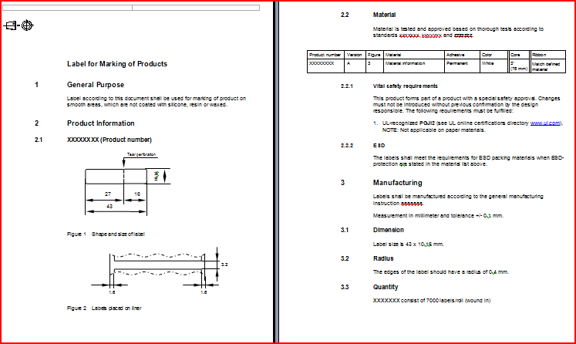
Marking specification
Shape
  Dimension
  Radius
  Color
Material
  Specific or common
Printing
Purchasing
Notes:
Requesting, Specifying, Selecting and Qualifying Label Material
EDTMHJA-11:0033 Uen, Rev C

Slide 6
Issues Today
Specifications of label material
  Differs from every supplier/converter
Material is to be used with a given ribbon
  Hard (impossible) to have multiple options/combinations
Sourcing – no multiple source
  No Competition – one supplier for one product
  Difficult to secure supply – product manufactured at few locations
Supply - total change of material and ink ribbon
  Same ink ribbon may not to be used for multiple label materials
  Ink ribbon lasts longer than labels on rolls or in boxes
  Incompatibility between suppliers/converters
Notes:
Requesting, Specifying, Selecting and Qualifying Label Material
EDTMHJA-11:0033 Uen, Rev C

Slide 7
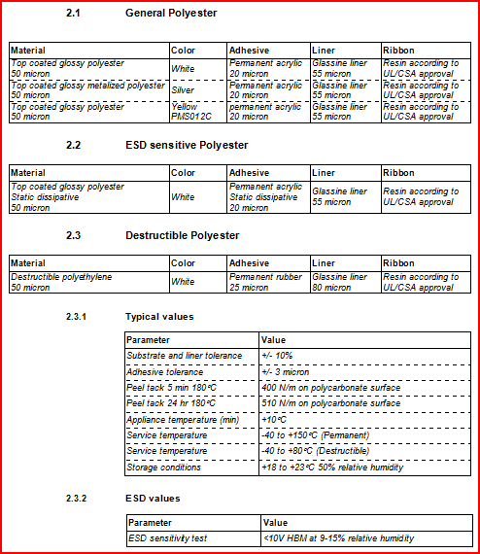



Harmonization Drivers
Defined way of specifying label material characteristics
  Common for all, uniform measure
  Provide most important characteristics
  Use of comparable test methods
Label materials to be more easily comparable
  Green Apple vs. Green Apple and not Apple vs. Orange
Source and usage
  Several options exists for a given application using a common specification
Man. A
Man. B
Notes:
Requesting, Specifying, Selecting and Qualifying Label Material
EDTMHJA-11:0033 Uen, Rev C

Slide 8
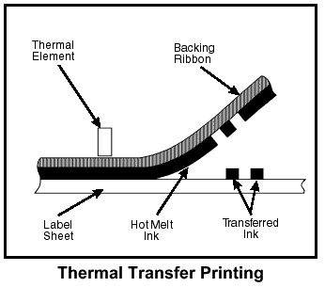
Technical Specifications
Questions and guidance around label material characteristics
  Share knowledge around complexity around label material
  Help when to define and source material for an application
Template for definition and specification of label material
  High level to enable comparisons based on data sheets
  Base for evaluation and tests to define label material for an application
Notes:
Requesting, Specifying, Selecting and Qualifying Label Material
EDTMHJA-11:0033 Uen, Rev C

Slide 9
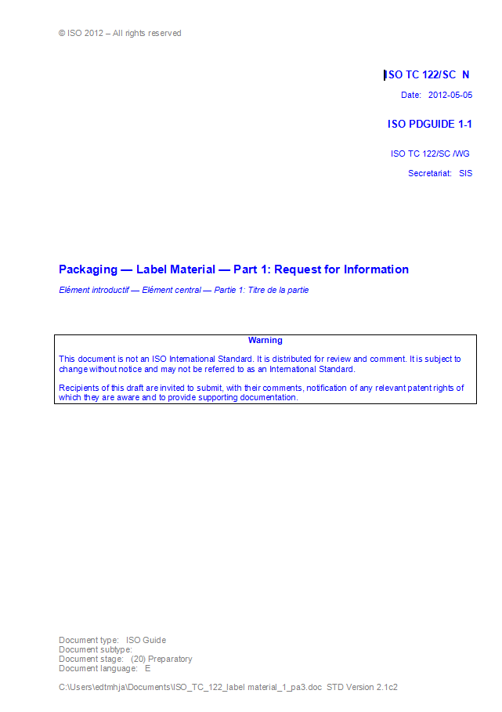
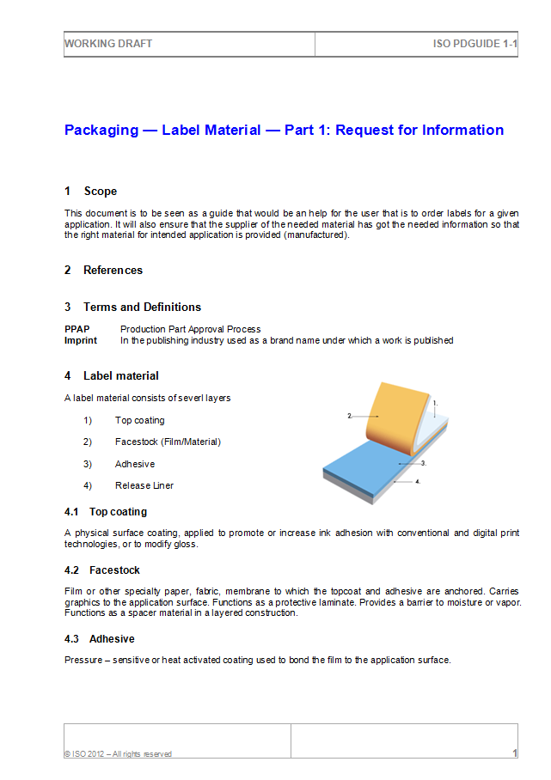
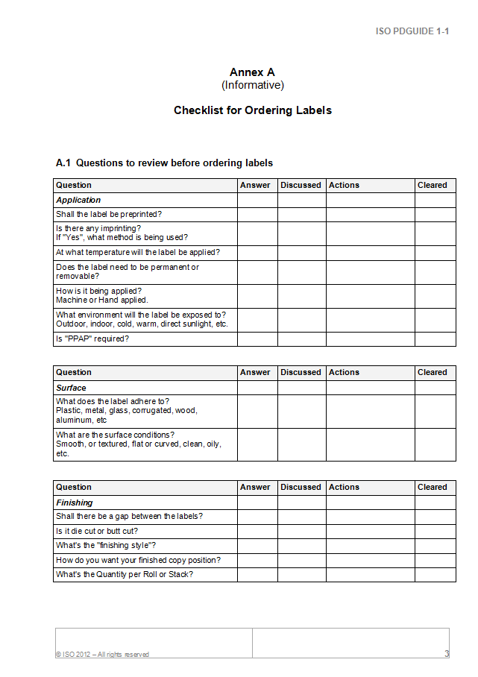
TS – Request for information
Notes:
Requesting, Specifying, Selecting and Qualifying Label Material
EDTMHJA-11:0033 Uen, Rev C

Slide 10

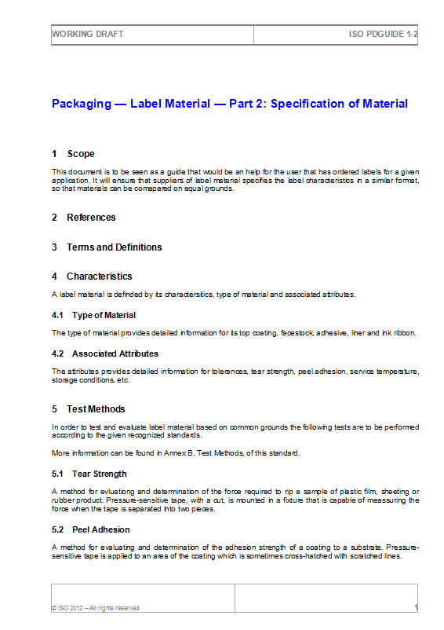
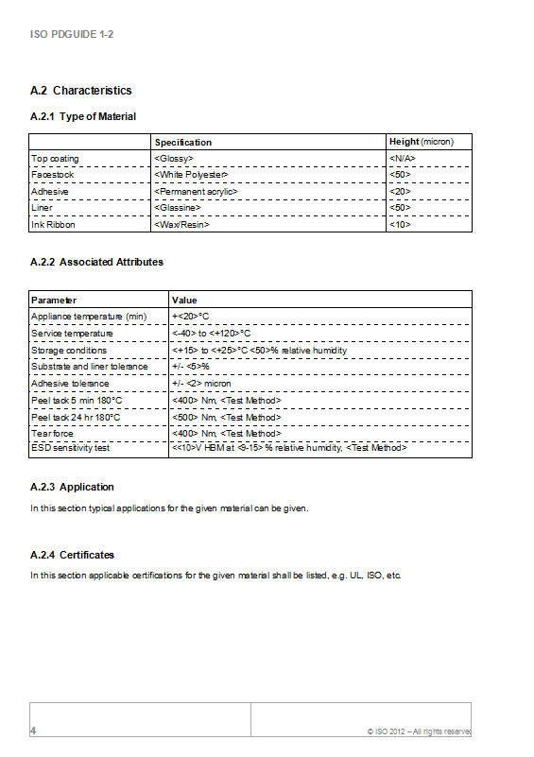
TS – Specification of Material
Notes:
Requesting, Specifying, Selecting and Qualifying Label Material
EDTMHJA-11:0033 Uen, Rev C

Slide 11

Notes:
Requesting, Specifying, Selecting and Qualifying Label Material
EDTMHJA-11:0033 Uen, Rev C

