Slide 1
CS5478 | FINAL PROJECT | NOVEMBER 2026
One Policy, Multiple
Grasp Recovery Skills
A Unified Transformer with Shared Action Primitives
Team 5 | Li Jiaqi
National University of Singapore | 13 November 2026

Slide 2
PROBLEM & MOTIVATION
Grasp recovery is not a single behavior
A grasp can fail even after it looks secure.
Uncertain friction, object dynamics and contact geometry
Slip, rotation or complete loss of contact during lifting
Excessive correction can destabilize an otherwise safe grasp
External disturbance
Ball impact
on the grasp
→ slip / detach / pose error
Scope of this work
Observe → Correct → Hold
We currently study only one external disturbance family: a ballistic ball impact on the grasped object. Other failure modes (sensor noise, actuator fault, human push, etc.) are out of scope for now.
MuJoCo · Franka two-finger
CS5478 | Final Project Presentation
2 / 13

Slide 3
MULTI-SKILL SETTING
Four recovery families, one deployed policy
A · Re-seat after ball impact
C · Detach and recatch
Regain a secure bilateral grasp after impact destabilizes contact.
Recover after impact causes full loss of contact; re-establish grasp.
B · Re-grasp after ball impact
D · Precision correction
Recover a disrupted grasp with a different corrective sequence.
Return pose/orientation after impact while keeping contact.
A–D classify expert demonstrations / eval scenarios only. The deployed Actor has no skill ID and does not select among A/B/C/D strategies.
CS5478 | Final Project Presentation
3 / 13

Slide 4
APPROACH & IMPLEMENTATION
From expert skills to a unified Transformer
Multi-skill experts
Shared vocabulary
Causal Transformer
Token + residual
Safe handoff
→
→
→
→
families A / B / C / D
111 motion primitives
history-conditioned Actor
7D corrective action
return to nominal control
Actor input
Actor output
Observation history plus the previous executed action.
Discrete motion primitive + continuous residual; or handoff.
Primitives are shared across skills. No skill ID is provided at test time.
CS5478 | Final Project Presentation
4 / 13

Slide 5
KEY DESIGN DECISION
Why discretize the action space?
Experts demonstrate multiple distinct skills.
Select primitive z_t
A single continuous regression target can blur different corrective behaviors.
A shared discrete vocabulary keeps modes separable.
A residual adds fine control without separate skill-specific policies.
The Actor also learns when to stop correcting and hand back control.
Predict residual r_t
a_t = clip(p_z + r_t)
CS5478 | Final Project Presentation
5 / 13

Slide 6
METHODOLOGY
Training and physical evaluation
Learning pipeline
Evaluation contract
Generate and validate expert recovery demonstrations.
Train a unified Actor with imitation learning.
Refine physical closed-loop performance with reinforcement learning.
Same frozen policy across families A–D
Official safe-handoff rule to the nominal controller
12-second physical stability after handoff
Closed-loop success matters more than offline action accuracy
Frozen final policy
Primary metric: 12-second relaxed physical success after handoff.
CS5478 | Final Project Presentation
6 / 13

Slide 7
RESULTS
Closed-loop success across four families
A
6/16
20/64
B
4/16
total successes
31.25%
C
3/16
D
7/16
Key observation
Detach–recatch (C) remains the hardest family.
Counts: successes / 16 trials per family. Same frozen Actor for A–D.
CS5478 | Final Project Presentation
7 / 13

Slide 8
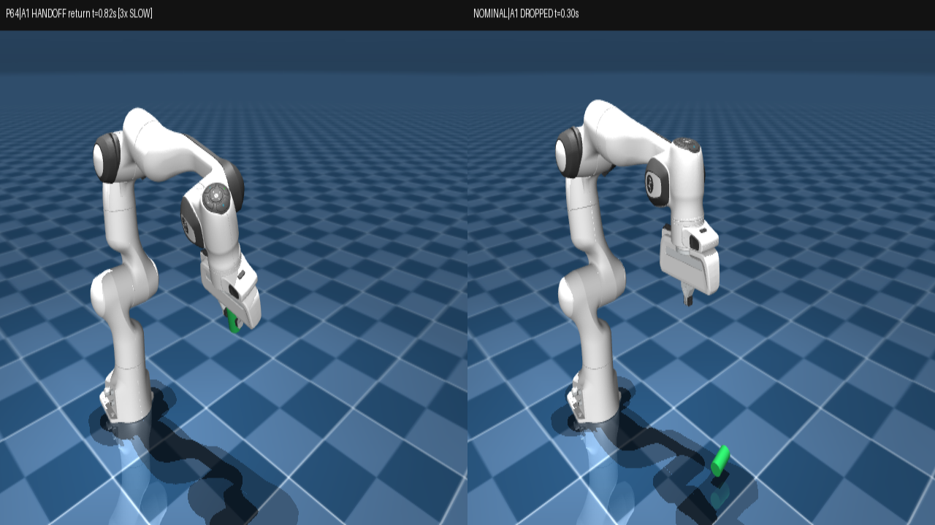
DEMONSTRATION · EXPERT FAMILY A
Expert family A — example closed-loop recovery
A / B / C / D = expert demonstration taxonomy only — not a skill ID, and not the policy’s chosen strategy.
Eval scenario from expert family A. Left = unified policy; right = do-nothing hold (drops). Click to play.
CS5478 | Final Project Presentation
8 / 13

Slide 9
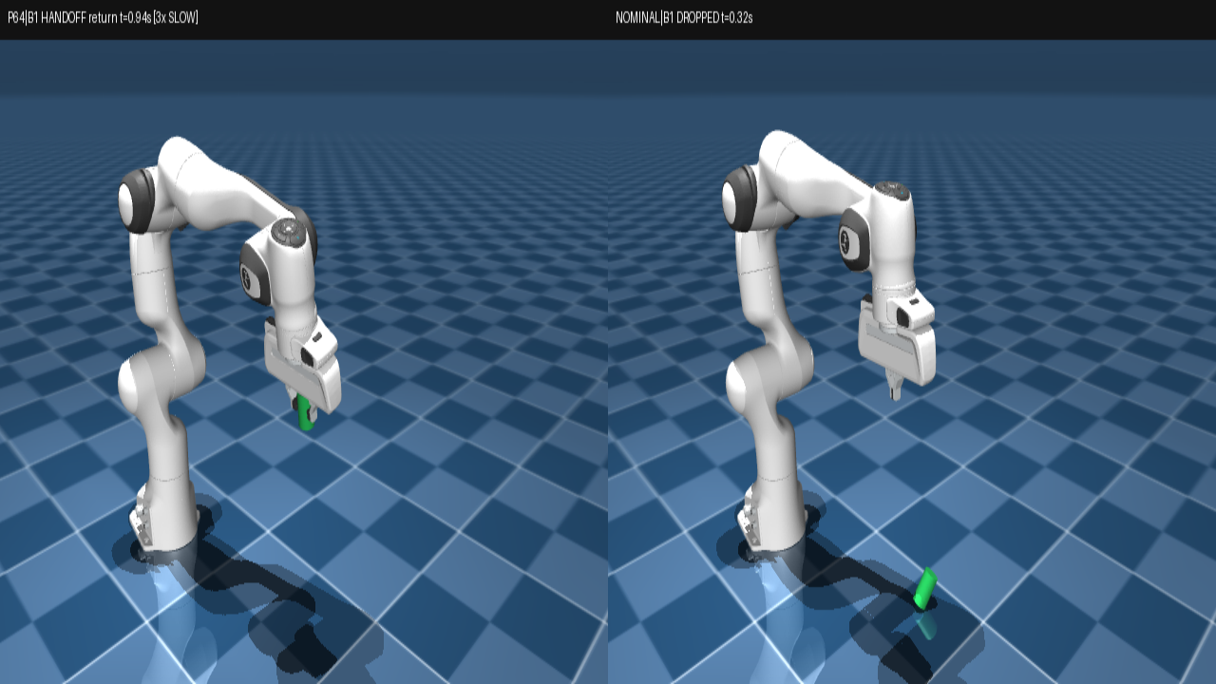
DEMONSTRATION · EXPERT FAMILY B
Expert family B — example closed-loop recovery
A / B / C / D = expert demonstration taxonomy only — not a skill ID, and not the policy’s chosen strategy.
Eval scenario from expert family B. Same frozen Actor — no B-specific strategy switch. Click to play.
CS5478 | Final Project Presentation
9 / 13

Slide 10
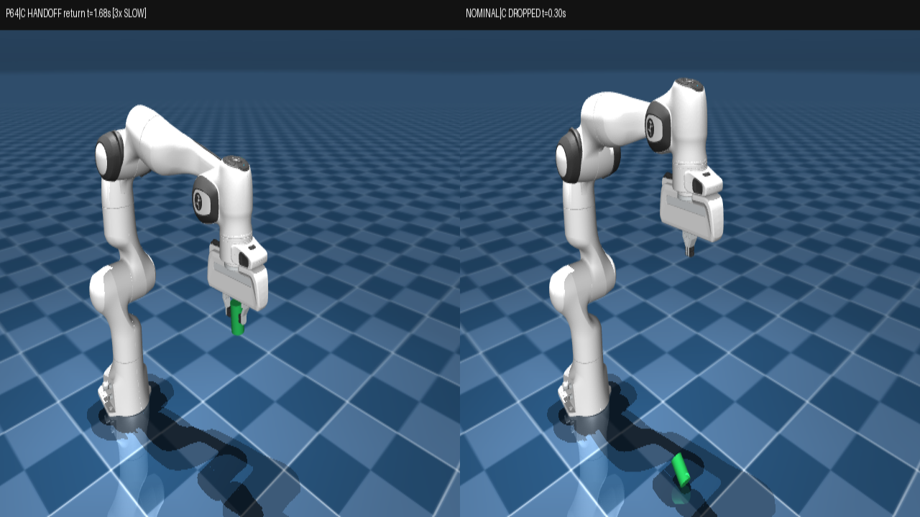
DEMONSTRATION · EXPERT FAMILY C
Expert family C — example closed-loop recovery
A / B / C / D = expert demonstration taxonomy only — not a skill ID, and not the policy’s chosen strategy.
Eval scenario from expert family C. Behavior emerges from the unified policy, not a C skill label.
CS5478 | Final Project Presentation
10 / 13

Slide 11
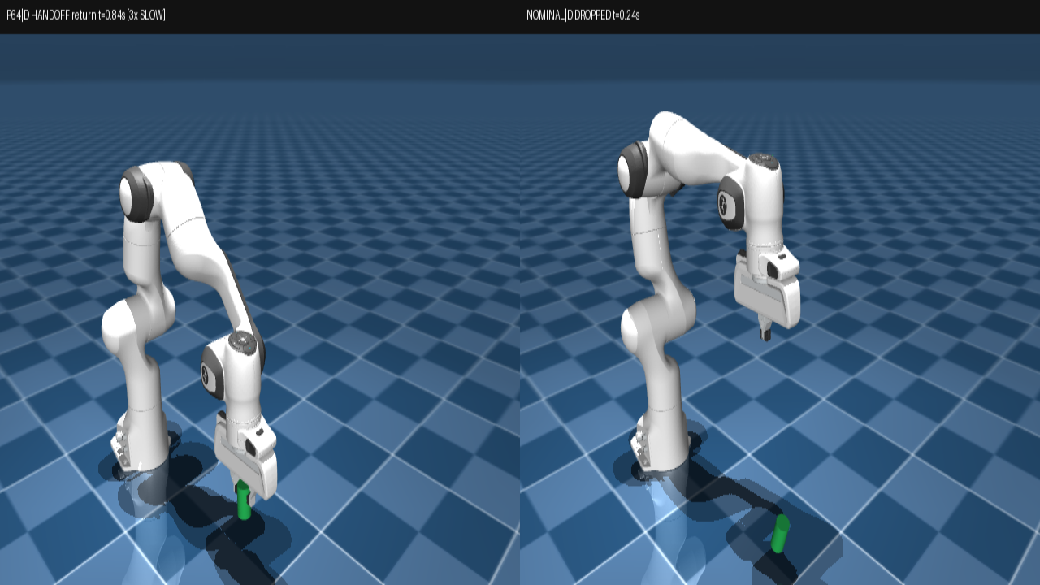
DEMONSTRATION · EXPERT FAMILY D
Expert family D — observed: release + catch
A / B / C / D = expert demonstration taxonomy only — not a skill ID, and not the policy’s chosen strategy.
Still an expert-family-D scenario label only. In this clip the policy actually releases and recatches — not a separate “D strategy”.
CS5478 | Final Project Presentation
11 / 13

Slide 12
DISCUSSION & LIMITATIONS
What the experiments taught us
What worked
What remains difficult
A single Actor can execute multiple recovery behaviors.
Token + residual supports varied expert skills without a skill router.
Physical closed-loop testing exposes failures missed by imitation metrics.
Recatch generalization and contact stability after full detachment.
Distribution shift after the Actor's own actions.
Only ball-impact disturbances studied so far — other failure modes remain open.
Follow-up diagnostics: early contact prediction was not a useful warning signal; extra corrective imitation alone did not replace closed-loop gains.
CS5478 | Final Project Presentation
12 / 13

Slide 13
CONCLUSION
Takeaways and next steps
One unified policy can express different grasp recovery skills, but reliable generalization is not solved.
Achievements
Next research questions
MuJoCo recovery benchmark with multi-skill experts
Shared primitives + residual unified Transformer Actor
Physical closed-loop validation with a frozen checkpoint
Better coverage of recoverable physical states
Stable sequencing through contact transitions
Extend beyond ball-impact to other disturbance types
Thank you! Questions?
CS5478 | Final Project Presentation
13 / 13

