Slide 1
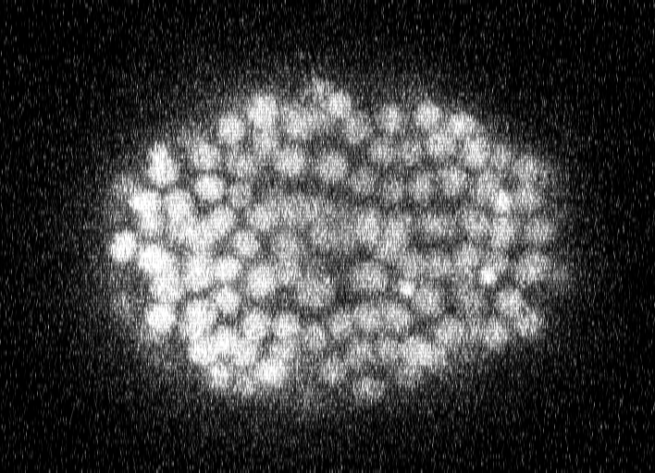
Ground truth (for comparison)
Reference cells (annotated)
Prediction (whole frame)
t = 192
t = 192
t = 192
○ ground truth ○ reference cell ○ prediction

