Slide 1
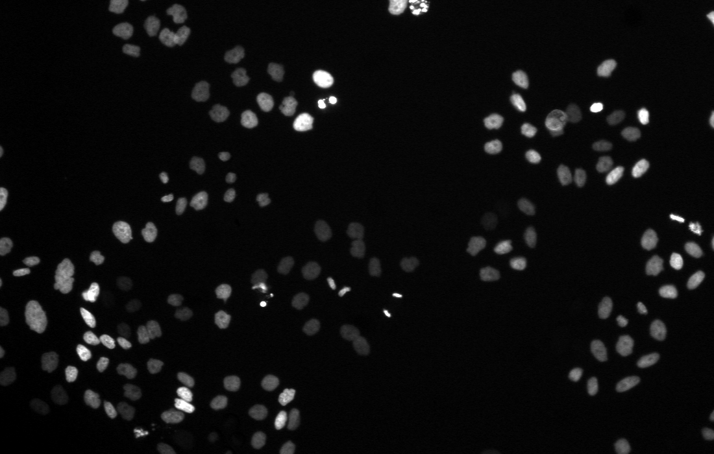
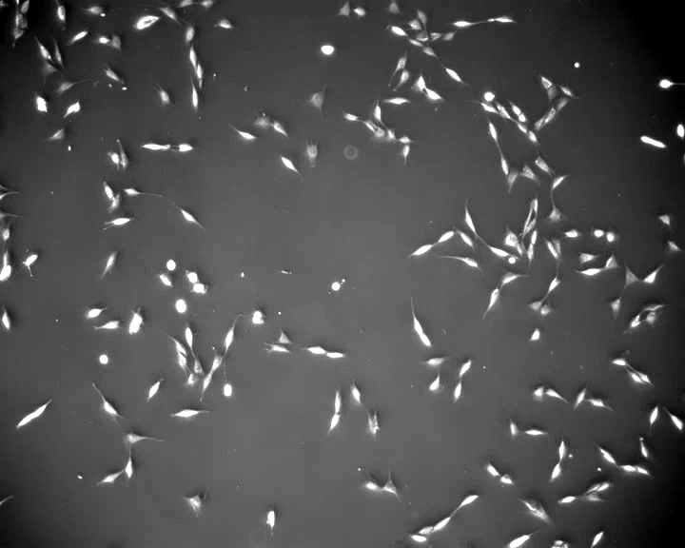
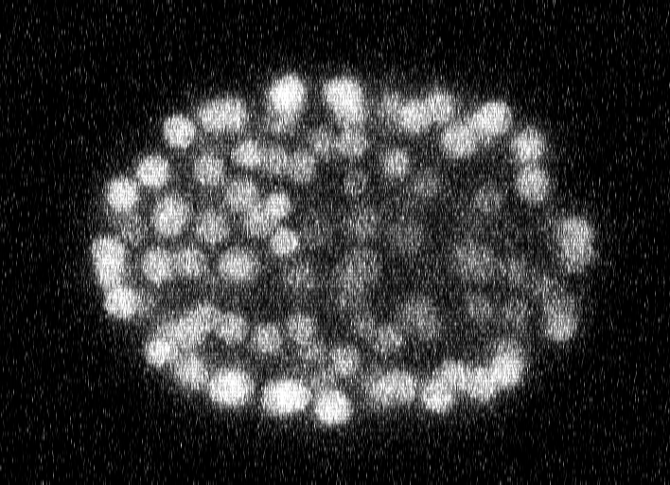
Fluo-N2DL-HeLa
PhC-C2DL-PSC
Fluo-N3DH-CE
t = 91
t = 150
t = 150
○ ground truth ● matched ● merged (two or more cells) ● false detection ● missed cell
Lineage: ground truth | Automahout
Lineage: ground truth | Automahout
Lineage: ground truth | Automahout
t = 0 (top) to 91
t = 0 (top) to 299
t = 0 (top) to 194
│ ground-truth lineage │ Automahout track — division linked — wrong division link — not judged ○ break ● linked to a cell outside the lineage

