Slide 1
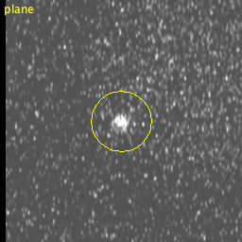
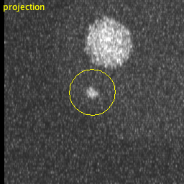
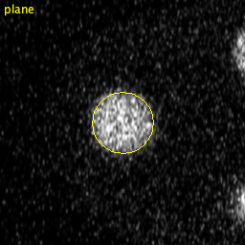
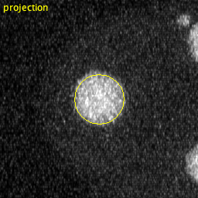
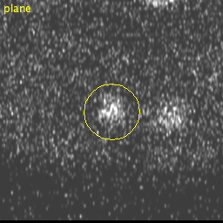
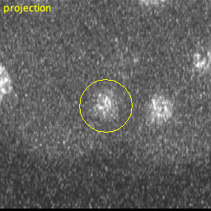
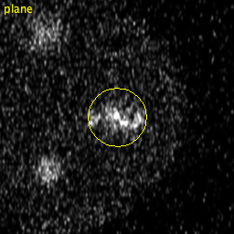
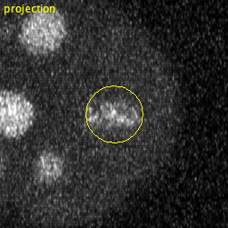
What the vision-language model was shown, and what it answered
t = 0, (14.5, 30.7, 6.0) µm
Ground truth: no nucleus (nearest centre 13.9 µm)
VLM: not a nucleus — right
“The spot shows a bright compact core in the plane view with a much larger diffuse halo in the projection, which is characteristic of out-of-focus debris or an optical artifact rather than the homogeneous intensity distribution expected of a true nucleus.”
t = 0, (17.0, 22.6, 17.0) µm
Ground truth: a nucleus (0.0 µm from its centre)
VLM: a nucleus — right
“The spot shows a bright, well-defined circular structure with internal texture consistent with a cell nucleus, and the intensity is substantially above background noise in both the focal plane and projection views.”
t = 9, (31.1, 31.1, 21.0) µm
Ground truth: a nucleus (1.0 µm from its centre)
VLM: not a nucleus — wrong
“The spot appears as isolated, punctate signal with no surrounding cytoplasmic halo or characteristic nuclear morphology, and shows asymmetric intensity distribution more consistent with debris or noise rather than a typical cell nucleus.”
t = 9, (47.7, 24.6, 17.0) µm
Ground truth: a nucleus (2.0 µm from its centre)
VLM: not a nucleus — wrong
“The spot shows irregular, fragmented morphology with poor internal structure consistency across planes, characteristic of debris or nuclear fragments rather than a complete, well-defined nucleus.”

