Slide 1
EPILEPSY DETECTOR
TEAM: WEBX

Slide 2
Problem Statement
Emergency medical care is needed in diverse circumstances.
Developing innovative strategies to meet the range of needs
posed by such diverse circumstances is vital in the current era.

Slide 3
Idea summary
The idea is to implement an epilepsy detector.
A continuous EEG monitoring device in created in the form of a
comfortable neckband through which the EEG is detected
which is then processed in a mobile application.

Slide 4
Epilepsy is a central nervous system (neurological) disorder in which brain activity becomes abnormal, causing seizures or periods of unusual behaviour, sensations and sometimes loss of awareness.

Slide 5
EEG
ELECTROENCEPHALOGRAM:-
A test that measures electrical activity in the brain using small, metal discs (electrodes) attached to the scalp. Brain cells communicate via electrical impulses and are active all the time, even during asleep. This activity shows up as wavy lines on an EEG recording.

Slide 6
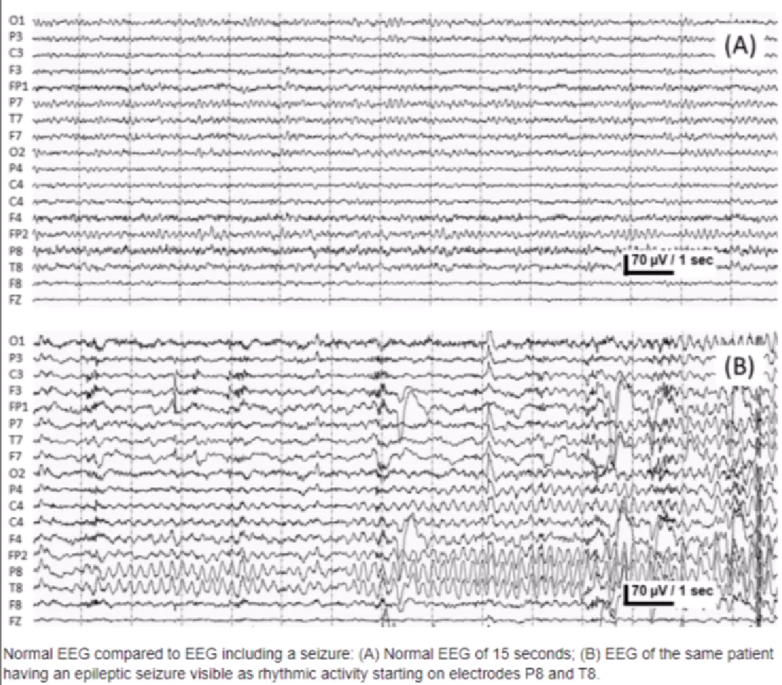

Slide 7
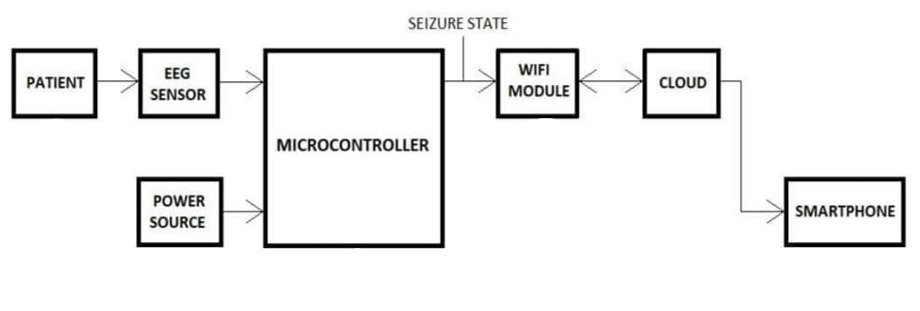

Slide 8
MAIN APPARATUS REQUIRED

Slide 9
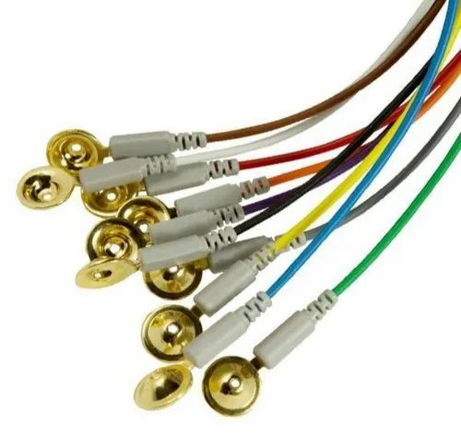
GOLD PLATTED CUP ELECTRODE
The proposed electrodes have the potential to be exploited in other applications including electronics, electrochemistry, and biosensors.

Slide 10
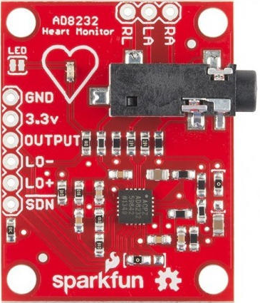
AD8232
The AD8232 is an integrated signal conditioning block for ECG and other
biopotential measurement applications. It is designed to extract, amplify, and filter small biopotential signals in the presence of noisy conditions, such as those created by motion or remote electrode placement.

Slide 11
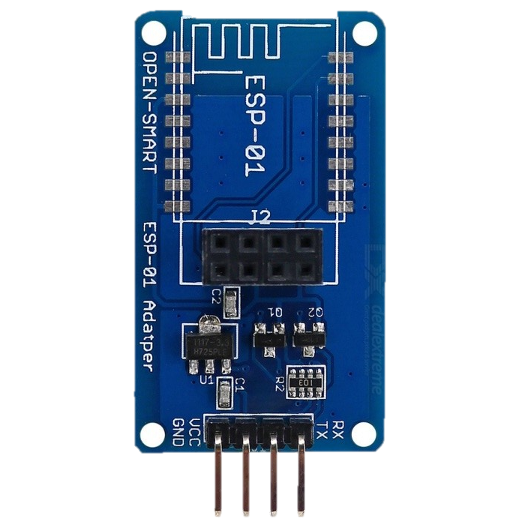
ESP8266-01
The ESP 01 ESP8266 Serial WIFI Wireless Transceiver Module is a self-contained SOC with integrated TCP/IP protocol stack that can give any microcontroller access to your WIFI network. The ESP8266 is capable of either hosting an application or offloading all Wi-Fi networking functions from another application processor.

Slide 12
EXISTING METHODS
SmartWatch-Inspyre
It detects repetitive motion. It will record data and signal the user’s iPhone or Android device to call or send a text to multiple designated people about seizure activity.
SeizAlarm
The Apple Watch even has a built-in fall detection feature that has successfully alerted the families of epileptic patients to seek emergency services.

Slide 13
IMPACT
This idea will enable the detection and cure of epilepsy easier

Slide 14
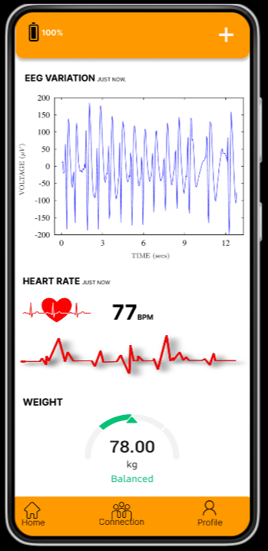
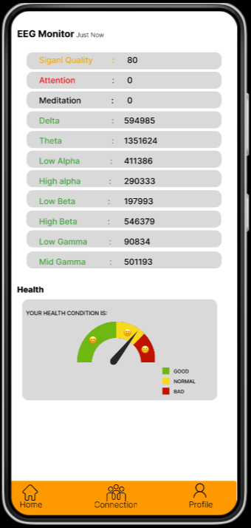
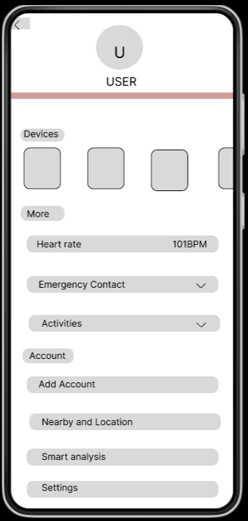
The system prototype is shown

Slide 15
FUTURE ENHANCEMENTS

Slide 16


