Slide 1
Appium
Appium is a freely distributed open source mobile application UI Testing framework.
Supports
Appium allows native, hybrid and web application testing.
Automation test on physical devices as well as an emulator or simulator both.
Wrapper that translate Selenium Web driver commands into UIAutomation (iOS) or UIAutomator (Android)

Slide 2
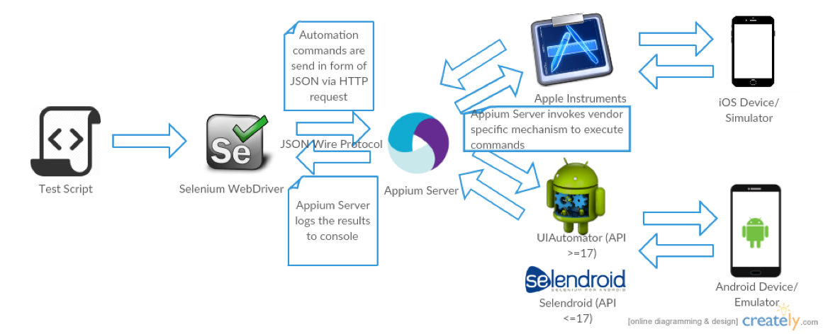
Appium Workflow Diagram:

Slide 3
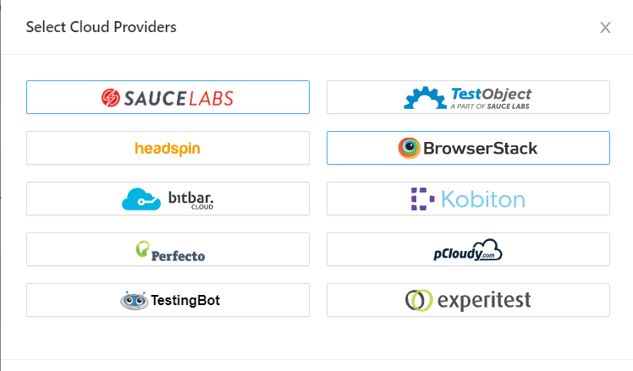
Appium supports cloud providers:

Slide 4
Prerequisite to use APPIUM
Install ANDROID SDK (Studio)[Link]-
Install JDK (Java Development Kit) [Link]
Install Eclipse [Link]
Install TestNg for Eclipse [Link]
Install Selenium Server JAR [Link]
Appium Client Library[Link]
APK App Info on Google Play [Link]
js (Not Required - Whenever Appium server is installed, it by default comes with "Node.exe" & NPM. It's included in Current version of Appium.)
Install Appium Desktop

Slide 5
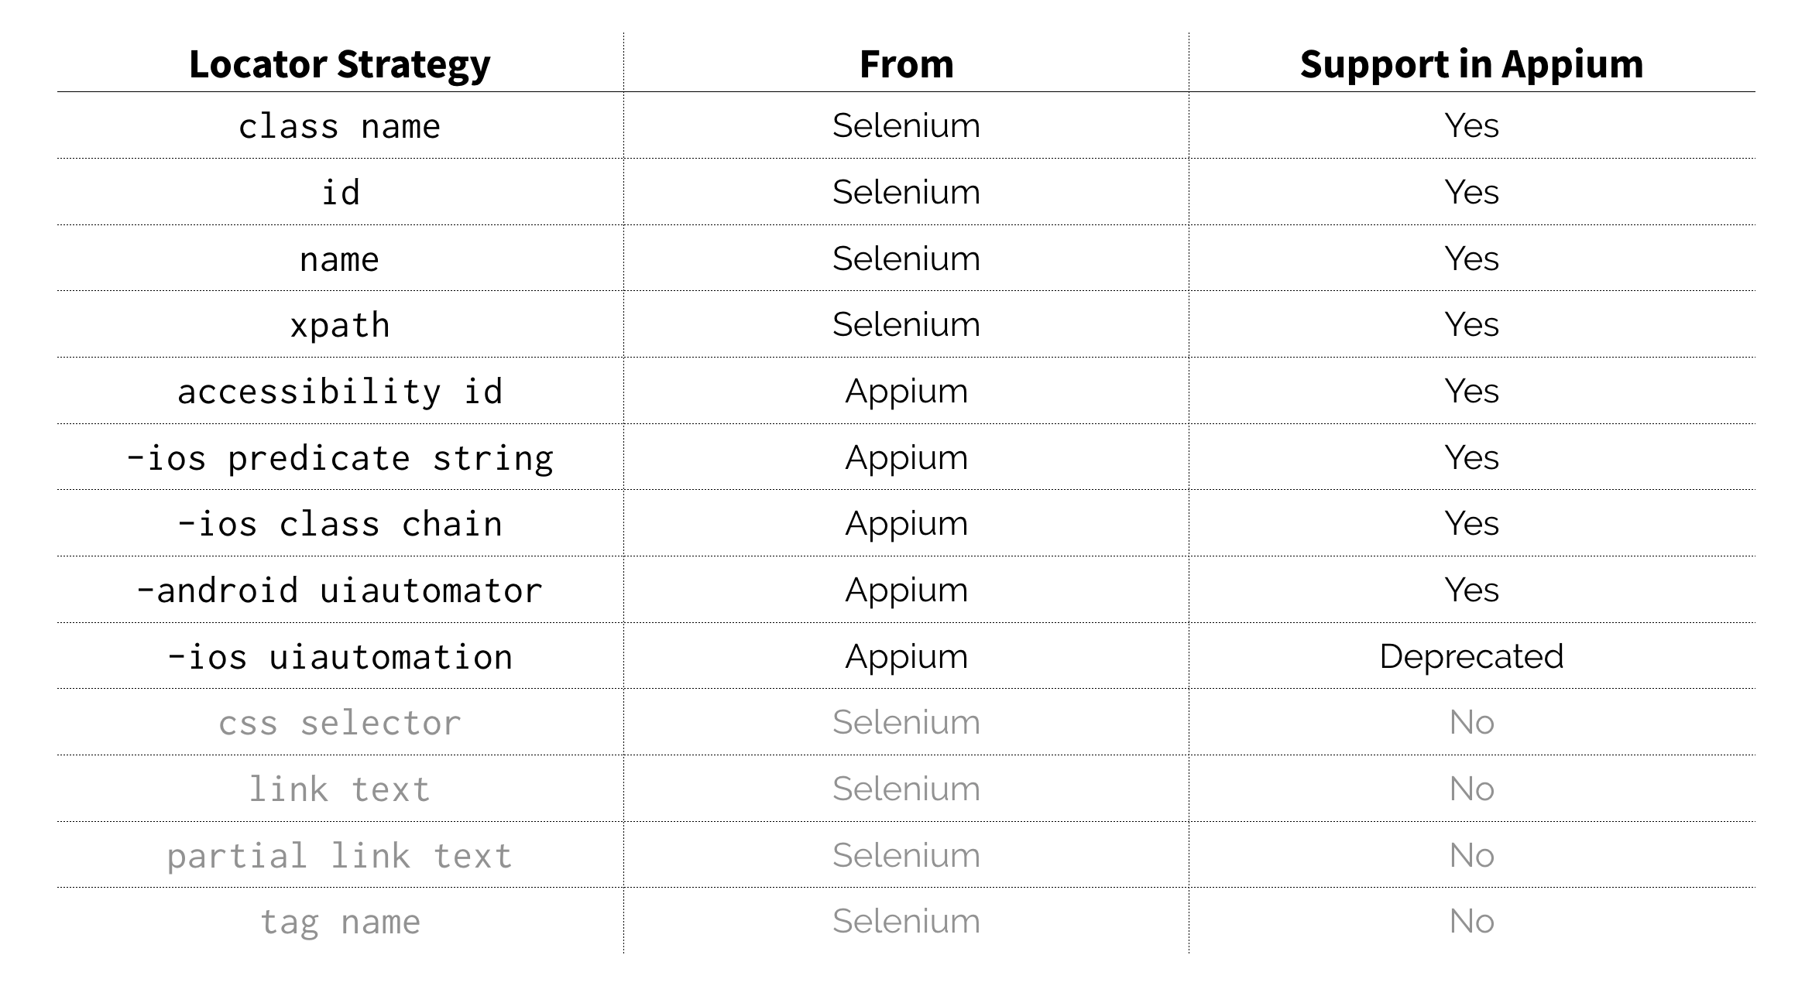
Locator Strategies

Slide 6
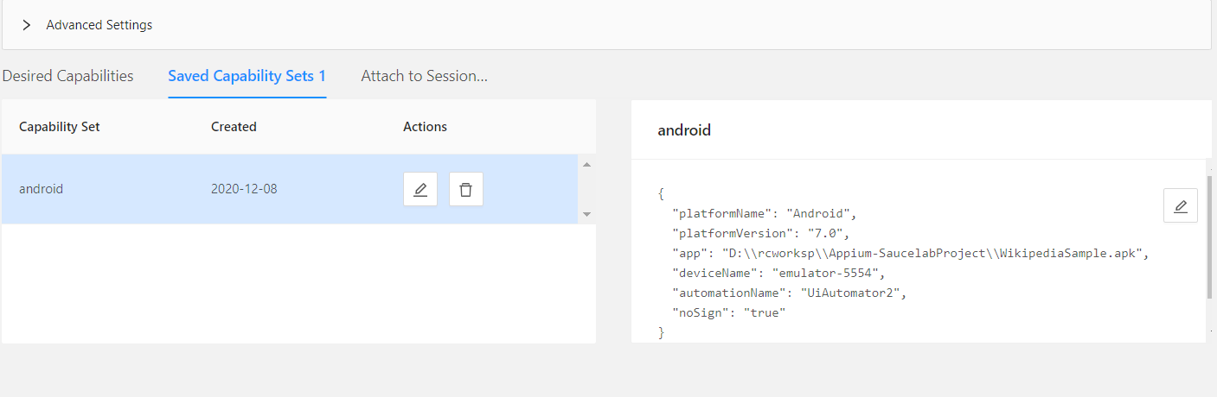
Desired capabilities

Slide 7
Limitation of Appium
Appium does not allow the testing for Android versions lower than 4.2.
Appium provides limited support for testing Hybrid applications.
E.g., Switching action of application is not possible to test i.e., web app to native app and vice versa.

Slide 8
Thank you

