Slide 1
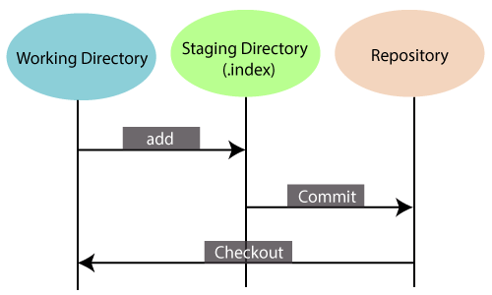
What is Git?
Git is an open-source distributed version control system.
Scalable(increasing many users) & Distributed
Branching and merging(creation, deletion, and merging on branches)

Slide 2

Why Git?
Add changes and commit
Featured branches
Updating and merging
Log option
Replace changes

Slide 3
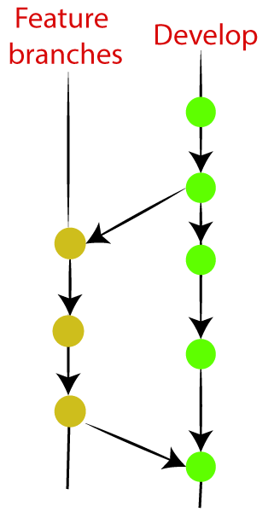
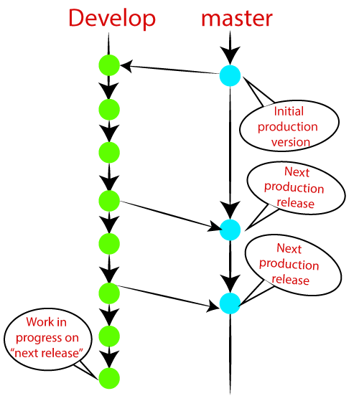
Git Flow / Git Branching Model
Master Branch: Main branch of the project
Develop Branch:Develop branch reaches a stable point and is ready to release
Feature branches: Considered as topic branches(new features and next version)
Release branches:This is create by senior developer and should be deployed to a staging server for testing.

Slide 4
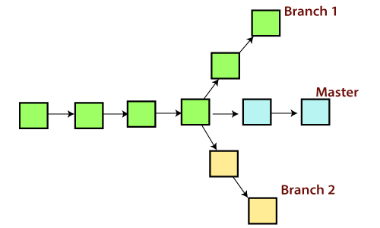
Branching & Merging
Operations
Create Branch
Delete Branch
Switch Branch
Rename Branch
Merge Branch

Slide 5
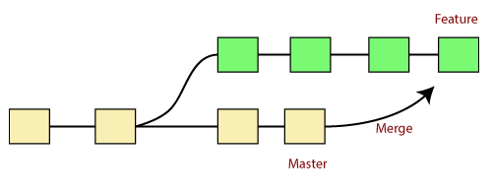
Git Merge and Merge Conflict
Scenario1: To merge the specified commit to currently active branch
Scenario2: To merge commits into the master branch:
Scenario 3: Git merge branch.

Slide 6
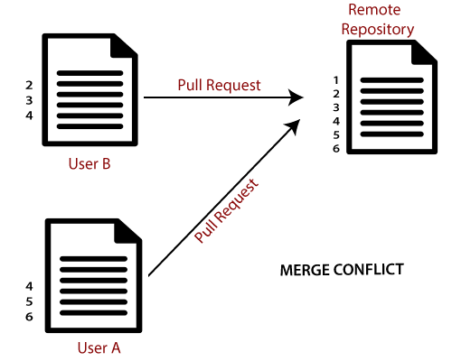
Git Merge and Merge Conflict

Slide 7
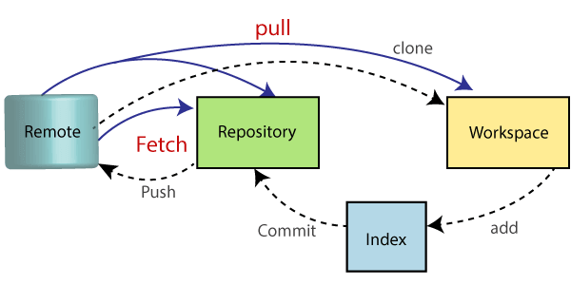
Collaborating
Git Fetch: $ git fetch< repository Url>
Git Pull : $ git pull <option> [<repository URL><refspec>...]
Git Push:$ git push <option> [<Remote URL><branch name><refspec>...]

Slide 8
Advantages and Disadvantages
Fast Processing: As compared to other software or apps, it runs more quickly. Both the server as well as local operations are performed easily with high speed.
Flexible: The work-flow operations in the system are flexible in nature. It is possible to make a choice from the work-flow options.
Easy Merging: It is possible to start merging another code in the system. It is a great way for the developers to interact with each other and add-on their contributions. No long procedure is required to follow during the merging time.
Disadvantages :
Not suitable for binary files: It fails with the presence of files having binary data. It starts processing every work slowly. Any file which doesn’t support textual data is not compatible with this technology.

Slide 9
Thank you
Thank you
Thank you

