Slide 1
Squish (Froglogic)
GUI and regression testing tool -test applications based on a variety of GUI technologies.
Record and replay test scripts written in JavaScript, Perl, Python, Ruby or Tcl.
Squish supports the following platforms.
Qt, QML, QtQuick
Java SWT/Eclipse RCP
Java AWT/Swing
JavaFX
Windows MFC, .NET Windows Forms and WPF
Mac OS X Carbon/Cocoa
iOS Cocoa Touch
Web/HTML/AJAX
Flex
Android
XView
Tk

Slide 2
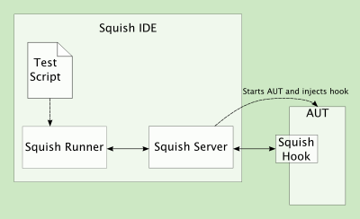
Squish (Froglogic) Workflow
It is a two-component system,
Runner- which interprets and executes scripts
Server- which hooks in and controls the application under test (AUT) (provides a TCP/IP connection between the AUT and the program running the test)
Support for behavior-driven development (BDD)
Squish uses property-based object identification (independent of screen position)

Slide 3
Squish (Froglogic)
Advantages
Reusability and scalability with respect to the changing requirements.
Elevated performance and superior efficiency during the test execution phase.
Disadvantages
Not completely automatable, requires manual interference.
Additional cost for every additional feature added to the original licensed version of the tool.

Slide 4
Thank you

