Slide 1
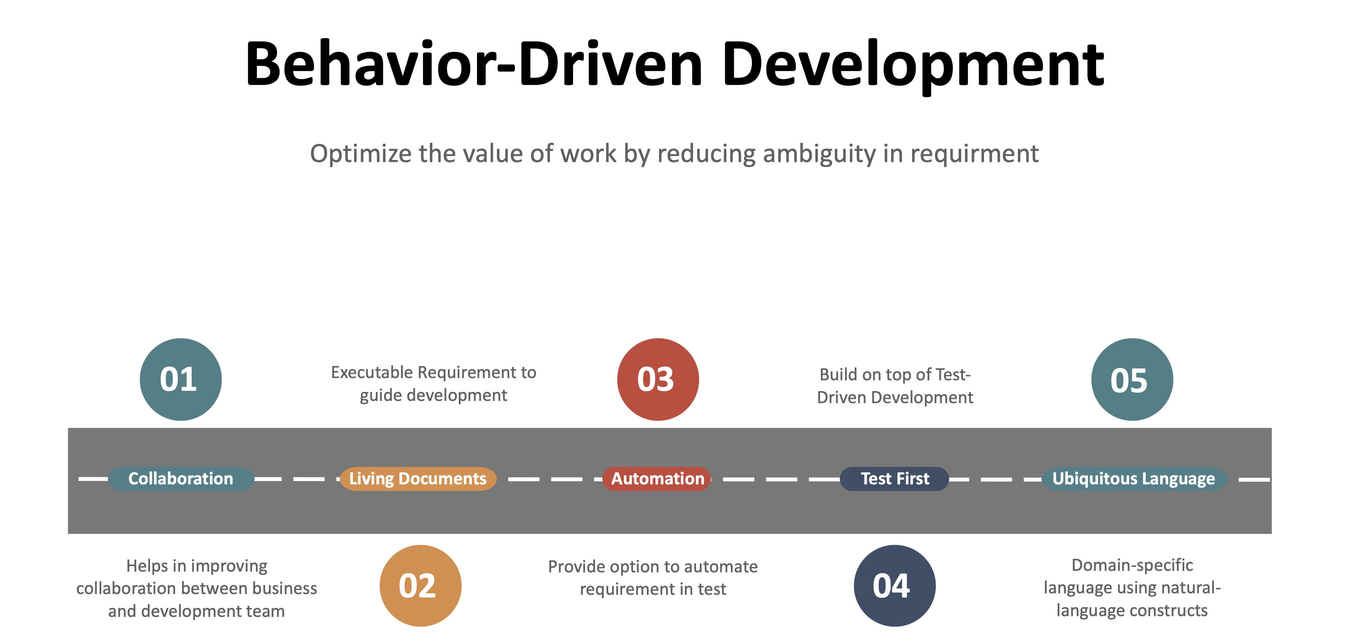
Behavior-driven development (BDD) can be described as the intersection between domain-driven design (DDD) and test-driven development (TDD).

Slide 2
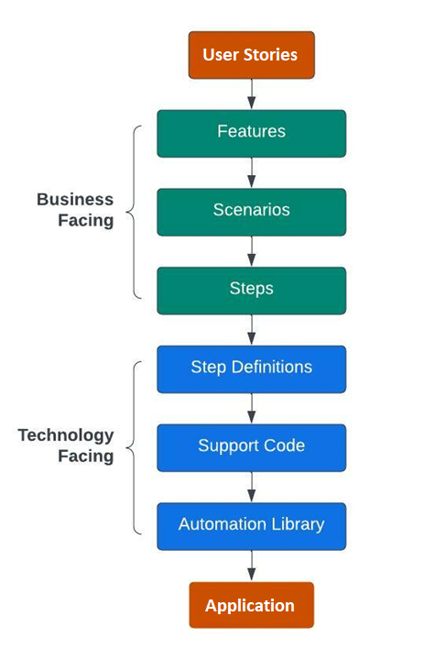
Cucumber:
Cucumber is a an open-source software testing tool. Cucumber is used to execute automated acceptance tests written in the “Gherkin” language.
Cucumber test automation makes use of two important files –
Feature file – Contains code written in Gherkin (plain English text. Each step starts with Given, When, Then, And, or But.
Given: Precondition step
When: Key actions to be performed
Then: To observe outcomes or validation
And, But: To enumerate more Given, When, Then steps
Step definition file – Contains the actual code written in using cypress with JavaScript. And supporting codes for data creation, report generation etc
Benefits of Cucumber
Acts bridge between business and technical language.
Easy and understandable.
End-to-end testing framework
Shift left
Code Reusability
Better Artifacts
Parameterization
Modularity
Steps Involved
Describe business needs using Gherkin language
Implement step definitions to automate tests
Integrate BDD to Jenkins
Keep test suite fast and lean with refactoring

