Slide 1
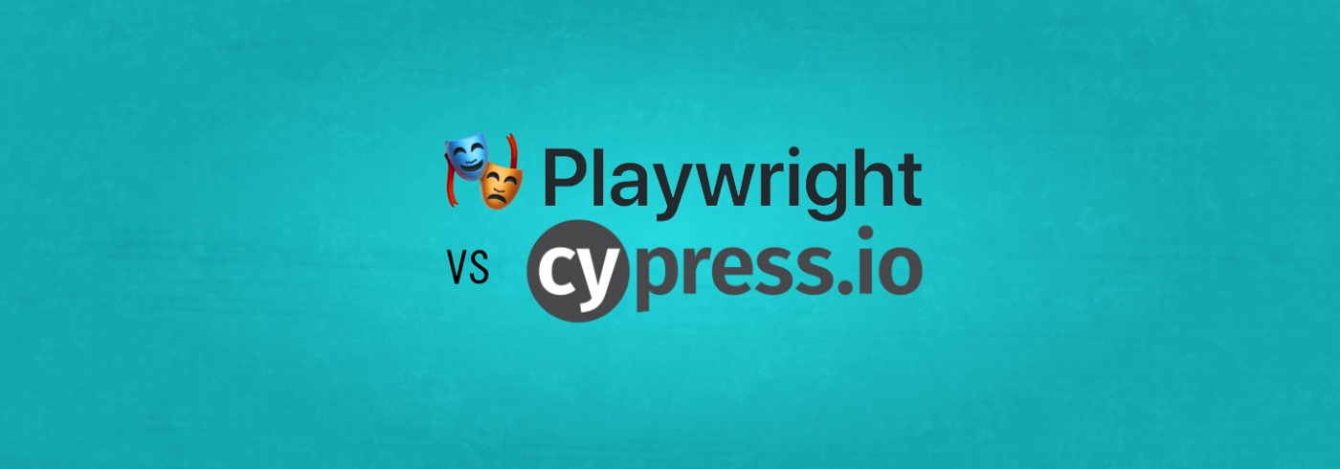
- VIGNESH AYYAMANI

Slide 2
CRITERIA | PLAYWRIGHT | CYPRESS
Language | Supports multiple languages such as JavaScript, Java, Python, and .NET C# | Supports JavaScript
Open Source | Open Source and Free | Open Source and Free
Operating Systems Supported | Windows, Linux, and macOS | Windows, Linux, and macOS 10.9 and above
Test Runner Frameworks Supported | Mocha, Jest, Jasmine | Mocha
Architecture | Headless Browser with event-driven architecture | Executes test cases directly inside the browser
iFrame | Well Supported | Limited
MultipleWindow | Well Supported | Limited
Browsers Supported | Chromium, Firefox, and WebKit | Chrome, Firefox, and Edge
Execution Speed | Much Faster (Uses Browser context) | Slow (Runs inside browser)
Locating Strategy | Xpath, CSS both supported | Only CSS supported. Plugin needed for Xpath
Page Object Pattern | Supported | Supported but Not recommended by cypress
Parallel Browser Testing | Well Supported and Free | Supported but needs License
Parallel support for test | Supports parallel tests within a single test file | Need to split tests into different files
Async/Await issues | Fully supports | Limited
Test Grouping and Test Suites | Supported | NA
Automatic waits | Supported for few event based mechanism | Not Supported
Support | Since Playwright is fairly new, the support from the community is limited as compared to Selenium | Strong community support from professionals across the world

Slide 3
CYPRESS
PROS
Very easy to learn and get set up with basic tests.
It has a nice dashboard to view test reports, analytics and recordings.
It has a very slick Test Runner UI.
It's built specifically for end-to-end testing.
We can edit our test code in the browser instantly and run it.
It's mature and has good community support.
Easier to understand for people new to testing
CONS
It doesn't support multiple domains.
It doesn't support Webkit (Safari)
You cannot run tests against multiple browsers at the same time.
IFrame support is limited.
There is no "hover" support.
Premium account needed for accessing to some dashboard features (e.g flake detection) and parallelization etc.

Slide 4
PLAYWRIGHT
PROS
It supports Chromium, Firefox and WebkIt (Safari).
It supports multiple domains and tabs.
It supports 5 language bindings (Javascript, Typescript, Java, Python, .NET)
It's fast.
We can run tests against multiple browsers at the same time.
It fully supports parallelization, even locally.
It supports parallel tests Within a single test file.
It has "hover" support.
iFrames are natively supported.
It supports reuse of authentication state to speed up tests.
It lets you choose your test runner (e.g. Jest but the default one is advised)
CONS
It's still quIte new, so possibilIty of a smaller community.
It does not have a dedicated dashboard so would be harder to debug tests remotely.

