Slide 1
Beyond Self Actualization?
Now!
Dante's Blog
Exploring Realities,
Developing Alternatives
http://dante.ecobytes.net/beyond-self-actualization-now/
http://hitchwiki.org/en/Dante

Slide 2
The “Peak Experience”...
tends to be uplifting and ego-transcending
releases creative energies
affirms the meaning and value of existence
gives a sense of purpose to the individual
gives a feeling of integration
leaves a permanent mark on the individual...
evidently changing them for the better.
http://en.wikipedia.org/wiki/Peak_experience

Slide 3
Peak experiences can be therapeutic in that they tend to increase the individual's free will, self-determination, creativity, and empathy.
The highest peaks include "feelings of limitless horizons opening up to the vision,
the feeling of being simultaneously more powerful and also more helpless than one ever was before,
the feeling of great ecstasy and wonder and awe,
and the loss of placing in time and space
http://en.wikipedia.org/wiki/Peak_experience

Slide 4
“My feeling is that we are moving from individualism towards a more holistic
”cooperative individualism”
…and maybe even beyond...
where individualism only becomes a tool to liberate the individual from a reproductive and controlling structure
...and discover greater perspectives towards continual discovery and creation.”

Slide 5
“When individuals connect with each other , creating synergies of 'greater intentions'
...understanding that the smaller individual is not enough in itself to create such opportunities...
...overcoming the specific addictions of the smaller 'I'...
...then new opportunities arise for all individuals within societies and communities as a whole...
...towards paradigms of shared inspiration rather than of control.”

Slide 6
VALS typology
Need-Driven
  Survivor lifestyle
  Sustainer lifestyle
Outer-Directed
  Belonger lifestyle
  Emulator lifestyle
  Achiever lifestyle
Inner-Directed
  I-Am-Me lifestyle
  Experiential lifestyle
  Societally Conscious lifestyle
Combined Outer- and Inner-Directed
  Integrated lifestyle
http://www.context.org/iclib/ic03/srivals/

Slide 7
“It is increasingly difficult for big businesses to appeal to 'oneness greater individuals'
...as there is greater awareness of
mechanisms of addicted control...
...and such individuals rather develop lifestyles and actions that decrease dependency on specific sources...
while increasing overall dependency on everything and everyone,
as to maximize opportunities.”

Slide 8
“In effect, guaranteeing as much as possible the independent access to the fulfillment of basic needs such as food or shelter, while eventually also reducing the specific dependency on one specific community, and facilitating the further development of opportunities that lead to development of ongoing shared awareness
...discovery, creation, and solution development towards holistic intentions.”

Slide 9
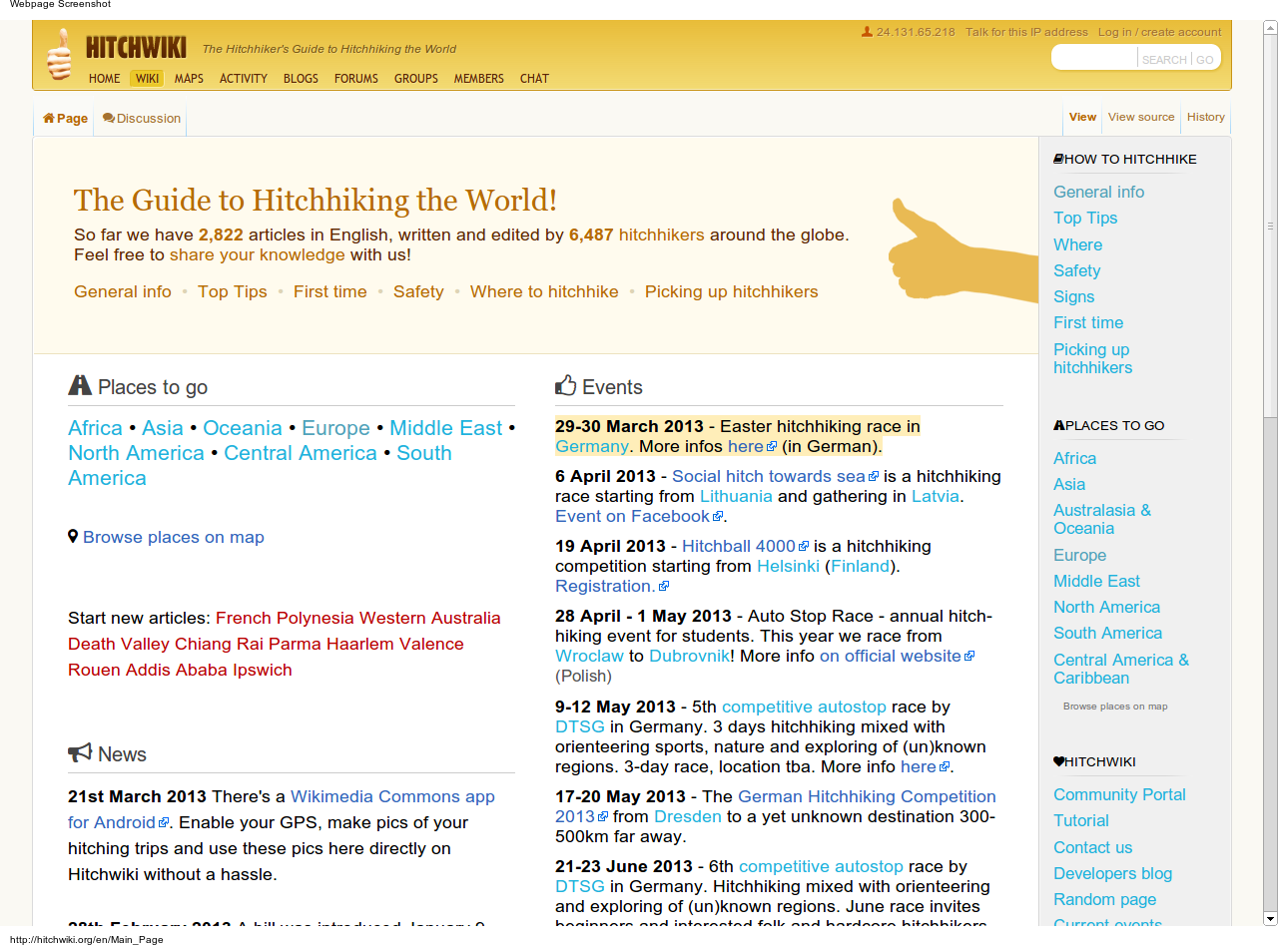

Slide 10
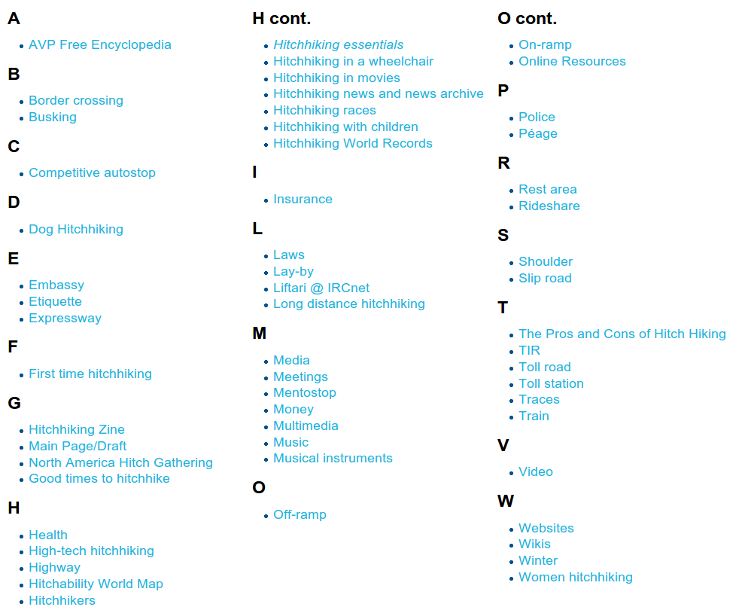
HitchWiki

Slide 11
Awareness not only of the ”I”, but of the greater ”I”, and of the maximization of opportunities for the smaller ”I” through the greater ”I”, through taking into account the creation of synergies.

Slide 12
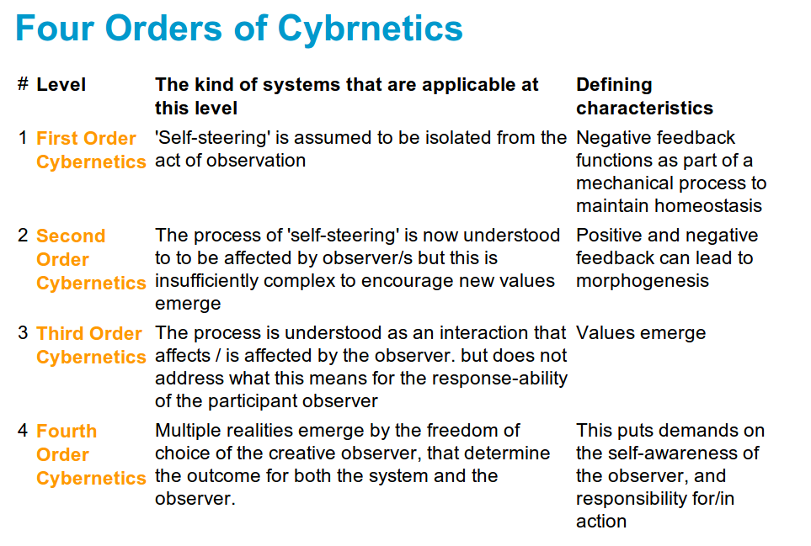
http://attainable-utopias.org/tiki/CyberneticOrders

Slide 13
This development is already the case in, for example: free open-source movements, and peer-to-peer (P2P) movements.
By sharing and connecting, everyone has access to more resources, materials, & solutions.

Slide 14
“Traditional” businesses and power structures designed to maximize hierarchical control will progressively lose control... unless they can somehow reduce developments that enable greater consciousness.. such as imposing global fascism (which is already happening right now, in case you did not notice.)

Slide 15
The present financial and monetary systems, which allow ourselves to get indebted as all money issued is at interest... are designed to concentrate wealth for the parasitical elite.

Slide 16
This is the big struggle we are currently facing... and might be the struggle we might continue facing all along our lives... the paradigmatic battle between: the power of specific and addicted control vs. the power of inspiration

Slide 17
CONTINUED IN PART 2
http://dante.ecobytes.net/beyond-self-actualization-now/

