Slide 1

Bachelorproject Presentation
Significance-Analysis
Anton Merlin Geburek
Significance-Analysis Bachelorproject Anton Merlin Geburek
https://github.com/automl-private/significance_analysis
Notes:
1

Slide 2
Topic
Significance-analysis
A model-based approach to comparing performance of (HPO)-algorithms
Published by Stefan Riezler and Michael Hagmann as part of
Validity, Reliability, and Significance: Empirical Methods for NLP and Data Science (Morgan & Claypool Publishers, 2022)
Based on Linear Mixed Effect Regression with Generalized Likelihood Ratio Testing
Has multiple layers of analysis, containing useful information
Significance-Analysis Bachelorproject Anton Merlin Geburek
https://github.com/automl-private/sinificance_analysis
Notes:
2

Slide 3
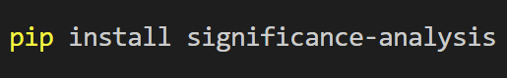
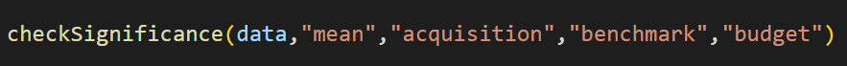
Setup: HPO with multiple acquisition functions
acquisition functions
Expected Improvement
MC Expected Improvement
benchmarks
Branin
seeds
100 seeds
Upper Confidence Bound
Probability Of Improvement
MC Upper Confidence Bound
MC Probability Of Improvement
MC Simple Regret
MC Knowledge Gradient
+ SOBOL-Random Search (Baseline)
Hartmann6
Jahs-Bench
NN-Benchmark
from HPO-Bench
per config
+
8 SOBOL-Rounds
42 Botorch-Rounds
180000 data points
https://github.com/automl/mf-prior-exp/tree/vPaper-PriorBand/
Significance-Analysis Bachelorproject Anton Merlin Geburek
https://github.com/automl-private/sinificance_analysis
NeurIPS MetaLearn Workshop 2022
Notes:
3

Slide 4
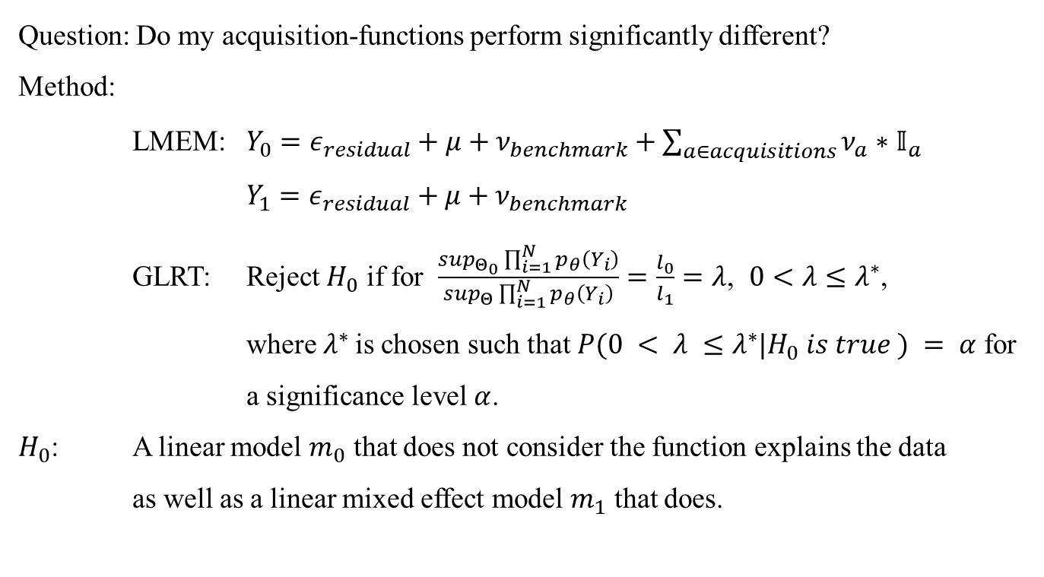
Layer One: Theory
Question: Do my acquisition-functions perform significantly different?
Method:
LMEM: $Y_{0}=ε_{residual}+μ+ν_{benchmark}+\sum_{a∈acquisitions}{ν_{a}∗𝕀_{a}}$ $Y_{1}=ε_{residual}+μ+ν_{benchmark}$
GLRT: Reject $H_{0}$ if for $\frac{\sup_{Θ_{0}}\prod_{i=1}^{N}{p_{θ}\left(Y_{i}\right)}}{\sup_{Θ}\prod_{i=1}^{N}{p_{θ}\left(Y_{i}\right)}}=\frac{l_{0}}{l_{1}}=λ$, $0<λ≤λ^{∗}$,
where $λ^{∗}$is chosen such that $P(0 < λ ≤λ^{∗}|H_{0} is true ) = α$ for a significance level $α$.
$H_{0}$: A linear model $m_{0}$ that does not consider the function explains the data
as well as a linear mixed effect model $m_{1}$ that does.
https://github.com/automl/mf-prior-exp/tree/vPaper-PriorBand/
Significance-Analysis Bachelorproject Anton Merlin Geburek
https://github.com/automl-private/sinificance_analysis
NeurIPS MetaLearn Workshop 2022
Notes:
GLRT=Generalized Likelihood Ratio Test
Values of lambda close to 1 show that Theta0 is already very good, i.e. the H0 stays, while closeness to 0 shows that it explains the data poorly
4

Slide 5

Layer One: Result
IMAGE OF RESULT
As $p<0.05, H_{0}$ can be rejected, i.e. the algorithms perform significantly different from each other.
Visual comparison:
IMAGE OF BOXPLOT
https://github.com/automl/mf-prior-exp/tree/vPaper-PriorBand/
Significance-Analysis Bachelorproject Anton Merlin Geburek
https://github.com/automl-private/sinificance_analysis
NeurIPS MetaLearn Workshop 2022
Notes:
GLRT=Generalized Likelihood Ratio Test
Values of lambda close to 1 show that Theta0 is already very good, i.e. the H0 stays, while closeness to 0 shows that it explains the data poorly
5

Slide 6
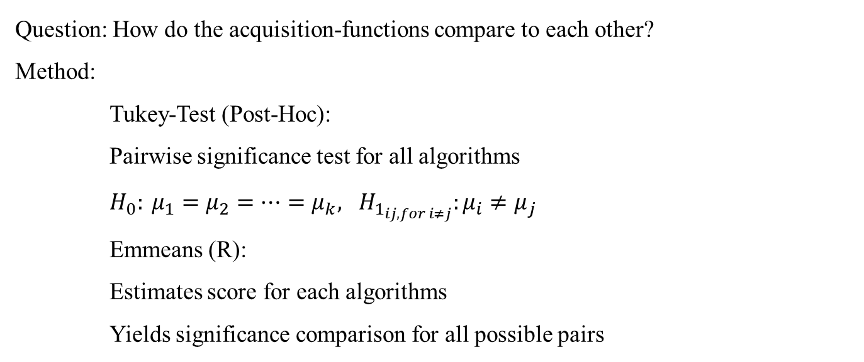
Layer Two: Theory
Question: How do the acquisition-functions compare to each other?
Method:
Tukey-Test (Post-Hoc):
Pairwise significance test for all algorithms
$H_{0}: μ_{1}=μ_{2}=…=μ_{k}, H_{1_{ij, for i≠j}}:μ_{i}≠μ_{j}$
Emmeans (R):
Estimates score for each algorithms
Yields significance comparison for all possible pairs
https://github.com/automl/mf-prior-exp/tree/vPaper-PriorBand/
Significance-Analysis Bachelorproject Anton Merlin Geburek
https://github.com/automl-private/sinificance_analysis
NeurIPS MetaLearn Workshop 2022
Notes:
Post-Hoc Tests testen Signifikanz
6

Slide 7
Layer Two: Result
IMAGE OF RESULT
There are significant performance differences, most notably compared to the baseline
IMAGE OF CRITICAL DIFFERENCE DIAGRAM
https://github.com/automl/mf-prior-exp/tree/vPaper-PriorBand/
Significance-Analysis Bachelorproject Anton Merlin Geburek
https://github.com/automl-private/sinificance_analysis
NeurIPS MetaLearn Workshop 2022
Notes:
GLRT=Generalized Likelihood Ratio Test
Values of lambda close to 1 show that Theta0 is already very good, i.e. the H0 stays, while closeness to 0 shows that it explains the data poorly
7

Slide 8
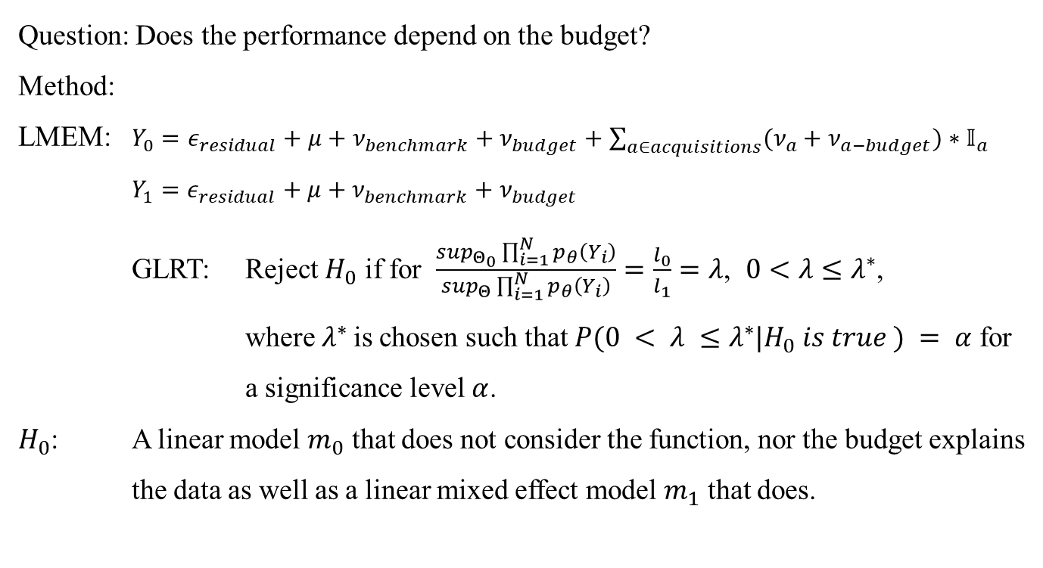
Layer Three: Theory
Question: Does the performance depend on the budget?
Method:
LMEM: $Y_{0}=ε_{residual}+μ+ν_{benchmark}+ν_{budget}+\sum_{a∈acquisitions}{(ν_{a}+ν_{a−budget})∗𝕀_{a}}$ $Y_{1}=ε_{residual}+μ+ν_{benchmark}+ν_{budget}$
GLRT: Reject $H_{0}$ if for $\frac{\sup_{Θ_{0}}\prod_{i=1}^{N}{p_{θ}\left(Y_{i}\right)}}{\sup_{Θ}\prod_{i=1}^{N}{p_{θ}\left(Y_{i}\right)}}=\frac{l_{0}}{l_{1}}=λ$, $0<λ≤λ^{∗}$,
where $λ^{∗}$is chosen such that $P(0 < λ ≤λ^{∗}|H_{0} is true ) = α$ for a significance level $α$.
$H_{0}$: A linear model $m_{0}$ that does not consider the function, nor the budget explains the data as well as a linear mixed effect model $m_{1}$ that does.
https://github.com/automl/mf-prior-exp/tree/vPaper-PriorBand/
Significance-Analysis Bachelorproject Anton Merlin Geburek
https://github.com/automl-private/sinificance_analysis
NeurIPS MetaLearn Workshop 2022
Notes:
8

Slide 9
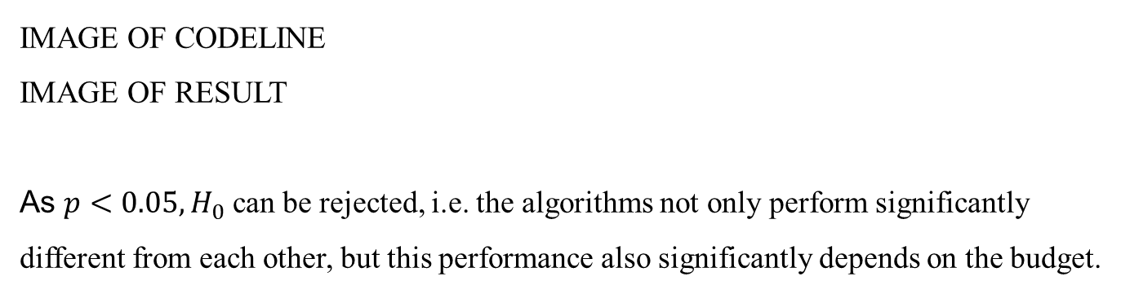
Layer Three: Result
IMAGE OF CODELINE
IMAGE OF RESULT
As $p<0.05, H_{0}$ can be rejected, i.e. the algorithms not only perform significantly different from each other, but this performance also significantly depends on the budget.
https://github.com/automl/mf-prior-exp/tree/vPaper-PriorBand/
Significance-Analysis Bachelorproject Anton Merlin Geburek
https://github.com/automl-private/sinificance_analysis
NeurIPS MetaLearn Workshop 2022
Notes:
GLRT=Generalized Likelihood Ratio Test
Values of lambda close to 1 show that Theta0 is already very good, i.e. the H0 stays, while closeness to 0 shows that it explains the data poorly
9

Slide 10
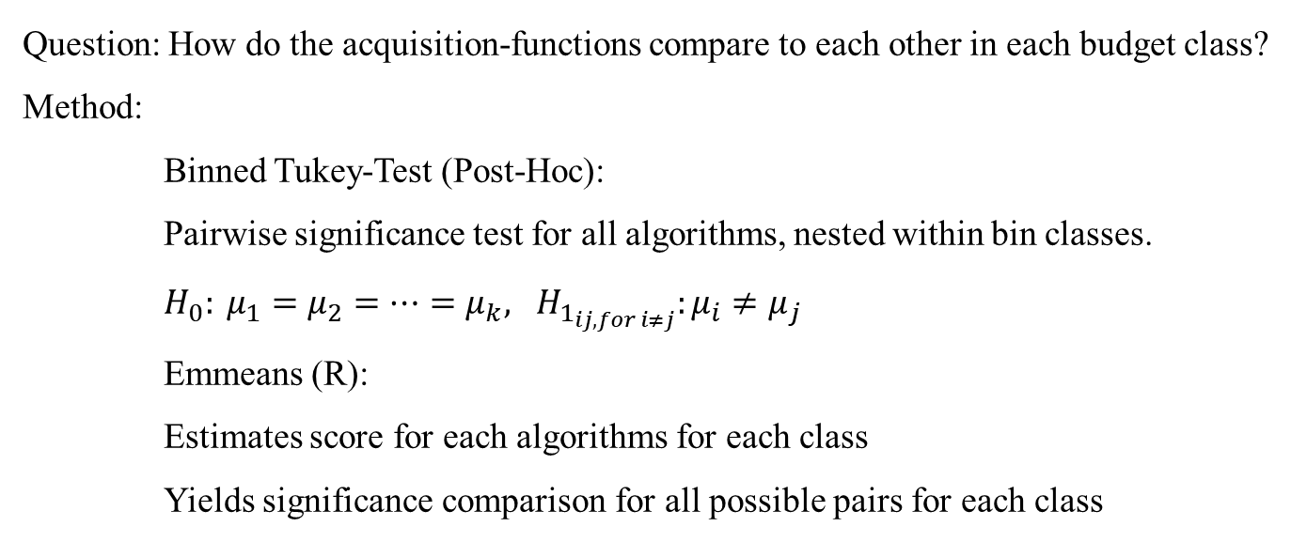
Layer Four: Theory
Question: How do the acquisition-functions compare to each other in each budget class?
Method:
Binned Tukey-Test (Post-Hoc):
Pairwise significance test for all algorithms, nested within bin classes.
$H_{0}: μ_{1}=μ_{2}=…=μ_{k}, H_{1_{ij, for i≠j}}:μ_{i}≠μ_{j}$
Emmeans (R):
Estimates score for each algorithms for each class
Yields significance comparison for all possible pairs for each class
https://github.com/automl/mf-prior-exp/tree/vPaper-PriorBand/
Significance-Analysis Bachelorproject Anton Merlin Geburek
https://github.com/automl-private/sinificance_analysis
NeurIPS MetaLearn Workshop 2022
Notes:
Post-Hoc Tests testen Signifikanz
10

Slide 11
Layer Four: Result
IMAGE OF RESULT
There are again significant performance differences, but almost none during SOBOL
The remaining effect can be attributed to the large numbers during SOBOL, which would vanish when increasing the number of random seeds.
https://github.com/automl/mf-prior-exp/tree/vPaper-PriorBand/
Significance-Analysis Bachelorproject Anton Merlin Geburek
https://github.com/automl-private/sinificance_analysis
NeurIPS MetaLearn Workshop 2022
Notes:
11

Slide 12
Layer Four: Graph
IMAGE OF ONLY BOTORCH RESULT-GRAPH
https://github.com/automl/mf-prior-exp/tree/vPaper-PriorBand/
Significance-Analysis Bachelorproject Anton Merlin Geburek
https://github.com/automl-private/sinificance_analysis
NeurIPS MetaLearn Workshop 2022
Notes:
12

Slide 13
Alternative Usecase: Theory
Question: How do MC acquisition functions compare to analytical?
Method:
One small change to the function:
IMAGE OF SIGN-FUN WITH ACQU-CLASS AS SYSTEM_ID
https://github.com/automl/mf-prior-exp/tree/vPaper-PriorBand/
Significance-Analysis Bachelorproject Anton Merlin Geburek
https://github.com/automl-private/sinificance_analysis
NeurIPS MetaLearn Workshop 2022
Notes:
13

Slide 14
Alternative Usecase: Result
IMAGE OF RESULT
There is no significant difference in performance.
https://github.com/automl/mf-prior-exp/tree/vPaper-PriorBand/
Significance-Analysis Bachelorproject Anton Merlin Geburek
https://github.com/automl-private/sinificance_analysis
NeurIPS MetaLearn Workshop 2022
Notes:
14

