Slide 2

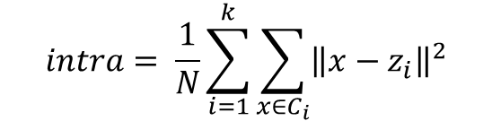
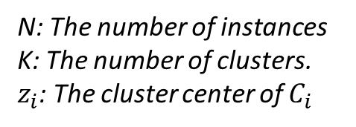
Ray – Turi
$$intra= \frac{1}{N}\sum_{i=1}^{k}{\sum_{x∈C_{i}}{{\left\|x−z_{i}\right\|}^{2}}}$$
N: The number of instances
K: The number of clusters.
$z_{i}$: The cluster center of $C_{i}$
$$inter=min⁡({\left\|z_{i}−z_{j}\right\|}^{2})$$

Slide 3

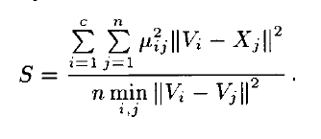

Xie Beni 1991
“ An index that evaluates the quality of fuzzy clusterings”
$$Let d_{ij}=μ_{ij}$$

