Slide 1

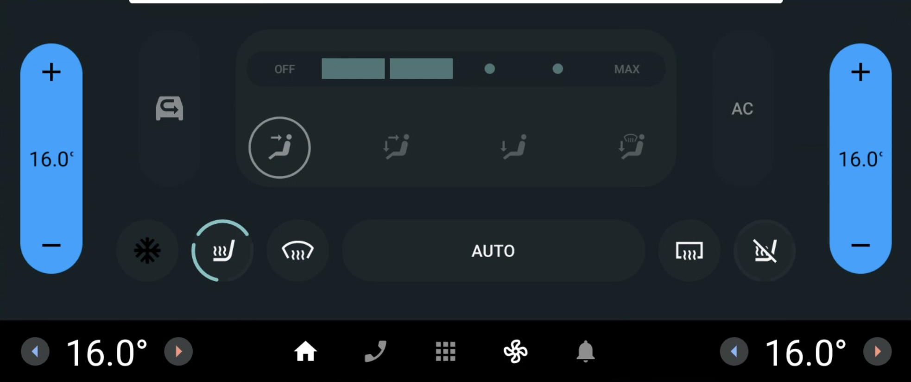
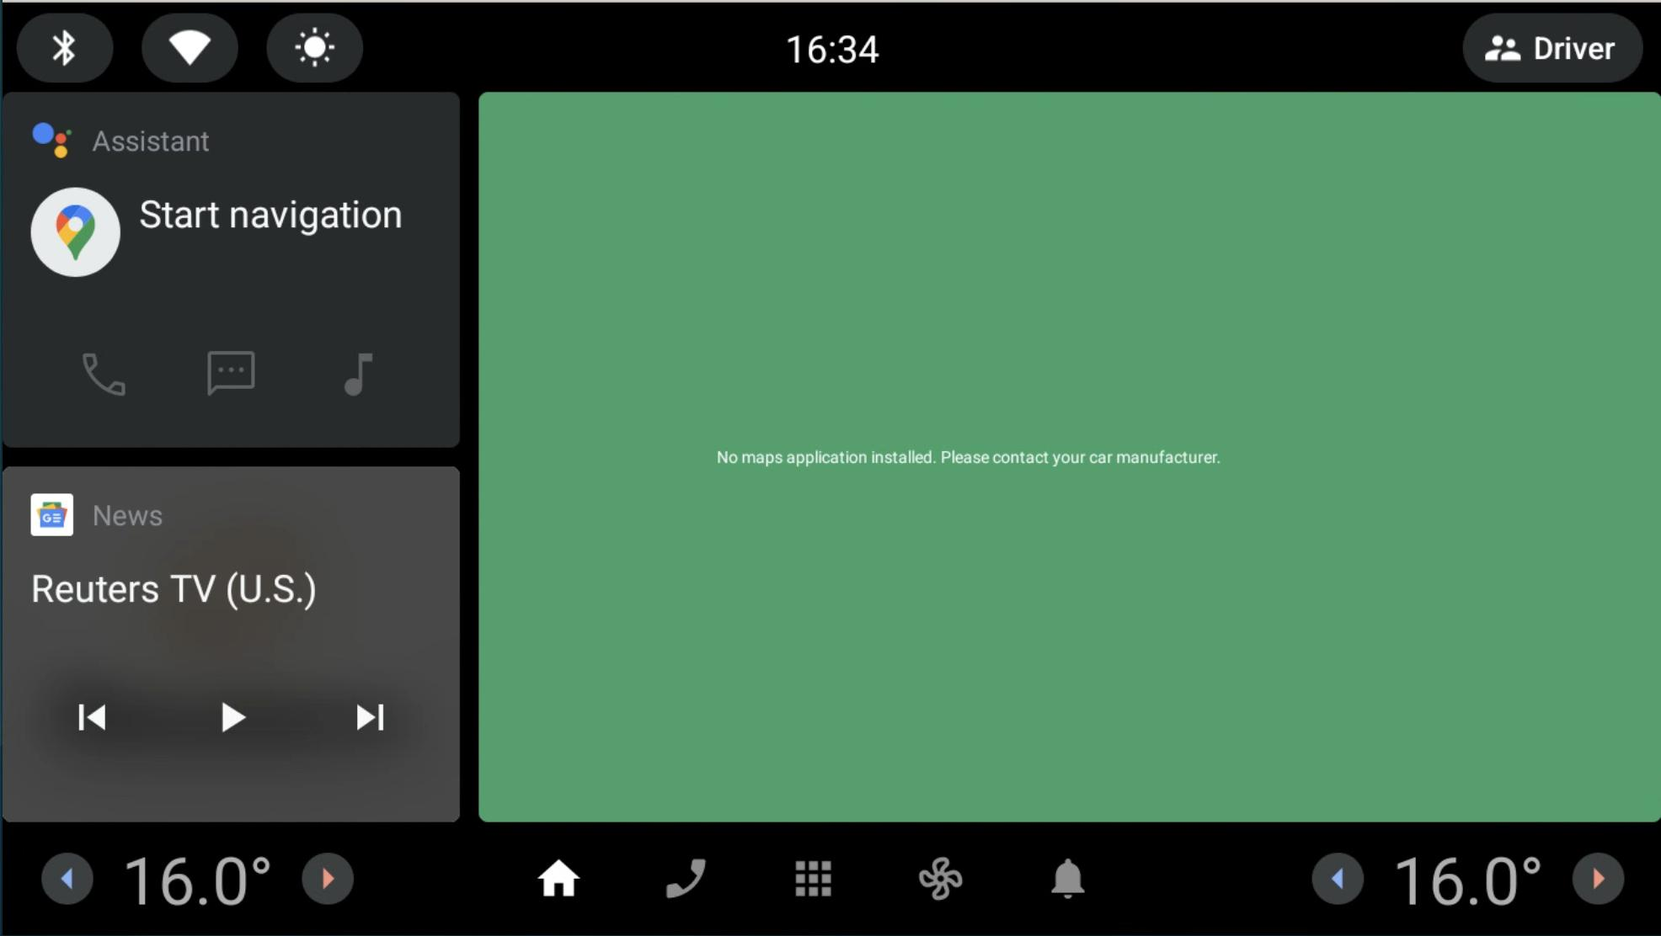
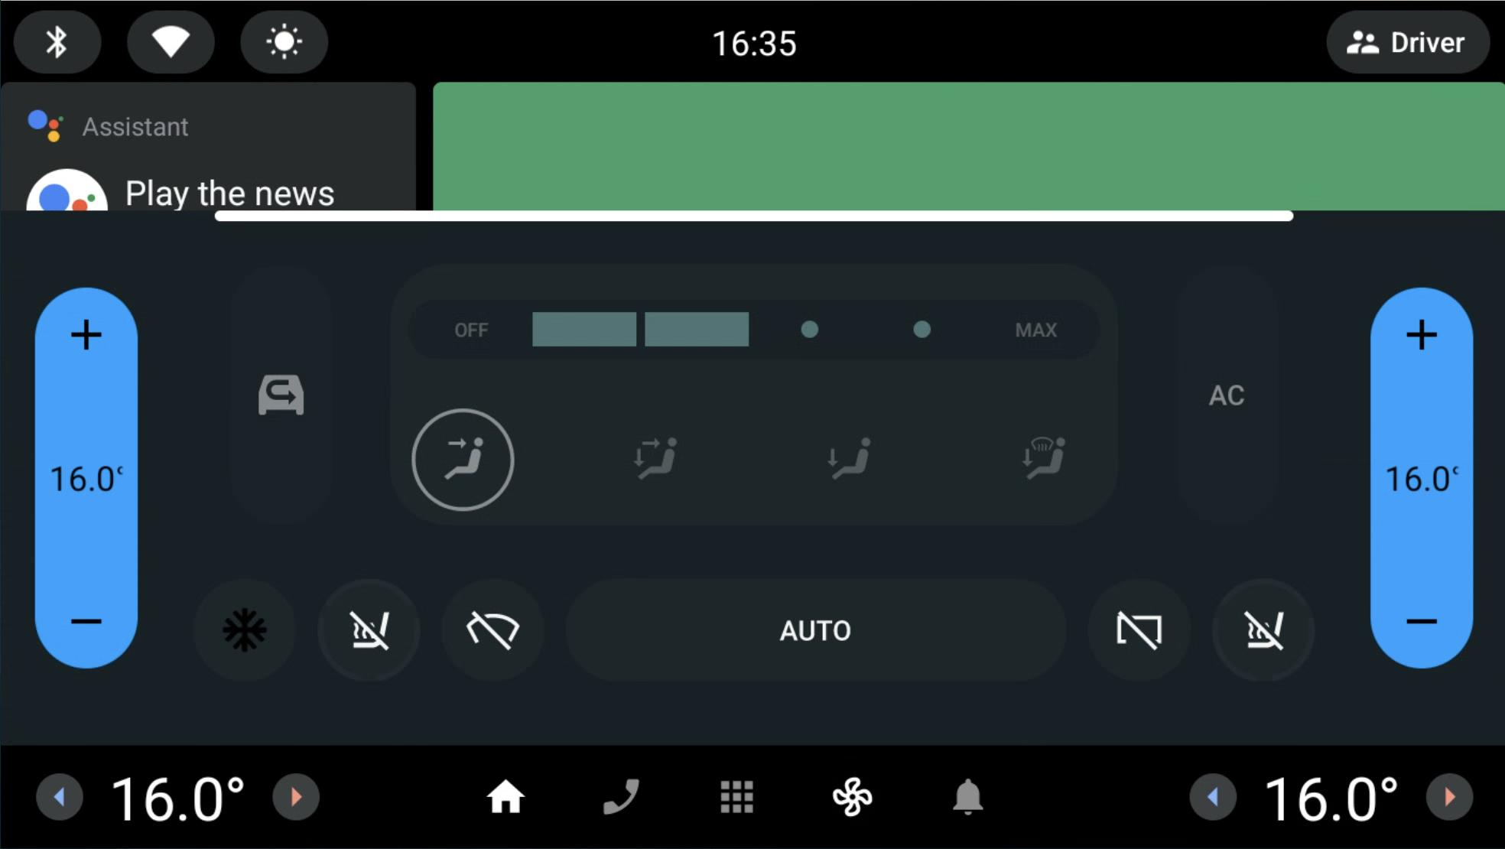
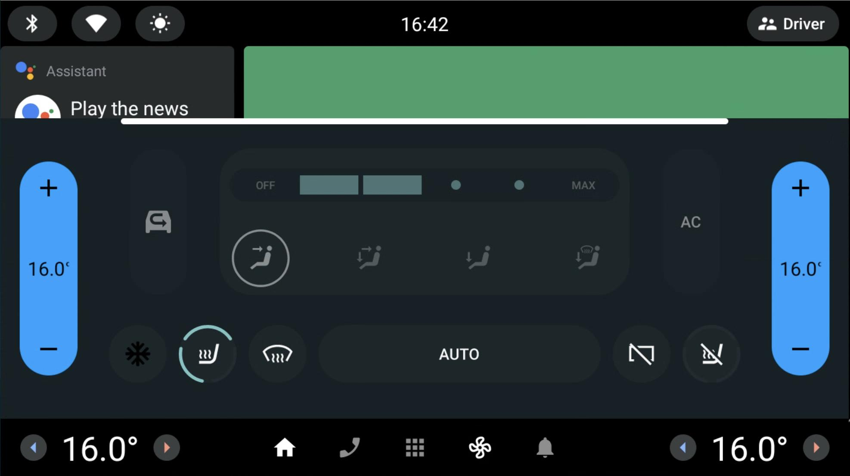
Automotive-ENV
SIMULATED COCKPIT BENCHMARK
420 TASKS
TASK
Passenger seat heat:
maximum.
Rear defrost
Front and rear defrost:
on.
Act
Agent
Observe
Home
Seat heat
Front defrost
After episode
Deterministic checks
Final state + task trace
AI-GENERATED CONCEPT SETTING
ORIGINAL AAOS CAPTURES

