Slide 1
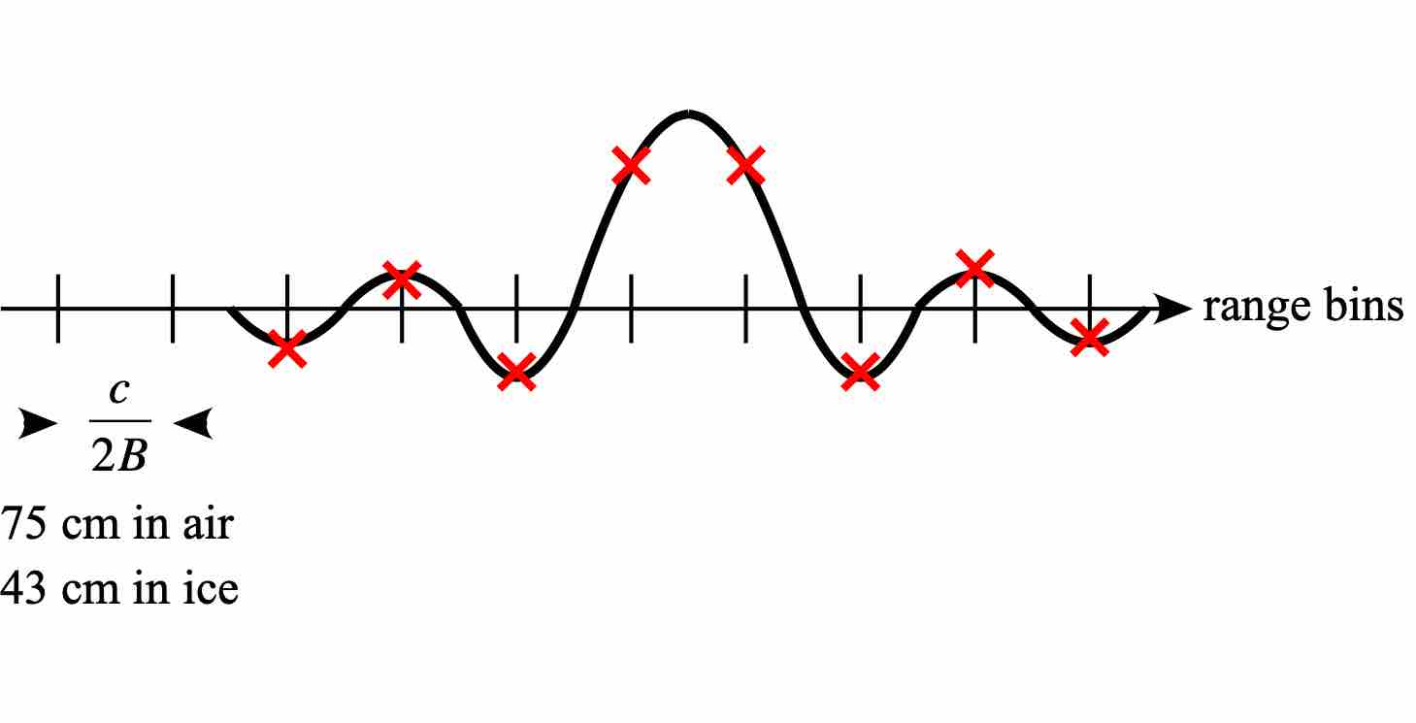
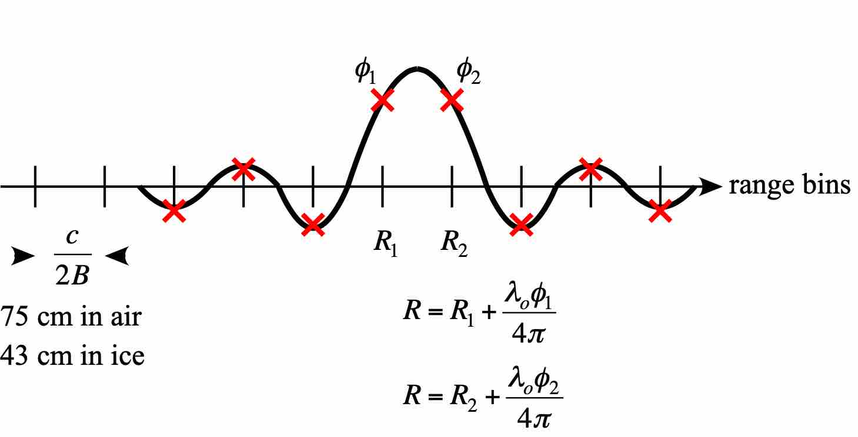
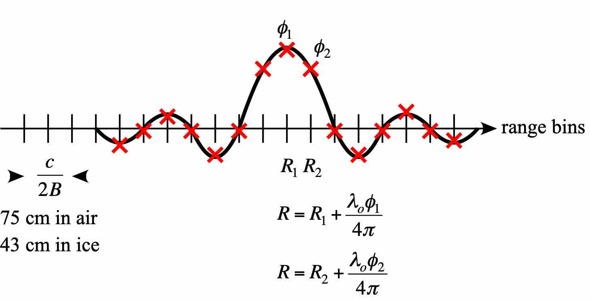
How does ApRES work?
FFT-processed FMCW de-ramped signal
Standard range processing gives 43 cm resolution in ice, maybe c. 4 cm precision estimate of peak. Not mm-precision.
Include phase measurement to combine the coarse range estimate from the nearest range bin(s) with a fine estimate based on phase. Gives sub-mm-precision, but…
For absolute measurement of range, use zero-padding so that phase change between range bins < 2π, requiring a pad factor of p ≥ f_{o}/B, ≥ 2 for ApRES.

Slide 2
How does ApRES work?
But how to correctly form and interpret the deramped FMCW phase at each range bin?
Deramped signal instantaneous phase*:
CW signal corresponding
to target range bin ➔R_{coarse}
CW component centred on t = T/2 hence fftshift to eliminate range-dependent phase
Phase term corresponding
to offset from range bin ➔ R_{fine}
Generate reference phase to deduce the FMCW phase at the nth range bin:
Δt here is to allow for the small timing difference
between the chirp and the ADC
*Brennan et al, ‘Phase-sensitive FMCW radar system…’, IET Proc., 2014

Slide 3
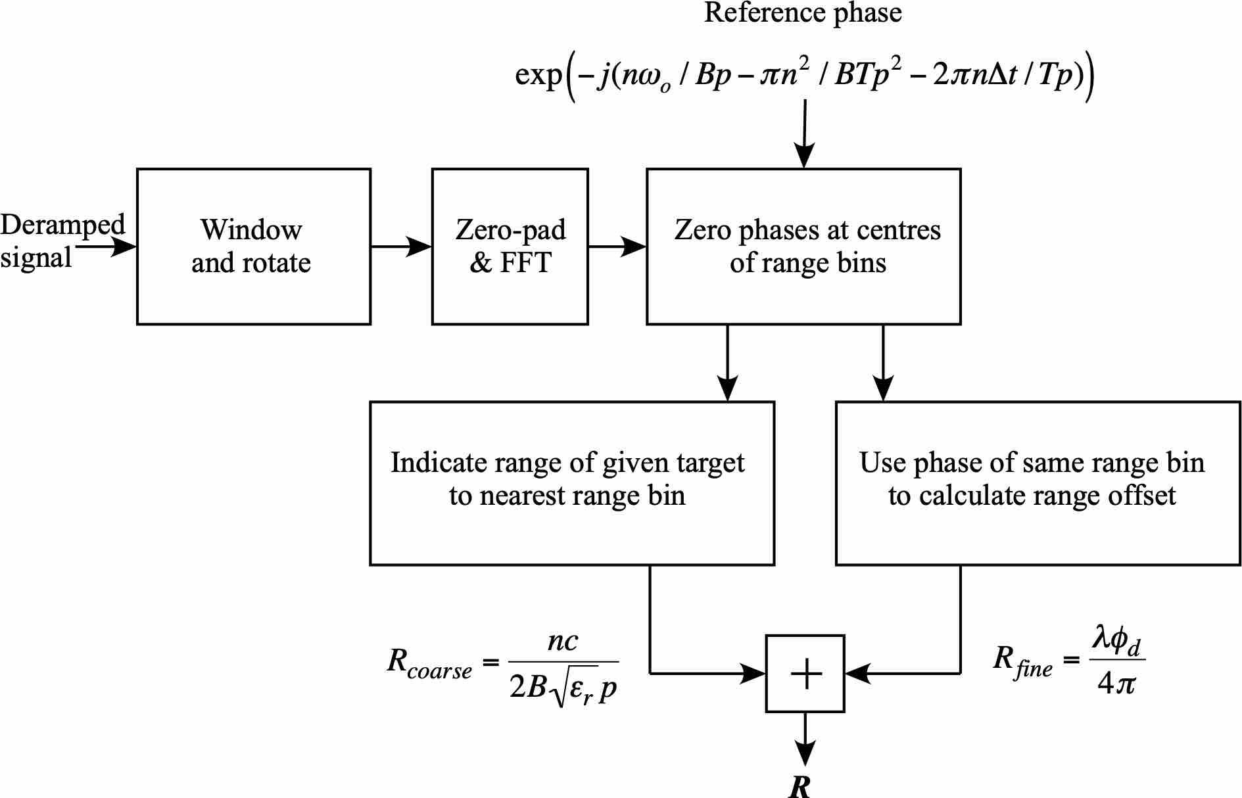

How does ApRES work?
Without zero-padding
With zero-padding

