Slide 1



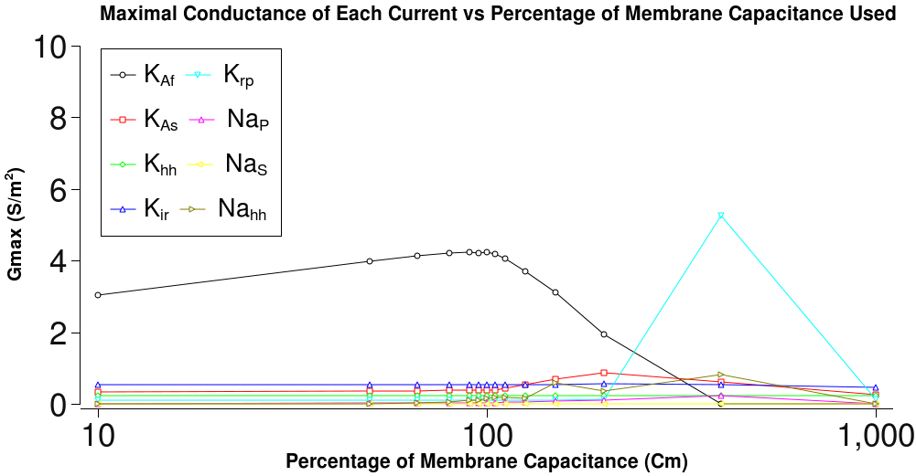
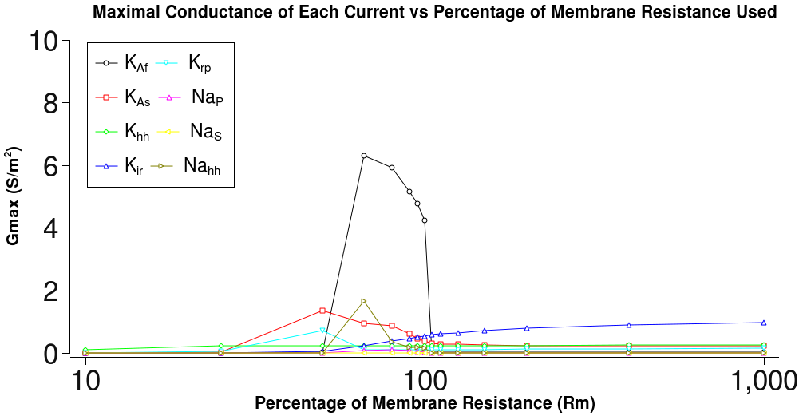
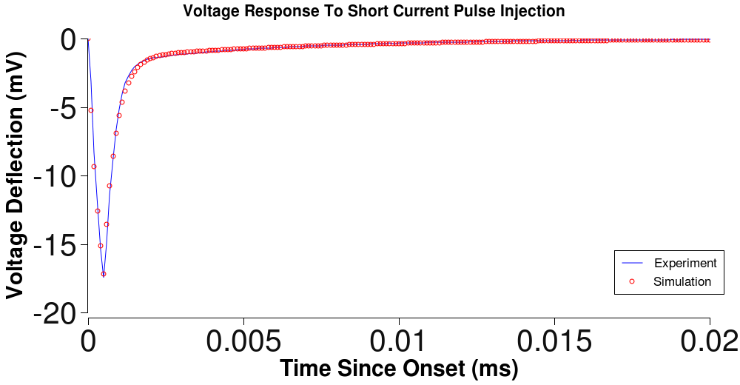
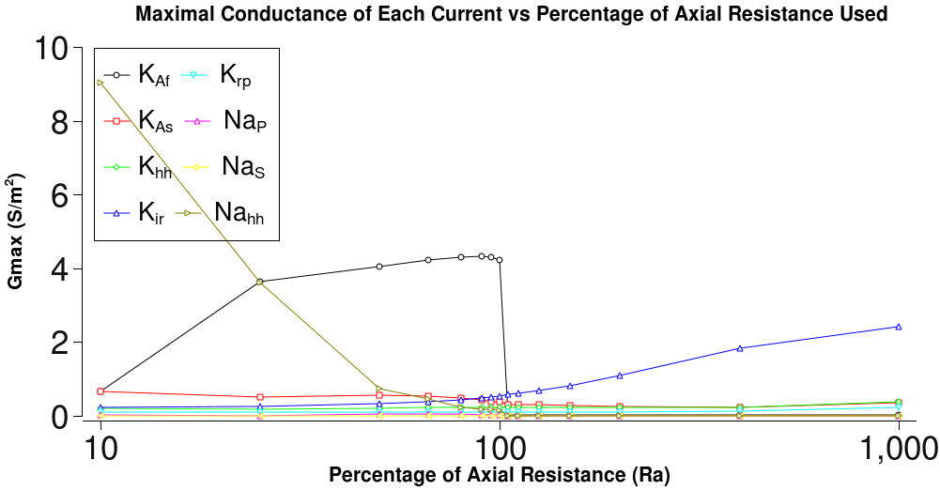
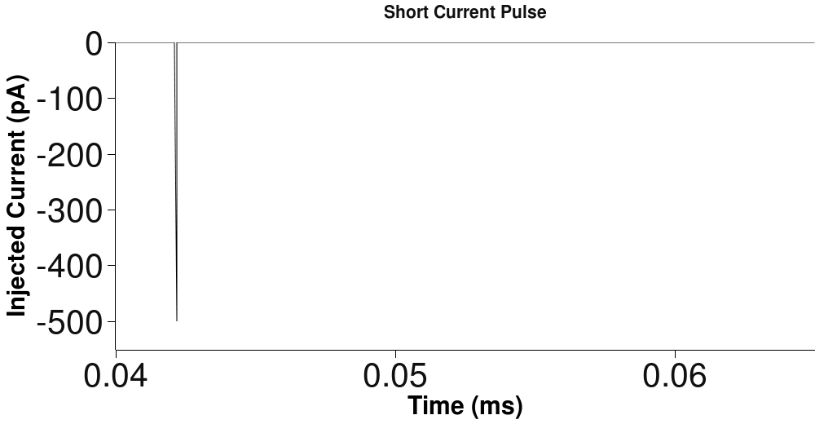
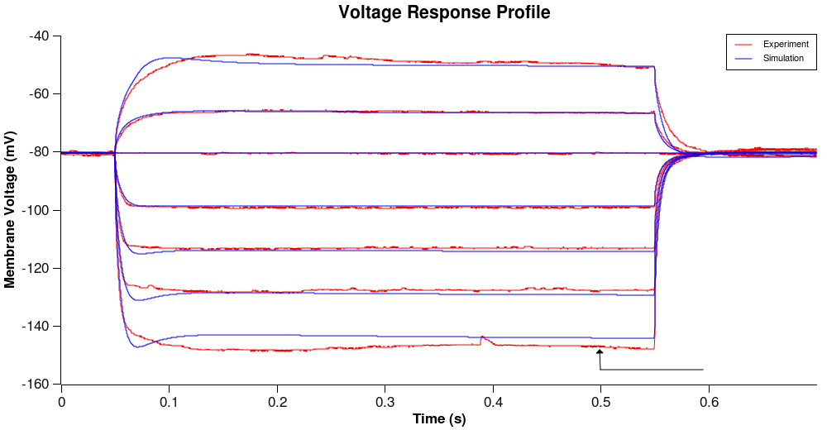
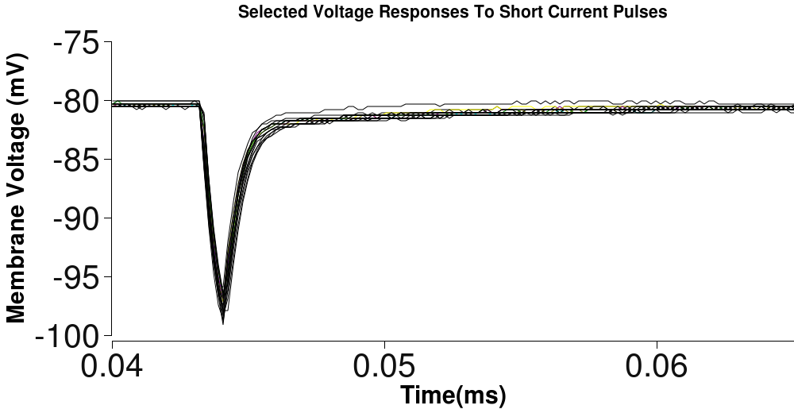
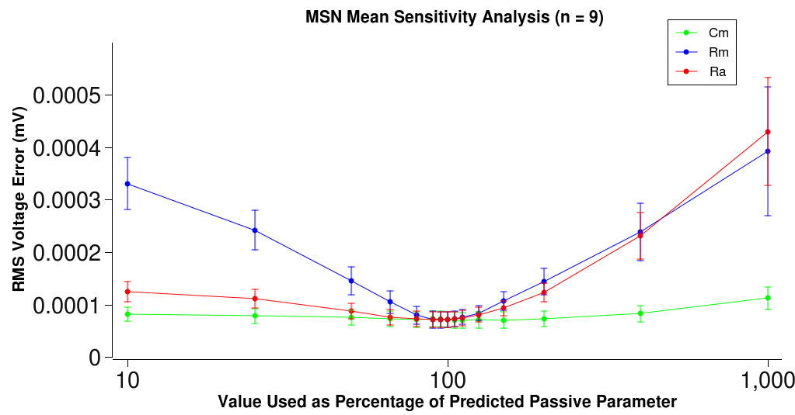
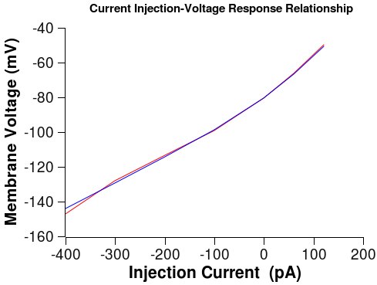
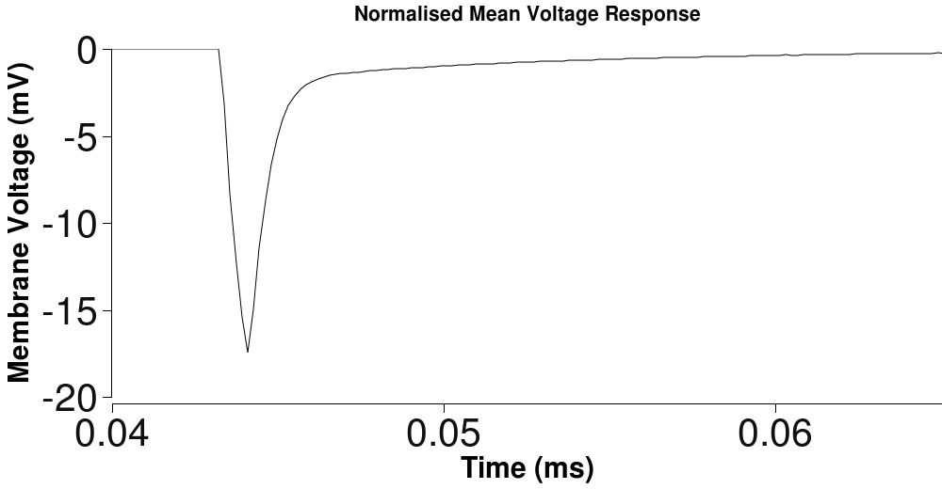
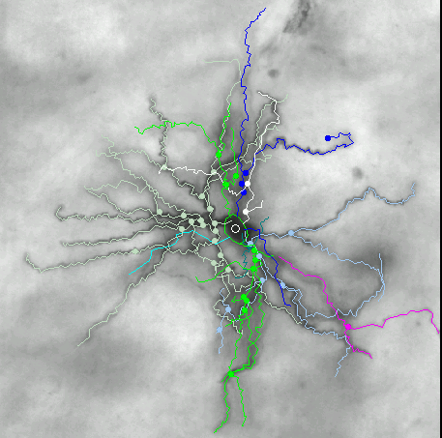
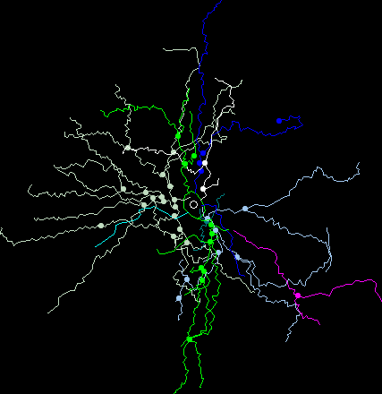
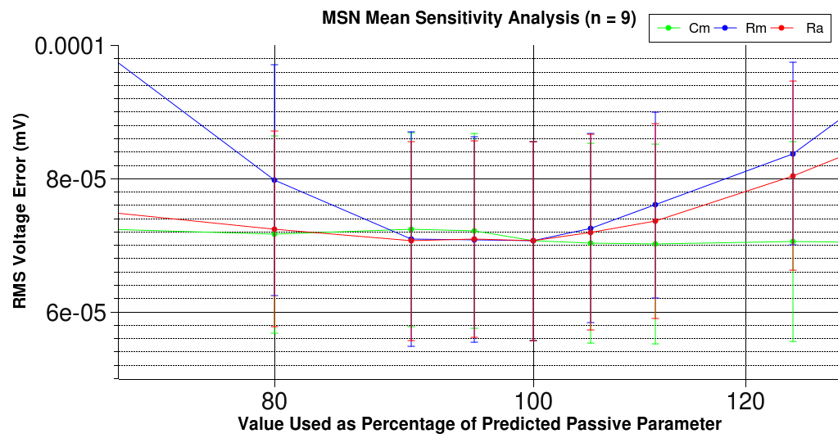
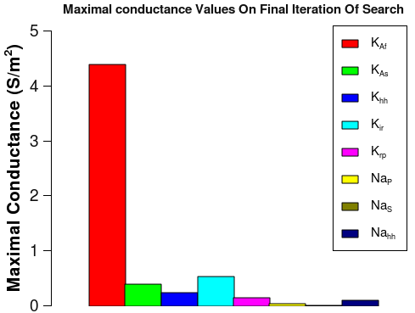
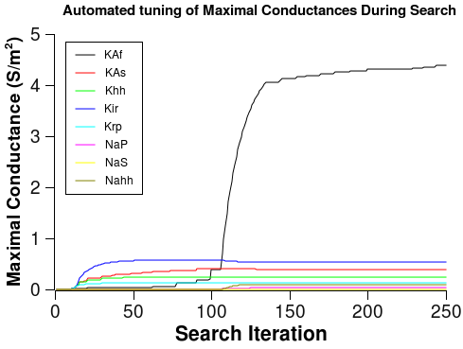
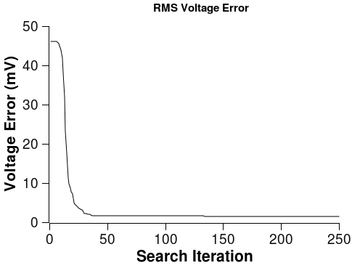
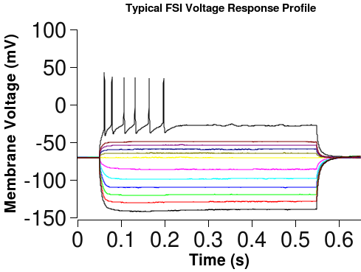
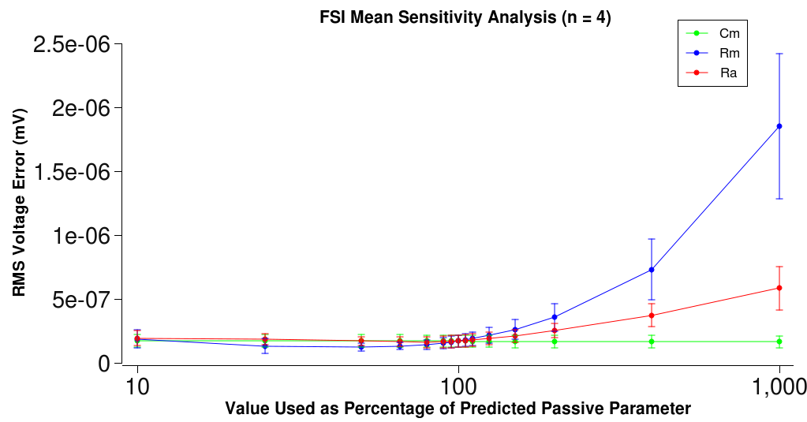
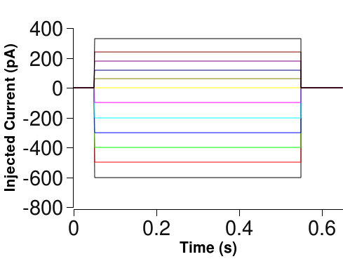
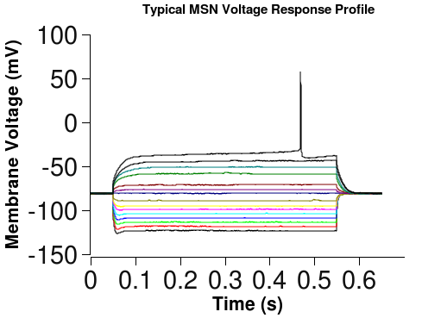
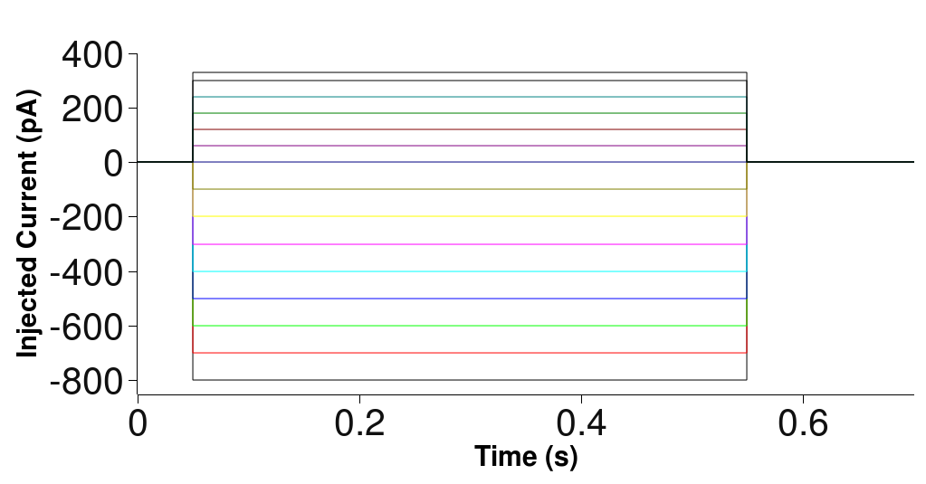
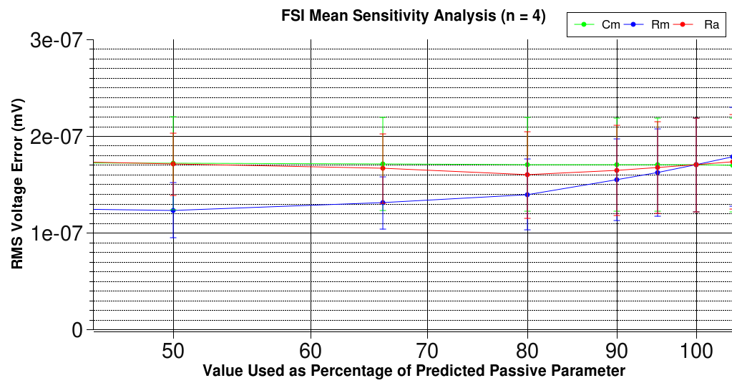
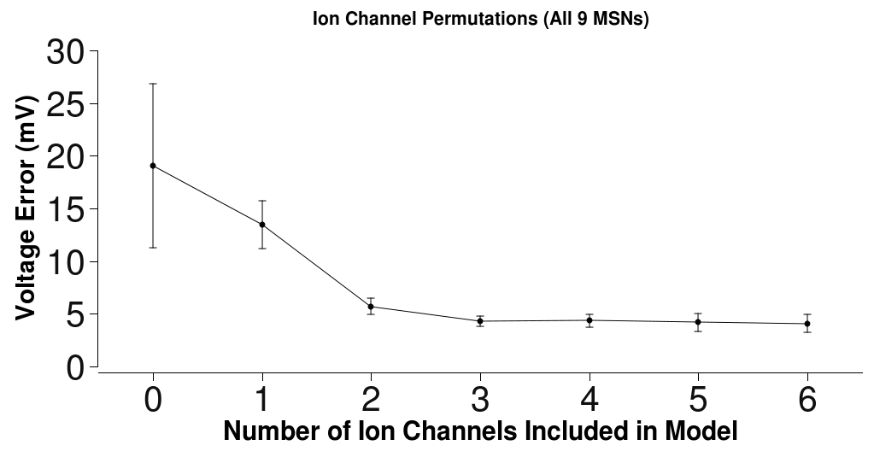
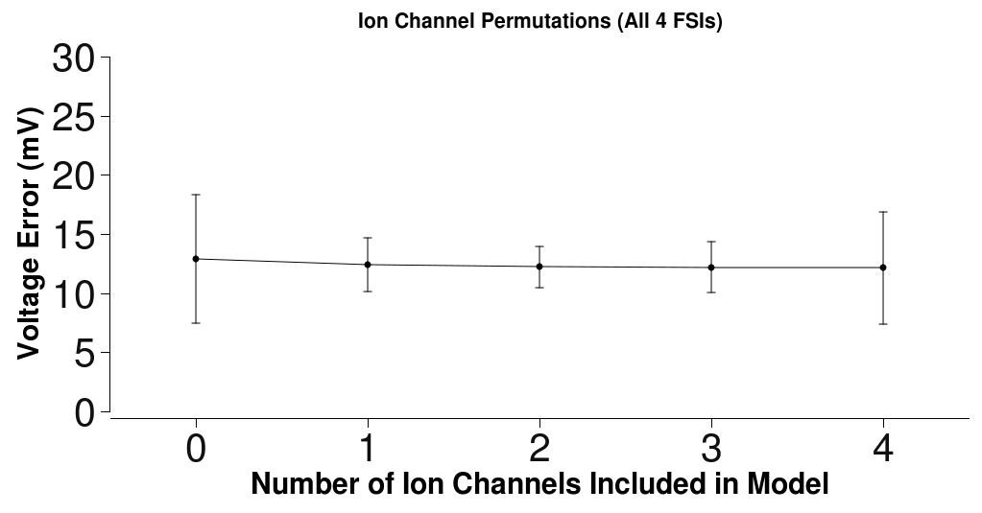
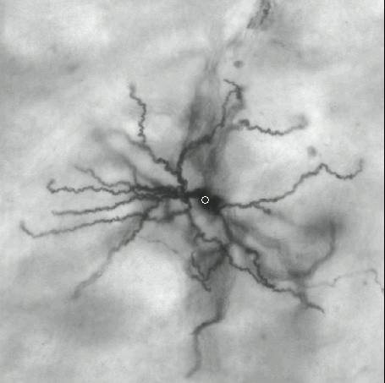
Integrated Data Collection And Automated Parameter Estimation In The Construction Of Conductance-Based Neostriatal Neurons
D. S. HOYLAND, N. LEPORA, R. WOOD, P. G. OVERTON, K. G. GURNEY
Department of Psychology,
The University of Sheffield,
Western Bank,
Sheffield, UK S10 2TP
694.4
Contact email: D.S.Hoyland@shef.ac.uk
UU65
Data Acquisition
Introduction
Analysis
Electrophysiological recordings taken in the whole cell patch clamp configuration.
Neostriatal brain slices (250 -400μm) of Wistar and Hooded-Lister rats (P14-19).
Data obtained for Medium Spiny Neurons (MSNs) and Fast Spiking Interneurons (FSIs)
Biocytin also injected into cell whilst recording to enable morphological reconstruction.
Computational modelling of single neurons often encounters a severe limitation in that the modelling enterprise is divorced from the gathering of physiological data. As a result, most models tend to be fundamentally flawed because, while they are based upon data which has been accurately recorded from electrophysiological experiments, they are also based on assumptions regarding the passive behaviour of the cell membrane (the membrane capacitance, Cm, membrane resistance, Rm, and axial resistance, Ra) .
Here we present an INTEGRATED approach where we have determined the passive parameters by fitting to short current pulse voltage responses, and used these to determine the active parameters (the maximal conductances, Gmaxes, of the ion channels).
To accomplish this, we used the 'GmaxSearch' algorithm: an AUTOMATED fitting tool used to determine the relative contribution of each species of ionic channel present in the cell by constructing, testing and refining neuronal models until the target voltage behaviour is achieved[1].
Passive Parameter Sensitivity Analysis
Short Current Pulses
Short Current Pulse Response Fitting
Gmax Search Algorithm
Current pulses (480μs / 1-2 Hz) so short that membrane-bound voltage activated ion channels do not have time to respond injected.
Passive Parameters
Eleak
Neuronal Morphology (or an electrotonic equivalent)
Active Parameters
GmaxSearch
The results from the GmaxSearch are only useful if the search is adequately constrained using correct passive parameters. These plots show how the active parameters can vary depending on the value of the passive parameter used.
Exponentials fitted to the mean of the short current pulse response data [2] using the fminsearch routine in Matlab.
6 free parameters: the 3 passive parameters and 3 morphological parameters (soma diameter, electrotonic dendritic diameter and electrotonic dendritic length).
Morphological Reconstruction
For the MSNs, the sensitivity analysis (below) shows that using the passive parameters predicted from the short current pulse data fit, the GmaxSearch produces a better 'closest match' to the target data (lower error) than that for non-predicted parameters.
Long Current Pulses
Neurolucida was used to measure the 3D structure of the cells. By using this instead of an electrotonic equivalent, we hope to further constrain the short current pulse fitting exercise.
Discussion
We have demonstrated that the GmaxSearch is a generic tool that can be used on multiple cell types. By taking advantage of this automated method, we were able to conduct analyses which would otherwise be so time consuming that they would be practically impossible.
A sensitivity analysis was undertaken which revealed that the algorithm was better able to produce more accurate fits to the data when using the predicted passive parameter values. This shows that in order to build a realistic model, it is vital to obtain the true value for the passive parameters, extracted from the data of each individual cell, as opposed to using generic values. Otherwise, the active parameters will have to compensate for inaccurate passive parameter values and so will be incorrectly reported.
For this reason, we believe that the integrated approach taken here leads to much more accurate models being constructed, in addition, this approach allows us to acquire values for the passive parameters without resorting to more invasive methods such as using toxins to block all of the membrane channels [2].
We also conducted an ion channel permutation analysis and we show that the search produced better fits when more channels are available to capture the dynamics of the real neuronal membrane. However, they do need to be the right channels! The existing suite of ion channels attributed to Fast Spiking Interneurons in the literature is inadequate to fully capture the properties of this cell type.
Improvements to this method are currently taking place which include using the morphological data also recorded from these neurons to further constrain the passive parameter fitting and this should yield even more accurate models.
The effect was less pronounced for the Fast Spiking Interneurons (below), although as very little is known about this cell type, these models were based on a very impoverished channel set.
A series of half-second current pulses injected into each cell. Cells can be identified by their voltage response as different ion channels will result in different voltage response patterns.
Ion Channel Permutation Analysis
Morphology
References
To accurately represent a neuron, a model must have the correct ion channels available to fully capture the dynamics of the changing membrane voltage. However, as we have seen in the case of the sensitivity analysis for the Fast Spiking Interneurons, an inaccurate channel set leads to inaccurate models.
Immunohistochemical staining of biocytin filled cells. 3 of the Medium Spiny Neurons were successfully stained (left) and 2 of the Fast Spiking Interneurons (right).
[1] Wood R, Gurney KN, Wilson CJ - “A Novel Parameter Optimisation Technique for Compartmental Models Applied to a Model of a Striatal Medium Spiny Neuron” - Neurocomputing, 2004, 58-60:1109-1116
[2] Thurbon D, Luscher HR, Hofstetter T, Redman SJ - “Passive electrical properties of ventral horn neurons in rat spinal cord slices” - J Neurophysiol. 1998 Jul;80(1):2485-502.

