Slide 1
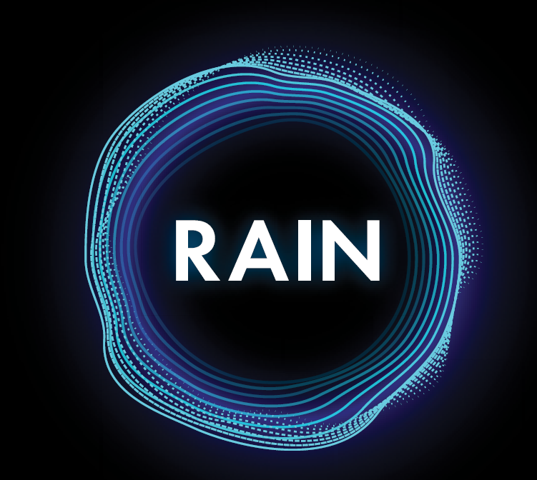
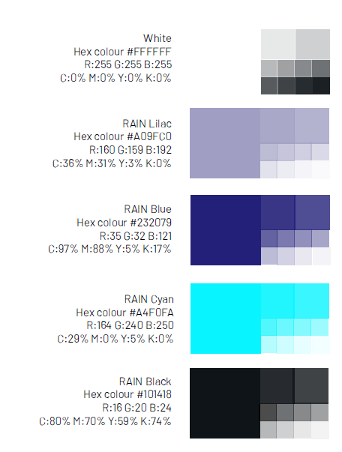
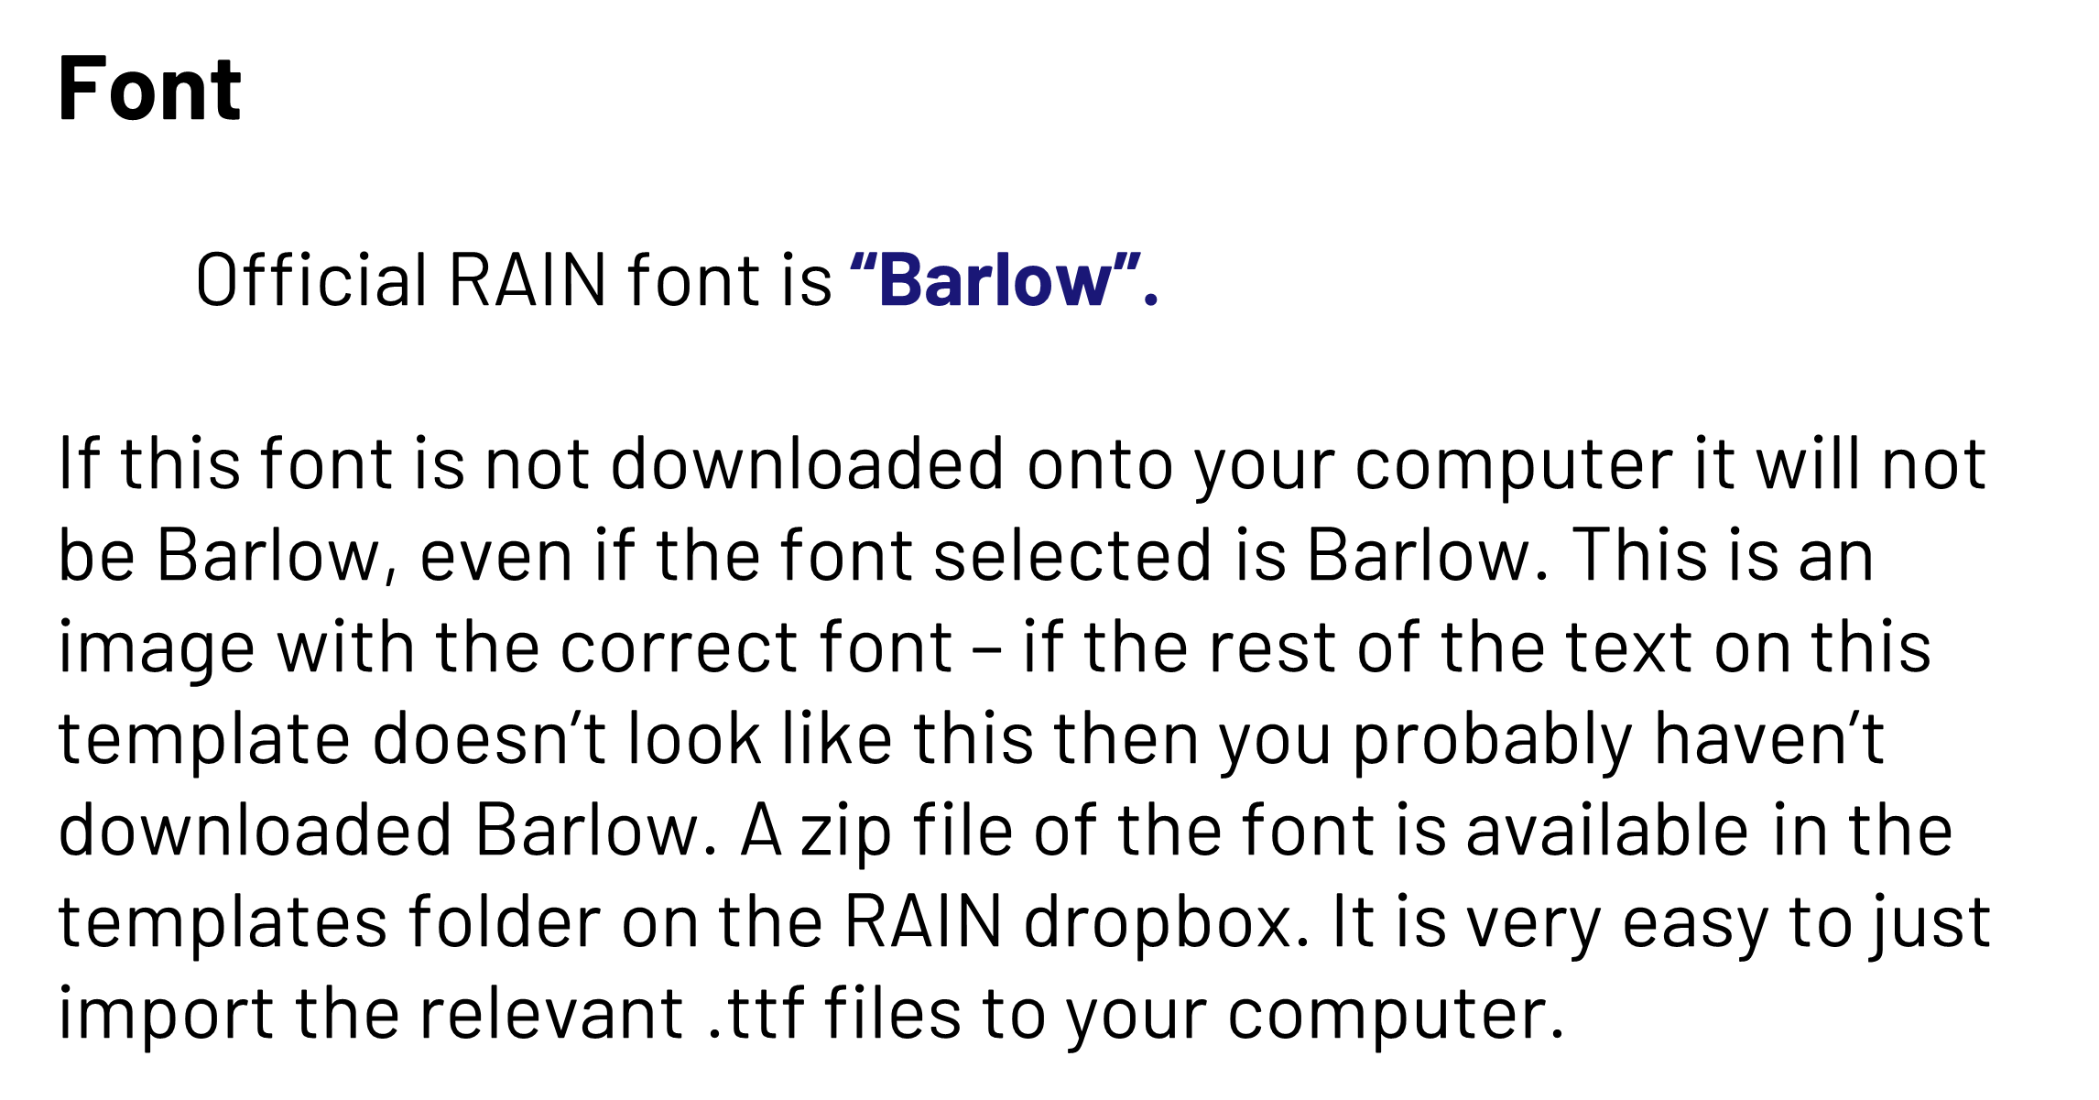

Title here
Name, co-authors and affiliations
Content
Use this space for text and images relating to your research. Try to have no text that travels further than half the width of the sheet or smaller than font size 24.
Less is more!
You can use colours from the RAIN colour palette (Fig. 1) to highlight key messages.
Feel free to use a mixture of light text on dark / vice versa in chunks to break up the middle space and give an obvious flow to the reader.
Arial is a fine alternative
Figure 1. The RAIN colour palette
This poster template is not restrictive, but here to give ideas. For this middle portion, do what is aesthetically best for the content. Some images look better on a white background, some on a dark – try things out and see. Have a key message and make sure that is communicated clearly and easy to find. Make sure all figures make sense on one glance.
The RAIN logo and ISCF starburst / UKRI logo must be included.
References / web links / acknowledgements
Include logos of other funders / linked projects here too

