Slide 1
Autoplot
Virbo meeting Boulder Aug 2008

Slide 2
Introduction to Autoplot
“plot anything” software
java-based
Reads data from many sources
  Abstract File formats: CDF, netCDF
  Common formats: Excel, .JPG
  API’s: OpenDAP, das2Server, ODBC
  Low level: ASCII tables, Binary tables

Slide 3
Introduction—Automatic…
Tries to present reasonable view of data:
  rendering method (line vs spectrogram)
  Axis ranges and log/lin
When metadata is available (e.g. CDF)
  Axis labels
  Fill data

Slide 4
Introduction—DataSources
DataSources are plugins that convert URL to plottable DataSet (QDataSet)
DataSources provide metadata in tree-structure, maybe along with MetaDataModel that is used to interpret the metadata.
DataSources provide completion engine and (soon) GUI for creating URLs.

Slide 5
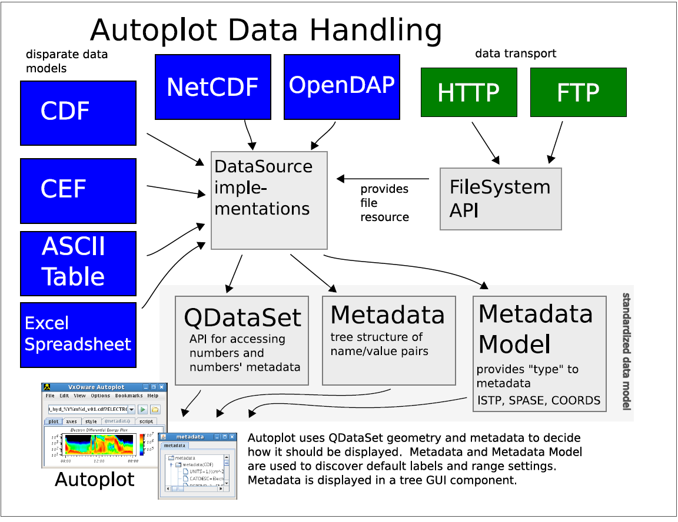

Slide 6
Axis Tab for Control
Axis ranges, log/linear, labels
Plot Title
Valid range and fill value (e.g. ascii table)
Disable “auto” controls
Rank Reduction

Slide 7
Rank Reduction
Autoplot only plots 2-D graphics
Datasets must be “rank” 1 or 2
Rank 1 is displayed as lineplot
Rank 2 spectrogram (unless DEPEND_1 is coordinate dimension)
Rank 3 can be “sliced” to reduce dimension
  Pick dimension to slice. It tries to guess best slice dimension based on names like (Lat,Lon,Angle)
  Pick index to slice. Axis ranges are preserved, so you can make comparisons between indexes. Mousewheel controls.

Slide 8
Autoplot Tabs
Axis: described already
Style: style preferences
  Symbol color and shape
  Spectrogram rebin-to-pixel method (NN or Interpolate)
Metadata: information about the plotted dataset
Script: Editor for Jython scripts
All tabs undock with mouse drag

Slide 9
Features, features
“Browser for Data on the Web”—look for browser features
  Bookmarks
  Downloaded resources cache. (plus controller)
Unlimited undo/redo support
Save/Load state to .vap file
  Option to embed data into .vap

Slide 10
Metadata Tab
Tree GUI for inspecting DataSource metadata
Statistics tree node (mean, std.dev, count)
QDataSet node for inspecting properties and digital data.

Slide 11
Mouse Features
Come via das2 plotting library
Right-click on plot to select action
  Box zoom default
  Crosshair digitizer
  Vertical and Horizontal slicing
  Length can show fit model
  Display digital data within box

Slide 12
Print to…
Print to printer
SVG, increasingly supported format
PDF
  much effort to make PDF and SVG output hackable for publication (e.g. tweak labels)
PNG

Slide 13
Export Data to…
DataSources can provide formatting as well
  ASCII tables
  Binary tables
  Das2streams (serial version of QDataSet)
  Excel (why not)
  CDF

Slide 14
Scripting Support
Provides way to drive internals directly
Autoplot presents API to script
Applications:
  Batch processing: for each datafile, make a plot
  “Mash up” data sources
  Process data: pile of gifs to array of timetags
  Tweak data: add physical units to ascii table

Slide 15
Script Tab
JythonDataSource is DataSource that runs script, then plots the result
Script tab displays loaded jython script for reference
Allows editing of script as well.
“minimally useful” IDE for creating scripts
  Execute this script
  Error annotation when error is encountered

Slide 16
Autoplot Containers
Java application run on client via webstart
  Webstart downloads and installs software
Java applet that runs within browser
  Only a few DataSources work in this mode
Server-side servlet
  URL is POST request
  .png image is returned
  Support thin-clients

Slide 17
Autoplot Limitations
Only one dataset can be plotted
Shortcomings with Vectors and Rank 3
Application State support (undo/redo, save/load) isn’t comprehensive
  das2 property editor allows changes that aren’t reflected
Still buggy

Slide 18
What’s Coming
VMO and Plasma Wave Group are supporting Autoplot
more DataSources
Overplots, Stack Plots, multiple Canvases
Uniform, comprehensive DOM
  State support
  Scripting

Slide 19
Thanks!

