Slide 1
QDataSet Data Model
What is a data model?
  My definition…
  “model” in the CompSci sense
    A bank’s software has model for customers
    Store what’s relevant to their business
  A representation of data that allows data access to the numbers and metadata
  Bias towards visualization and analysis

Slide 2
QDataSet Motivation
Dataset abstraction layer allows data from different sources to be plotted in Autoplot
All data-handling systems have some sort of data model.
All have limitations in what they can represent.
Dataset abstraction provides nouns and verbs that develop a vocabulary.

Slide 3
Data Model Goals
The model should be an interface, not a file format.
Flexible to accurately represent many types of data
Simple so as not to burden
Range of abstraction
  From a set of times data when was collected: Time
  To high-dimension dataset that can be displayed and sliced, like
    Flux( scan mode, Time, energy, pitch )‏

Slide 4
Context for Development
das2 has had two data models, QDataSet will become the third (and final, hopefully).
Current is overly abstract.
  Optimized for line plots and spectrograms.
  All data must be tagged with physical units
  Datasets must be Y(T) or Z(Mode,T,Y).
  But cannot represent common things like Flux(Time,Energy,PitchAngle)‏
  Or GsmPos(T)‏
API is big, “TableDataSet” has 28 methods

Slide 5
Context For Development-TableDataSet
Here are example methods to give context:
Tds.getZUnits(), tds.getYUnits(), tds.getXUnits()‏
Tds.tableCount()‏
Tds.getYLength( itable )‏
Tds.getXLength()‏
Tds.getYTagDatum( itable, iy )‏
Tds.getDatum( ix, iy )‏
Tds.getDouble( ix, iy, units )
Tds.getProperty( DataSet.PROPERTY_X_TAG_WIDTH )‏

Slide 6
Context for Development—das2 & PaPCo
Groping for the ideal model for two+ years
PaPCo data model is based on CDF model
  CDF file is a collection of datasets
  datasets are 1,2,3,4-D arrays
  datasets have attribute (name=value) pairs
  dependencies between datasets

Slide 7
Context for Development--Autoplot
Autoplot goal is to plot data from many sources, uses das2
“QDataSet” introduced when das2 data model limitations got in the way.
  Supports untagged data (bunch of numbers)‏
  Combinations of data types (timetags are doubles, data are floats) make implementing one giant interface impossible.
  (in OOP, has-a is always better than is-a)

Slide 8
QDataSet
Java API inspired by CDF and NetCDF
DataSet = Array + name=value properties
Property names like DEPEND_0, UNITS
  DEPEND_0 points to the dataset that tags dimension
“rank” is number of indexes
Abstraction comes from composition.
Density( Time=1440 )‏
  Density is rank 1 dataset with 1440 values.
  Time is rank 1 dataset with 1440 values
  Density.property( QDataSet.DEPEND_0 ) -> Time(1440)‏

Slide 9
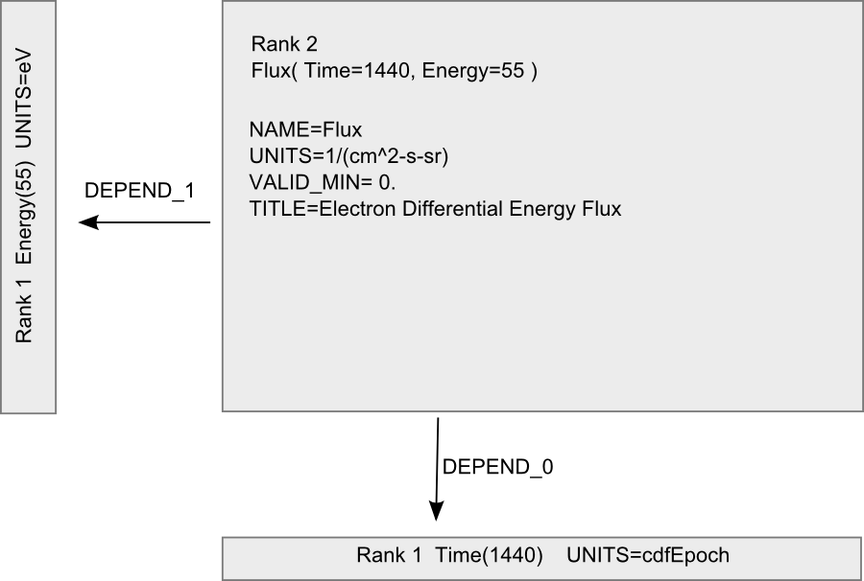

Slide 10
QDataSet—rank 3
Flux( Time=1440, Energy=55, Pitch=18 )‏
Flux.rank() -> 3
Energy.property( QDataSet.UNITS )->eV
Flux.property( QDataSet.DEPEND_1 ) -> Energy(55)‏

Slide 11
Accessing Data
Density.value(i) -> double
Density.property( QDataSet.FILL ) -> -1e31
for ( int i=0; i<Density.length(); i++ ) {
  double d= Density.value(i)‏
  }
Iterator hides rank
  iter= DataSetIterator( Density )‏
  while ( iter.hasNext() ) {
  double d= iter.value( Density )‏
  }

Slide 12
Timetags
Time.property( QDataSet.UNITS )->cdfEpoch
Time.value( 0 ) -> 1.0263511345382e13
das2 “Datum” is double + Unit
cdfEpoch.createDatum( Time.value(0) ) -> “2004-05-04T01:23:45”
Canonical time unit in das2 is Units.us2000, microseconds since midnight, Jan 1, 2000.

Slide 13
QDataSet implementations
DDataSet is backed by double array, FDataSet is backed by floats.
TagGenDataSet computes value() with each call.
NetCDFDataSet adapts the NetCDF api to make it look like a QDataSet.
DoubleBufferDataSet is backed by java.nio.DoubleBuffer, and has practically no limit to size since it is not bounded by physical memory

Slide 14
QDataSet interface
rank()
length(), length(dim0), length(dim0,dim1)
value(dim0), value(dim0,dim1),…
property( name ), property( name, dim0 ),…
Note, there are extensions such as “WritableDataSet” with additional methods.

Slide 15
QDataSet layers
Java API is thin syntax layer
Abstraction comes from semmantics
Thin syntax layer means easy to implement in different languages
  Java
  C++
  Xml

Slide 16
Rank-reducing Operators
“Slice” reduces rank by extracting a dataset from array of datasets.
  Remove context to see detail
  Flux( Time, Energy, Pitch ) -> Flux( Energy, Pitch)‏
“collapse” reduces rank by averaging elements along a dimension
  Remove details to see context
  Flux( Time, Energy, Pitch ) -> Flux( Time, Energy )‏

Slide 17
Qube DataSets
In general, QDataSets are arrays of arrays.
Length method is qualified by index
  ds.length() gives first dimension length
  ds.length(0) might not equal ds.length(1).
Slice operator only defined for 0th index.
Qube implies data is simple N-dimensional array and dimensions are independent.
  Slice or collapse any dimension
  Flux( Time=1440, Energy=32 ) implies Qube.
Flux.property( QDataSet.QUBE ) -> True

Slide 18
Math Operators
Add, subtract, multiply divide, pow, cos etc
He_density( Time=1440 )‏
H_density( Time=1440 )‏
Total_density= Ops.add( He_density, H_density )‏
FFT, magnitude, etc
angle= new TagGenDataSet( 0, 100*PI, 10000 )‏
fft= Ops.FFT( cos( angle ) )‏
pow= Ops.pow( magnitude(fft), 2 )‏

Slide 19
Other operators
join appends one dataset to another
  (add the dependencies too)‏
findex shows how two (tags) datasets interleave.
Boxcar average for rank 1 datasets.
etc…

Slide 20
IDL, Matlab inspired
IDL’s findgen(20) -> 0,1,2,3,4,…
Matlab’s linspace( 0., 1., 20 )-> 0.00, 0.05, 0.10, …
IDL’s where( Density > 20. )‏
  but with zero length result!
  no aliasing 2-D to 1-D! (result preserves dimensionality)‏

Slide 21
Limitations
Rank1, 2, and 3 implemented in Java API.
  Rank0 exists, but you can’t do anything with it
  RankN exists, but you can only slice it.
Many operators assume QUBEs
Still groping for how to represent coordinate dimensions
And bundles of correlated data
Das2Stream current cannot represent rank 3 datasets.

Slide 22
Jython Support
Jython is Python implemented in Java
allows operator overloading
QDataSet + jython = expressive language
similar to IDL or matlab
Autoplot script panel
  N1= getDataSet( “/home/jbf/density.dat?column=N1” )‏
  N2= getDataSet( “/home/jbf/density.dat?column=N2” )‏
  plot( N1 + N2 )‏

Slide 23
example Saturn Density contours
200 lines of jython code
reads in 5 datasets
produces 4 datasets
Datasets are then displayed in Autoplot with contours feature added.
ported from IDL script in about an hour

Slide 24
Thanks!

