Slide 1
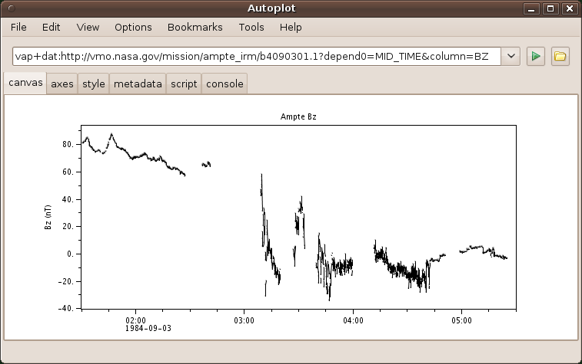
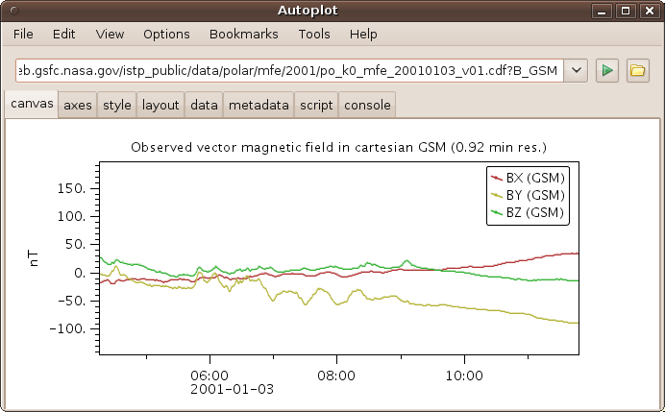
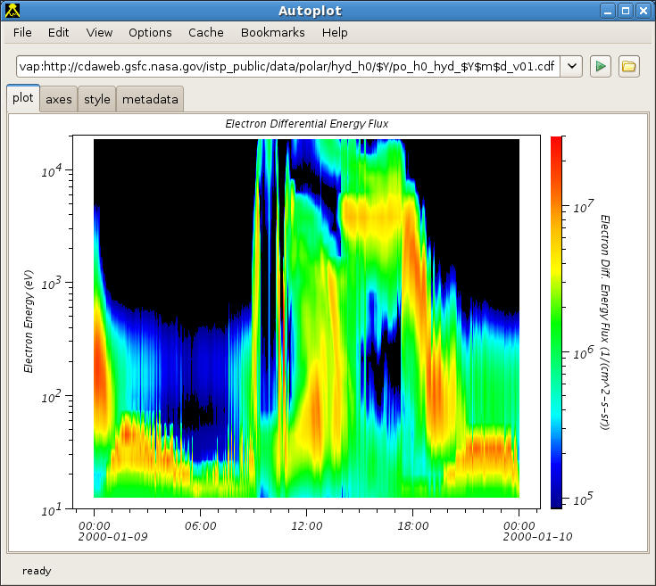
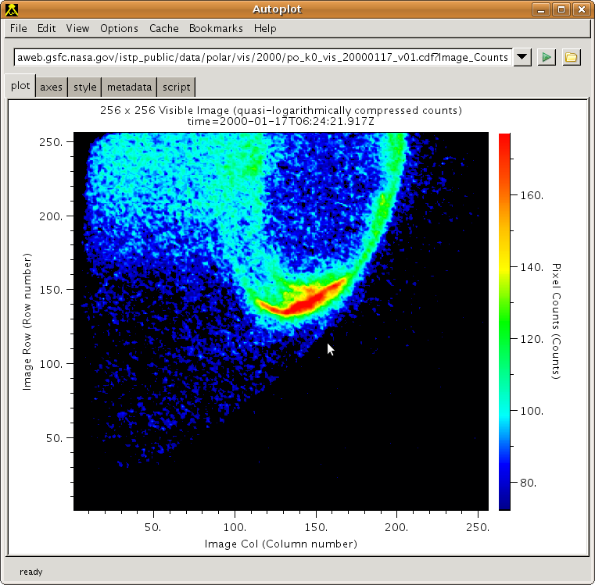
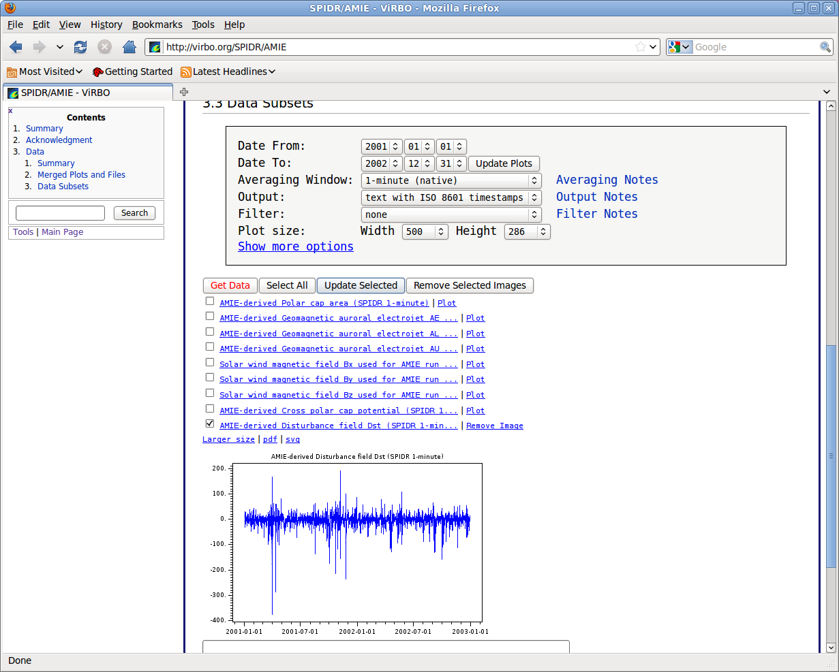
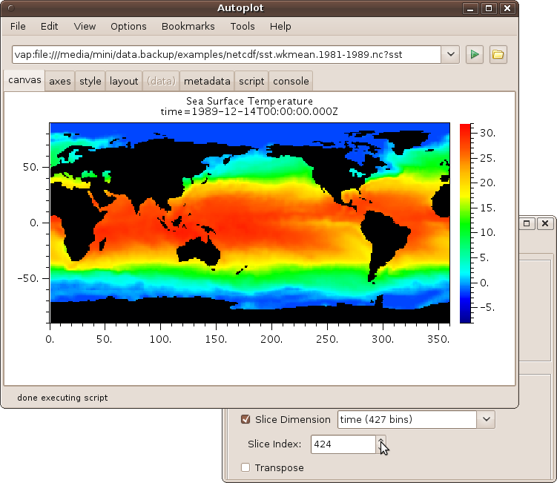
Autoplot and MMS
Jeremy Faden
Cottage Systems, Iowa City, Iowa
University of Iowa, RPW Group
Scalar Time Series Bz(Time)
from ASCII File
Image from CDF File
Vector Time Series
from CDF File
Spectral Time Series
Flux(Time,En) from
CDF file
On-the-fly graphics on ViRBO
SST(Time,Lat,Lon) Qube
from NetCDF File

Slide 2
Autoplot is plotting software that plots data in local and remote files and from data servers.
Scalar Time Series Bz(Time)
from ASCII File
Image from CDF File
Vector Time Series
from CDF File
Spectral Time Series
Flux(Time,En) from
CDF file
On-the-fly graphics on ViRBO
SST(Time,Lat,Lon) Qube
from NetCDF File

Slide 3
Autoplot History
Autoplot comes out of the Virtual Observatories ViRBO and VMO (2007-now).
Many of its features come from PaPCo, IDL plotting software developed by Reiner Friedel, myself and others (1994-2006).
Das2 is the Java graphics framework we developed at Univ. of Iowa Plasma Wave Group (2003-2006)
Using Java and Das2, end-users can compose plots as they could in PaPCo using Autoplot
why Java? freely available, fast, supports all the platforms, truly platform independent, popular

Slide 4
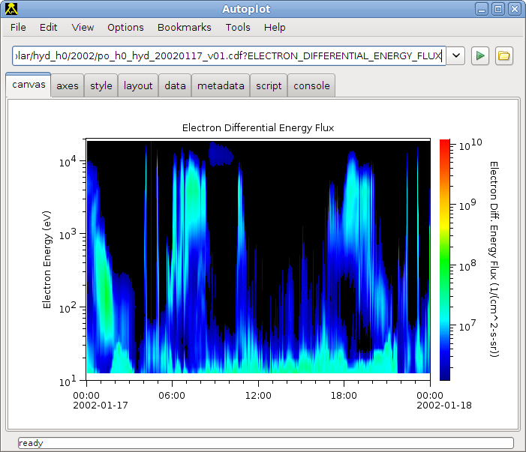
Using Autoplot
All data in Autoplot has a data address, or URI, that identifies it. The address is entered in the address bar, and the data is loaded and displayed. Typically URIs are the names of data files and additional parameters needed to access.
The axes and plot are interactive: you can adjust settings like you would with Google Maps: the mouse wheel zooms and you can do box zoom, etc. There are horizontal and vertical slices as well.
(DEMO of pointing Autoplot to an ASCII file with two columns)

Slide 5
Demo of Axes and Tabs
Start at Autoplot.org, launch
Type in name of ASCII file with two columns of data
Data comes up with automatic settings
Note data source plugin
Mouse can be used to adjust x and y axes
Slide right or tear off to show both tabs
Axis tab can be used for ranges, labels, title
  Note on ranges, not separate min, max
Style tab adjusts colors, etc.
Metadata tab has tree of statistics and other metadata found in data source
CDF file with spectrogram, show colorbar adjustment
Note tooltips contain documentation

Slide 6
You can see the various data sources Autoplot supports
with example URIs can be found in Bookmarks->Demos.
These include:
  Demo 1: Data from OpenDAP server
  Demo 3: CDF file
  Demo 4: Excel Spreadsheets
  Demo 6: reference within SPASE record
  Demo 9: ASCII file
  Demo 10: NCML (NetCDF) file

Slide 7
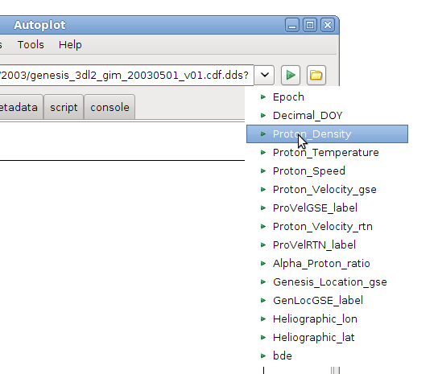
Developing URIs
Typically URIs would be created by data providers, but end users create them as well.
Data source plug-ins provide completions to show what's available.
(Autoplot now generates a GUI based on completions, instead of the droplist.)
Completions for
OpenDAP URI

Slide 8
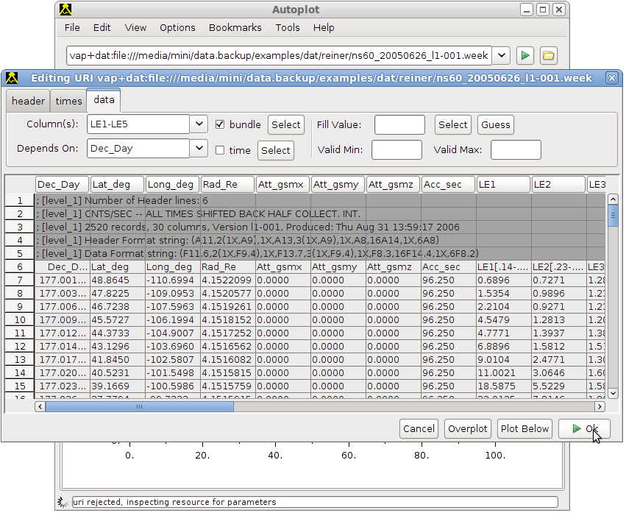
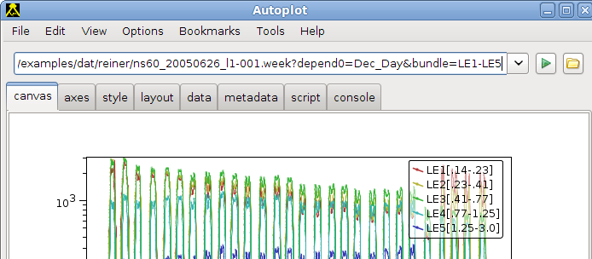
Data Source Editors
Some URIs are complex, so editors make it so users don't have to think about them. The folder icon next to the URI bar enters the editor.

Slide 9
Complex URI Example
vap+dat:ftp://nssdcftp.gsfc.nasa.gov/spacecraft_data/
omni/omni2_1972.dat
?column=field17
&time=field0
&timeFormat=$Y+$j+$H
&validMax=999
Even though these are long, the editor makes them manageable and they identify a chunk of data.
They can be pasted into email, used in a program,
or recorded in a log.

Slide 10
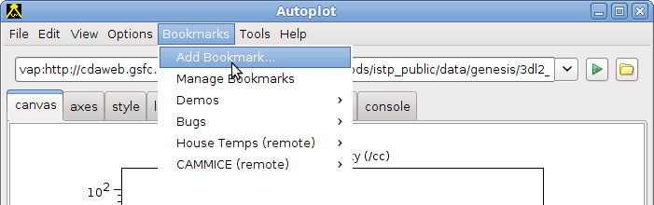
Bookmarks
Bookmarks allow us to keep track of data. Look for “add bookmark” on the GUI, which will save the current URI (and to bookmarks file in $HOME/autoplot_data/bookmarks/autoplot.xml)
You can export bookmarks to a file and
send them to a colleague

Slide 11
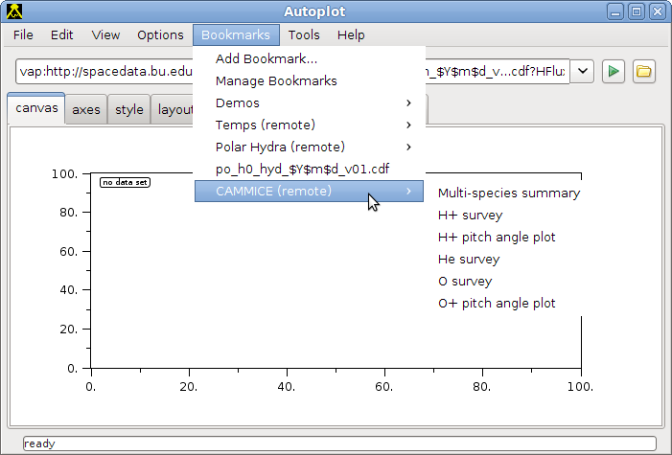
Bookmarks
You can put a bookmarks xml file on a website to publish “remote bookmarks,” which is a folder of bookmarks others can add. For example, you can create a folder for all workgroup team members.

Slide 12
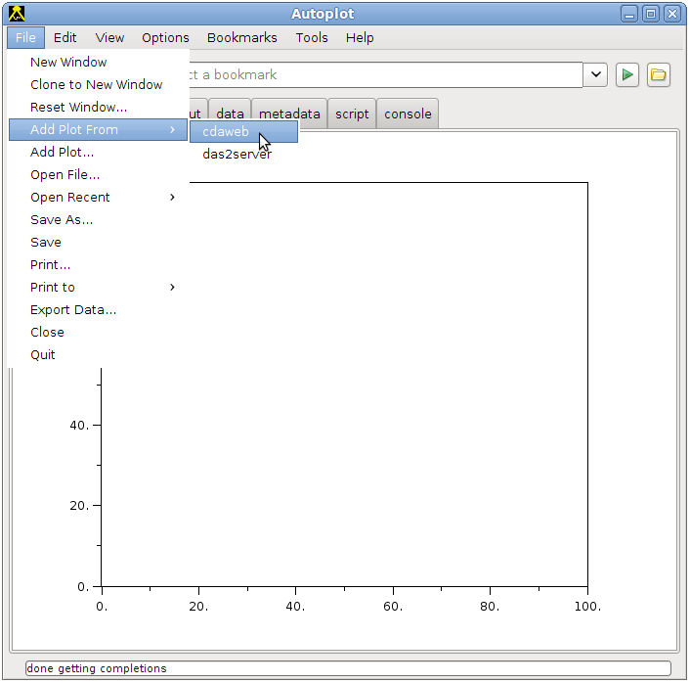
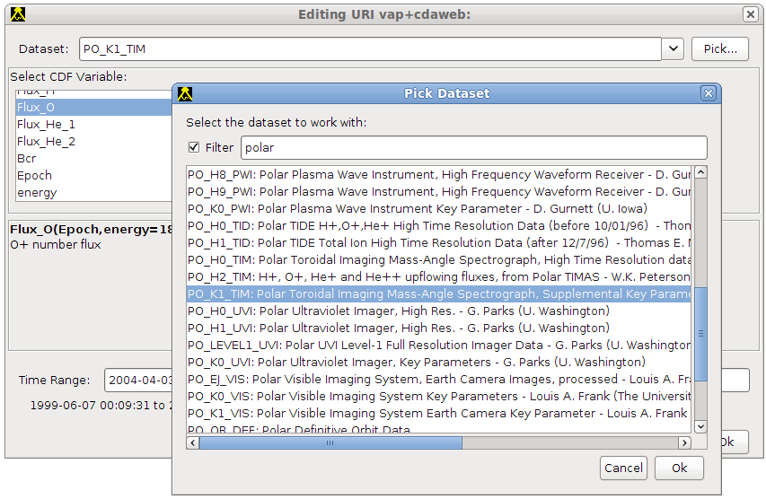
Some data sources allow for data “discovery.” These can be entered immediately to create valid URIs with its editor.

Slide 13
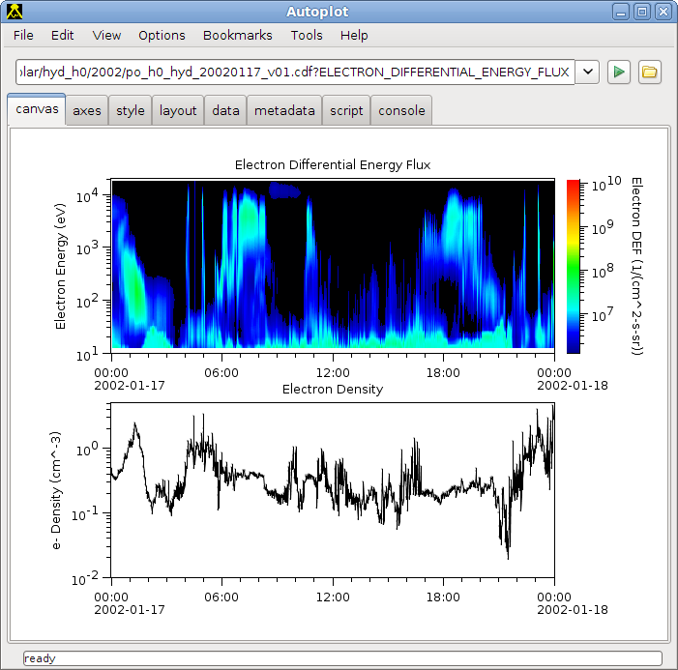
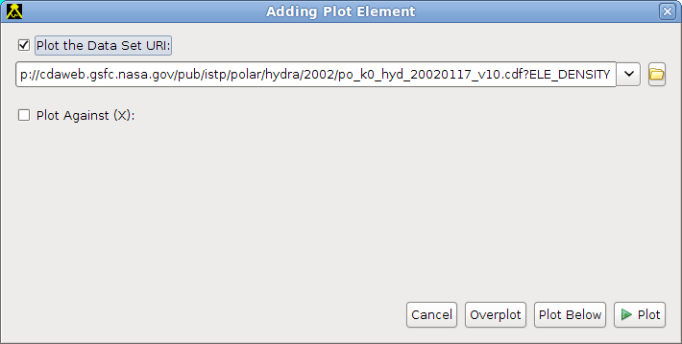
More complex layouts
File->'Add Plot...' dialog is used to add additional plots.
Time axes are automatically bound together, but they can be disconnected.
Entire layout can be saved as a “.vap” file, an XML file describing the layout.

Slide 14
Output from Autoplot
Render to PNG and PDF
Save application state to .vap file,
email .vap to colleague
Cut and paste image into
email or PowerPoint
Export data into ASCII table,
Excel spreadsheet, CDF file,
Binary table and more

Slide 15

File Aggregation
Autoplot works fine with just a pile of files. If there's a file on the web, you can read it or point a colleague to it. We can consume data from old web servers created in the 1990's, without ingesting it into a special server.
Often the data files form a long time series, and aggregation allows us to view the files as one data set.
.../omni2_1972.dat is one file, but
.../omni2_$Y.dat?timerange=1970-1980 is part of a time series.
Autoplot lists the remote directory, brings over the data it needs, then combines each granule into a long time series.

Slide 16
File Aggregation
See the unix “date” command for field types like
.../$Y$m$d_$H$M.dat
Subdirectories and Versioning are supported as well, so Autoplot will use the best version of a file:
.../$Y/$m/$Y$m$d_$H$M_v$v.dat
File aggregation provides a simple way to store, manage, and use data in long time series, without the need for a complex server.

Slide 17
Who's Using Autoplot
ViRBO, VMO and other Virtual Observatories
ACE Science Center
RBSP mission
  LANL, APL, Plasma Wave Group at Iowa
Plasma Wave Group
  Juno, RBSP--Use in instrument building
  Cassini, Polar, Cluster, old missions
  Read data into IDL and Matlab
CDAWeb
Michigan Virtual Model Repository is using it to produce graphics for web

Slide 18
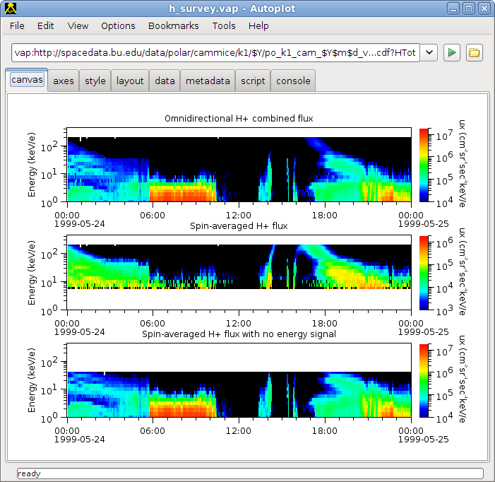
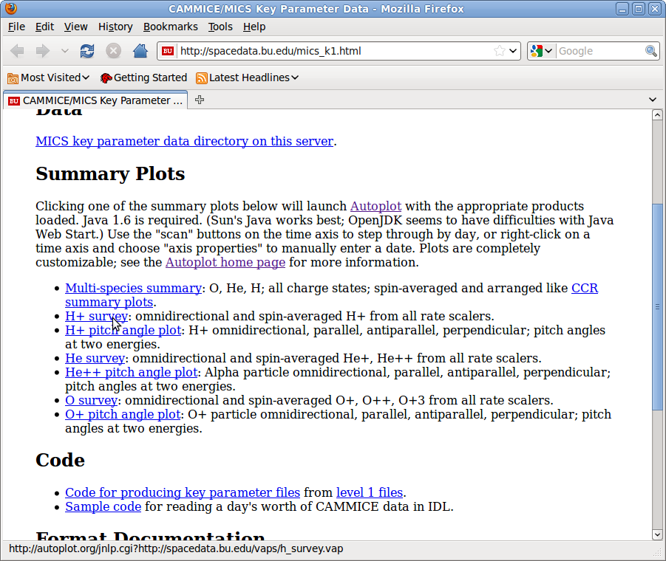
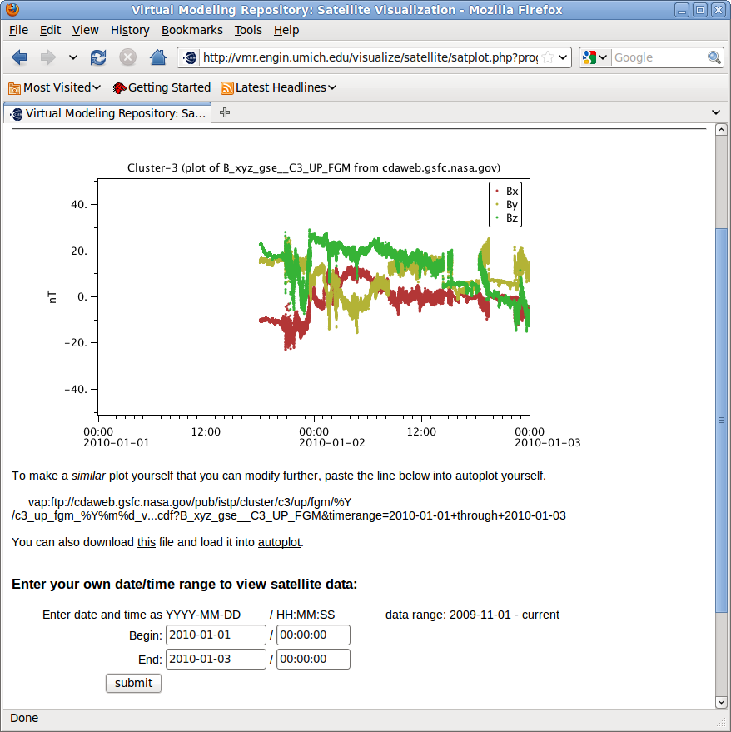
Autoplot in Web Servers
Website links to
autoplot.org's
server that launches
app with specific configuration.
Java Webstart®
Autoplot called
from the command
line on the server
to produce
graphics

Slide 19
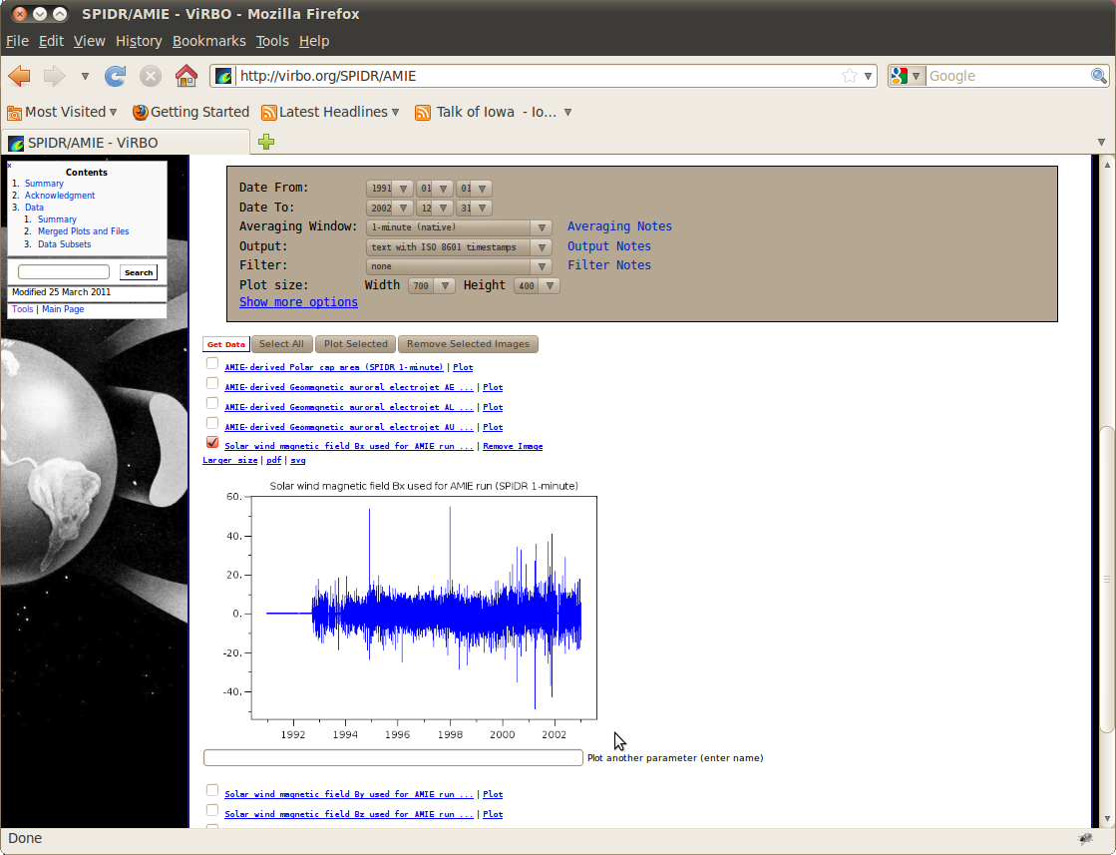
Autoplot in Web Servers
Autoplot can can also be embedded in Java-based web servers
(like Apache Tomcat) as a webapp, or as an applet to make
interactive plots within a web page.
Autoplot can be used
off-line as well, as a
command line
application. This
allows use in meetings
and secure areas
without internet access.

Slide 20
Matlab/IDL interface
Autoplot's data access libraries can be used to read data into IDL and Matlab. The design goal is if you can see it in Autoplot, you should be able to read the digital data into these data environments.
Unix$ export CLASSPATH=/tmp/AutoplotAll.jar
IDL> qds= OBJ_NEW('IDLjavaObject$APDataSet', 'org.virbo.idlsupport.APDataSet')
% QDataSetBridge v1.6.04
% APDataSet v1.2.2
IDL> qds->setDataSetUrl, 'http://www.autoplot.org/data/swe-np.xls? column=data&depend0=dep0'
IDL> qds->doGetDataSet
IDL> print, qds->toString()
http://www.autoplot.org/data/swe-np.xls?column=data&depend0=dep0
data: data[dep0=287] (dimensionless)
dep0: dep0[287] (t1970) (DEPEND_0)
IDL> plot, qds->values('dep0'), qds->values()
IDL> qds->setPreferredUnits, 'hours since 2007-017T00:00'
IDL> plot, qds->values('dep0'), qds->values()
Use with Matlab is similar, just a different way to link in the software
and syntactic differences.

Slide 21
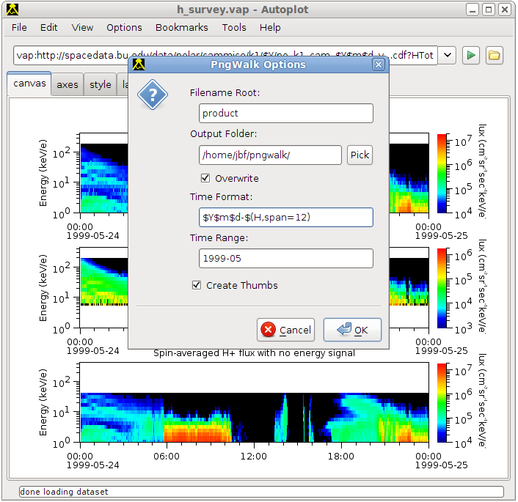
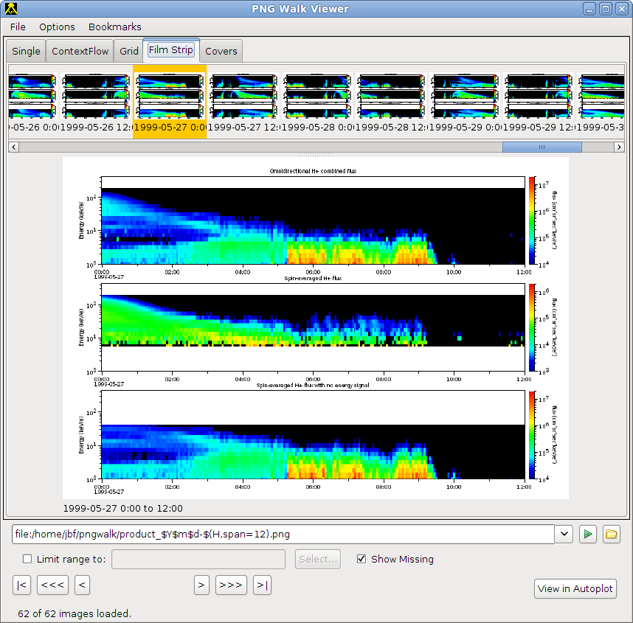
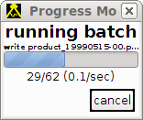
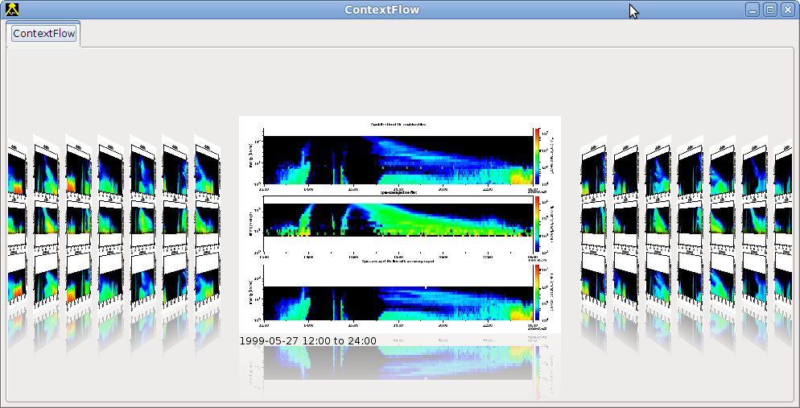
Autoplot PNGWalk Tool
PngWalk Tool creates a time series of png image files.
Here we make half-day plots for the month of May 1999

Slide 22
Customizations
1. Products are "vap" files. Develop vap files for your applications, serve them via Autoplot cgi:
http://autoplot.org/autoplot.jnlp?http://yourserver/data.vap
2. Remote Bookmarks
3. Custom Data Source Plug-ins to finely control user experience with custom GUI and data rendering, custom filters, etc.
4. Das2 library, Autoplot, and its plug-in loaders are GPL open source and have been used in other applications.

Slide 23
Limitations
1. this is all 2-D graphics: line plots and spectograms.
2. focus on individual needs, inefficiency in workgroup (multiple copies of data files)
3. memory. No client-side reduction limits size of data sets. Windows Webstart has 1GB limit
4. “Late Optimization” means some duplicated work, storage
5. Java Webstart® causes some grief with installations (e.g. LANL firewall). Webstart feedback gets better and better.

Slide 24
What's coming
1. Pluggable “Renderers”: Data painters plug-in like data sources
2. Improve workflow for building more complex plots
3. Improve support for data from SPASE. Current version is based on early version of SPASE, now SPASE is mature.
4. Improved documentation and the Autoplot “book.” Course outline.
5. Improvements to units handling, including SI units handling.
6. “Dashup” tool for data mashing

