Slide 1

Single Page Application (SPA) PIV Authentication with the Security Gateway (R6Portal) Pilot Project Preliminary Design T.H. 8/9/2017
EAD Group

Slide 2
Leverage the Security Gateway as SAML Service Provider (SP) with the ICAM as Identity Provider (IDP) for PIV Authentication
SAML Service Provider (SP)
SPA Client
Security Gateway
MANAGEMENT SCREEN
CREATE APPLICATION CONNECTION:
Name:
Domain:
Client ID:
Client Secret:
Callback URL:
CORS:
TO CREATE SAML IDP TRUSTED CONNECTION
(Provided from ICAM):
Connection Name: ICAM SAML Connection
Identity Provider Sign-in URL: https://ip.USDAeAuth/SAML2/SSO/Redirect
Entity_ID (Same as Assertion Consumer Service):https://r6portal.wrk.fs.usda.gov/r6portal/saml2/acs?so=00D
Sign Assertions: X509 Signing Certificate: PER or CER format of DIP (IDP Public Key)
Sign Response:
Sign-out URL: https://ip.USDAeAuth/SAML2/SSO/Signout
Sign Request Algorithm: RSA-SHA256
Components:
- Authorization Server
- Token Server
- SAML SP Server
Resource Server access will not be
enforced here.
Application
Client ID: 'YOUR_CLIENT_APP_ID'
Domain: ‘app.wrk.fs.usda.gov'
ResponseType: 'token id_token'
audience: 'https://r6portal.wrk.fs.usda.gov/userinfo‘ (The unique identifier of the target API you want to access)
RedirectUri: ' https://Your_Application/callback '
scope: 'openid‘
state: used by the client to prevent CSRF attacks
nonce: included in the ID token to prevent token replay attacks
TO CREATE SAML IDP CONNECTION
(Provided from ICAM):
Connection Name: ICAM SAML X509 Signing Certificate: PER or CER format of DIP Public Key
Sign-out URL: https://ip.USDAeAuth/SAML2/SSO/Signout
Sign Request Algorithm: RSA-SHA256
RELM Discovery for IDP:
IDP123.fs.fed.us or email
SAML Identity Provider (IDP)
OAuth2
Implicit
Grant, OpendID
SAML
Passive Profile
ICAM
TO CREATE SAML SP CONNECTION:
(Provided from Gateway)
Assertion Consumer Service URL: https://r6portal.wrk.fs.usda.gov/r6portal/saml2/acs?so=00D
SAML Request Binding: HTTP Redirect
SAML Response Binding: HTTP Post
SAML Response can be signed
SAML Assertions can be encrypted
May use Public key of the Gateway

Slide 3
Application to Security Gateway Interface with OAuth2 Implicit Grant Flow\OpendID Connect
The Gateway will service Single Page Applications (SPAs) for PIV authentication with Implicit Grant OAuth 2.0\OpenID tokens.
The application is running on the browser using JavaScript.
Follows an Implicit Grant OAuth 2.0 flow (defined in RFC 6749)
The client will receive an ID and access tokens and will by-pass the authorization code.
The access token is exposed on the client side.
Implicit Grant cannot keep private a refresh token.
Refresh tokens will be requested from a /refresh token point when token expires.
The client app receives his access and ID tokens in the hash fragment of the URI and uses the token to call the API on behalf of the user.

Slide 4
Application to Security Gateway Interface (Cont.) SPA Client Request
GET https://r6portal.wrk.fs.usda.gov/r6portal/saml2/sso ?
audience=API_IDENTIFIER& | The unique identifier of the target API you want to access.
scope=SCOPE& | The space separated scopes which you want to request authorization. for example, update:contacts OIDC scopes about users, such as profile and email.
response_type=token|id_token|id_token token& | REQUIRED This will specify the type of token you will receive at the end of the flow. Use token to get only an access_token, id_token to get only an id_token (if you don't plan on accessing an API), or id_token token to get both an id_token and an access_token
client_id=YOUR_CLIENT_ID& | REQUIRED Your application's Client ID.
redirect_uri=https://YOUR_APP/callback& | The URL to which the Portal will redirect the browser after authorization has been granted by the user.
state=STATE& | An opaque value the clients adds to the initial request that the portal includes when redirecting back to the client. This value must be used by the client to prevent CSRF attacks.
nonce=NONCE& | RECOMMENDED A string value which will be included in the ID token response from the Portal, used to prevent token replay attacks. It is required for response_type=id_token token.
connection=Connection | The name of the connection configured to your client.

Slide 5
Application to Security Gateway Interface (Cont.) SPA Client Response
HTTP/1.1 302 Found Location: https://YOUR_APP/callback#access_token=TOKEN&
state=STATE& | An opaque value the clients adds to the initial request that the portal includes when redirecting back to the client. This value must be used by the client to prevent CSRF attacks.
token_type=TYPE& | This will specify the type of token you will receive at the end of the flow.
expires_in=SECONDS

Slide 6
Application to Security Gateway Interface (Cont.) OpenID Connect and OAuth2 Tokens
OpenID Connect issues an identity token, known as an id_token, while OAuth 2.0 issues an access_token. Contents of an ID_TOKEN. This token is meant for authenticating the user to the client. For a list of libraries you can use to verify a JWT refer to jwt.io. The audience (aud claim) of the token is set to the client's identifier, which means that only this specific client should consume this token. { "iss": "http://YOUR_AUTH0_DOMAIN/", "sub": "auth0|123456", "aud": "YOUR_CLIENT_ID", "exp": 1311281970, "iat": 1311280970, "name": "Jane Doe", "given_name": "Jane", "family_name": "Doe", "gender": "female", "birthdate": "0000-10-31", "email": "janedoe@example.com", "picture": "http://example.com/janedoe/me.jpg" } | Contents of an ACCESS_TOKEN The access_token can be any type of token (not necessarily a JWT) and is meant for the API. Access Tokens should be treated as opaque strings by clients, that should not attempt to decode. Use the access_token in an HTTP Authorization header. Valid for calling the /userinfo API, which will return the user's profile information. The intented audience (aud claim) of the token is either the API (my-api-identifier) or the /userinfo endpoint (https://YOUR_AUTH0_DOMAIN/userinfo). { "iss": "https://YOUR_AUTH0_DOMAIN/", "sub": "auth0|123456", "aud": [ "my-api-identifier", "https://YOUR_AUTH0_DOMAIN/userinfo" ], "azp": "YOUR_CLIENT_ID", "exp": 1489179954, "iat": 1489143954, "scope": "openid profile email address phone read:appointments email" }

Slide 7
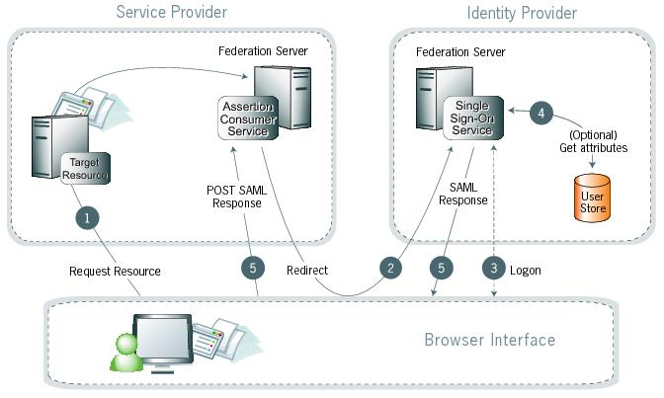
Security Gateway to ICAM Interface SAML Partnership for SSO Using the Security Gateway as Service Provider and the ICAM as Identity Provider
Gateway – Asserting Party
ICAM – Relying Party
The Gateway Application will be integrated with ICAM using the SAML2 protocol for PIV authentication.
The asserting party is the Gateway, also known as service provider (SP), which requests assertions about the subject from the relying party (ICAM), also known as the Identity Provider.

Slide 8
Security Gateway to ICAM Interface (Cont.) SAML SSO Workflow Steps
The following describes a typical SAML SSO workflow, Enterprise passive profile (SP initiated SSO).
User directs browser to the target resource URL.
The relying party checks for a valid existing SSO session for that user and redirects with an authentication request to the asserting party, if no session was found. Optionally, the relying party also includes a destination URL for user redirection post successful authentication as a RelayState.
The IDP SSO Service redirects the user’s browser to the authentication page for collecting their credentials.
Upon successful authentication, user attributes may be fetched from the user store. Would like to pass the same header attributes from eAuth.
The IDP (ICAM) signs the assertion with its digital signature and sends the signed assertion back with a session token. If the relying party had included a RelayState with the authentication request, the asserting party then redirects the user’s browser to the RelayState URL.

Slide 9
Security Gateway to ICAM Interface (Cont.) SAML2 Exchange Example for Step2
2.A The SP generates an appropriate SAMLRequest (and RelayState), then redirects the browser to the SSO Service, using a standard HTTP 302.
302 Redirect
Location:
https://ip.USDAeAuth/SAML2/SSO/Redirect?SAMLRequest=<request>&RelayState=<relaystate> ????
The SAMLRequest may optionally be signed using the SP signing key. For this basic example, it is not.
The RelayState token is an opaque reference to state information maintained at the SP.
Also included is a destination URL for user redirection post successful authentication, as a RelayState
The value of the SAMLRequest parameter is a deflated, base64-encoded and URL-encoded value of an <samlp:AuthnRequest> element:
<samlp:AuthnRequest
xmlns:samlp="urn:oasis:names:tc:SAML:2.0:protocol"
xmlns:saml="urn:oasis:names:tc:SAML:2.0:assertion"
ID="identifier_1" Version="2.0" IssueInstant="2004-12-05T09:21:59"
AssertionConsumerServiceIndex="0">
<saml:Issuer> https://r6portal.wrk.fs.usda.gov/r6portal/saml2/sso
</saml:Issuer>
<samlp:NameIPolicy AllowCreate="true"
Format="urn:oasis:names:tc:SAML:2.0:nameid-format:transient"/>
</samlp:AuthnRequest>
2B. Request the SSO Service at the IP (by the Browser)
According to the HTTP standard, the user agent issues a GET request to the SSO service at the identity provider:
GET /SAML2/SSO/Redirect?SAMLRequest=request&RelayState=token HTTP/1.1
Host:r6portal.fs.usda.gov
Where the values of the SAMLRequest and RelayState parameters are the same as those provided in the SP 302 response.
The SSO service at the IDP processes the <samlp:AuthnRequest> element (by URL-decoding, base64-decoding and inflating the request, in that order) and performs a security check. If the user does not have a valid security context, the identity provider identifies the user with PIV enforcement.

Slide 10
Security Gateway to ICAM Interface (Cont.) SAML2 Exchange Example for Steps 3 to 5
3. The IDP redirects the user’s browser to the authentication page for collecting their credentials.
4. Upon successful authentication, the relying party will also provide the eAuth attributes.
5. The IDP signs the assertion with its digital signature and sends the signed assertion back with a session token to
Gateway (asserting party).
If the relying party had included a RelayState with the authentication request, the asserting party then redirects the user’s
browser to the RelayState URL.
Below is the IDP response with an XHTML form
The SSO service validates the request and responds with a document containing an XHTML form:
<form method="post" action=" https://r6portal.wrk.fs.usda.gov/r6portal/saml2/acs" ...>
<input type="hidden" name="SAMLResponse" value="response" />
<input type="hidden" name="RelayState" value="token" /> ... <
input type="submit" value="Submit" />
</form>
The value of the RelayState parameter has been preserved from step 3.
The value of the SAMLResponse parameter is the base64 encoding of the following
<samlp:Response> element:
<samlp:Response xmlns:samlp="urn:oasis:names:tc:SAML:2.0:protocol" xmlns:saml="urn:oasis:names:tc:SAML:2.0:assertion"
ID="identifier_2" InResponseTo="identifier_1" Version="2.0" IssueInstant="2004-12-05T09:22:05"
Destination=" https://apps.fs.usda.gov/authenticateme/saml2/acs "> <saml:Issuer> https://ip.USDAeAuth/SAML2</saml:Issuer>
<samlp:Status> <samlp:StatusCode Value="urn:oasis:names:tc:SAML:2.0:status:Success"/> </samlp:Status>
<saml:Assertion xmlns:saml="urn:oasis:names:tc:SAML:2.0:assertion" ID="identifier_3" Version="2.0" IssueInstant="2004-12-05T09:22:05">
<saml:Issuer>https://ip.USDAeAuth/SAML2</saml:Issuer> <!-- a POSTed assertion MUST be signed -->
<ds:Signature xmlns:ds="http://www.w3.org/2000/09/xmldsig#">...</ds:Signature>
<saml:Subject> <saml:NameID Format="urn:oasis:names:tc:SAML:2.0:nameid-format:transient"> 3f7b3dcf-1674-4ecd-92c8-1544f346baf8
</saml:NameID> <saml:SubjectConfirmation Method="urn:oasis:names:tc:SAML:2.0:cm:bearer">
<saml:SubjectConfirmationData InResponseTo="identifier_1" Recipient=" https://apps.fs.usda.gov/saml2/acs"
NotOnOrAfter="2004-12-05T09:27:05"/> </saml:SubjectConfirmation> </saml:Subject>
<saml:Conditions NotBefore="2004-12-05T09:17:05" NotOnOrAfter="2004-12-05T09:27:05"> <saml:AudienceRestriction>
<saml:Audience>https://sp.example.com/SAML2</saml:Audience> </saml:AudienceRestriction> </saml:Conditions>
<saml:AuthnStatement AuthnInstant="2004-12-05T09:22:00" SessionIndex="identifier_3"> <saml:AuthnContext>
<saml:AuthnContextClassRef> urn:oasis:names:tc:SAML:2.0:ac:classes:PasswordProtectedTransport </saml:AuthnContextClassRef>
</saml:AuthnContext> </saml:AuthnStatement> </saml:Assertion> </samlp:Response>
The SAML response will contain the same user attributes as the existing eAuth headers.

Slide 11
Security Gateway to ICAM Interface (Cont.) Security Requirements for SAML
Create trust between two parties (Security Gateway and ICAM)
All SSO transactions and communications between the asserting party and the relying party and are to be SSL encrypted.
The relying party (ICAM) software will verify the asserting party’s digital signature and block a user login if the presented digital signature within an assertion is a mismatch.
All the current eAuth user attributes will be provided by the relying party (ICAM).
ICAM will import published data about the SECURITYPORTAL_SP.XML to establish the SP trust.
ICAM will send LDAP Attributes as Claims.
ICAM will map LDAP attributes with outgoing claim types to create claim rules.
ICAM provides the secure hash algorithm level to use for the SP (SHA-1 or SHA-2).
ICAM will provide all the current eAuth user attributes
ICAM provides an SSL certificate (server authentication certificate that proves its identity) for the SP from a Certificate Authority (recommend well-known public CA).
PKI for encrypting with the public key passed to the clients and decrypting with the private key.
- Common Name — The fully-qualified domain name (FQDN) — or URL
- RSA SChannel Cryptographic Provider, Bit length 2048

Slide 12
Security Gateway to ICAM Interface (Cont.) Information Provided to the Relying Party (ICAM)
The base Dev URL for the (SP) service provider.
https://r6portal.wrk.fs.usda.gov
The assertion consumer service URL.
https://r6portal.wrk.fs.usda.gov/r6portal/saml2/acs?so=00D
The remote (SPID) Service Provider Identification. https://r6portal.wrk.fs.usda.gov.
The SP public key to be used for encrypting assertion attributes.
Will need also the re-direct URL from the relying party. ie.
https://ip.USDAeAuth/SAML2/SSO/Redirect?SAMLRequest=<request>&RelayState=<relaystate>

Slide 13
SPA Application PIV Authentication Flow with OpenID Connect and SAML2 (Using the Relay State)
Browser
SPA Application
Application Resource
Security Portal - SAML Service Provider
ICAM- Identity Provider
Get ClientURL
Main Application View
GET https://r6portal.wrk.fs.usda.gov/r6portal/saml2/sso?audience=API_IDENTIFIER&scope=SCOPE&response_type=token|id_token|id_token token&client_id=YOUR_CLIENT_ID&redirect_uri=https://YOUR_APP/callback&state=STATE&nonce=NONCE&connection=Connection
302 Redirect + SAML Request + RelayState
https://ip.USDAeAuth/SAML2/SSO/Redirect?SAMLRequest=<request>&RelayState=<relaystate>
ICAM Authentication Request
ICAM Authentication Response
Client Redirect View (embedded SAML Response)
Post /AuthResponce + SAML Responce
HTTP/1.1 302 https://YOUR_APP/callback#access_token=TOKEN&state=STATE&token_type=TYPE&expires_in=SECONDS
https://YOUR_APP/callback#access_token=TOKEN&state=STATE&
token_type=TYPE&expires_in=SECONDS
Get /api/Resource
Resource
Authorized

Slide 14
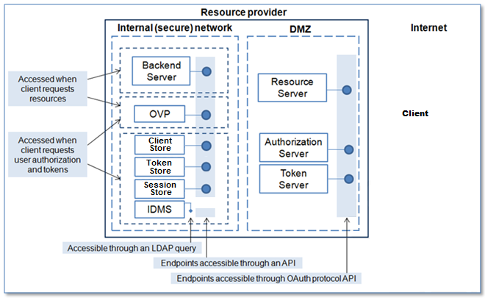
Security Gateway Components in the Preferred Network Zones
Accessed in the Internal Network when requesting resources:
- Backend Server
- REST API OAuth Validation Point: Validation of incoming requests
Accessed in the Internal Network when invoking client requests, user authorization and tokens
- REST API Clientstore for clien_ids storage
- REST API Tokenstore Where all tokens are stored
- Session store for calls to Clientstore and Tokenstore
OAuth 2.0 Authorization Framework: http://tools.ietf.org/html/rfc6749

Slide 15
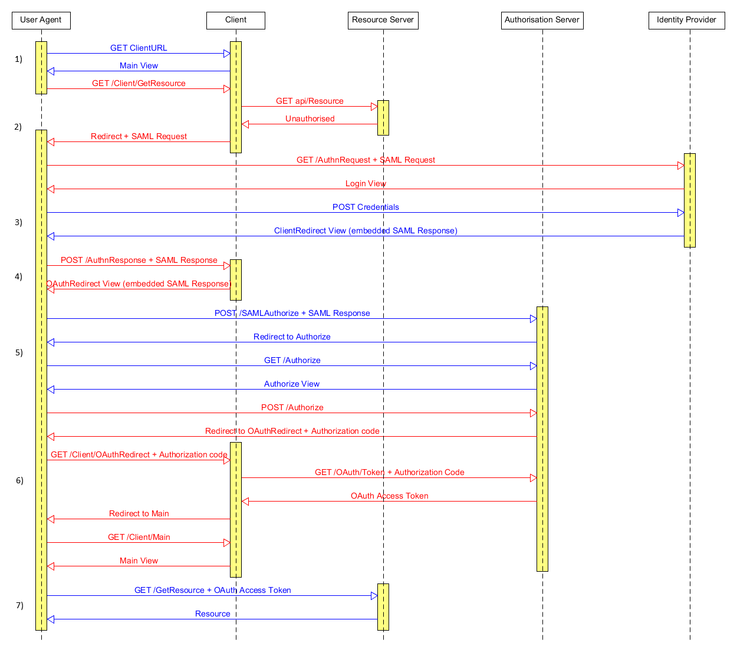
Example of a Portal Web App (API Driven) Authenticating via SAML and OAuth2
Browser
Portal – SAML Service Provider
OAuth2 Authorization Server
ICAM Identity Provider

Slide 16
Security Considerations
User access is not confined to the network perimeter.
Token and assertion replays.
Web gateways can protect against malware.
Classify data over SSL sent out of the organization and uncover shadow IT.
Provide application logs and access points.
Uploading documents.
Certificates.
Rolling out new software to every API endpoint.
API driven network zone componentization.
Application SDKs for web, SPA, mobile and different technologies.
Security flows, JWT tokens and assertion types.
JWT single point generation and validation.
Traditional eAuth vs API driven application security.

