Slide 1
AUTOTEST
  Martin J. Bligh mbligh@google.com
  Andy Whitcroft apw@shadowen.org
  Steve Howard showard@google.com
  John Admanski jadmanski@google.com
  + many others
  http://autotest.kernel.org/
  http://test.kernel.org
Notes:
Theme created by
Sakari Koivunen and Henrik Omma
Released under the LGPL license.

Slide 2
Autotest Objectives
Fully automated system testing
  Functional
  Regression
  Performance
  Cluster
  Test suites
Automate kernel development
  Debug
  Profile
  Share and communicate
  Search for data
Visualise, analyse, publish, share
  Matrixes
  Graphs
  Dashboards
  Email

Slide 3
Why fully automated testing for the Linux Kernel?
Changes in the development model (eg. no 2.7 tree)
Increasing pace of development
Increasing diversity of hardware
Linux more broadly deployed, higher expectations
People are slow, and either expensive or unreliable.
Automated testing is cheap, and fast.
Consistent, available testers that don't disappear.
Good debug setups - serial consoles, etc.
Filter hardware problems by replication of machines.

Slide 4
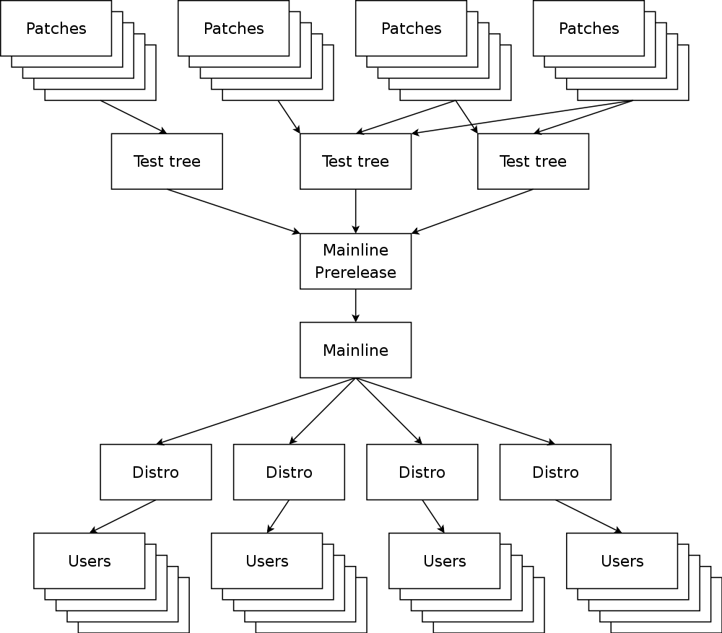
Code flow of the Linux Kernel

Slide 5
Why test upstream?
Test early. Test often.
Prevent replication of bad code into other code bases
Fewer users are exposed to the bug
Code is still fresh in the authors mind
Change isn't interacting with subsequent changes
Code is at the top of the stack - easy to remove.
You're going to hit the same bugs eventually anyway ...
Goal is to run the SAME tests upstream as downstream
Kernel is hard to unit test
Huge number of developers. Loose methodology

Slide 6
Testing isn't just running tests
Testing is about finding and FIXING problems; running tests is the easy part. We need:
Clear PASS / FAIL.
Performance statistics (multiple aspects per test)
Warnings for unusual events (observed errors, etc)
Profiling data (oprofile, /proc files, sar, vmstat, ...)
Reproducible situations
Hand off to other teams, developers, vendors, etc.
Efficient machine sharing, access control
Capture procedural knowledge in a system, not a person

Slide 7
State of the union
Testing done too late, in isolated silos
Hardware vendors, Distros, ISVs
Harnesses vs test suites:
  LTP, STP, ABAT/autobench.
Developers are busy
Fixing bugs is boring - facilitate
Waste time doing repetitive tasks
Poor communication on problem repro

Slide 8
What needs to change?
We are great at sharing some code
Terrible at sharing tests, and test results
Open, pluggable client, share tests (autotest)
More tests, more machines, further upstream
Collation of results from multiple sources (tko)
Push results back to community (email + web)
Bring together hardware, OS, userspace testing
FIX THE BUGS!

Slide 9
A closer look inside
So ... how does
this thing work?

Slide 10
Autotest vs Other harnesses
ONE harness to do performance, stress, multi-machine testing, etc.
Consistent results & logging structure
Web and CLI front end
Web and CLI analysis backend
Shared machine pool & scheduler
EASY to write new tests: low entry barrier
Open source – share tests with vendors
Control files are powerful!
Proven scaling – 6000 machines+

Slide 11
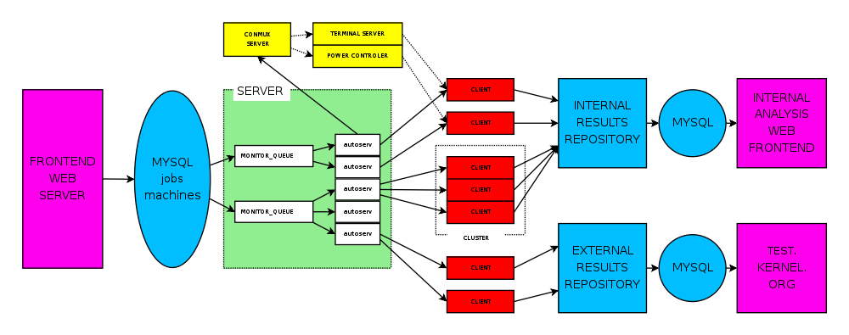
Structural overview of autotest

Slide 12
Autotest Client
Client was the original part of autotest
Runs on the machine under test
Pluggable – can be run directly by developer, etc.
$ bin/autotest <control file>

Slide 13
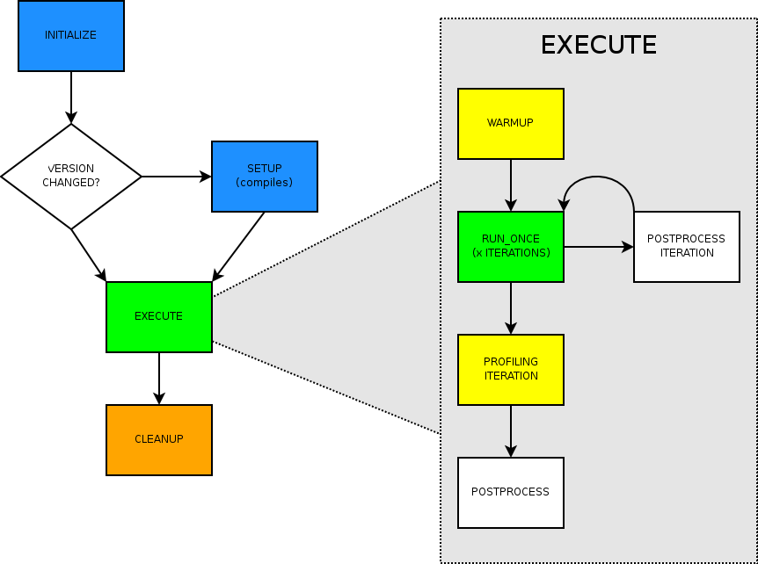
Anatomy of a test

Slide 14
Autotest server
Server side consists of:
  Mirror / trigger engine
  Scheduler and job queueing
  One autoserv process per server-side job
Server capabilities
  Install client from scratch, reboot, flash BIOS
  Run multi-machine jobs
  Machine health monitoring (verify, repair)
  Results collection
$ server/autoserv -m mach1,mach2 -c <control file>

Slide 15
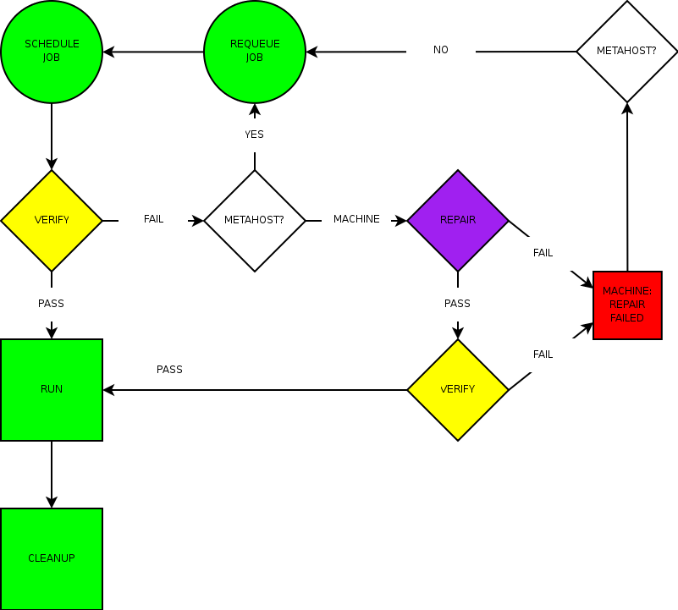
Day in the life of a job

Slide 16
Autotest design goals
Modular, simple, well defined APIs.
Separate tests from core
Powerful and flexible.
Simple - low barrier to entry for test development
Distributed, scalable development and maintainership
Maintainable code
Robust, consistent results. Good error handling.
Isolate different failure types.
Results format is consistent, human readable, and easily machine-parsible.

Slide 17
What is test.kernel.org (tko)?
A collation, publication, and analysis engine.
Parse log files into a database
Draw graphs and pretty pictures
The “back end” of autotest
Can take collated input from many sources.

Slide 18
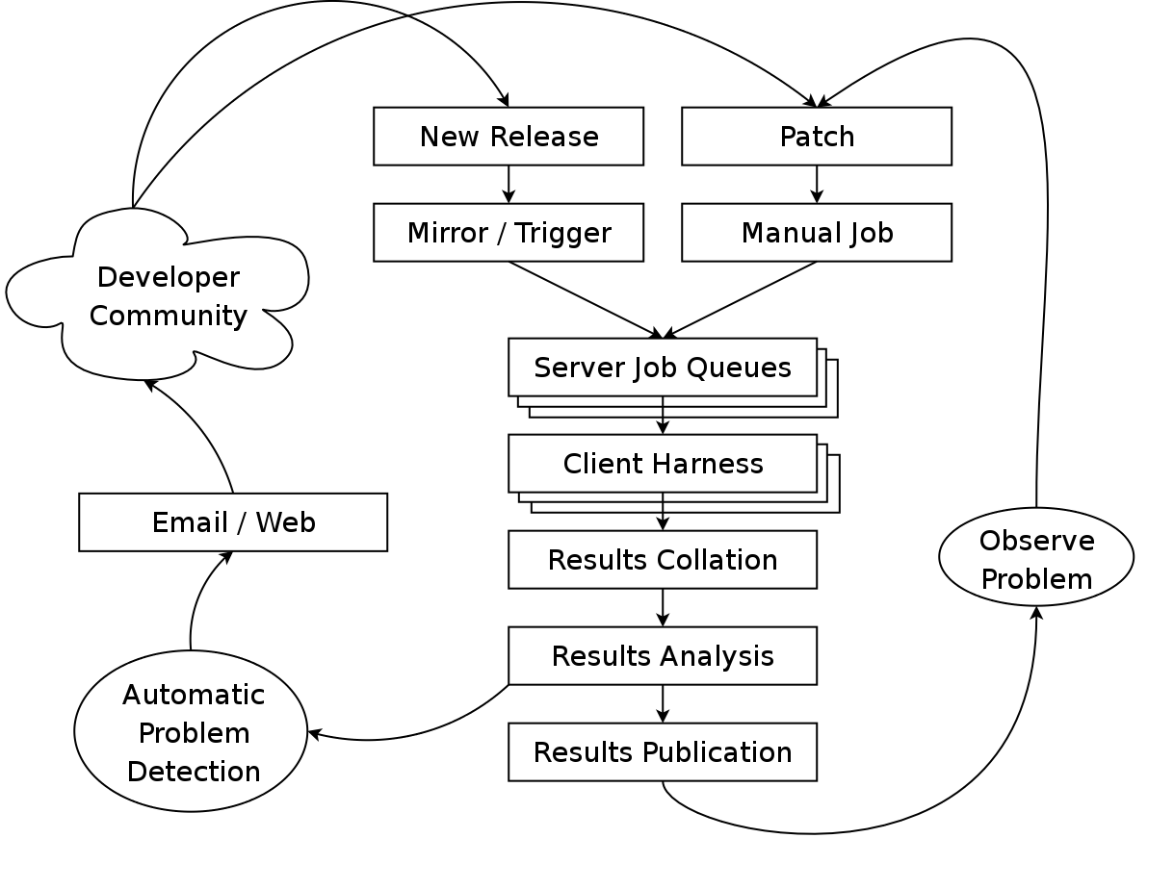
TKO (test.kernel.org) workflow

Slide 19
What tests are supported?
This is the list of external client tests. We also support custom tests
Tests / Testsuites
aborttest, aio_dio_bugs, aiostress, barriertest, bash_shared_mapping, bonnie, btreplay, container_functional, cpu_hotplug, cpuset_tasks, cyclictest, dacapo, dbench, dbt2, disktest, download, fio, fs_mark, fsdev, fsfuzzer, fsstress, fsx, hackbench, interbench, iosched_bugs, iozone, iperf, ipv6connect, isic, kernbench, kernelbuild, kvmtest, libhugetlbfs, linus_stress, lmbench, lsb_dtk, ltp, memory_api, netperf2, netpipe, parallel_dd, perfmon, pi_tests, pktgen, posixtest, profiler_test, reaim, real_time_tests, rmaptest, rttester, scrashme, selftest, shrink_slab, signaltest, sleeptest, sparse, spew, stress, sysbench, tbench, tiobench, tsc, unixbench, uptime, xmtest
Profilers
iostat, lttng, oprofile, sar, ktrace, catprofile,
lockmeter, mpstat, readprofile, vmstat, blktrace
It only takes about 10 minutes to wrap a test

Slide 20
Inside the sausage factory
So ... what do these
control files look like?
And what about tests?

Slide 21
Control files are powerful
Every test comes with a sample control file
  job.run_test('dbench')
Most have optional arguments
  job.run_test('dbench', nprocs=4, tag='small')
  job.run_test('dbench', nprocs=32, tag='large')
Enable profilers
  job.profilers.add('oprofile', 'ICACHE_MISSES:100000')
  job.run_test(kernbench)
  job.profilers.delete('oprofile')
Flow control
for threads in (2, 64, 1024):
  job.run_test('kernbench', threads, 5, tag=str(threads))

Slide 22
Control files are powerful
Handle filesystems
  p = job.partition('/dev/hda2', job.tmpdir)
  p.mkfs('ext4', args='-O ^has_journal')
  p.mount(args='-o nobh')
  try:
  job.run_test('fsx', dir=job.tmpdir, tag='ext3')
  finally:
  fs.unmount()
Run multiple tests in parallel
  def kernbench():
  job.run_test('kernbench', iterations=2, threads=5)
  def dbench():
  job.run_test('dbench')
  job.parallel([kernbench], [dbench])

Slide 23
Control files are powerful
Handle filesystems
  p = job.partition('/dev/hda2', job.tmpdir)
  p.mkfs('ext4', args='-O ^has_journal')
  p.mount(args='-o nobh')
  try:
  job.run_test('fsx', dir=job.tmpdir, tag='ext3')
  finally:
  fs.unmount()
Build a new kernel and reboot
  def step_init():
  job.next_step([step_test])
  testkernel = job.kernel('2.6.16')
  testkernel.patch('/tmp/fix_everything.patch.bz2')
  testkernel.config('http://mbligh.org/config/config.up')
  testkernel.build()
  testkernel.boot()
  def step_test():
  job.run_test('kernbench', threads=2, iterations=5)

Slide 24
Example test - dbench
import os, re
from autotest_lib.client.bin import utils, test
class dbench(test.test):
version = 3
# http://samba.org/ftp/tridge/dbench/dbench-3.04.tar.gz
def setup(self, tarball='dbench-3.04.tar.gz'):
tarball = utils.unmap_url(self.bindir, tarball, self.tmpdir)
utils.extract_tarball_to_dir(tarball, self.srcdir)
os.chdir(self.srcdir)
utils.system('patch -p1 < ../dbench_startup.patch')
utils.system('./configure')
utils.system('make')
def run_once(self, dir='.', nprocs=None, seconds=600, args=''):
if not nprocs:
nprocs = self.job.cpu_count()
loadfile = os.path.join(self.srcdir, 'client.txt')
dbench = os.path.join(self.srcdir, 'dbench')
cmd = '%s %s %s -D %s -c %s -t %d' % (dbench, nprocs, args,
dir, loadfile, seconds)
self.results = utils.system_output(cmd, retain_output=True)
def postprocess_iteration(self):
pattern = re.compile(r"Throughput (.*?) MB/sec (.*?) procs")
(throughput, procs) = pattern.findall(self.results)[0]
self.write_perf_keyval({'throughput':throughput, 'procs':procs})

Slide 25
This is just an introduction
Server vs. client side control files & tests
Comparisons across releases
Automated bisection chop search
Better failure capture / debug tools
  sysinfo
  Netconsole, Crashdump
  Hardware probes, fault injectors
  Thermal, power consumption, etc.

Slide 26
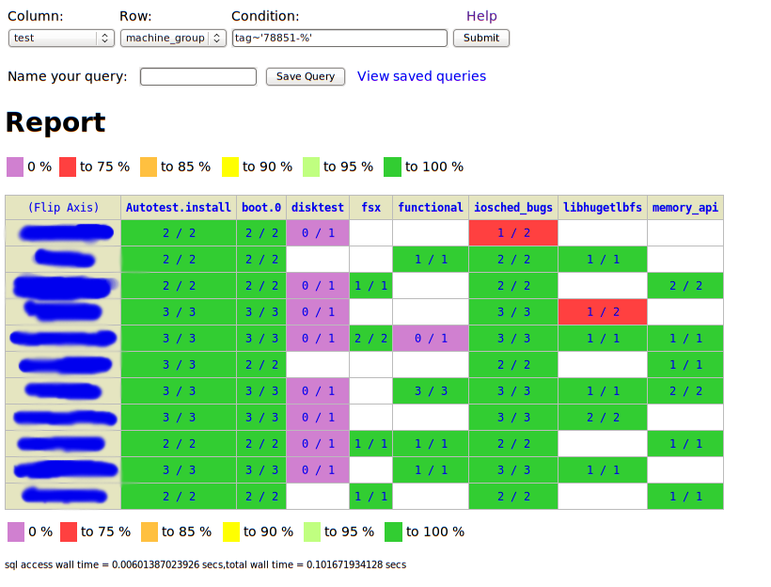
Results analysis

Slide 27
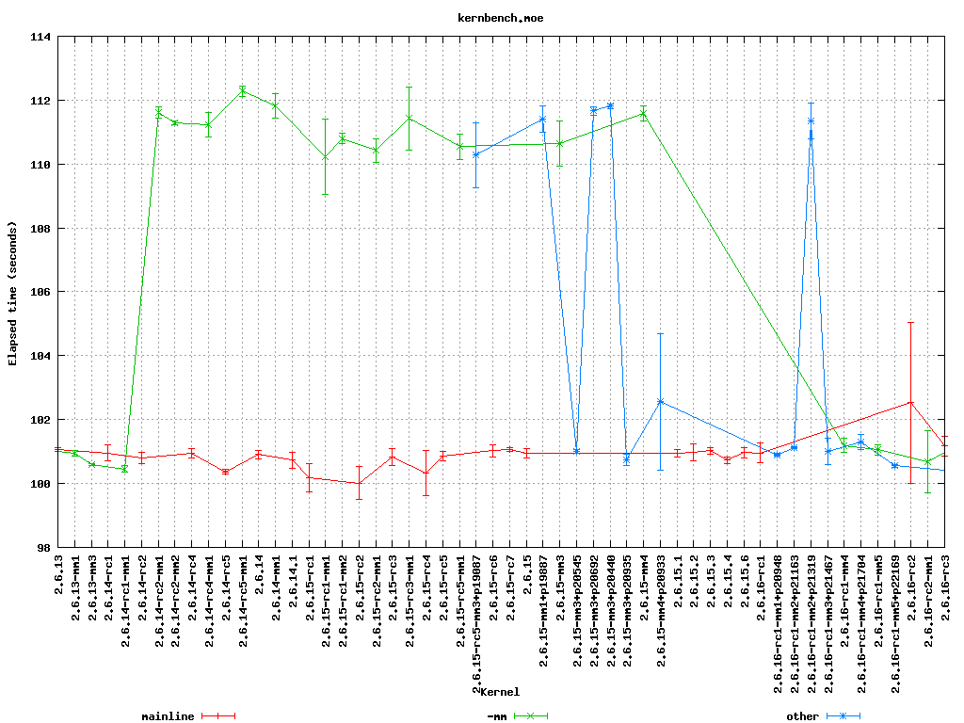
Performance analysis

Slide 28
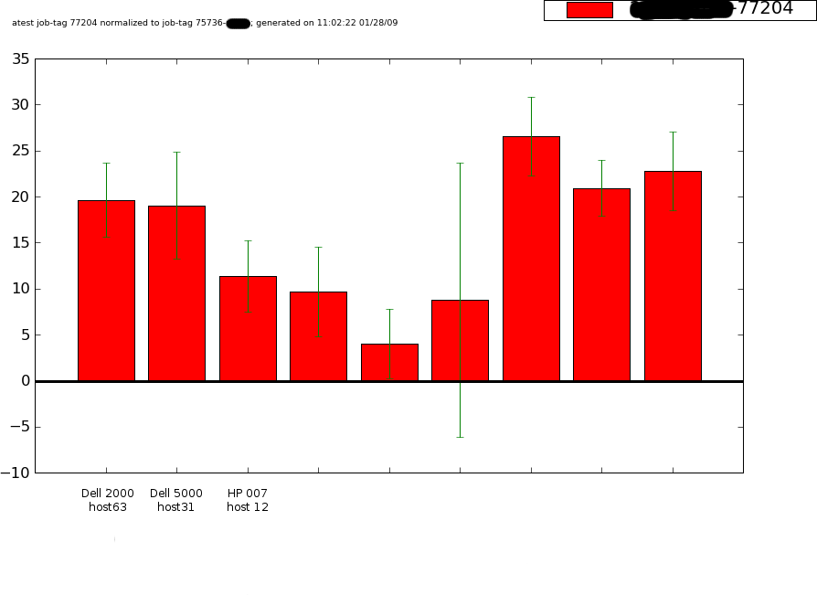
Performance analysis

Slide 29
Why Python?
Easy to learn, simple syntax
Easy to maintain, consistent style
Exception handling
Powerful
Has a wide library of modules to leverage
The spacing "issue"

Slide 30
Summary
Automate testing
Move testing upstream
Autotest is a powerful modular system
  Pluggable into any harness, or standalone
  Flexible control scripts in Python
  Tests, profilers, multi-machine, filesystems
  Performance, stress, functional
test.kernel.org collates, analyses and publishes

Slide 31
Conclusion
Thanks to ...
  The Autotest development community
  Google, IBM, OSL
References
  http://autotest.kernel.org/
  http://test.kernel.org

