Slide 1
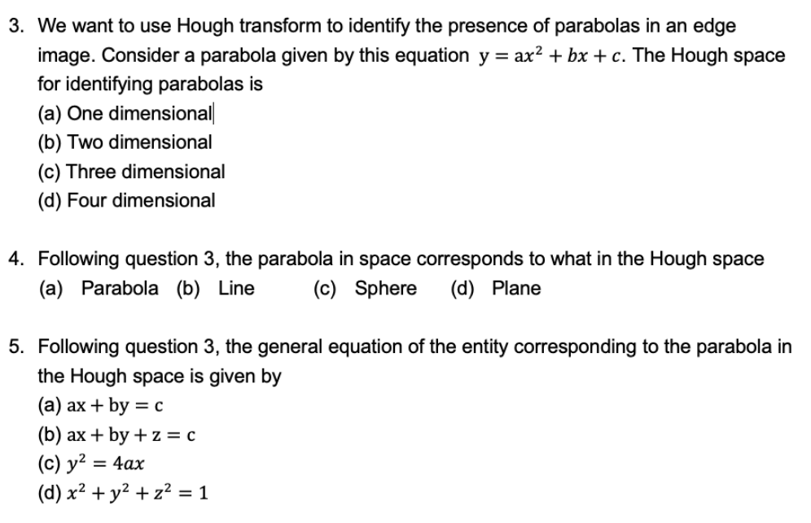

Slide 2
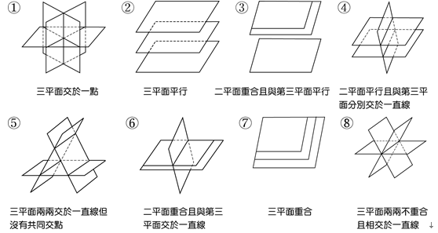



$y=ax^{2}+bx+$c
$$x,y∈R$$
$$a=\frac{y}{x^{2}}−\frac{b}{x}−\frac{c}{x^{2}} ⇒a+α_{1}b+β_{1}c=γ_{1}{ ∀α}_{i}{、β}_{i}{、γ}_{i}∈R$$
$$b=\frac{y}{x}−ax−\frac{c}{x}⇒α_{2}a+b+β_{2}c=γ_{2}$$
$c=y−ax^{2}−bx$ $⇒α_{3}a+β_{3}b+c=γ_{3}$
$find a 、b、$ c

Slide 3
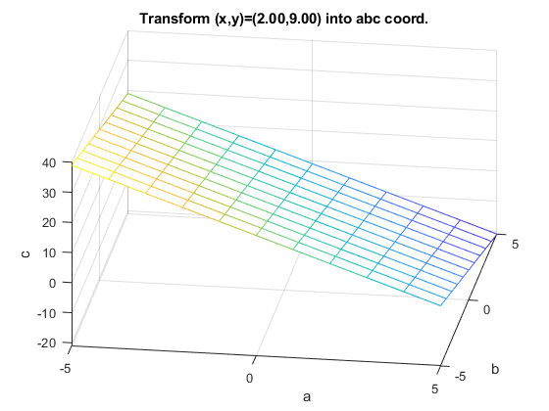
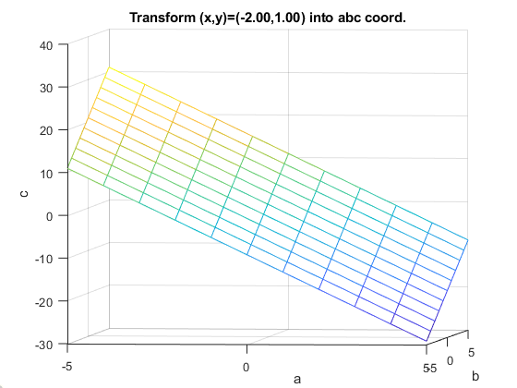
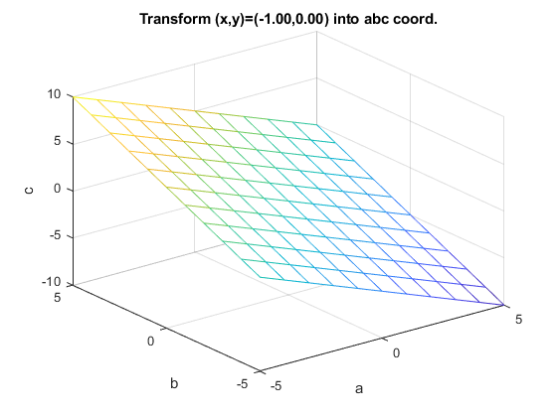
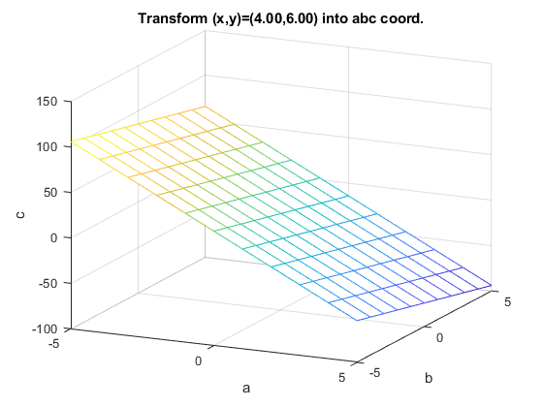



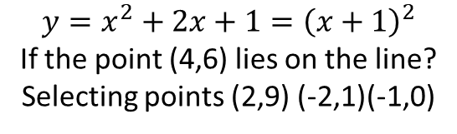


$$c=9−4a−4b$$
$$c=1−4a+2b$$
$$example 1.$$
$$c=0−1a+1b$$
$$c=4−36a−6b$$
$y=x^{2}+2x+1={\left(x+1\right)}^{2}$
If the point (4,6) lies on the line?
Selecting points (2,9) (-2,1)(-1,0)
$c=y−ax^{2}−bx$

Slide 4
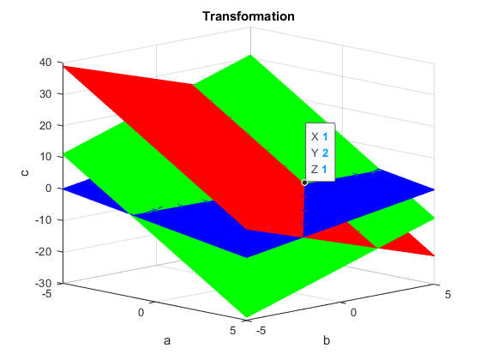
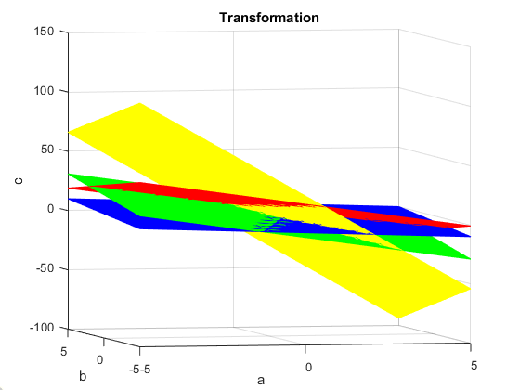

Slide 5
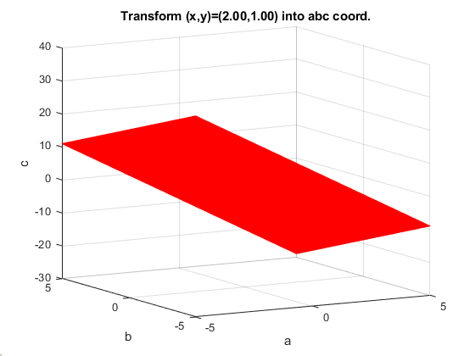
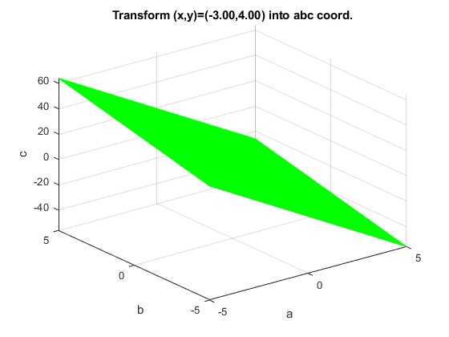
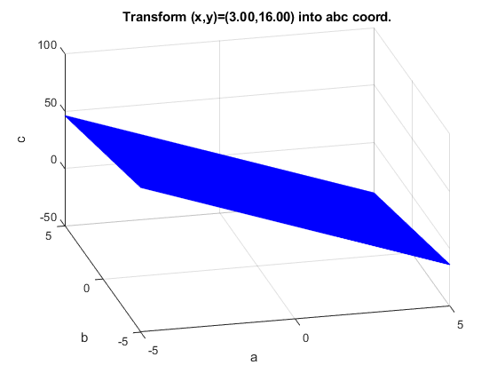
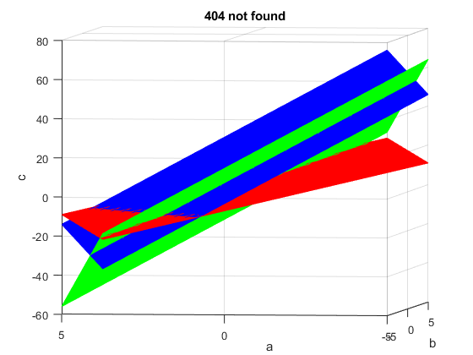

$example 2.$ a, b, c are unknown
Selecting points (2,1) (-3,4)(3,16)

Slide 6
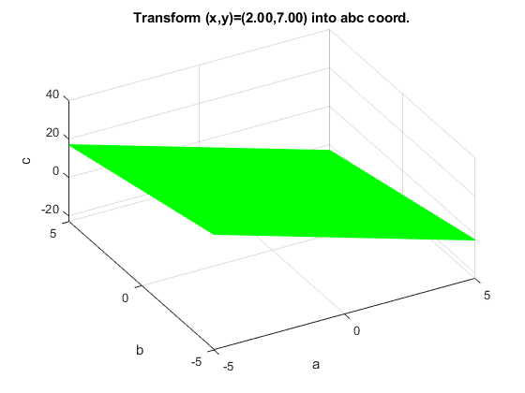
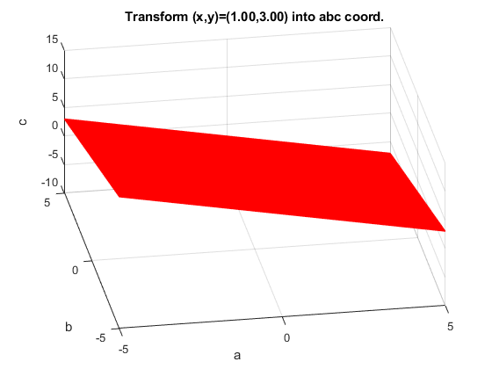
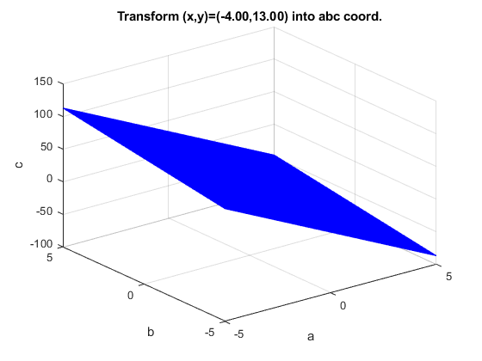
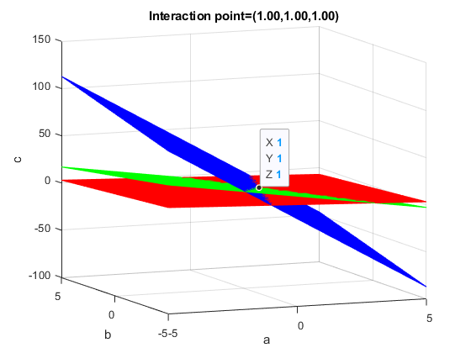

$example 3.$ a, b, c are unknown
Selecting points (1,3) (2,7)(-4,13)

