Slide 1
Mesh negative Jacobian, issues and recommendations for autotwin
Yaohui Wang, Robert Morris University
wangy@rmu.edu

Slide 2
Negative jacobian (scaled jacobian) found in mesh
A 3D all-hex human head model (All_Hex_Dec.inp), pediatric subject D from UnivWisconsin is using to run various simulations with Abaqus
173 elements were found with negative jacobian (scaled jacobian) values by Cubit
Cubit>quality hex all scaled jacobian global high 0 draw mesh
ERROR: Malformed element.
Hex quality, 173 elements:
------------------------------------
Function Name Average Std Dev Minimum (id) Maximum (id)
--------------- --------- --------- ------------------- ------------------
Scaled Jacobian -1.684e-01 1.554e-01 -6.802e-01 (1090373) -3.747e-03 (904387)
------------------------------------
Finished Command: quality hex all scaled jacobian global high 0 draw mesh

Slide 3
How does Abaqus handle mesh quality?
Abaqus build-in mesh verify tool doesn’t calculate jacobian directly
It has shape metrics (corner angle and aspect ratio), size metrics (edge sizes and stable time increment)
The analysis checks gives errors and warnings
Abaqus simulations can run into ‘negative jacobian’ error in simulation prerun process.
It refers to negative volume

Slide 4
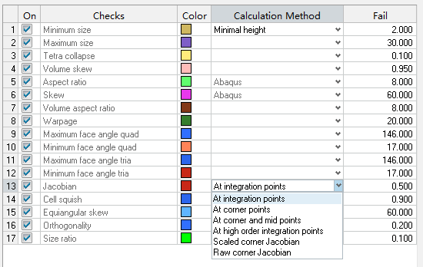
How does Hypermesh handle mesh quality
The jacobian threshold was set to be 0.1 (default value is 0.05) in Hypermesh when model was developed by Sushan
The jacobian in Hypermesh is calculated at integration point(s) by default
There’s no element found with negative jacobian when calculated at integration points

Slide 5
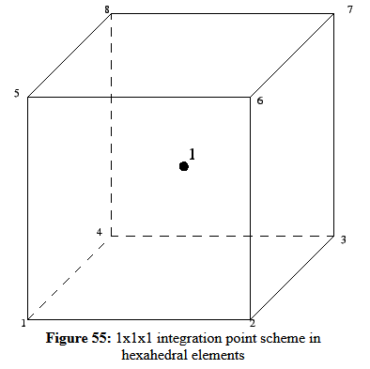
Integration point(s)
Element type is C3D8R, ‘R’ stands for reduced integration in Abaqus (1 integration point)
The element is less stiff in bending
Results are more accurate at integration point
https://web.mit.edu/calculix_v2.7/CalculiX/ccx_2.7/doc/ccx/node27.html

Slide 6
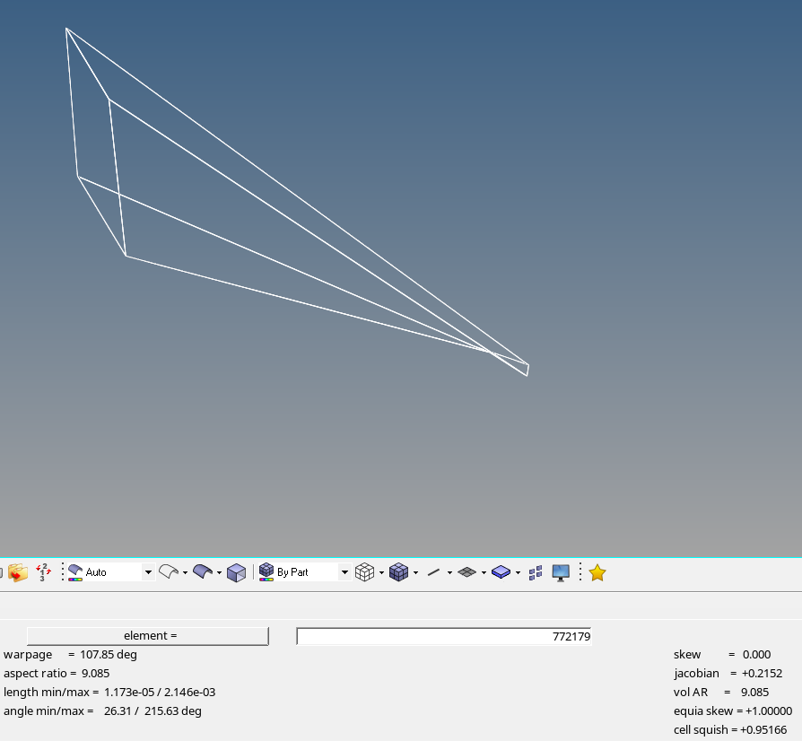
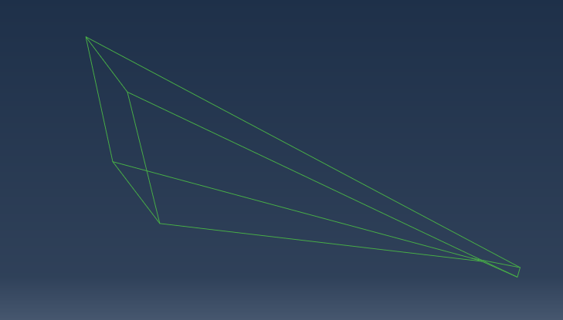
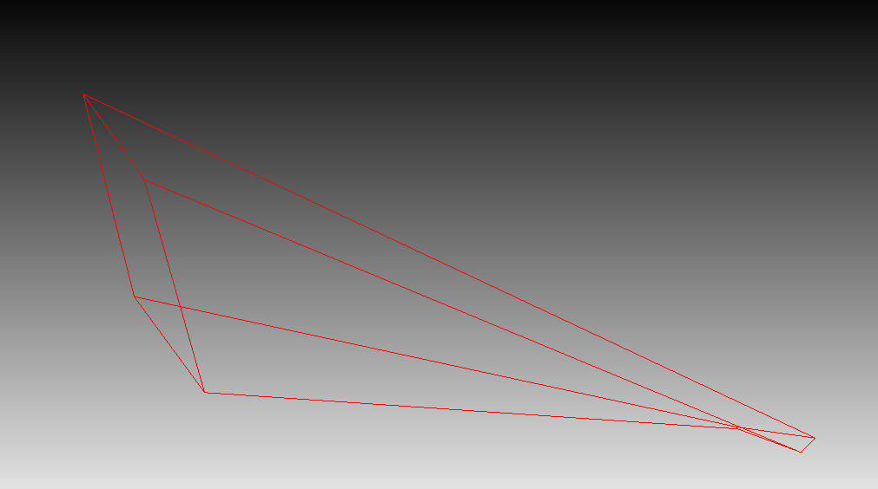
Example element with negative jacobian
Element ID: 772179, distorted element showing positive jacobian when calculated at integration point
Hypermesh
Abaqus
Cubit
Min/Max angle: 26.31 / 155.10, Aspect ratio: 9.09
Geometric deviation factor: NA
Stable time increment: 1.38e-07, Max frequency: NA
Shortest/Longest edge: 2.36e-04 / 0.00215, Analysis checks: Warning
Cubit>quality hex 772179 jacobian global high -0.1 draw mesh
ERROR: Malformed element.
Finished Command: quality hex 772179 jacobian global high -0.1 draw mesh

Slide 7
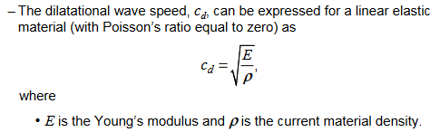
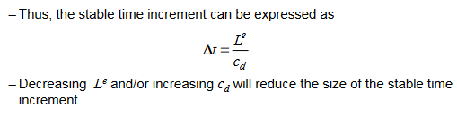
Optimization for mesh
https://imechanica.org/files/0-overview%20Explicit.pdf
An important metric in this model is the stable increment time
Determines if we can get reasonable results within reasonable time
It depends on the element size, material stiffness and density

