Slide 1
Learning-based Vehicle Calibration for Longitudinal Dynamic
Cristian Gariboldi ~ Pix Moving ~ Autonomous driving department

Slide 2
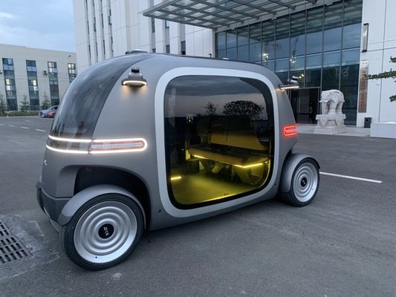
Robobus ~ Level 4 autonomous vehicle

Slide 3
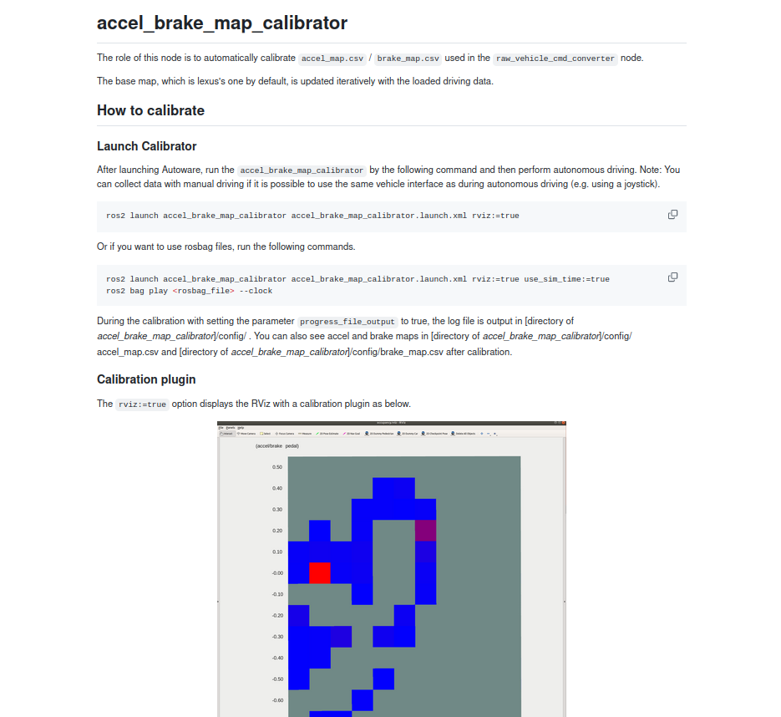
Autoware Calibration Node

Slide 4
Data Collection
2 scenarios:
1) Braking
2) Throttling
For each scenario there are different configurable sub-scenarios depending on velocity and brake/throttle levels

Slide 5
Data Preprocessing
1) Pitch compensation:
2) Consistency threshold:
3) Mean filter:
4) Outliers removal:

Slide 6
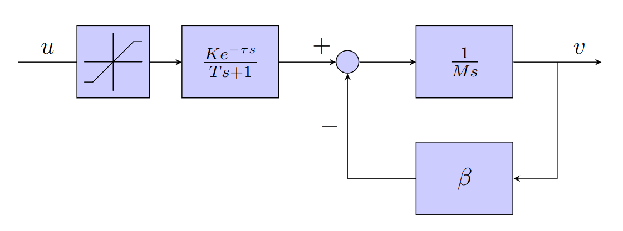
Models Design
1) Grey-box Linear Model

Slide 7
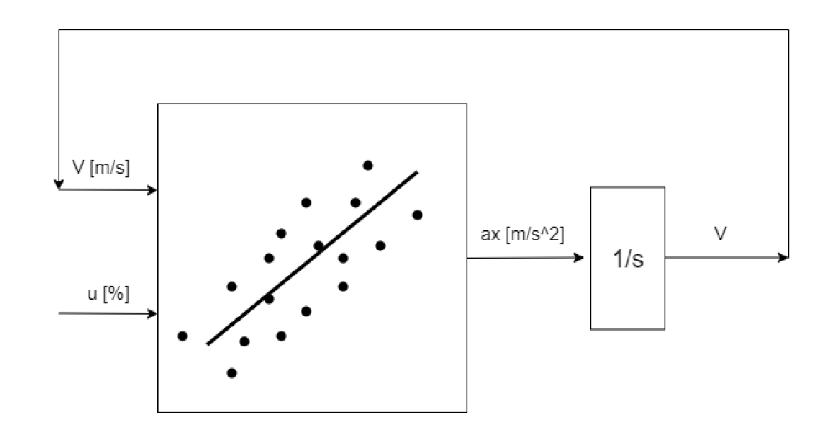
Models Design
1) Black-box Linear Model

Slide 8
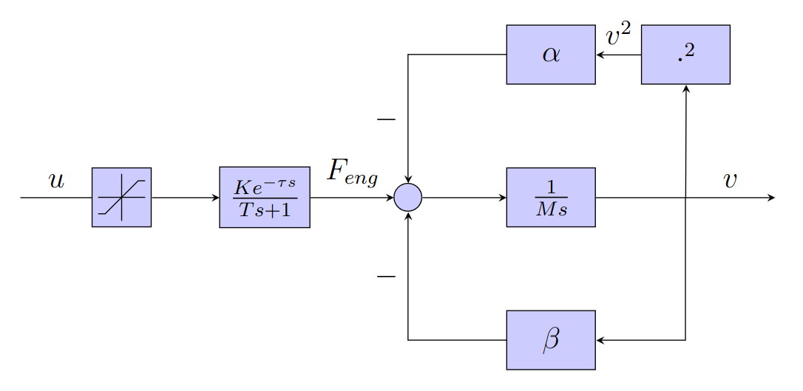
Models Design
1) Grey-box Non-Linear Model

Slide 9
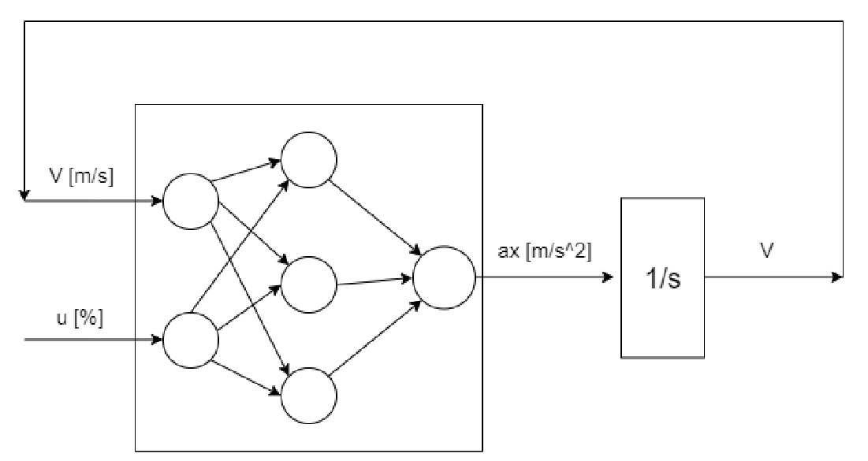
Models Design
1) Black-box Non-Linear Model

Slide 10
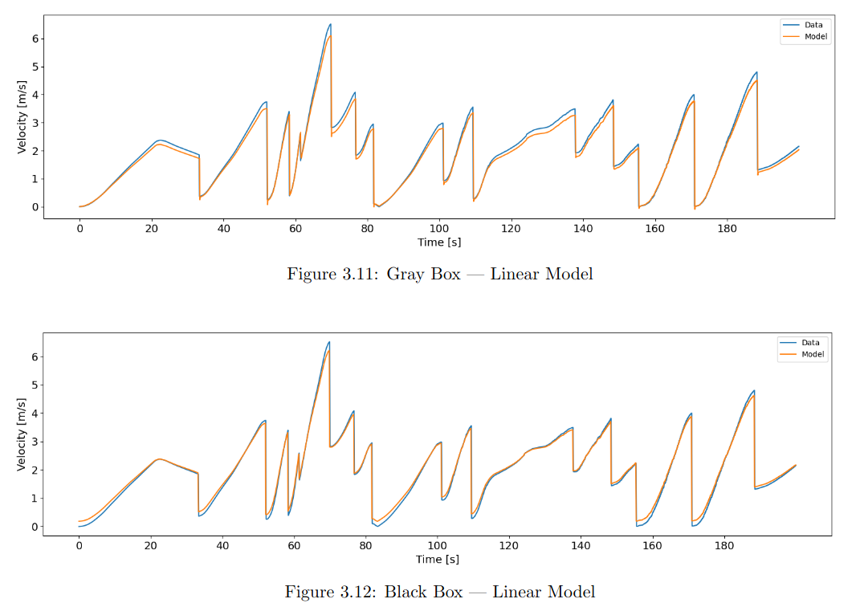
Results ~ Linear Models

Slide 11
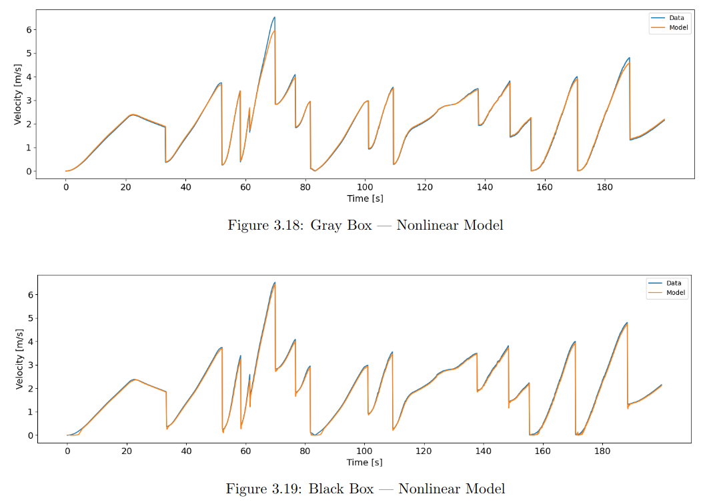
Results ~ Non-Linear Models

Slide 12
Results ~ Metrics

Slide 13
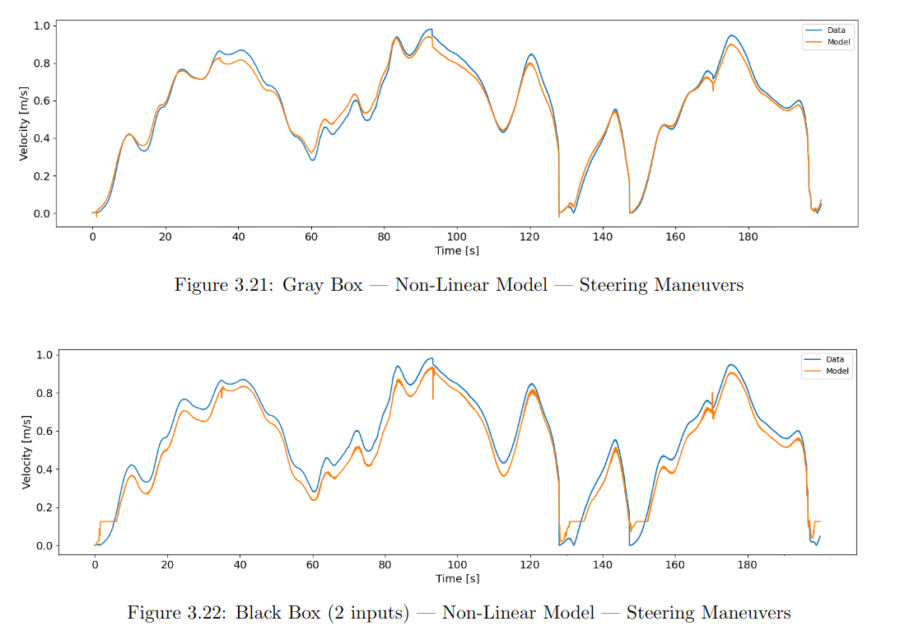
Results ~ Non-Linear Models ~ Steering Maneuver

Slide 14
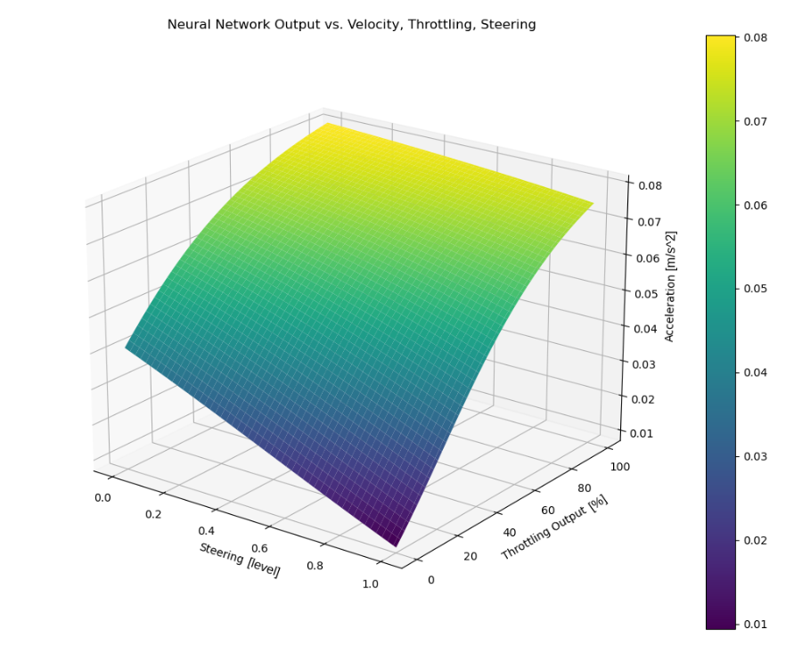
Steering Friction Force
When steering angle increases, acceleration decreases for constant throttle level due to a higher friction force which has to be compensated

Slide 15
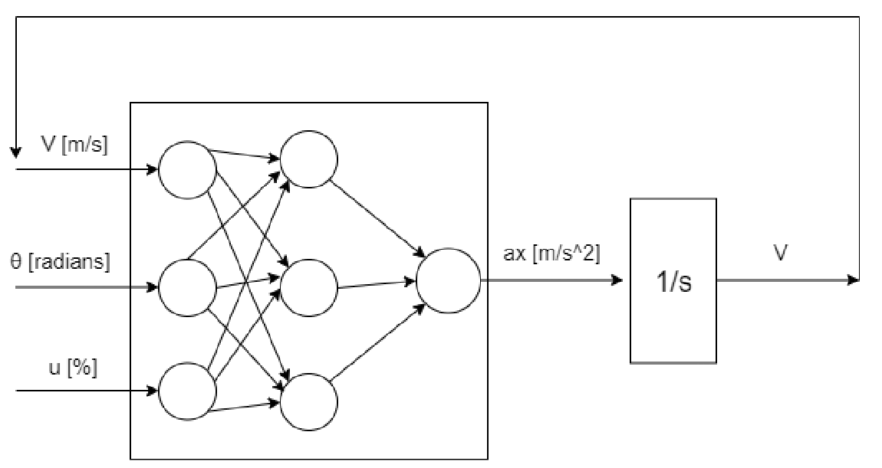
Solution ~ Enlarged Neural Network

Slide 16
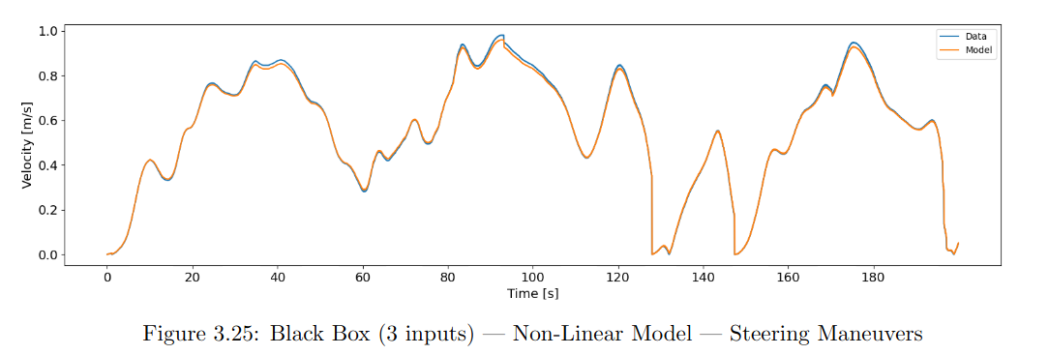
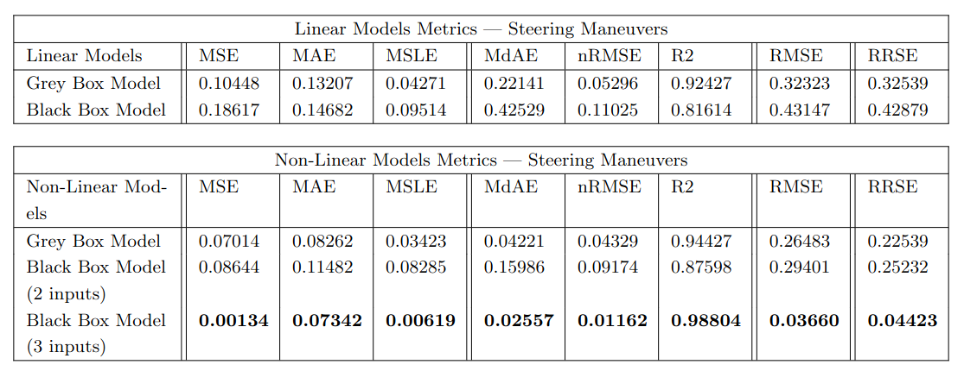
Results ~ Steering Maneuver

Slide 17
Advantages of Black Box Model
1) It is data-driven (not first principle based), so it can be used for a wide range of different vehicles, with different dynamics and transmission systems
2) It is very easy to build and to use, you just need to collect data and the neural network finds the model by itself
3) It can be easily improved and adapt to different scenarios by increasing the number of inputs of the neural network (such as steering angle, pitch angle etc.)

Slide 18
Tutorial ~ How to use?
1) Clone the repository, build the package, install the required libraries

Slide 19
Tutorial ~ How to use?
2) Launch Autoware

Slide 20
Tutorial ~ How to use?
3) Launch “collection_launch.py”

Slide 21
Tutorial ~ How to use?
4) Collect data

Slide 22
Tutorial ~ How to use?
5) Collection status visualization

Slide 23
Tutorial ~ How to use?
6) Data storage

Slide 24
Tutorial ~ How to use?
7) Launch training and visualization

Slide 25
Tutorial ~ How to use?
8) Calibration maps storage

Slide 26
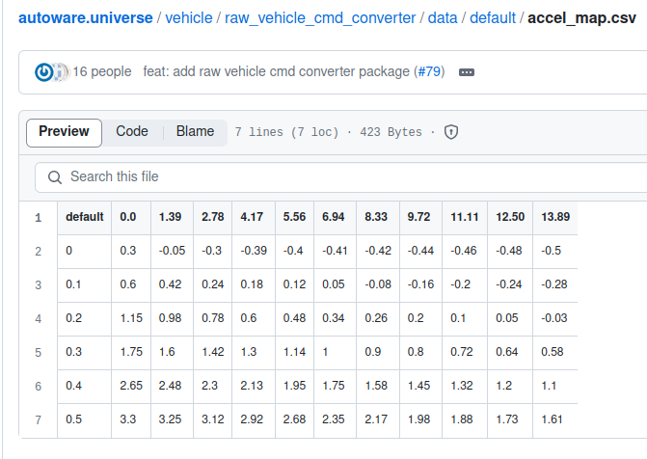
Tutorial ~ How to use?
8) Maps inspection

Slide 27
Tutorial ~ How to use?
PART 2: Steering Dynamic

Slide 28
Tutorial ~ How to use?
1) Launch “calibration_steering_launch.py”

Slide 29
Tutorial ~ How to use?
2) Collect data

Slide 30
Tutorial ~ How to use?
3) Collection status visualization and data storage

Slide 31
Tutorial ~ How to use?
4) Launch training and visualization

Slide 32
Tutorial ~ How to use?
5) Calibration maps storage

Slide 33
Tutorial ~ How to use?
Additional information

Slide 34
Tutorial ~ How to use?
1) This software is compatible with Autoware, so always remember to source it and launch it

Slide 35
Tutorial ~ How to use?
2) When launching the file to collect data, pay attention to data_monitor

Slide 36
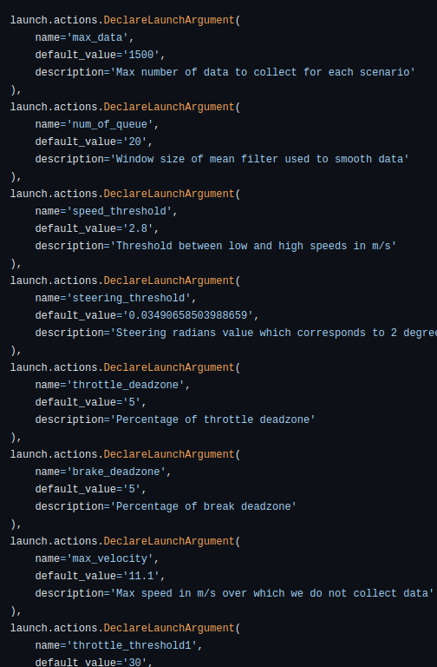
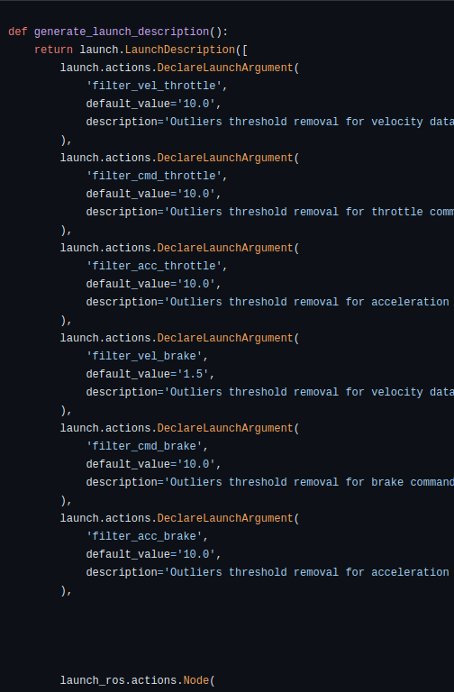
Tutorial ~ How to use?
3) Configurable parameters

Slide 37
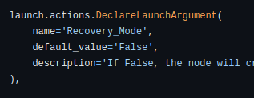
Tutorial ~ How to use?
4) “Recovery_Mode” parameter

