Slide 1
WEEK 1
Data, AI & You
"Data as the New Gold & AI as the Data Specialist"

Slide 2

Week 1: Activity 1
Access SenseiiWyze
Access SenseiiWyze
Log in to the SenseiiWyze platform
Navigate to the assessment section
Prepare for your data exploration journey
10 minutes

Slide 3
Week 1: Activity 2
Complete Big 5 (OCEAN) Assessment
Complete Big 5 (OCEAN) Assessment
Take the personality assessment honestly because it evaluates your:
Openness: Creativity, curiosity, willingness to try new things
Conscientiousness: Organization, reliability, follow-through
Extraversion: Social energy, assertiveness, communication
Agreeableness: Cooperation, trust, helpfulness
Neuroticism: Emotional sensitivity, stress response
20 minutes

Slide 4
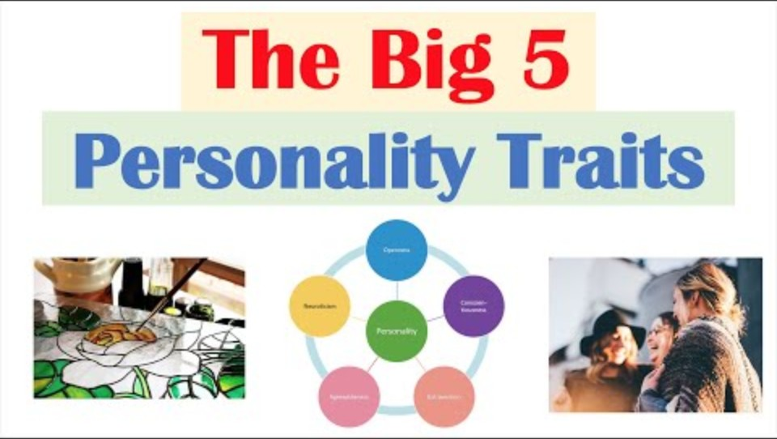

Slide 5
Week 1: Activity 3
Review Results Privately
Review Results Privately
Analyze your results within the app
Identify your dominant traits
Consider how these traits affect your business decisions
Note any surprises or insights
15 minutes

Slide 6
Week 1: Key Takeaway
Strategic Takeaway
"Small businesses that win are not the ones with the most technology, but the ones who ask better questions of their data."

