Slide 1


Big Query – Best practices
November 2021

Slide 2
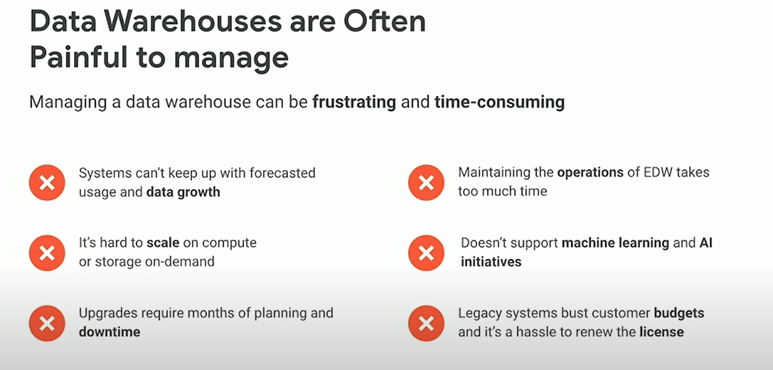

Slide 3
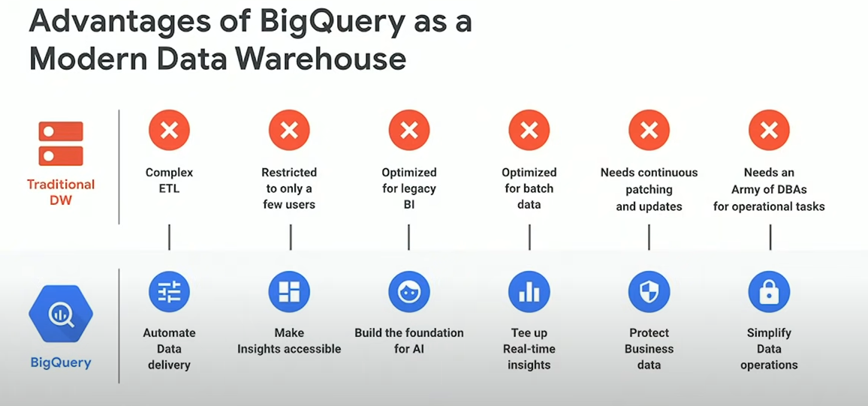

Slide 4
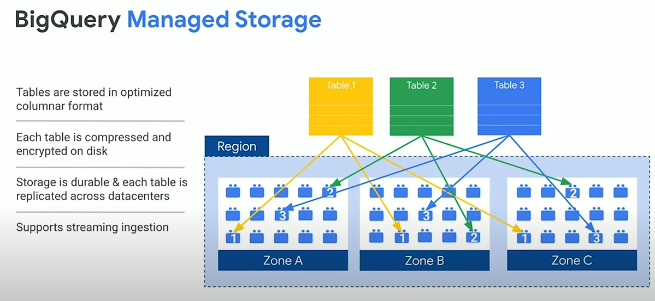

Slide 5
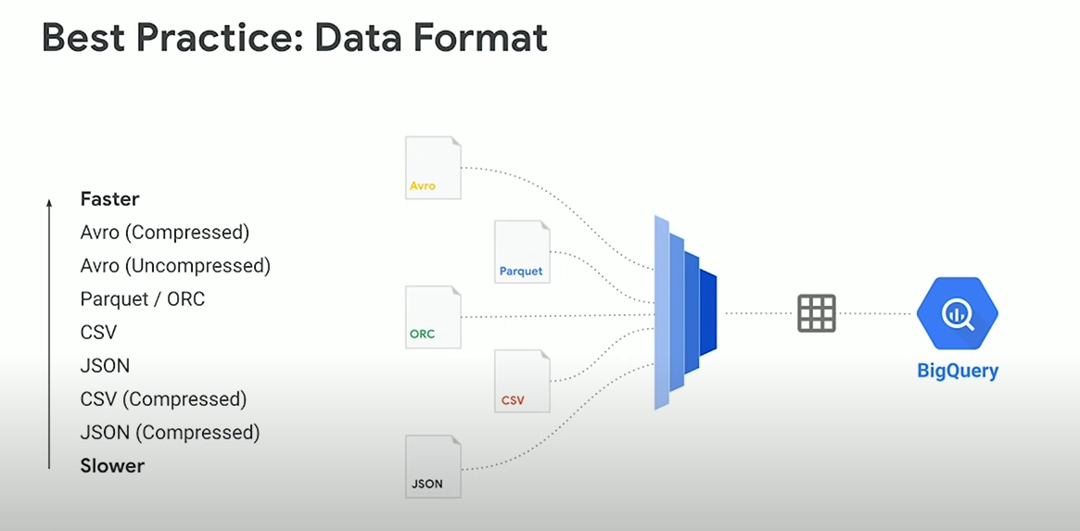

Slide 6
The costs for the queries run on BigQuery depend on the amount of data scanned, not the data retrieved. Control projection: the projection is the number of columns that you read when you execute your query. You should always try to select only the columns you need and avoid using "Select *" (also known as select all) at all costs. Even if you use the LIMIT clause, it will not reduce the cost of the query. If you need to explore the data before writing your query, use the table preview option, which is free. Before executing your query, verify the query validator, which will tell you approximately how much data will be scanned, so you can get an idea of ​​how much it will cost with the GCP price calculator.

Slide 7
Always prefer partitioned tables (time or data partitions) over fragmented tables (with date). When partitioning tables are consulted, it is recommended to first filter the required partitions in the most internal selection query. Filter the amount of processed data before joining with other queries / tables. Avoid joining the same subquery several times in the same query. Instead, try to save this subquery as an intermediate table and use it. The cost of storage is much less than the cost of repetitive queries. The Order By clause is very expensive, so, unless it is necessary, try to limit your use of the Order By clause as much as possible. Or simply use it in the outermost query to sort the results and not in subqueries. When joining two tables, start with the larger table for better performance.

Slide 8
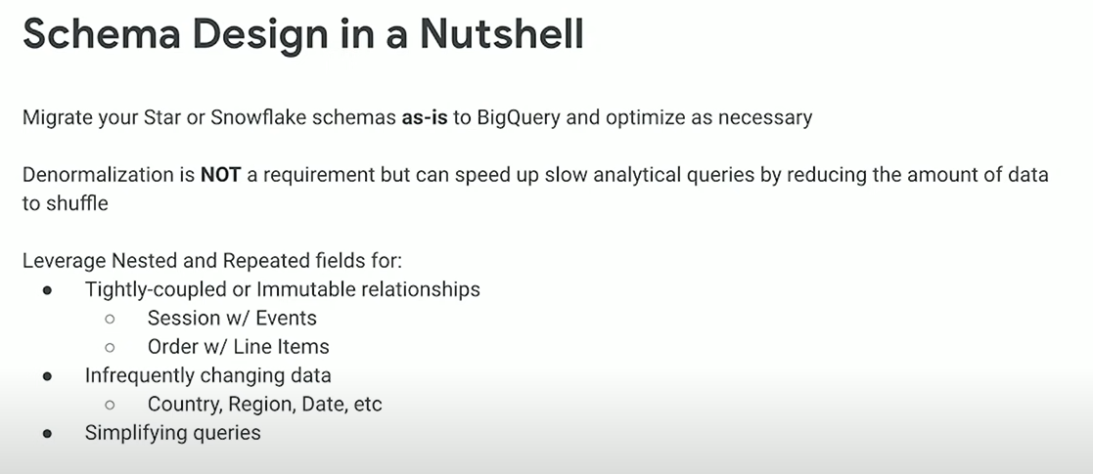

Slide 9
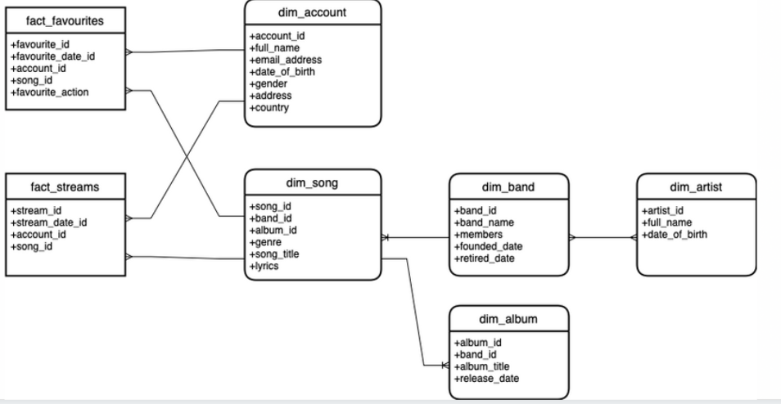

Slide 10

Thank you.

