Slide 1
Personal data presentation
Autrin Peralta

Slide 2
Questions and Variables
Does wearing flip flops effect my time to walk to class?
Response variable: time to bike to class
Predictor variable: wearing flip flops vs shoes
Does jumping in the ocean affect how many hours of sleep I get?
Response variable: How many hours of sleep I get
Predictor variable: Jumping in the ocean vs not

Slide 3
Alternate variables
Flip Flop question
leave time(hh:mm) – continuous
Need to know to measure time it took to bike to class
arrival time(hh:mm) –continuous
Same need to know for biking time
Temperature(degrees F) – continuous
Could possibly affect biking time based on temps
distance to walk(miles) – continuous
Distance could affect biking time obviously
eating before leave(yes/no) - binary categorical
Maybe eating before leaving gives me energy or makes me lethargic
backpack weight(lbs) – continuous
If I'm weighed down, it could affect my biking time
Sleeping question
Workout(yes/no) - binary categorical
If I worked out maybe I'd sleep more anyway
Bed time(hh:mm) – continuous
This helps measure how many hours I slept
Wake up time(hh:mm) – continuous
Same measured sleep time
eat 2 hours before bed(yes/no) – binary categorical
Eating right before bed could possibly affect how I sleep

Slide 4
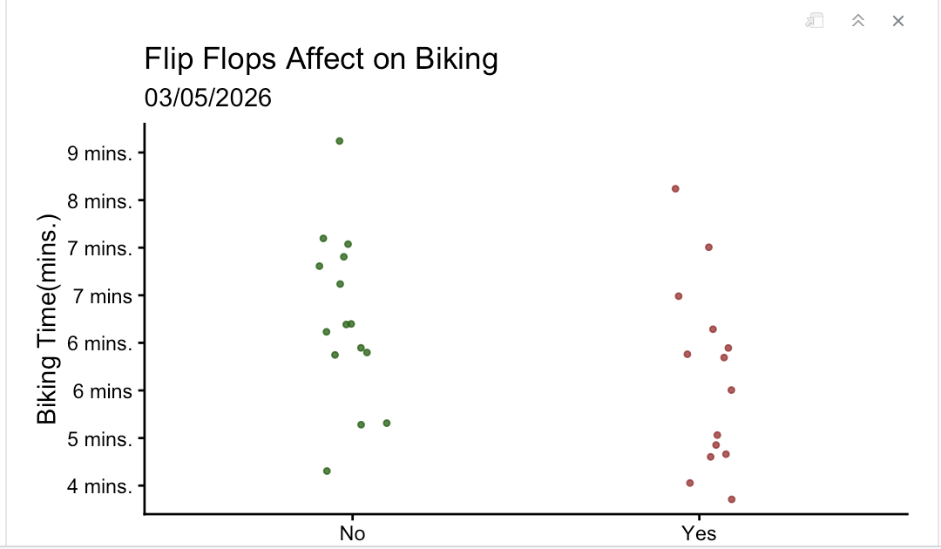
Biking Visualization

Slide 5
Visualization ideas
Biking graph
My idea starting as connecting the points into a bike path, but it switched to changing the points into biking wheels and making each two points into a bike. I did this after seeing a cartoon graph depiction. I am thinking of making the bike wheels bigger as it goes up, indicating longer time riding. Also, the “no” side bikes have shoes riding them and the “yes” side has flip flops riding them
Sleeping graph
My idea starting with waves for both sets of points with each point being z’s instead of fish. I changed it to putting a bed on the bottom of the graph and changing each point into z’s(indicating sleeping) and only a wave on the ”yes side

Slide 6
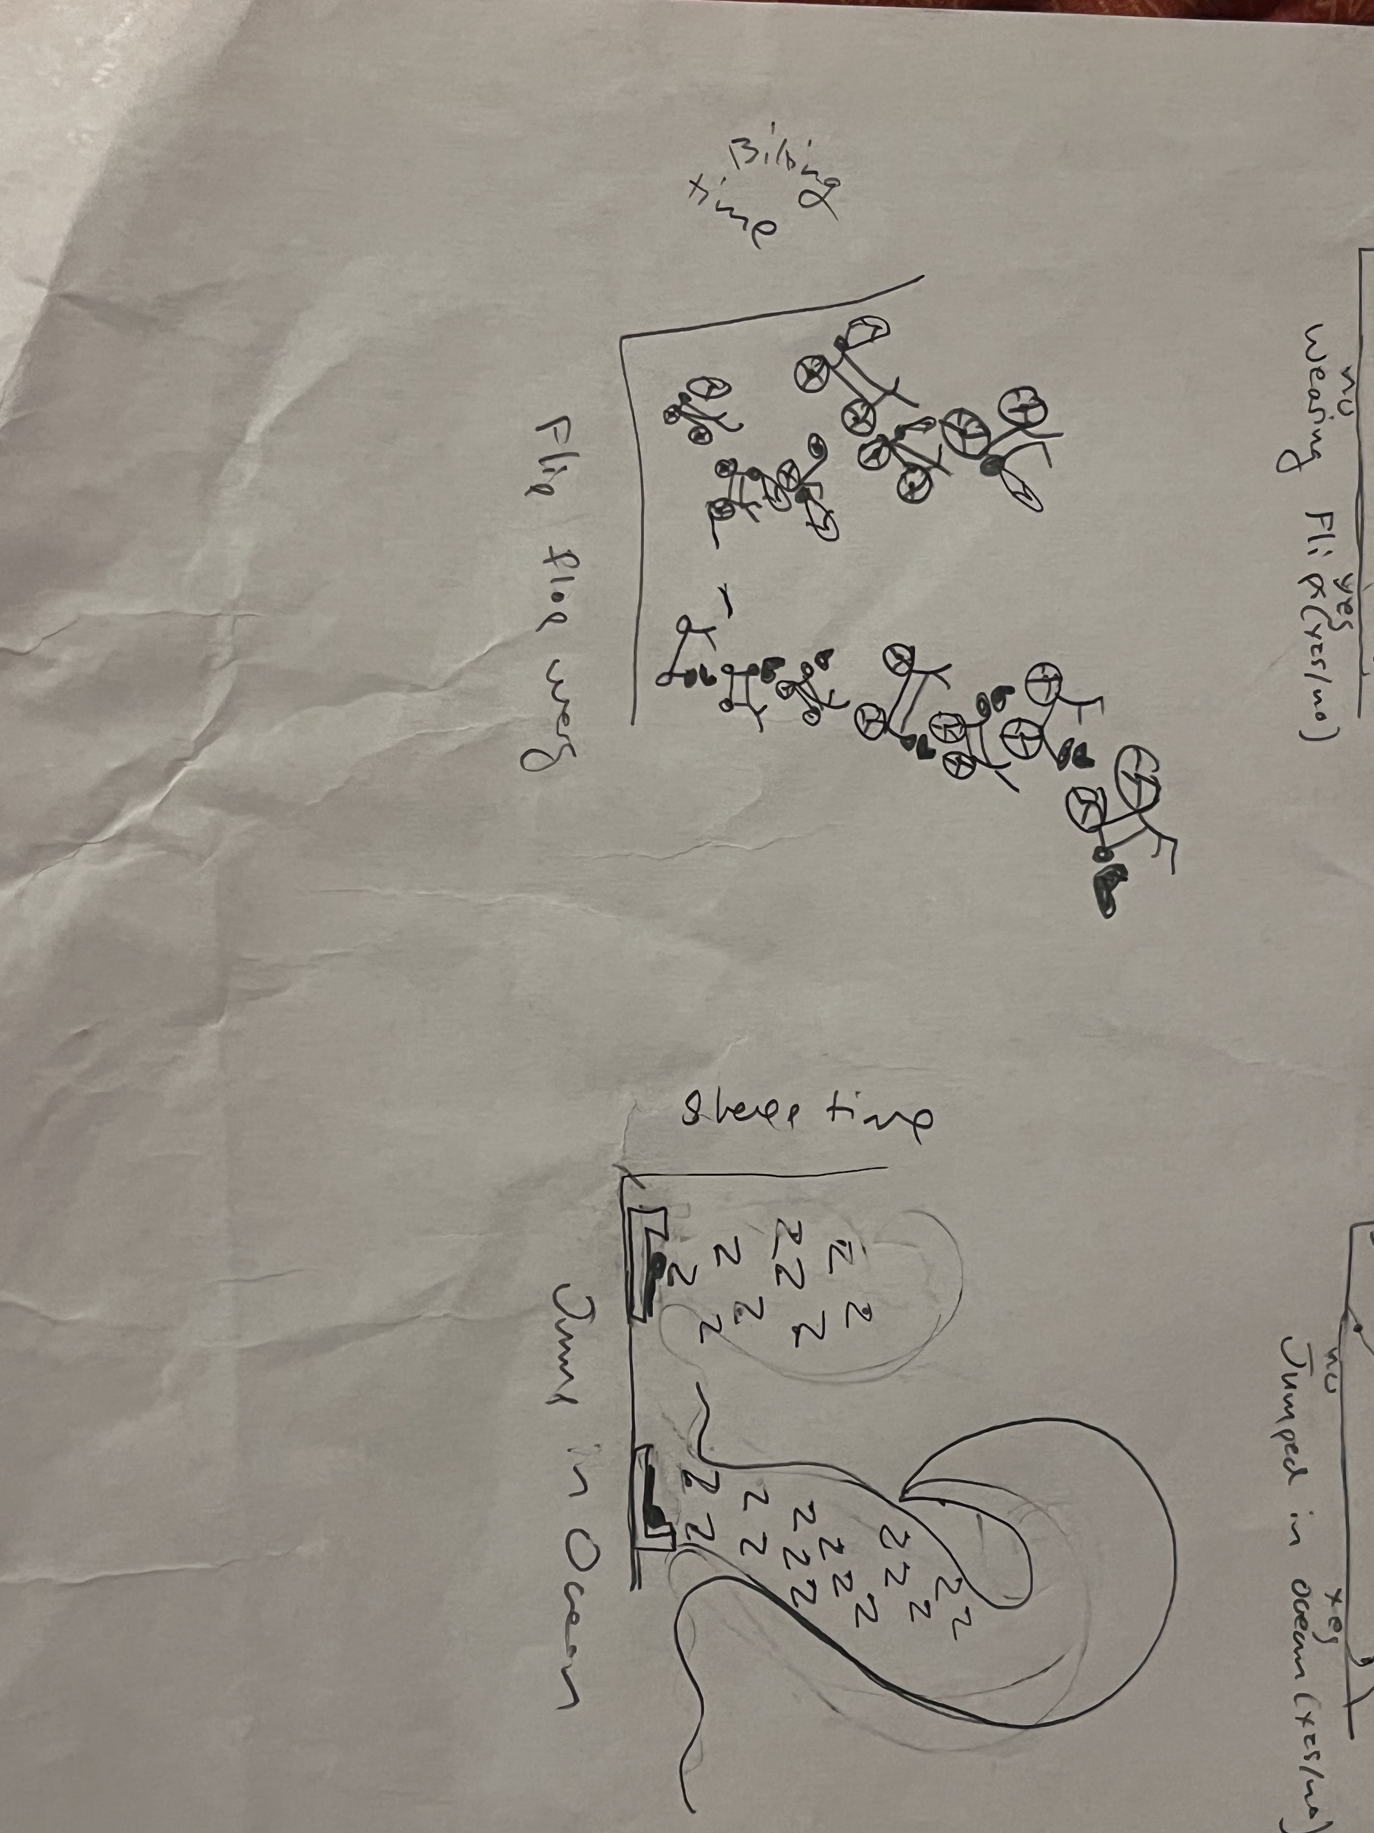
Visualization draft
For my final ideas I changed my two graphs. For the biking one, I made each point a bike wheel and made it so the wheels got bigger the higher they went(indicating more time), I still had flip flops riding the "yes" bikes and shoes riding the "no" bikes. For the sleeping one, I put a bed under the points and made all the points into Z's, and on the yes side i drew the bed and z's inside a wave. This was a sketch that was sparked by my original idea. I wanted a cartoon sort of idea that involved both variables.
I'm not fully sure how to go about making this but this is what I am thinking.

