Slide 1
ソフトウェアテスト [11] テスト駆動開発演習
Software Testing
[11] Exercise: Test-Driven Development
あまん ひろひさ
阿萬 裕久（AMAN Hirohisa）
aman@ehime-u.ac.jp

Slide 2
Exercise purpose
Experience and learn test-driven development based on test first
Main contents
Practice test-driven development with a simple example
Test-driven development of a function meeting the requirements

Slide 3
Exercise content
Exercise 1
Experience test-driven development with a simple example
Exercise 2
Complete a function that satisfy the given specification though test-driven development

Slide 4
Exercise 1
[Target program] sample1101.c
[Support program] run_test.h
run_test.h provides a function to support test-driven development exercises
Complete the program by editing sample1101.c as explained below

Slide 5
What is test-driven development?
A method of repeating “first create a test case, then write a program that passes it”
A new test should fail the first time (because it hasn't been implemented yet).
① Test case creation
Review
②Testing
③ Programming
Success
Failure
Refactoring
(If necessary)
④ Testing
Success
Failure

Slide 6
Development goals for Exercise 1
Create function get_digit_number
This function returns the number of digits for the integer x given as an argument
Where, 0< x <1000000 (=10⁶) and
If an integer outside the above range is given, return -1 as an error
(Ex1) get_digit_number(256) …This value will be 3
(Ex2) get_digit_number(0) …This value will be -1 (error)

Slide 7
How to test in Exercise 1
Use the function run_test prepared here
Defined in the distributed run_test.h
Usage is as follows:
run_test(1,get_digit_number(5),1);
Test No. (used to display results)
Calling (execution) of the function to be tested
Expected result of the test (return value of correct answer)

Slide 8
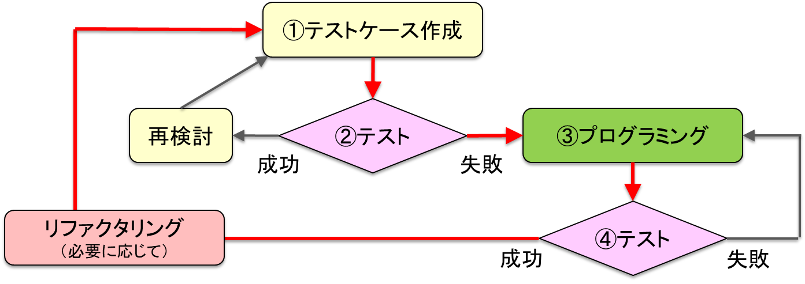
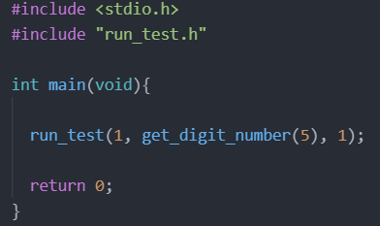
Exercise 1 How to proceed (1/7)
First, write the first test case in the main function (step ①)
At this point, the function get_digit_number does not exist yet.

Slide 9
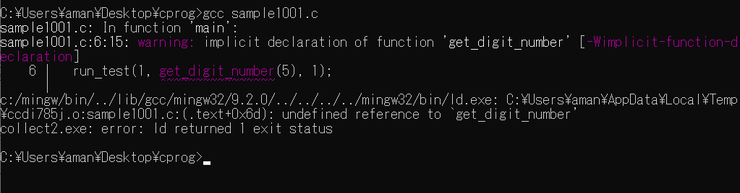
Exercise 1 How to proceed (2/7)
Compile once and check that it will be an error (Step ②)
In this case, the correct answer is to get an error because the function get_digit_number does not exist.
(If no error occurs here, it means that a function with that name already exists, which will cause confusion in subsequent tests.)

Slide 10
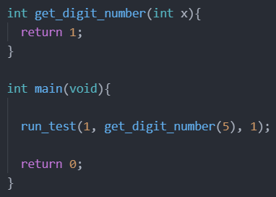
Exercise 1 How to proceed (3/7)
Next, prepare the function get_digit_number: If you set the return value to 1, the test should succeed set(Step ③)
Currently, let's try to make it work, although it is "ad hoc"

Slide 11

Exercise 1 How to proceed (4/7)
This time there is no compilation error, and when we run it, it is displayed that test No.1 passed (step ④)
No. 1: The PASS display is done by the function run_test.

Slide 12
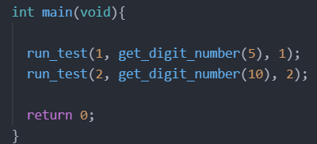
Exercise 1 How to proceed (5/7)
Add the following test case (Step ①)
Give a 2-digit integer (10) as an argument as No.2 and create a test case that expects the answer to be 2.
Add test case No.2

Slide 13
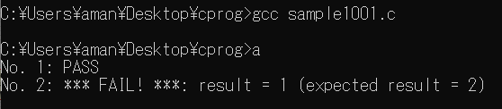
Exercise 1 How to proceed (6/7)
Compile and run again, this time, confirm that the No.2 test fails (Step ②)
No.1 remain PASS, but No.2 has failed (FAIL)
Display that the function execution result (return value) is 1 (result = 1) but the expected result is 2 (expected result = 2)

Slide 14
Exercise 1 How to proceed (7/7)
Next, modify the program to pass both No.1 and No.2 tests (step ③)
Test-driven development gradually improves the degree of perfection of the program by repeating this process.
You can refactor along the way
The number of test cases gradually increases, but the key point of this method is that all test cases are re-executed each time

Slide 15
Repeat the above steps
Repeat “Add test case & modify program” until you can confirm that the function works as specified.
Don't forget error handling! In case of an error, the return value is -1, but it is not good to write -1 directly (it would be hard-coding), so it is better to define it as a macro called ERROR.

Slide 16
Submission of Exercise 1
Submit to Teams sample1101.c
Submission deadline: 23:59, May 24
If you do pair programming with two people, both of you should submit the same thing.
[11] Exercise-1 (TDD)

Slide 17
Exercise 2
Complete the program sample1102.c in the same way as Exercise 1
The specifications of this program are spec1102.pdf

Slide 18
Submission of Exercise 2
Submit to Teams sample1102.c
Submission deadline: 23:59, May 24
If you do pair programming with two people, both of you should submit the same thing.
[11] Exercise-2 (TDD)

Slide 19
Things to note in Exercises 1 and 2
For each exercise, think about various calls to test functions and add them
One run_test is one test case, so create as many as possible.
run_test(1,get_digit_number(5), 1);
run_test(2,get_digit_number(10), 2);
……………………

Slide 20
Answer the survey
In this exercise, you can do it alone, or you can do pair programming with two people.
I would like to know which one you chose, so please answer the survey first
[11] Survey (All student MUST answer first)

