Slide 1
ソフトウェアテスト [3] ソフトウェア開発プロセス
Software Testing
[3] Software Development Process
あまん ひろひさ
阿萬 裕久（AMAN Hirohisa）
aman@ehime-u.ac.jp

Slide 2
Outline of software development
Development planning (overall plan)
Requirements analysis
Design
Implementation
Testing
Operation/Maintenance
Development
process
Notes:
Development plan (Kaihatsuikaku):development planning
Overall plan:total planning
Requirements analysis:requirements analysis
Design (soap):design
Implementation (quiet):implementation
Operation:operation
Maintenance:maintenance
Development process (Kaihatsu Process):development process

Slide 3
(0) Development planning
Development planning
Requirements analysis
Design
Implementation (Programming)
Testing
Operation/Maintenance

Slide 4
(0) Development planning
Settings → Estimation → Preparation
Set what to make and by when
Estimation of man-hours and costs
Determination of development method
Since it is not always possible to realize all the functions you want to create on your own within the time period and budget, you can also set the extent to which you want to create them.
Preparation
Staff assignment
Budgetary measures
Environment arrangement
Notes:
Settings:settings
Estimate (Mitsumo):estimation
Preparation:preparation
Self-realization (Jimae de Jitsugen):implementing by themselves
Development method (kaihatsu method):development methods
Man-hours:effort
Cost:cost
Staffing (jinin no haichi):staff assignments
Budget measures (yosansochi):Budgetary measures
Environmental maintenance (Kankyo no Seibi):environmental arrangement

Slide 5
(0) Development planning: Determination of development method
Basic policy
Develop something new?
Based on an existing system?
Calculate the scale of development
(e.g.) How much code do I need to write?
Effective in estimating man-hours and costs
Many other issues that need to be considered
Securing human resources & structure? Environment? Budget?
Notes:
Develop new:newly develop
Existing (existing):existing
Scale (Kibo):size
Calculate:calculate, compute
code=Source code
It works for estimates:they influence the cost estimation
Securing Human Resources (Jinzai no Kakuho):securing human resources
Challenge:issues, problems
System:structure (team/organization structure)
Budget (yosan):budget

Slide 6
(1) Requirements analysis
Development planning
Requirements analysis
Design
Implementation (Programming)
Testing
Operation/Maintenance
The beginning of the development process

Slide 7
(1) Requirements analysis
Requirements specifications
Artifact
Business analysis
Analyze and organize the work to be achieved of software
Description of request content
Write accurately without ambiguity
Consider feasibility: function, cost, delivery date
Clarify what you are trying to achieve with the software
Notes:
Requirement specifications:requirements specification
Business analysis (gyomubunseki):job analysis
Ambiguity:ambiguity
Function (yesterday):functionality
Delivery date (Nouki):time to delivery

Slide 8
[Example] Bulletin notification system (1) Requirements analysis
I want a system that notifies me on my smartphone when a notice related to me appears.
Is it real time? Do you summarize it by day?
How would you like to be notified?
How do I register/change notification destinations?
How to prevent spoofing and protect security?
In what format should you enter the content of the bulletin board?
What are the conditions for “related postings”?
Is it necessary to link with the student database?
Notes:
content:contents
Transmission management (Soshinkanri):sending management
User management (ryoshakanri):user management

Slide 9
[Exercise 1]
Requests from customers “I want you to create a system that allows you to check the congestion status of the cafeteria with your smartphone."
Consider and list the items that should be confirmed with the customer when creating the requirement specifications.
Notes:
Considerations (kentojikou):items to be studied
customer: customer
Request:request
Dining room:cafeteria
Congestion status (Konzatsu Jokyo):congestion situation
Enumerate:enumerate

Slide 10
(2) Design
Development planning
Requirements analysis
Design
Implementation (Programming)
Testing
Operation/Maintenance

Slide 11
(2-1) External design
Artifact
External specifications
Divide target system → subsystems
Design external specifications for each subsystem
Users & external systems
Whole system
What kind of function should it have?
What kind of interface should I use?
How does it operate?
How will data and control be exchanged?
Subsystem
Notes:
External design:external design
External specifications:external specifications
Split:divide
Operation (yes):manipulation
Function (yesterday):functionality
interface:interface
Control:control

Slide 12
(2-2) Internal design
Artifact
Internal specifications
About the contents of each external design
Design detailed Program specifications
Program structure
(allocation of work as a function)
Specifications of each function (input / output, functions)
Data structures and algorithms
Subsystem
functionA.
functionB.
functionC.
functionD.
functionF.
*Accurately, the concept is not “function” but “module”
Design up to the first step of programming
Notes:
Internal design:internal design
Internal specifications:internal specifications
in detail: in detail
Function:function
Program structure (program structure):program structure
Data Structures and Algorithms (Data Structures and Algorithms):data structures and algorithms

Slide 13
[Example] Bulletin notification system (2-1) External design
Content
Management (Mgmt)
User
Mgmt
Sending
Mgmt
User
Information input person
Student
database
User
database
Notes:
content:contents
Transmission management (Soshinkanri):sending management
User management (ryoshakanri):user management

Slide 14
[Example] Bulletin notification system (2-2) Internal design
Sending management subsystem
Sending management main
Create a address list
Content creation
Send Message
What data structure should the destination list have?
Search in database
How should we link with the database?
How do I send a message?
Notes:
Destination list (Atesaki Ichiran):address list
Create:making

Slide 15
(3) Implementation
Development planning
Requirements analysis
Design
Implementation (Programming)
Testing
Operation/Maintenance

Slide 16
(3) Implementation
Artifact
Program specifications
Source code
Using a programming language
Create Program specifications, flowcharts, etc. as related documents
Coding based on internal specifications
Notes:
coding:coding
Programming Language (Programming Language):programming language
Related documents (kanren documents):related documents
flowchart:flow chart

Slide 17
[Example] Bulletin notification system (3) Implementation
Use the appropriate libraries and programming languages to achieve the desired functionality
Take advantage of OS-specific features → C
Databases Integration →Java or Python
Proactively create documents such as program specifications and flowcharts with consideration for later maintenance.
Notes:
OSunique features (OSDoctor's Day):OS-specific functions
Actively:actively

Slide 18
(4) Testing
Development planning
Requirement analysis
Design
Implementation (Programming)
Testing
Operation/Maintenance

Slide 19
(4) Testing
Test specification
Test report
Artifact
Functions (modules) according to the program specifications? → Unit test
Subsystem meet Internal specifications? → Integration test
System meet External specifications? → System test
System meet Requirement specifications? → Acceptance test
Based on various specifications
Test if the software works properly
Notes:
Test specifications (testing):test specifications
Test report (test report):test result report
unit test (tansea ​​breamtest):unit testing
Integration test (Ketsugo test):integration testing
system test:system testing
Acceptance test (acceptance test):Acceptance testing

Slide 20
(4) Testing
Unit test
Does it work correctly at the level of one part (function, etc.)?
Integration test
Does it work correctly when several parts are connected (a function calls another function, etc.)?
System test
Does the system work as designed and according to specifications?
Acceptance test
Does the system work in a way that satisfies the customer?
Notes:
Parts:parts
Customer (Kokyaku):customer, user
Convincing form:in a convincing manner / in a way satisfying the customers

Slide 21
(5) Operation and maintenance
Development planning
Requirement analysis
Design
Implementation (Programming)
Testing
Operation/Maintenance

Slide 22
(5) Operation and maintenance
Artifact
Various manuals
Failure/Response Report
Prior to operation, create operation manual
If a failure occurs, record and retain the report and response.
User Operation &
Maintenance according to discovery of defects and correction requests
Notes:
Various Manuals (Kakushu Manuals):manuals of every kind
Disability/Response Report:trouble shooting report
Bug discovery (Fuguai no Hakken):finding bugs, finding failures
Correction request:request for modification

Slide 23
(Supplementary) Use of terminology
Malfunction, failure
Phenomenons where the software does not work properly
Defect, fault
Direct cause of failure
Error
The mistake that created the defect
Bug is an ambiguous term that includes these three things.
Notes:
障害（しょうがい）
不具合（ふぐあい）
故障（こしょう）
現象（現象）：phenomenon
欠陥（けっかん）
原因（げんいん）：cause
曖昧な用語（あいまいなようご）：vague term

Slide 24
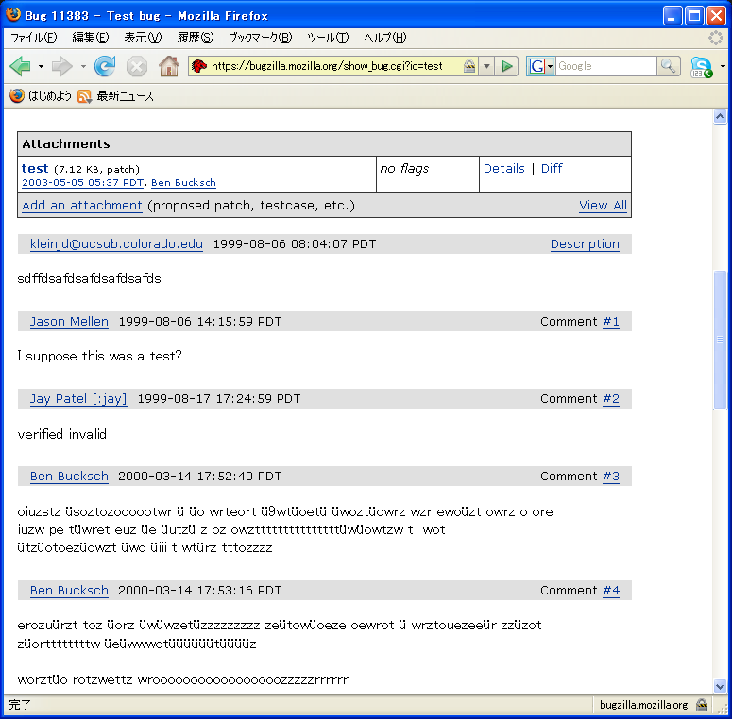
[Example] Bulletin notification system (5) Operation and maintenance
Operation (Have them actually use it)
Report any problems
If there is a request, ask for it
Maintenance
Bug fixes
Responding to requests
Bugzilla or JIRA
(There are also bug management systems such as)
→

Slide 25
[Exercise 2] Answer the relevant process
Answer which process the following work corresponds to.
“Cafeteria congestion check system"
① Congestion data will be structured data of measurement time (d,h,m), seat occupancy rate (%), and will be recorded in a file at 3-minute intervals.
③ System configuration
(1) Congestion degree data management unit
(2) User interface section
(3) Controll (Controller) section
④ Conducted a user survey & identified issues that need improvement
② Before going live, we checked the behavior by allowing 1,000 people to access at the same time and by allowing them to access outside of business hours.
Notes:
Process:process, step
Measurement time (measurement time):measurement date
Structure:struct data in C language
Interval:intervals
Before production (Honka Doumae):before the start of operations
Outside business hours (eigyojikangai):outside business hours
Management Department (Kanribu):management/control parts
User questionnaire (Ryoshaquestionnaire):user survey
Issues that should be improved:issues to be improved

Slide 26
[Exercise 2] Answer the relevant process
① Congestion data will be structured data of measurement time (d,h,m), seat occupancy rate (%), and will be recorded in a file at 3-minute intervals.
③ System configuration
(1) Congestion degree data management unit
(2) User interface section
(3) Controll (Controller) section
[External design]
[Internal design]
④ Conducted a user survey & identified issues that need improvement
[Operation/Maintenance]
② Before going live, we checked the behavior by allowing 1,000 people to access at the same time and by allowing them to access outside of business hours.
[Test]
Notes:
Process:process, step
Measurement time (measurement time):measurement date
Structure:struct data in C language
Interval:intervals
Before production (Honka Doumae):before the start of operations
Outside business hours (eigyojikangai):outside business hours
Management Department (Kanribu):management/control parts
User questionnaire (Ryoshaquestionnaire):user survey
Issues that should be improved:issues to be improved

Slide 27
Process models
Software development process (Basically, the following 5 steps)
Requirement analysis
Design
Implementation
Testing
Operation/Maintenance
A model that expresses how to proceed is called a process model

Slide 28
Typical examples of process models
Waterfall model
(One variation is the V model)
Prototyping
(This itself is more of a development method than a process model)
Spiral model
Notes:
Development method (Kaihatsu Shuho):development methods

Slide 29
Waterfall Model
Proceed step by step from requirements analysis to operation and maintenance
Requirements analysis
Like water flowing from high to low
External design
Internal design
Implementation
Test
Operation/maintenance

Slide 30
Waterfall Model: Features
Once the "requirements analysis" is completed, proceed to the next "external design", and so on, and perform each step in order.
Easy to understand project progress status
The division of work is clear.
Traditional “standard” model and easy to teach
(*First document published in 1970)
Even today, it is often employed in large-scale projects that require many people.

Slide 31
Waterfall Model: Problems
1. Requirements analysis is not always "perfectly" completed
Design, etc. based on incomplete Requirements Analysis → Processes are overturned and confused
2. Delays in upstream processes directly affect downstream
Failure to meet delivery deadlines or affecting engineer schedule adjustments
3. Not suitable for retrospective correction/redo
Go back upstream and start over → Increase costs
4. Tests will not be implemented until late
Testing is conducted only after “implementation” is complete, Requires major rework if defects are discovered
Notes:
Ideal:ideal
Dashitsukusu:output all of them
Incomplete:imperfection
Migrate:transition
The premise is overthrown:shatter the assumptions
Confusion occurs:cause much confusion among the developers

Slide 32
Ｖ Model
The essence is the same as the waterfall model
Detailed testing process and correspondence with upstream process
Requirements analysis
Confirmation/Verification
Acceptance test
External design
System test
Internal design
Unit/Integration test
It implies which level you will have to start over.
Implementation
Notes:
本質（ほんしつ）：essence
詳細化（しょうさいか）：elaboration, refinement

Slide 33
Prototyping
A method of proceeding with the development process while checking by creating a prototype
May be a mockup for confirmation
Used to confirm and evaluate the specifications and designs
Requirements analysis
External design
Internal design
・・・
For example, "Is it okay for the screen to look like this?"
Prototype
Notes:
Prototype:prototype
mock up:mock-up

Slide 34
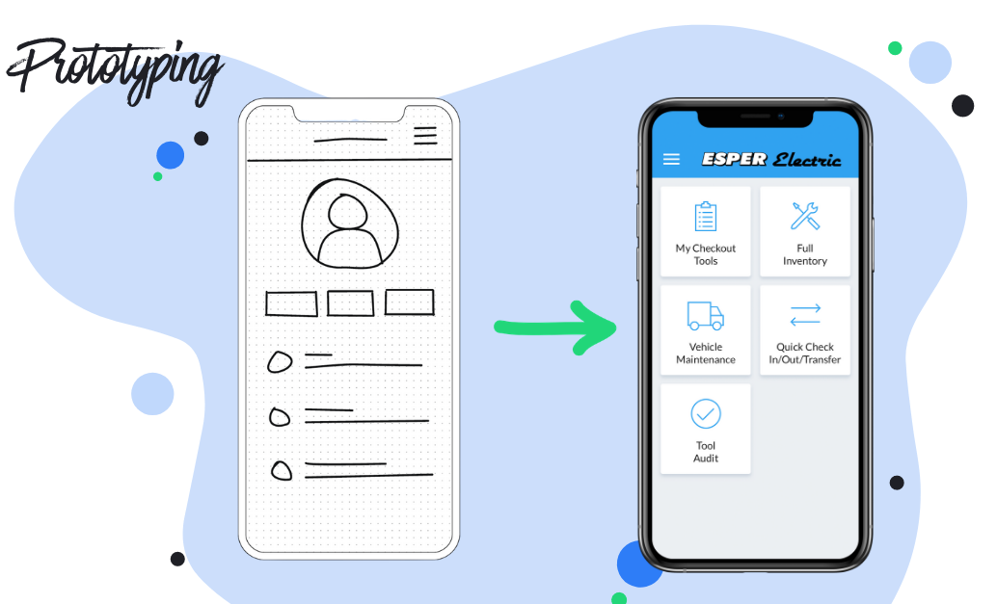
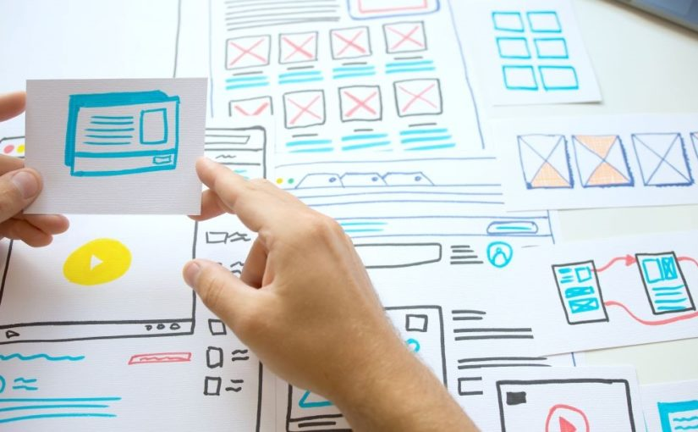
Prototyping (Example)
Notes:
Prototype:prototype
mock up:mock-up

Slide 35
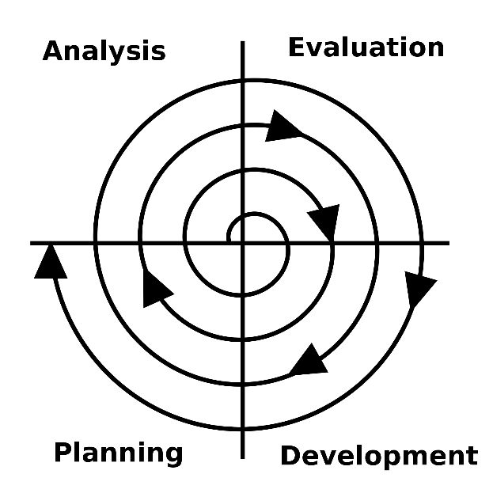
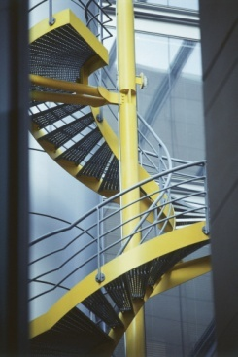
Spiral Model
Include waterfall and prototyping
Risk-driven management process
Develops by repeating the same process round and round
Suitable for large-scale projects
Notes:
Contain:include
Risk-driven (risk-driven):risk-driven

Slide 36
Basic cycle of spiral model
①Goal setting
Set what you want to create (Goals)
Consider (AMAP) methods that match your goals
④ Next plan
Plan for the steps to be performed in the next iteration
②Evaluation
Evaluate the merits and risks of each method
Confirmation with prototype
③ Creation/execution
Create documents and systems
Run test
Notes:
Goal setting:goal setting
Rating:evaluation
Create:making, developing
Execution:carry out, perform
Repeat (repeat):iteration

Slide 37
Intuitive image of the spiral model
The main trend is the waterfall model, but it is not a matter of suddenly creating a finished product.
Reduce the risk of failure by checking and assessing risks at each step.
Notes:
Intuitive:intuitive
image:image

Slide 38
Summary
~ Software Documentation
Artifact
Development planning & Requirements analysis are important first
Then, external design (subsystem)，internal design (module/function)，implementation，testing, operation/maintenance
Development process model
Waterfall: "From top to bottom"
Prototyping: "Based on the prototype"
Spiral: “Repeat Evaluation and confirmation”

Slide 39
Homework
Answer “[3] quiz”
by tomorrow 13:00pm
(Notes: Your quiz score will be a part of your final project evaluation)
Notes:
summary: summary
Development project: development projects
lead to success: lead to success
industry: industry

