Slide 1
ソフトウェアテスト [4] ブラックボックステスト
Software Testing
[4] Black Box Testing Techniques
あまん ひろひさ
阿萬 裕久（AMAN Hirohisa）
aman@ehime-u.ac.jp

Slide 2
Testing phase (For waterfall model)
Requirement analysis
Design
External design
Internal design
Implementation
Testing
Operation/Maintenance
Development process
Notes:
テスト工程（テストこうてい）：testing phase

Slide 3
Purpose and content of testing
Purpose
Find errors (mistakes, bugs) that may exist in the software
Content
Run the software and check whether it works correctly according to specifications
Confirm AMAP that failures will not occur even in situations that are not in the specifications
Notes:
Error:error
bug:bugs
Correct movement according to specifications: correct behavior according to the specification
Situation not in specification: exceptional situations which were not specified in the specification
Non-disturbance (gaining):no failure occurs
As far as possible (as much as possible):as many as possible

Slide 4
Difficulty of testing
Originally, designers and developers tried to make something according to specifications
Check compliance by following specifications → It is difficult to be comprehensive
If it is outside the specifications → Difficult to test as they may not be expected or may go unaware
Notes:
Difficulty (difficulty):difficulty
Covers:encompass, cover the whole cases
Out-of-specification:unspecified
Unexpected (very good):unexpected
I don't notice (I don't notice):unaware
Very hard:hard work

Slide 5
The importance of testing: Cases that could have been prevented by testing
AT&T's network was completely shut down, leaving 7.5 million telephone calls out of service (1990)
Cause: Only one line of the program was added during update.
Ariane 5 rocket explodes in mid-air (1996)
Cause: 64 bits numbers were handled as 16 bits *Development cost over 8 billion dollars (nearly 1 trillion yen)
Mars explorer crashes on Mars (1999)
Cause: Regarding the thrust of the engine injection for landing, the analysis side and the operation side used different units: pounds and newtons
Notes:
電話（でんわ）：telephone
不通（ふつう）：disconnected
更新（こうしん）：update
空中（くうちゅう）で爆発（ばくはつ）： exploded in midair
開発費（かいはつひ）：development cost
80 億（おく）ドル： 80 billions of US dollars
1 兆円（ちょうえん）：1 trillion(million million) Japanese yen
火星（かせい）調査機（ちょうさき）：Mars explorer
墜落（ついらく）：crash
着陸（ちゃくりく）：landing
エンジン噴射（エンジンふんしゃ）：engine injection
推力（すいりょく）：thrust force
解析側（かいせきがわ）：analysis side
運用側（うんようがわ）：operation side
単位（たんい）：unit
ポンド：pound
ニュートン：newton

Slide 6
Terms: Test case, Test suite, Test domain
Test case
Certain input data/conditions & expected output
Test suite
A collection of test cases that runs a series of tests
Testing Domain
A complete set of test cases that can guarantee that there are no errors in the program
Notes:
Terminology (yougo):technical terms
Certain (mostly):a certain
Input data:input data
Conditions:condition
Expected output:expected output
Set:sets
A series of:a series of
Warranty:assurance
Full set:entire set

Slide 7
Test example (1): Length conversion
*1 kilometer
= 0.621371 miles
“Kilometers → Miles” Converter
【Input】 A real number between 0 and less than 10000, with two decimal places
【Output】 Value converted to miles, rounded down to 3 decimal places
input | expected output
0 | 0.000
9999.99 | 6213.703
1 | 0.621
1.001 | 0.621
input | expected output
9.99 | 6.207
10 | 6.213
-1 | error
10000 | error
Other exceptions
Notes:
Length:length
conversion):conversion
Kilometers:kilometer
Miles:miles
less than (miman):less than
Real numbers:real numbers
Decimal point:decimal points
decimal point2Digits:two decimal places
Valid:valid
Ignore:avoid
After the decimal point3Truncate to digits (kirisute):truncate the number to three decimal places
Exceptional cases:exceptional case

Slide 8
Test example (2): Triangle problem
Consider a triangle with three integers as input and each as the length of the side. The resulting triangle is:
Isosceles triangle
Equilateral triangle
Scalene triangle
Consider a test case for a program that determines which of the following.
Notes:
Triangle problem:triangle problem
Integer:integer
Side length:length of side
Isosceles triangle:isosceles triangle = a triangle with two equal sides
Equilateral triangle:equilateral triangle = a triangle with three equal sides
Scalene triangle:scalene triangle = a triangle with no two sides of equal length

Slide 9
Example test case for triangle problem
input | expected output
(2, 5, 5) | isosceles triangle
(5, 5, 5) | equilateral triangle
(3, 4, 5) | scalene triangle
(0, 0, 0) | error *become a point
(3, 4, 7) | error *become a line segment
(2, 5, 8) | error *longest side length > sum of the lengths of other sides
(1.3, 4, 5) | error *there are real numbers
(-2, 4, 5) | error *have a negative number
*Triangle Inequality: Length of longest side < sum of the lengths of other sides
Notes:
Dot:points
Line segment:segments
Longest side:the longest side
Sum of lengths of other sides:sum of the other sides' lengths
Real numbers:real numbers
Inequality:inequality
Formation:hold, satisfy
Negative numbers (Funosu):negative numbers
Input order:inputting order

Slide 10
[Exercise 1] Test an integer sorting program
Now, We are given a program to sorts N integers
0 ≤ N ≤ 10000
Input is from a file (containing number sequences)
Consider a test case (here only input is required) for this program
Notes:
sorting:sorting
Sequence (Suretsu):sequence of numbers

Slide 11
[Exercise 1] Answer Test an integer sorting program
Random number sequence
Sorted sequence
If there is only one or more than N
0 pieces
｛5, 1, 9, 2, 3, 7, …｝
｛1, 2, 3, 4, …｝
｛100, 99, 98, 97, …｝
｛ 2 ｝
｛ 1, 2, 3, …, N, N+1 ｝
It is also a good idea to consider other exceptions such as file not found or failure to open.
｛ ｝
Notes:
整列済み（せいれつずみ）：sorted

Slide 12
Important things in testing
Record the results
What kind of defect was found in which test case, who discovered it and when
→ Important information when making corrections later
Communicate properly
Ambiguous information is useless
Reporting problems are important, but the way you report them is also important
You should not proudly present to the developer that you have found a defect. There are some hardships that only the person who made it can understand, so human relationships are also important.
Simply reporting that it doesn't work is meaningless.
Notes:
Records (kiroku):records
Ambiguous:vague
Useless (unfriendly):does not work, cannot be useful
How to communicate:communication manner/style
proudly (specially):in (with) a proud tone
presentation: show, report
Hardships that only he himself can understandeffort that others do not know

Slide 13
Testability
Ease of testing
Reducing costs (man-hours) spent on testing
Shortened test period
➔ This leads to improved quality
Notes:
Cost reduction (sakugen):reduction in cost
Shortening the test period (test period):shortening of testing period
Directly connect (chokketsu):directly linked to
Characteristics:characteristics

Slide 14
Improved testability
Design and implementation considerations are essential
Which function corresponds to which part of the program
Design for testing (Ex: Split it into functions → Test them independently)
Keep testing in mind when making
Make it easy to understand what you’re doing → If an error is discovered → Can be handled immediately
Notes:
Function (yesterday):function, functionality
Corresponds to:correspond to
Clear:clear
Consideration:taking care, considering
Nicely divided into functions:Dividing the system into functions (subroutines) well
Independently (Dokkuritsu):independently
Keep in mind:bear it in mind
Makeshift (Sonobashinogi):ad hoc
Waste of time and effort:waste of time and effort

Slide 15
Supported by the V model
Unit/integration test: Module operation check
After system test: System operation check
Requirements analysis
Confirmation/Verification
Acceptance test
External design
System test
Internal design
Unit/Integration test
Implementation

Slide 16
Module
A unit of program that can be separated
Group/Block of programs (Sofware Parts) → Can be replaced at that level
Ex: In C, this corresponds to a “function” or "a collection of functions”
Java, “class” corresponds to this (*A "method" corresponds to a "function", but a method cannot exist by itself.)
Notes:
Separable:separable
Replacement:replace
Function:function
Object-oriented language (object-oriented language):object-oriented language

Slide 17

Unit test, Integration test
Unit test
Give various inputs to one module and check whether appropriate output is obtained
Integration test
Combine multiple modules (unit tested) and check whether the modules can perform appropriate input/output while having a connection relationship
Notes:
Unit test:unit testing
Various inputs (nyuryoku):various inputs
Appropriate output:appropriate/correct outputs
Binding test:integration testing
Connectivity:coupling

Slide 18
System test, Acceptance/Operation test
System test
Verify that the system works according to specifications
Acceptance test/Operation test
Similar to system test, but meaning of test under actual operational environment and test by customer
Notes:
system test:system testing
As per specification (as it should be):according to the specification
Acceptance test (acceptance test):Acceptance testing
Operation test (Unyo test):operational testing
Actual (actual):actual
Under operating environment:under the operational environment
Tested by customer (Kokyaku):testing by the customers/users

Slide 19
Classification of tests
Black box testing
Perform operational tests based on specifications without looking at the program
White box testing
Perform operational tests based on internal structure (mainly flowcharts) of the program
Random testing
Randomly create test cases and perform operation tests
Notes:
Blackbox test:black box testing
Based on the spec (based on what you want):based on the specification
White box test:white box testing
Internal structure:internal structure
flowchart:flowchart
Random test:random testing
Randomly:at random

Slide 20
Black Box Testing Techniques (1) Equivalence partitioning
To design test cases efficiently
Partition input space based on a kind of equivalence relation
One partition is called an "equivalence class“ → A collection of things that should be treated the same for each input condition
Two types of equivalence classes
Valid equivalence class: Valid input
Invalid equivalence class: Invalid input
Notes:
Equivalence partitioning method:equivalence partitioning
Equivalence relation:equivalence relation
Input space:input space
Division (Bunkatsu):divide, partition
Equivalence class (which class):equivalence class
Input conditions:input conditions
should receive the same treatment (should receive the same treatment):expected to get the same treatment
Valid:valid
Disabled:invalid

Slide 21
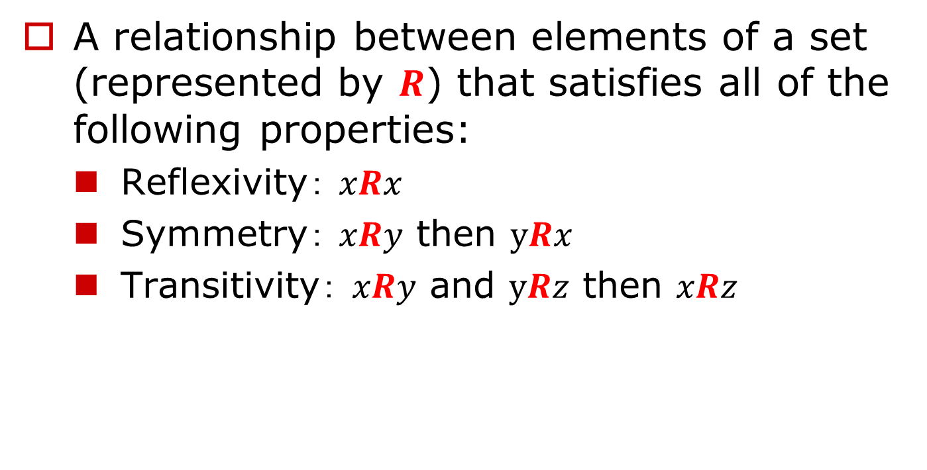
（Reference） Equivalence relation
A relationship between elements of a set (represented by $R$) that satisfies all of the following properties:
Reflexivity： $xRx$
Symmetry： $xRy$ then $yRx$
Transitivity： $xRy$ and $yRz$ then $xRz$
Once one representative example is determined, a group (equivalence class) is formed of those that have an equivalence relationship with it.
Notes:
集合（しゅうごう）：set
要素（ようそ）：element
関係（かんけい）：relation
反射律（はんしゃりつ）：reflexivity
対称律（たいしょうりつ）：symmetry
推移律（すいいりつ）：transitivity
直線が平行（ちょくせんがへいこう）：lines are parallel
10 で割った余り（10 でわったあまり）：remainder when divided by 10
重なる（かさなる）：overlap
代表例（だいひょうれい）：representative example

Slide 22
Equivalence Partitioning Procedure
(1) Set valid equivalence classes and invalid equivalence classes for each input condition
(2) Create all combinations of valid equivalence classes
(3) Create all combinations that include only one invalid equivalence class
*You can test by adding cases that include two or more, but first, just one. First, make sure that no problems occur by mixing invalid items.
Notes:
Procedure (Tejun):steps, procedures
Combination (kumiawase):combination
Mix (Mix):mix

Slide 23
Example of equivalence partitioning ① (1/2)
Input: Subject grade (integer value)
Output: “Excellent, Good, Satisfactory, Passing, Failure, Not evaluated"
Specifications: 90-100 → Excellent, 80-89 → Good, 70-79 → Satisfactory, 60-69 → Passing, 0 to 59 → Failure, -1 → Not evaluated
Notes:
Shu:Excellent
Yu:Good
Good:Satisfactory
Possible:Passing
Impossible (Fuka):Failure
Do not evaluate (do not exaggerate):not evaluated

Slide 24
Example of equivalence partitioning ① (2/2)
Valid and invalid equivalence classes
valid equivalence class | invalid equivalence class
90-100 | 101 or more
80-89 | -2 or less
70-79
60-69
0-59
-1
Select values from each equivalence class and test

Slide 25
Example of equivalence partitioning ② (1/4)
Parking fee calculator
[Input (1): Parking time (unit: minutes)]
1 minute – 30 minutes = 100 Yen
31 minutes - 60 minutes = 200 Yen
After that = 100 Yen up per hour
[Input (2): Purchase amount at partner stores]
1 hour free for purchases over 2,000 Yen
*If your parking time exceeds 1 hour, you will receive a discount of 200 yen (for the first hour).
Notes:
Parking fee (chusharyokin):parking fee
Parking time (chushajikan):parking time
Partner stores:partner shop
Shopping amount:purchased amount

Slide 26
Example of equivalence partitioning ② (2/4)
input condition | valid equivalence class | invalid equivalence class
(1) Parking time | 1~30 | 0 or less
 | 31~60
 | 61 or more
(2) Purchase amount | 0~1999 | -1 or less
 | 2000 or more
They are grouped together because the calculation method is the same.
*Negative values for time and money are not possible, but here we assume that they can be entered.

Slide 27
Example of equivalence partitioning ② (3/4)
Test case ex: 70’parking, & 2100 Yen shopping
⇒ Parking Fee: 100 yen
Create combinations of valid equivalence classes
(1) Parking time | valid | 1~30 | ○ |  |  | ○
 |  | 31~60 |  | ○ |  |  | ○
 |  | 61~ |  |  | ○ |  |  | ○
 | invalid | ~0
(2) Purchase amount | valid | 0~1999 | ○ | ○ | ○
Purchase amount |  | 2000~ |  |  |  | ○ | ○ | ○
 | invalid | negative
Test with one vertical column

Slide 28
Example of equivalence partitioning ② (4/4)
Test case ex: 0’parking, & 2100 Yen shopping
→ Invalid input ➔ Show error
Create combinations of only one invalid equivalence class
(1) Parking time | valid | 1~30 | ○
 |  | 31~60 |  | ○
 |  | 61~ |  |  | ○
 | invalid | ~0 |  |  |  | ○ | ○
(2) Purchase amount | valid | 0~1999 |  |  |  | ○
Purchase amount |  | 2000~ |  |  |  |  | ○
 | invalid | negative | ○ | ○ | ○
Notes:
Incorrect input:invalid input

Slide 29
Black Box Testing Techniques (2) Boundary-value analysis
Focus on the boundaries of program conditions
Test at the change of input and output conditions
Test at the edges or boundaries of valid and invalid equivalence classes, or outside of them
invalid
valid
invalid
Input value
Notes:
Turning point, boundary point: Sakaimeboundaries
Chopsticks:edge, end
When I went outside (where I went outside):outside

Slide 30
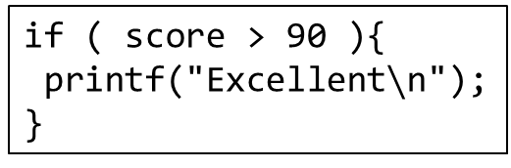
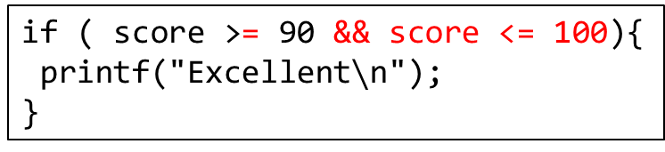
Why focus on changes in conditions?
Surprisingly many mistakes are made in the program’s condition checking part
Example
if ( score > 90 ){
printf("Excellent$∖$n");
}
90 → Is not "excellent"
101 → Become "excellent" instead of "error"
Correctly
if ( score >= 90 && score <= 100){
printf("Excellent$∖$n");
}
Notes:
Grade evaluation:assessment of academic achievements

Slide 31
Boundary value analysis example
Testing a program that outputs decimals (0 to less than 16) in binary
Change of conditions (Note the number of output bits) |  | Equivalence class edges and outside
(input) 0,1 | 1 bit | 0 | valid min value
2,3 | 2 bits | 15 | valid max value
4,7 | 3 bits | -1 | invalid
8,15 | 4 bits | 16 | invalid
It is also good to have other non-integer inputs as invalid equivalence classes.
Notes:
Tenhexadecimal (Tenbase):decimal numbers
0that's all16less than(0abnormal16Less than):greater than 0 and less than 16
2hexadecimal (2base):binary numbers
Maximum valid value:valid maximum value
Effective minimum value:valid minimum value
Disabled:invalid

Slide 32
[Exercise 2] Design test cases using boundary value analysis technique
Test object
Input: Two integers (0 to less than 10)
Output: Sum of them in hexadecimal
Output is 1 digit for 0-15, 2 digits for 16-18
Invalid input is displayed as ERROR
Notes:
Digits:digit

Slide 33
[Exercise 2] Answer
Change of conditions |  | Equivalence class edges & outside
６＋９ | １ digit | ０＋０ | valid min value
８＋７ |  | ９＋９ | valid max value
７＋９ | ２ digits | ｰ１＋０ | invalid
８＋８ |  | １０＋０ | invalid
９＋７ |  | １０＋１０ | invalid
５＋５ | Symbol | ｰ１＋１０ | invalid
It is also good to have other non-integer inputs as invalid equivalence classes.
*In the case of 1 digit, we consider not only 6+9 but also 8+7 because both patterns are considered based on the magnitude relationship between the two numbers. The same goes for 2 digits.

Slide 34
(Reference: Other methods) Using orthogonal array
When there are several functions to test, it is also important to cover all their combinations
Select 2 functions from n → n(n-1)/2 combinations ➔ Enormous number of combinations
Ex: n=10 → 45 ways, n=30 → 435 ways
Orthogonal arrays allow you to create combinations efficiently.
Notes:
Orthogonal table:orthogonal array
Comprehensive combinations (kumiawase wo ura):cover possible combinations
xxxStreet (street):xxx cases
Number of combinations (kumiawasesu):number of combinations
Enormous:enormous

Slide 35
Orthogonal array
For example, Character decoration in a Word processor
A = bold, B = italic, C = underline, D = shaded
2 functions (A, B)
4 functions (A,B,C,D)
The 8 options on the right are OK
(0,0), (0,1), (1,0), (1,1) appear the same number of times in any two columns
A | B | C | D
0 | 0 | 0 | 0
0 | 0 | 0 | 1
0 | 1 | 1 | 0
0 | 1 | 1 | 1
1 | 0 | 1 | 0
1 | 0 | 1 | 1
1 | 1 | 0 | 0
1 | 1 | 0 | 1
A | B
0 | 0
0 | 1
1 | 0
1 | 1
This type of table is called an orthogonal array, and it is effective in combinatorial tests.
Notes:
word processor=Word processor:word processor
Character modification:character decoration
Bold:bold
Italic:italic
Underline:underlined
Shading (Kagetsuki):shaded

Slide 36
How to make an orthogonal array
3 basic steps
①
②
③
0
1
0
0
1
1
0 | 0
0 | 1
1 | 0
1 | 1
0 | 0 | 0
0 | 1 | 1
1 | 0 | 1
1 | 1 | 0
Duplicate each row
Create a new column and fill it with 0 & 1 alternately
XOR between existing column & added column to create a new column
Notes:
XOR = exclusive OR
2times (2Bai) to increase (increase):duplicate
Alternately:alternately
Existing Columns (Kizon Noretsu):existing columns
Additional Columns (Shortly):added column

Slide 37
How to make an orthogonal array (continued)
Second round
0 | 0 | 0
0 | 0 | 0
0 | 1 | 1
0 | 1 | 1
1 | 0 | 1
1 | 0 | 1
1 | 1 | 0
1 | 1 | 0
0 | 0 | 0 | 0
0 | 0 | 0 | 1
0 | 1 | 1 | 0
0 | 1 | 1 | 1
1 | 0 | 1 | 0
1 | 0 | 1 | 1
1 | 1 | 0 | 0
1 | 1 | 0 | 1
0
0
0
0
0
0 | 0 | 0
0 | 1 | 1
1 | 0 | 1
1 | 1 | 0
①
②
③
0
0
0
1
1
Duplicate
0
1
1
0
0
Add 0,1
XOR
0
1
1
1
1
1
0
1
0
1
1
0
1
1
0
1
1
0
0
1
1
1
0
1
0

Slide 38
[Exercise 3] Add two more columns to the orthogonal array
In the orthogonal array above
Add 2 more columns?
0
0
0
0
0
0
0
0
0
0
0
0
0
1
1
0
0
0
1
1
0
1
1
0
0
0
1
1
0
0
0
1
1
1
1
0
1
1
1
1
1
0
1
0
1
1
0
1
0
1
1
0
1
1
0
1
0
1
1
0
1
1
0
0
1
1
1
0
0
1
1
1
0
1
0
1
1
0
1
0

Slide 39
[Exercise 3] Add two more columns to the orthogonal array - Answer
0
0
0
0
0
0
0
0
0
0
0
0
0
0
0
1
1
1
0
0
0
1
1
1
0
1
1
0
0
1
0
1
1
0
0
1
0
1
1
1
1
0
0
1
1
1
1
0
1
0
1
0
1
0
1
0
1
0
1
1
1
0
1
1
0
1
1
0
1
1
0
0
1
1
0
0
1
1
1
1
0
0
1
0
1
1
0
1
0
0
1
1
0
1
0
1

Slide 40
Effectiveness of combination of two functions
Relationship between number of combined functions and faults: Bug detection rate (%)
Num. of combinations | Expert system |  |  |  | OS | Embedded medical device | Mozilla | Apache | DB
1 | 61 | 72 | 48 | 39 | 82 | 66 | 29 | 42 | 68
2 | 36 | 10 | 6 | 8 | * | 15 | 47 | 38 | 25
3 | * | * | * | * | * | 2 | 19 | 19 | 5
4 | * | * | * | * | * | 1 | 2 | 7 | 2
5 | * | * | * | * | * |  | 2 | 0
6 | * | * | * | * | * |  | 1 | 4
D.R. Kuhn, et al., “Software fault interactions and implications for software testing,” IEEE Trans. Softw. Eng., vol.30, no.6, pp.418–421, June 2004.
Notes:
エキスパートシステム：expert system
組込み医療機器（くみこみいりょうきき）：embedded medical device
バグ検出率（バグけんしゅつりつ）：bug detection rate
フォールト：fault = software bug

Slide 41

Orthogonal array testing formula
OAT Formula
Runs (N) – Number of rows → Number of test cases that will be generated.
Factors (K) – Number of columns → Maximum number of variables that can be handled.
Levels (V) – Maximum number of values that can be taken on any single factor.

Slide 42
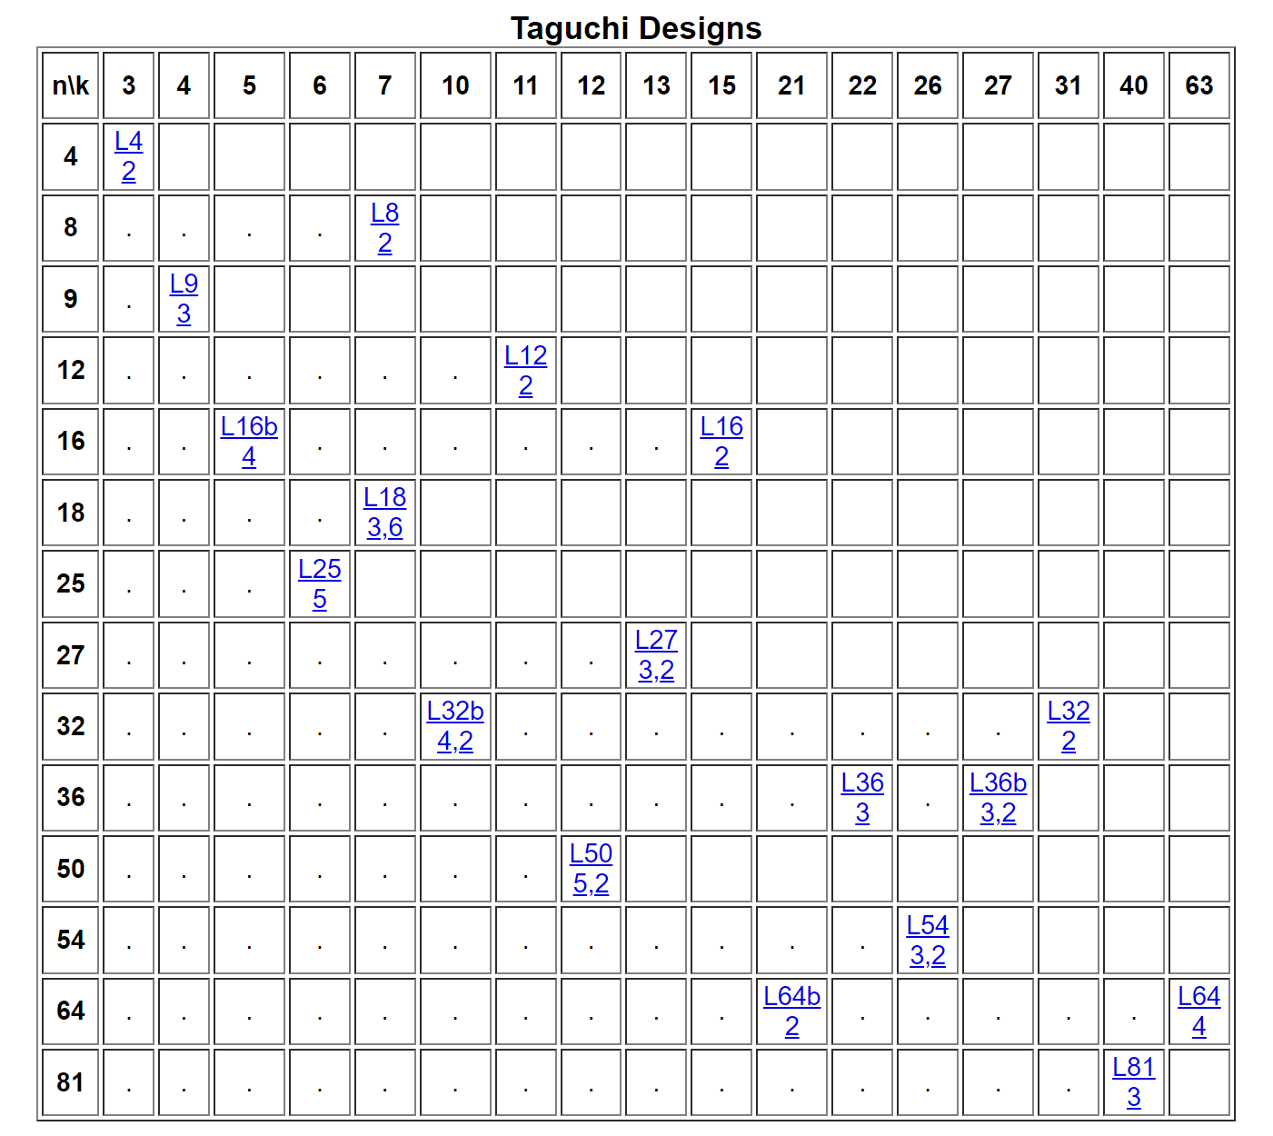
Table of Taguchi Designs (Orthogonal Arrays)
Table of Taguchi Designs
https://www.york.ac.uk/depts/maths/tables/taguchi_table.htm
http://support.sas.com/techsup/technote/ts723_Designs.txt

Slide 43
Orthogonal array example ① (1/2)
Example 1
A Web page has three distinct sections (Top, Middle, Bottom) that can be individually shown or hidden from a user
→ No of Factors = 3 (Top, Middle, Bottom)
→ No of Levels (Visibility) = 2 (Hidden or Shown)
Search in Taguchi Designs ➔ Array Type L₄(2³)

Slide 44
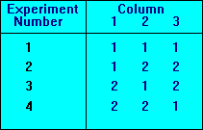
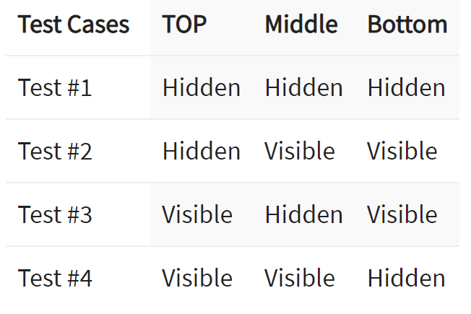
Orthogonal array example ① (2/2)
Result of Example 1
Replace the value of each Factor in order

Slide 45
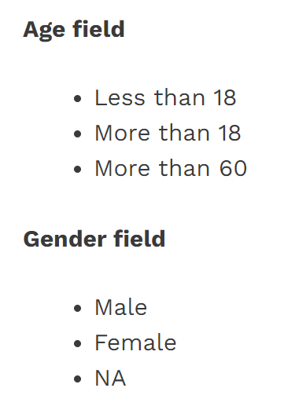
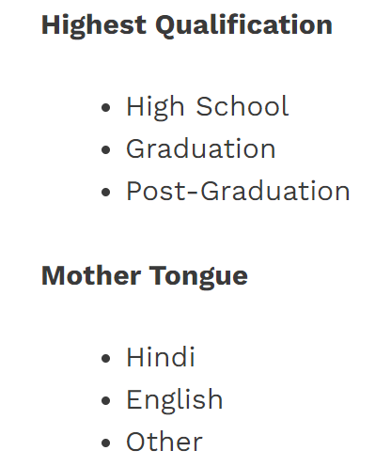
Orthogonal array example ② (1/2)
Example 2
Provide our personal information like below:
→ 4 Factors & 3 Levels
➔ Array Type L₉(3⁴)

Slide 46
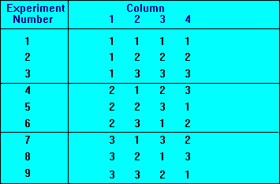
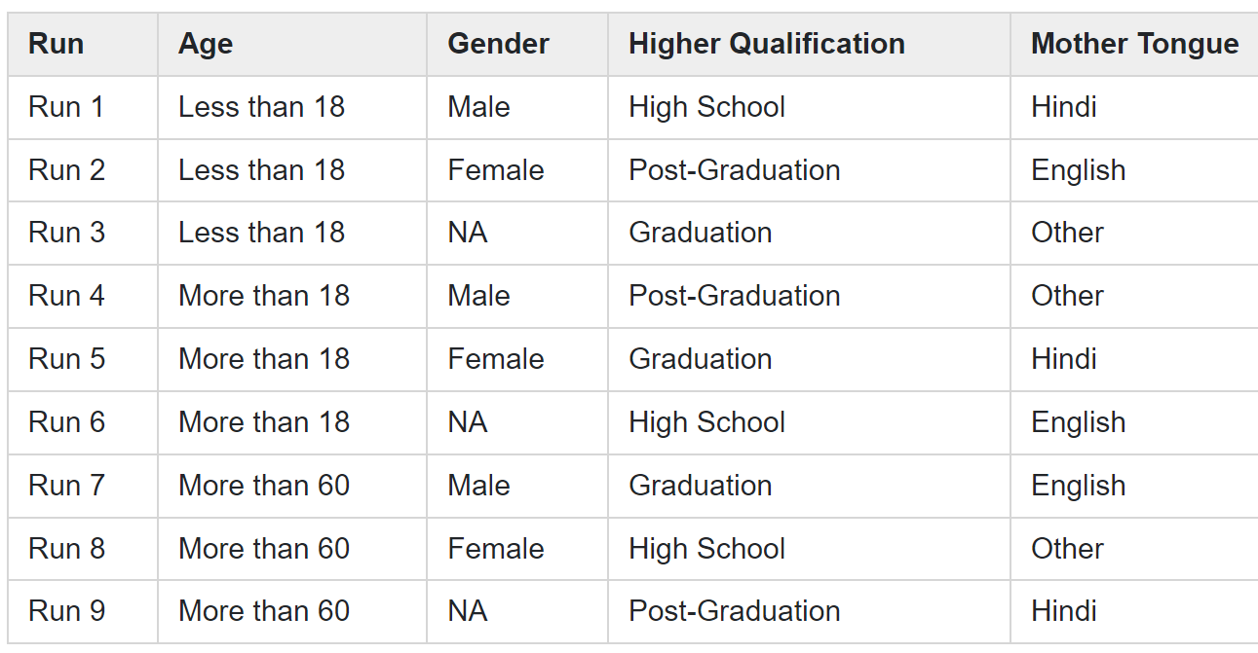
Orthogonal array example ② (2/2)
Result of Example 2

Slide 47
Orthogonal array example ② (1/2)
Example 3
3 variables:
A – 2 values (A1, A2)
B – 3 values (B1, B2, B3)
C – 3 values (C1, C2, C3)
→ 3 Factors & 3 Levels
➔ Array Type L₉(3⁴)
NOTE: L₄(2³) and L₈(2⁷) cannot be chosen because they have only 2 possible values (levels)

Slide 48
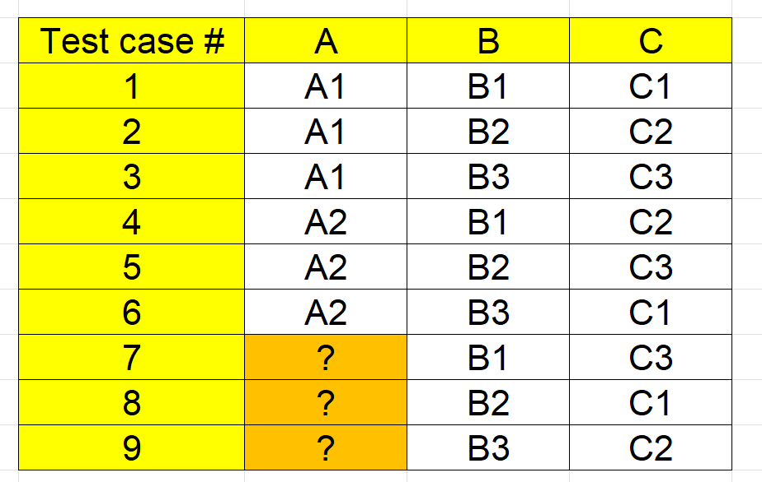
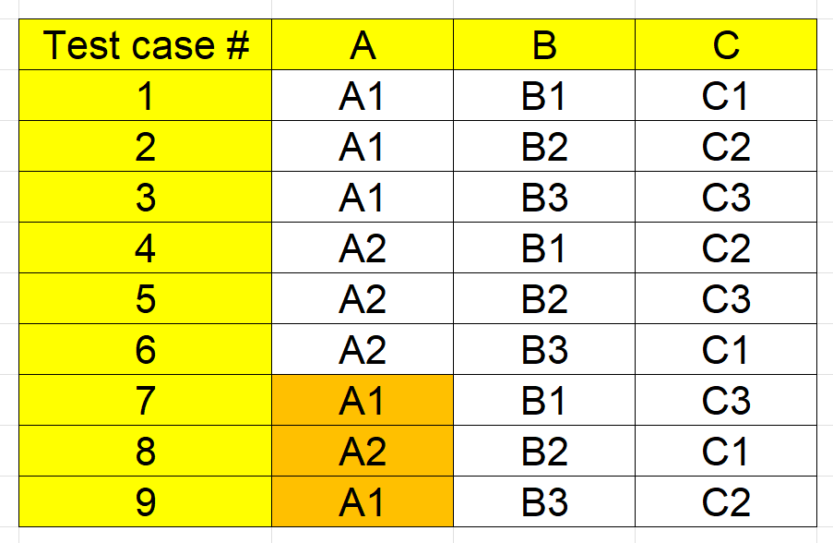
Orthogonal array example ② (2/2)
Result of Example 3
Empty Orthogonal Array cell → Cycle values in them.

Slide 49
Summary
Testing: Finding “Bugs”
Key to quality assurance
Flexible thinking is required
Black Box Testing: Operation confirmation seen from the outside
Equivalence partitioning:
Combination of valid and invalid equivalence classes
Boundary value analysis:
Focus on input/output conditions and boundaries between equivalence classes
Notes:
Quality Assurance:quality assurance
Kaname:key
Flexible thinking:flexible mindset
Example (Rei):example
Triangle problem:triangle problem

Slide 50
Homework
Answer “[4] quiz”
by tomorrow 13:00pm
(Notes: Your quiz score will be a part of your final project evaluation)

