Slide 1
ソフトウェアテスト [5] ブラックボックステスト演習
Software Testing
[5] Black Box Testing Exercise & Seminar
あまん ひろひさ
阿萬 裕久（AMAN Hirohisa）
aman@ehime-u.ac.jp

Slide 2
Exercise purpose
Perform Black Box Testing of programs (especially creating test cases) → Experience and learn the importance of software testing
Main contents
Program Black box testing
Creating programs according to specifications
Conducting tests by others
Fixing the program (if any defects are found)

Slide 3
Exercise content
Exercise 1
Create test cases and perform black box testing on a given program (with bugs)
Exercise 2
Create a program according to a given specification
Then, have someone else test the created program and if any defects are found, modify the program.

Slide 4
Exercise 1
*Bugs (errors) are intentionally created in the program.
Download both from Teams
[Test target] ex0501.c
Consider various test cases based on the program specifications (spec0501.pdf). and write them in an Excel sheet (test-report0501.xlsx)
Test the program for each test case. Write the test results in the Excel sheet
This is a black box test, so do not look at the contents of the program.

Slide 5
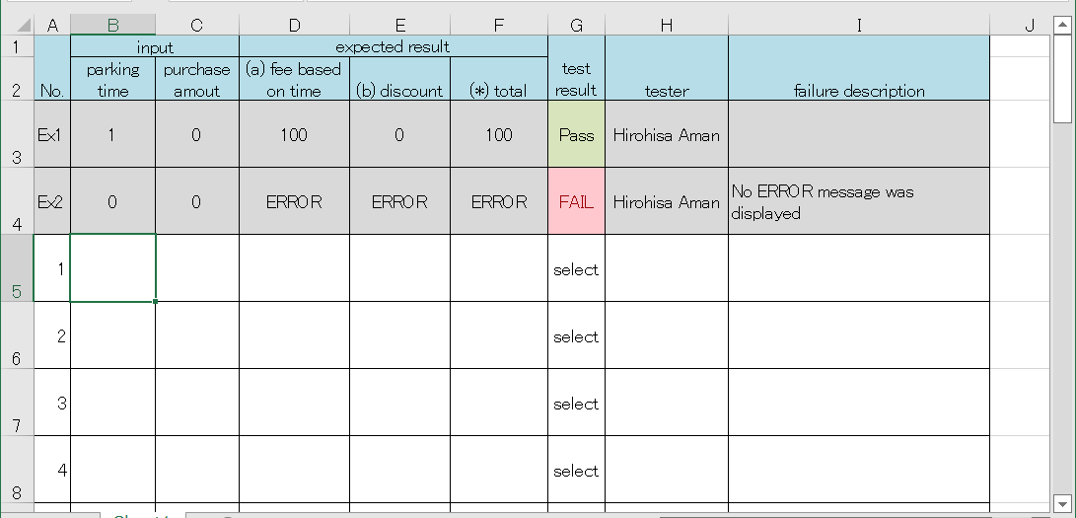
Test report created in Exercise 1
test-report0501.xlsx
Follow the example and fill in the blanks. Create various test cases using the equivalence partitioning method and boundary value analysis method (10 or more)

Slide 6
Submission of Exercise 1
Submit to Teams
test-report0501.xlsx
Submission deadline: Start of next lecture (Apr.1) 13:00 (Vietnam time)
[05] Exercise-1 (Black box testing)

Slide 7



Exercise 2
Create a program according to the specification spec0502.pdf
The source file name to be created is ex0502.c → Then, have someone else test it.
C
ex0502.c
program
Student A.
Student B.
test results
test-report0502.xlsx

Slide 8
Steps of Exercise 2 (1/2)
1. Create the program ex0502.c yourself (Specifications are spec0502.pdf)
2. Ask another student to test your ex0502.c 2-1) Fill in your name and fill in the tester’s name on test-report0502.xlsx. 2-2) Send your ex0502.c and test-report0502.xlsx to the tester.

Slide 9
Steps of Exercise 2 (2/2)
3. Test the program, enter the results into test-report0502.xlsx, and return it to the program author.
4. The program author checks the test results, corrects the program if there are bugs, and runs the test again.
5. The program author submits the final version of ex0502.c and test-report0502 to Teams.

Slide 10
Submission of Exercise 2
[05] Exercise-2 (Black box testing)
Submit to Teams
ex0502.c (final version)
test-report0502.xlsx
Submission deadline: Start of next lecture (Apr.1) 13:00 (Vietnam time)
yourself
ex0502.c
C
program
Student A.
Student B.
test results
test-report0502.xlsx

