Slide 1
ソフトウェアテスト [6] ホワイトボックステスト
Software Testing
[6] White Box Testing Techniques
あまん ひろひさ
阿萬 裕久（AMAN Hirohisa）
aman@ehime-u.ac.jp

Slide 2
Classification of tests
Explanation in the 4th session, exercises in the 5th session
Black box testing
Perform operational tests based on specifications without looking at the program contents (black box)
White box testing
Perform operational tests based on the internal structure of the program (mainly flowcharts)
Random testing
Create test cases randomly and perform operational tests

Slide 3
White box testing method
How to design test cases by focusing on the structure (contents) of the source program rather than the specifications
Test not in line with required specifications
Dealing with structural complexity (combination of conditions, etc.) in the source program
Tests that supplement black box testing

Slide 4
White box testing method (1) Statement coverage method
Execute all statements at least once
It may not be possible with only one test case (execution path)
With different test cases, and consider their collection of test cases → It is possible to cover them all
The percentage of statements that were executed is called the statement coverage rate.
This is also known as C0

Slide 5
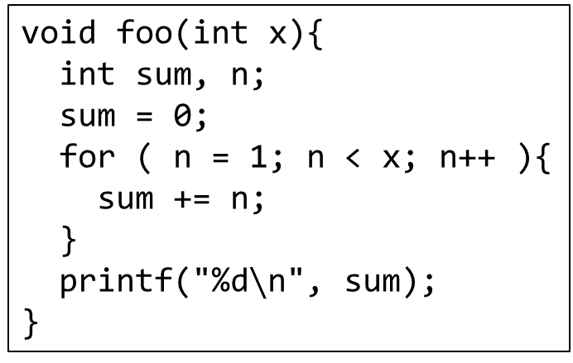
Example to test target (1)
void foo(int x){
int sum, n;
sum = 0;
for ( n = 1; n < x; n++ ){
sum += n;
}
printf("%d$∖$n", sum);
}
[input]
Arguments x
[output]
Values printed by printf
If x > 1, all statements can be executed (statement coverage rate = 100%)
Example test case
Input x = 2, output sum = 3

Slide 6
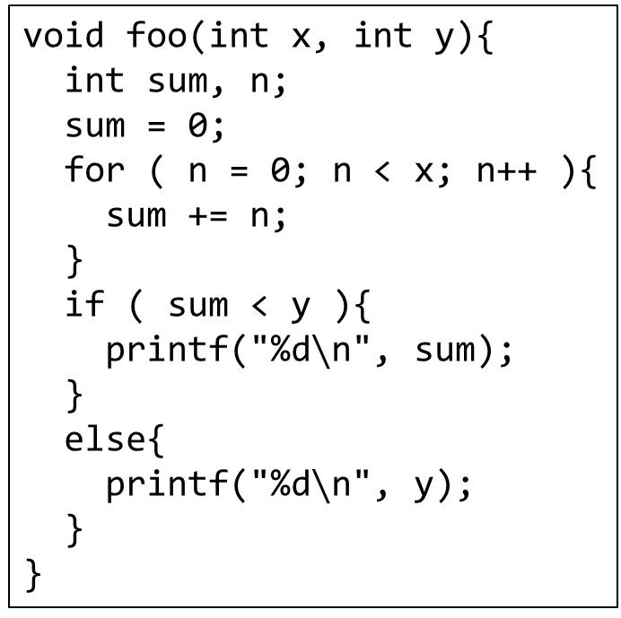
Example to test target (2)
void foo(int x, int y){
int sum, n;
sum = 0;
for ( n = 0; n < x; n++ ){
sum += n;
}
if ( sum < y ){
printf("%d$∖$n", sum);
}
else{
printf("%d$∖$n", y);
}
}
[input]
Arguments x, y
[output]
Values printed by printf

Slide 7
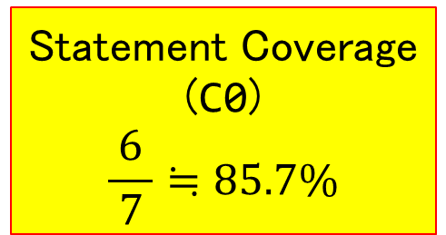
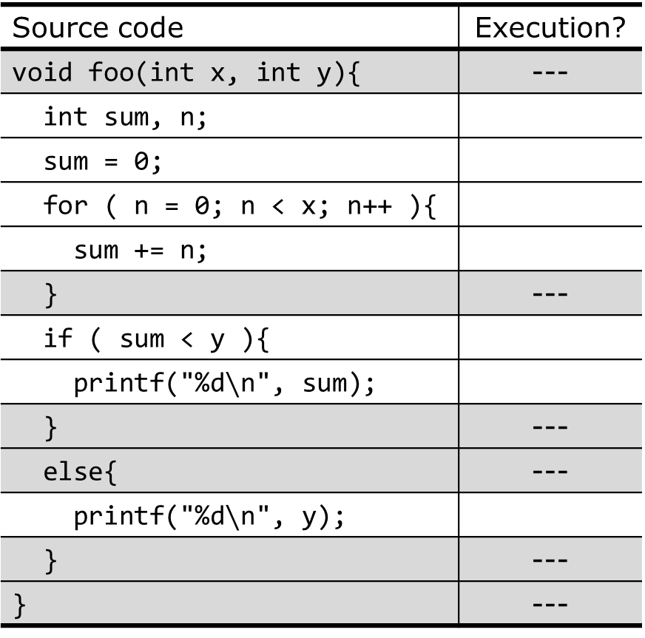
Statement coverage example: x=1,y=0
Source code | Execution?
void foo(int x, int y){ | ---
int sum, n;
sum = 0;
for ( n = 0; n < x; n++ ){
sum += n;
} | ---
if ( sum < y ){
printf("%d$∖$n", sum);
} | ---
else{ | ---
printf("%d$∖$n", y);
} | ---
} | ---
○
Statement Coverage (C0)
$$\frac{6}{ 7 }≒85.7\%$$
○
○
○
○
☓
← Since sum = 0
[Note]
It is necessary to define in advance which statements are counted as executable.
○

Slide 8
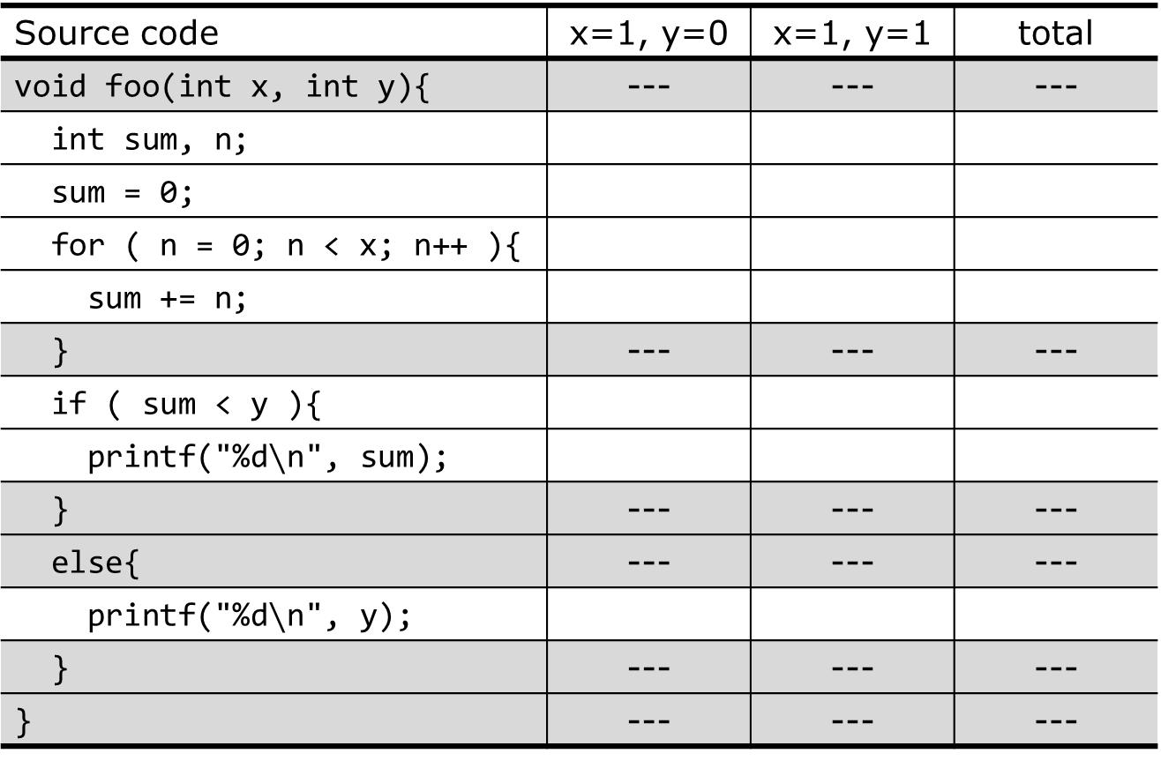
Example of 100% statement coverage
Source code | x=1, y=0 | x=1, y=1 | total
void foo(int x, int y){ | --- | --- | ---
int sum, n;
sum = 0;
for ( n = 0; n < x; n++ ){
sum += n;
} | --- | --- | ---
if ( sum < y ){
printf("%d$∖$n", sum);
} | --- | --- | ---
else{ | --- | --- | ---
printf("%d$∖$n", y);
} | --- | --- | ---
} | --- | --- | ---
○
○
○
○
○
○
○
○
○
○
○
○
○
○
○
☓
○
○
○
☓
○

Slide 9
When drawing a flowchart Test case ① x=1, y=0
START
Some statements are not executed
sum = 0
sum < y
F.
n = 0
T.
n < x
F.
output Sum
output Y
n++
T.
sum += n
END

Slide 10
When drawing a flowchart Test case ② x=1, y=1
START
Covers statements that were not executed in test case ①
sum = 0
sum < y
F.
n = 0
T.
n < x
F.
output Sum
output Y
n++
T.
sum += n
END

Slide 11
Automatic measurement of statement coverage rate
Checking and counting the execution of instructions by yourself is not an easy task
All you have to do is monitor whether all commands have been executed. The compiler gcc has an option for this, and when used with a tool called gcov, it can be checked automatically.
Use this in next week's exercise

Slide 12
Important
Next time, we will do a white box test exercise.
Everyone should bring a PC. Also, gcc and gcov are required, so be sure to install them.

Slide 13
White box test method (2) Branch coverage method
In all conditional branches (if statement, while statement, for statement), execute at least one case when the result is True and once when the result is False.
It would be better if it could be covered by a set of multiple test cases
The rate of experiencing “T” and “F” for all conditions is called the branch coverage rate.
This is also known as C1

Slide 14
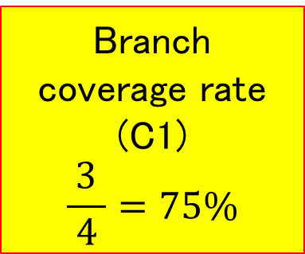
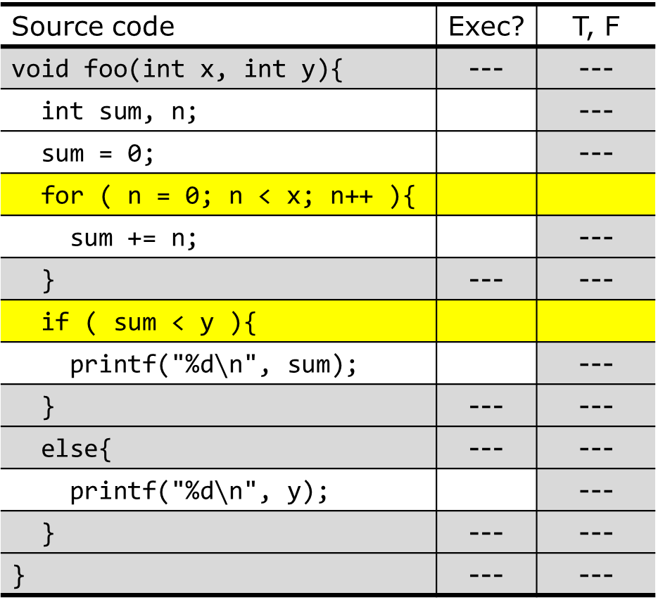
Branch coverage example: x=1, y=0
Source code | Exec? | T, F
void foo(int x, int y){ | --- | ---
int sum, n; |  | ---
sum = 0; |  | ---
for ( n = 0; n < x; n++ ){
sum += n; |  | ---
} | --- | ---
if ( sum < y ){
printf("%d$∖$n", sum); |  | ---
} | --- | ---
else{ | --- | ---
printf("%d$∖$n", y); |  | ---
} | --- | ---
} | --- | ---
○
Branch coverage rate (C1)
$$\frac{3}{ 4 }=75\%$$
○
○
T
F
○
○
F
☓
○

Slide 15
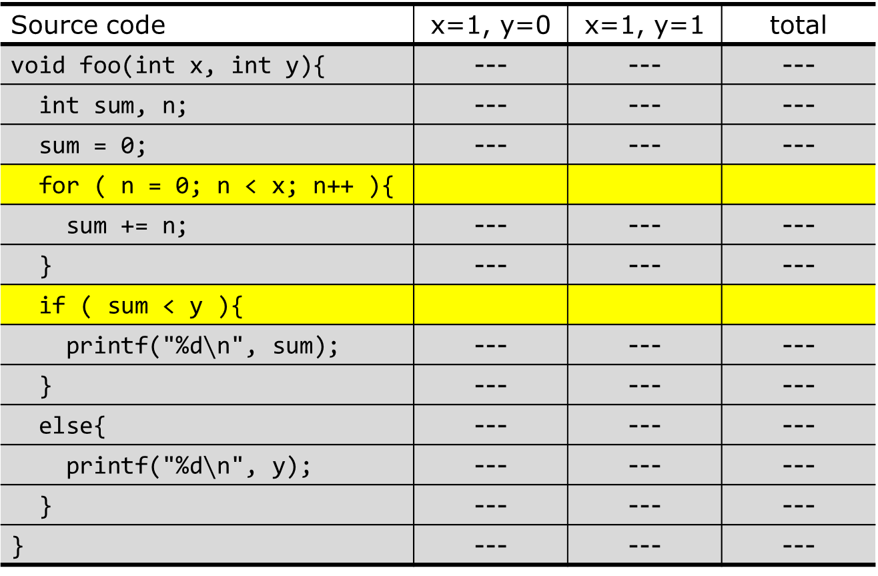
Example of 100% branch coverage rate
Source code | x=1, y=0 | x=1, y=1 | total
void foo(int x, int y){ | --- | --- | ---
int sum, n; | --- | --- | ---
sum = 0; | --- | --- | ---
for ( n = 0; n < x; n++ ){
sum += n; | --- | --- | ---
} | --- | --- | ---
if ( sum < y ){
printf("%d$∖$n", sum); | --- | --- | ---
} | --- | --- | ---
else{ | --- | --- | ---
printf("%d$∖$n", y); | --- | --- | ---
} | --- | --- | ---
} | --- | --- | ---
T.
F.
T.
F.
T.
F.
F.
T.
T.
F.

Slide 16
When drawing a flowchart Test case ① x=1, y=0
START
Experience only F
Experienced both T and F
sum = 0
Therefore, the branch coverage rate (C1) is 3/4
sum < y
F.
n = 0
T.
n < x
F.
output Sum
output Y
n++
T.
sum += n
END

Slide 17
When drawing a flowchart Test case ② x = 1, y = 1
START
Covers the “T” side that was not executed in test case ①
sum = 0
sum < y
F.
n = 0
T.
n < x
F.
output Sum
output Y
n++
T.
sum += n
END

Slide 18
Let's consider another example
Consider a program that performs a simple security check on passwords
[Check items]
Is the password length at least 6 characters?
Is the password the same as your username?

Slide 19
Example of 75% branch coverage rate
START
test cases
(username, password)
① ("taro","")
② ("taro","foobar")
③ ("taro","taro")
②
pwd length
>= 6
T.
Password != Username
①
F.
F.
③
There are password lengths < 6 and password lengths >= 6, some have different usernames and passwords, and some have the same password, but this is not exhaustive.
output No
②
T.
output OK
END

Slide 20
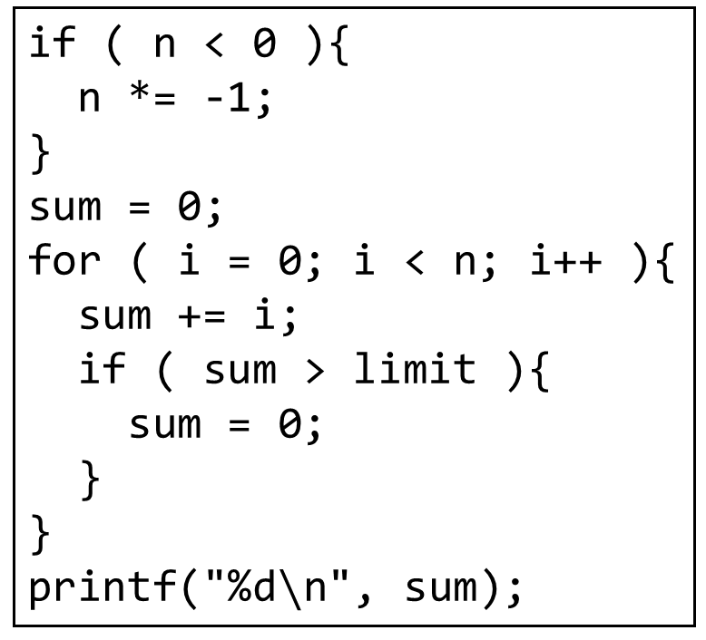
[Exercise 1] Calculate C0 and C1
(Note) “}” in the program is not counted as a statement.
I ran two test cases for the code on the right
(n, limit)
= (2, 1), (-2, 0)
In this case, calculate the C0 and C1
if ( n < 0 ){
n *= -1;
}
sum = 0;
for ( i = 0; i < n; i++ ){
sum += i;
if ( sum > limit ){
sum = 0;
}
}
printf("%d$∖$n", sum);

Slide 21
[Exercise 1] Answer: 100% for ① and ②
test cases
START
(n, limit) =
① (2, 1)
② (-2, 0)
i = 0
F.
n < 0
i < n
T.
①
②
T.
sum += i
i++
①
F.
①
n *= -1
sum > limit
F.
output sum
sum = 0
①
T.
②
sum = 0
END

Slide 22
[Exercise 2] Calculate branch coverage rate
(Note) Please note that when you execute the return statement, the function ends at that point.
int is_prime(int n){
int k;
if ( n < 2 ){
return 0;
}
for ( k = 2; k < n; k++ ){
if ( n % k == 0 ){
return 0;
}
}
return 1;
}
The function on the right
Calculate the branch coverage rate (C1) when testing by calling
is_prime(1);
is_prime(2);

Slide 23
Notes for exercise 2
It is a good idea to note down the conditions T and F for each of n=1 and n=2 while checking whether or not they are executed.
Source code | n=1 実行 条件 |  | n=2 実行 条件 |  | total
int k; |  | --- |  | --- | ---
if ( n < 2 ){
return 0; |  | --- |  | --- | ---
} |  | --- |  | --- | ---
for ( k = 2; k < n; k++ ){
if ( n % k == 0 ){
return 0; |  | --- |  | --- | ---
} |  | --- |  | --- | ---
} |  | --- |  | --- | ---
return 1; |  | --- |  | --- | ---

Slide 24
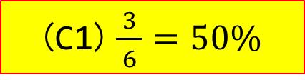
[Exercise 2] Answer
(C1) $\frac{3}{ 6 }=50\%$
Source code | n=1 実行 条件 |  | n=2 実行 条件 |  | total
int k; |  | --- |  | --- | ---
if ( n < 2 ){
return 0; |  | --- |  | --- | ---
} |  | --- |  | --- | ---
for ( k = 2; k < n; k++ ){
if ( n % k == 0 ){
return 0; |  | --- |  | --- | ---
} |  | --- |  | --- | ---
} |  | --- |  | --- | ---
return 1; |  | --- |  | --- | ---
○
○
○
T
○
F
T F
○
☓
☓
○
F
F
☓
☓
☓
☓
☓
○

Slide 25
White box testing method (3) Condition coverage method
Execute all conditional branches to cover all combinations of T and F
Ex: If there are two conditional branches
→ Test all of (F, F), (F, T), (T, F), (T, T)
The rate at which these can be executed is called the condition coverage rate, also called C2.
Ignore infeasible combinations
In the worst case,
The complexity is O(2^{n})

Slide 26
Example of 100% condition coverage
START
Combination |  | pwd length
 |  | < 6 | >= 6
Usr & Pwd | same | ー | ②
 | difference | ① | ③
pwd length
>= 6
T.
Password != Username
F.
F.
test cases
(username, password)
① ("taro","")
② ("momotaro","momotaro")
③ ("taro","foobar")
output No
T.
output OK
END

Slide 27
The difference between C1 and C2
test cases
①x = 1, y = 1 ②x = 0, y = 0
x > 0
T.
F.
(2) C1=100%
(3) C2=50%
processA.
processB.
 | T. | F.
x > 0 | ① | ②
y > 0 | ① | ②
 | x > 0 | y > 0
② | F. | F.
 | F. | T.
 | T. | F.
① | T. | T.
y > 0
T.
F.
processC.
processD.

Slide 28
Three types of inclusion relations
C2: 100%
⇒ C1: 100%
C1: 100%
⇒ C0: 100%
C0: 100%
C1: 100%
C2: 100%

Slide 29
Common Misconceptions
“C1: 100% ⇒ C0: 100%” means “C1 ≤ C0”, right?
This proposition only applies to the case of 100% coverage and is not guaranteed for other cases.
(Example)
Error
x > 0
T.
F.
A.
If the left condition is false (F.)
C1 = 1/2 = 50%
C0 = 1/3 = 33.3%
B.

Slide 30
Three types of white box testing
Statement coverage (C0) can be easily achieved
Branch coverage (C1) is somewhat complicated, but unless the scale is large, it is possible to increase the coverage rate (however, the more conditional branches there are, the more difficult it becomes).
The feasibility of condition coverage (C2) becomes much more difficult as the scale and complexity increases.
For example, if we consider the state transition of a smartphone, there are as many branches as there are icons that can be tapped on each screen, so the total number of combinations increases explosively.

Slide 31
Relationship with black box testing
White box testing is weaker than black box testing such as equivalence partitioning
In the first place, we did not test whether it complied with the required specifications.
However, it can check “complex combinations of conditions“ that are often overlooked in black box testing
Also, there may be problems caused by the program (rather than the specifications)
The function is to reinforce black box testing

Slide 32
Realistically, you should perform a black box test and then pay attention to the coverage rate (C0, C1)
It is of course necessary to check whether the specifications are met, so we execute several test cases using black box testing.
At that time, by paying attention to the statement coverage rate and branch coverage rate, you can eliminate omissions in checks that were not noticed during black box testing.
The most basic is the statement coverage rate (C0), and if this is not 100%, that is, if there are statements that are not executed, it is no good.

Slide 33
Classification of tests
Black box testing
Perform operational tests based on specifications without looking at the program contents (black box)
White box testing
Perform operational tests based on the internal structure of the program (mainly flowcharts)
Random testing
Create test cases randomly and perform operational tests

Slide 34
Random testing method
How to create input data randomly
It may be necessary to consider the probability distribution according to which random data is generated.
Normal distribution
Poisson distribution
Uniform distribution

Slide 35
For example, consider the Poisson distribution
When a request is sent to the server
When simulating such a situation, the number of requests per unit time can be modeled using a Poisson distribution.
Occurrence probability
Poisson distribution
Although it is random data,
➔ Can perform tests based on reality
Number of requests

Slide 36
Advantages and disadvantages of random testing methods
Advantage
A large number of test cases can be automatically generated.
Sometimes test cases are discovered that test designers and developers would not have thought of.
Disadvantage
It is not possible to perform tests according to specifications.
The coverage rate is low for the number of test cases.

Slide 37
Types of testing methods and stages of application
Black box testing method
Can be used widely from unit tests to system tests
White box testing method
Unit tests and (small) integration tests are limited (It is difficult to cover the control flow of the entire system)
Random testing method
Try various input patterns to make sure there are no unexpected mistakes

Slide 38
Testing various requests
The methods introduced so far mainly test the correctness of input and output.
But, in reality, many other tests are required.
For example,
Performance test (response time, processing speed)
Storage test (required memory and hard disk capacity)
Stress test (test under overload conditions)
Various assumptions are required (Knowledge and experience are also important)

Slide 39
Summary
White Box Testing: Execution Path Coverage
Statement coverage (C0): Execute all statements
Branch coverage (C1): Execute both True and False cases for all branches
Condition coverage (C2): Execute all combinations of True and False cases for all branches
Random testing: Generate input data randomly
It is also important to operate under load

Slide 40
Homework
Answer “[6] quiz”
by this Friday 23:59
(Note: Your quiz score will be a part of your final evaluation)

Slide 41
Important Notice
Next week’s lecture is an exercise. You all must do exercises on your PC. Install gcc and gcov on your PC before the lesson.

