Slide 1
ソフトウェアテスト [7] ホワイトボックステスト演習
Software Testing
[7] White Box Testing Exercise & Seminar
あまん ひろひさ
阿萬 裕久（AMAN Hirohisa）
aman@ehime-u.ac.jp

Slide 2
Exercise purpose
Perform White Box Testing of the program to experience and learn the importance of software testing together with black box testing
Main contents
Checking statement coverage using tools
Create a program according to specifications
Conducting tests by others
Fixing the program (if any defects are found)

Slide 3
Exercise content
Exercise 1
Test the given program (with bugs) and check the statement coverage (using tools)
Exercise 2
Create a program according to a given specification
Then, have someone else test the created program and if any defects are found, modify the program.

Slide 4
Exercise 1
Same as the one used in the 5th exercise ([05] Exercise)
[Test target] ex0501.c
Copy the test case created with [5] Exercise-1 (test-report0501.xlsx) to test-report0701.xlsx. Then, execute them in order and check the statement coverage rate.
If the statement coverage rate does not reach 100% even after executing all test cases, add new test cases until it becomes 100% (add it to test-report0701.xlsx).

Slide 5
Tools used in Exercise 1
Use a tool (program) called gcov
This is usually installed with gcc
This tool can examine source files and executable files compiled with gcc and record how many times each statement is executed.

Slide 6
gcov Usage flow (1/7)
① First, compile the program with gcc
however, add the option -coverage
② Then, run the program and test the first test case
gcc –coverage ex0501.c
For example
Parking time = 10
Purchase = 0

Slide 7
gcov Usage flow (2/7)
The statement coverage rate is slightly different in Mac
③ Next, use the gcov command to analyze the execution results and correlate them with the source program.
The statement coverage rate is displayed on this line (73.53%)
gcov ex0501.c
File 'ex0501.c'
Lines executed: 73.53% of 34
Creating ‘ex0501.c.gcov'
A file called
ex0501.c.gcov is created that records the details

Slide 8
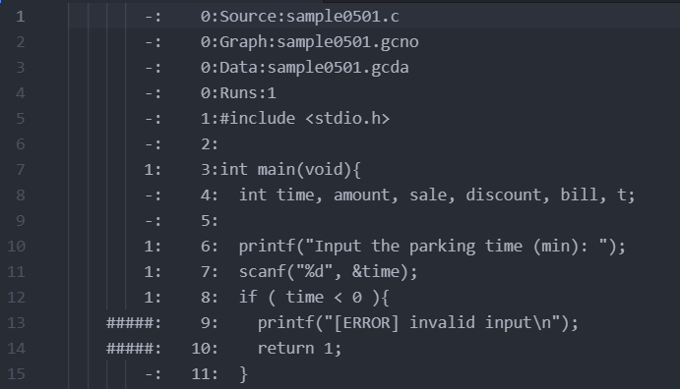
gcov Usage flow (3/7)
Slightly different in Mac
④ Take a look at ex0501.c.gcov
Number of executions
Focus on this
Below is the content of the program

Slide 9
gcov Usage flow (4/7)
Slightly different in Mac
Statement Coverage Information
symbol | meaning
- | does not count as an instruction
numbers | total number of executions of the line
##### | not executing that line

Slide 10
gcov Usage flow (5/7)
Slightly different in Mac
⑤ Next, run the second test case
⑥ Check with gcov again
For example
Parking time = -10 (to make an error)
The statement coverage is increasing (73.53%→79.41%)
gcov ex0501.c
File 'ex0501.c'
Lines executed: 79.41% of 34
Creating 'ex0501.c.gcov'

Slide 11
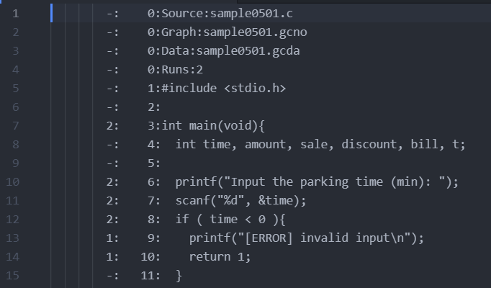
gcov Usage flow (6/7)
Slightly different in Mac
⑦ View the contents of ex0501.c.gcov again
The number of executions has been increased to 2
This part has also changed

Slide 12
gcov Usage flow (7/7)
By repeating steps ⑤ to ⑦, statement coverage will gradually increase (Note that it is cumulative. However, the manner in which the statement coverage rate increases will differ depending on the test case.
[Note!]
If you recompile with gcc, the count of executions will be reset, so be careful.

Slide 13
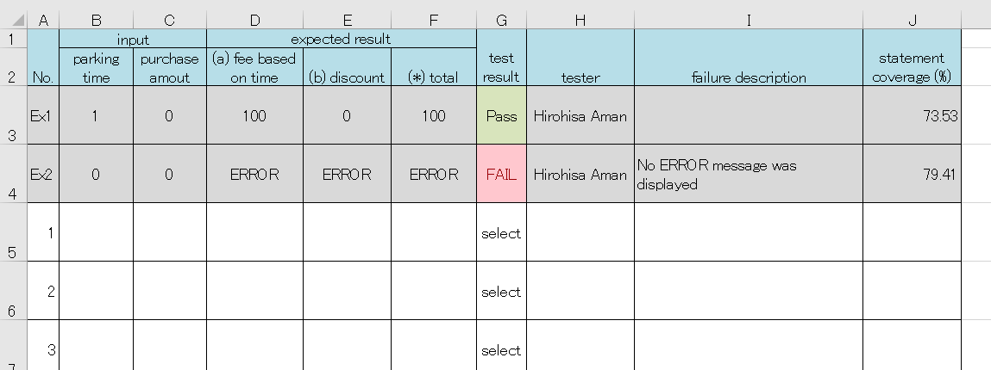
Test results in Exercise 1
test-report0701.xlsx
A column for "Statement Coverage" has been added to the sheet of Exercise 1 in the 5th session.
Copy the content you created in the 5th exercise (test-report0501.xlsx) and fill in the instruction coverage rate in order from top to bottom.
f it does not reach 100%, add a test case (change the color so you can see the added line)

Slide 14
Submission of Exercise 1
Submit to Teams test-report0701.xlsx
Submission deadline: Start of next lecture (Apr.15) 13:00 (Vietnam time)
[7] Exercise-1 (white box testing)

Slide 15



Exercise 2
Complete the ex0702.c program (program specification spec0702.pdf)
Test your program with others
C
ex0702.c
program
Student A.
Student B.
test results
test-report0702.xlsx

Slide 16
Steps of Exercise 2 (1/2)
Included in ex7-materials.zip but incomplete
1. Make your own program ex0702.c (specifications are spec0702.pdf)
2. Ask another student to test the program 2-1) Fill in your name and tester’s name on test-report0702.xlsx. 2-2) Send your ex0702.c and test-report0702.xlsx to the tester.

Slide 17
Steps of Exercise 2 (2/2)
3. Test the program, enter the results into test-report0702.xlsx, and return it to the program creator.
4. The program creator checks the test results, corrects the program if there are any bugs, and runs the test again.
5. The program creator submits the final version of ex0702.c and test-report0702.xlsx to Teams.

Slide 18
Submission of Exercise 2
[7] Exercise-2 (white box testing)
Submit to Teams
ex0702.c (final version)
test-report0702.xlsx
Submission deadline: Start of next lecture (Apr.15) 13:00 (Vietnam time)
yourself
ex0702.c
C
program
Student A.
Student B.
test results
test-report0702.xlsx

Slide 19
In the next lecture, we will analyze data using R and RStudio.
Notice: All students must use your PC in the next week’s lesson.
You must install R and RStudio on your PC before the lesson.

