Slide 1
ソフトウェアテスト [8] テストの評価と信頼性
Software Testing
[8] Evaluation of testing and reliability
あまん ひろひさ
阿萬 裕久（AMAN Hirohisa）
aman@ehime-u.ac.jp

Slide 2
Evaluation of the test
Testing is the activity of quality assurance of software
Evaluation of “Testing Activities” is necessary
Evaluation based on Coverage rate
Evaluation based on Bug resolution rate
Evaluation based on Operability
Perfect Testing
⇒ There is no defect (fault) and no failure occurs.
There are no so-called "bugs".

Slide 3
Test evaluation (1) Evaluation based on coverage rate
Evaluation from the perspective of "how much was covered”
Focus on state transition
Focus on behavior or input/output according to specifications
Focus on flow of program execution
*black box testing
*white box testing

Slide 4
Test evaluation (2) Evaluation based on bug resolution rate
Testing finds bugs and fixes them
If the total number of bugs is known, testing activities can be evaluated based on the number of bugs resolved.
Bug's
resolution rate
number of bugs resolved
=
total number of bugs
*Note: The term bug is not accurate; A phenomenon that does not work properly ("failure, defect") is found in the test, and "resolution" is to solve the "fault" that is the source of problem or the "error" that created it.

Slide 5
How do you know the “total number of bugs”?
In conclusion, the true number is unknown
If we compare humans to systems, it would be like trying to figure out how many times we will get sick in our lifetime.
If we consider that “occurrence of a problem = symptoms of a disease“, then a fault can be considered to be the bacteria or virus that caused it, and an error can be considered to be the action that led to the infection.
We can only estimate the total number of bugs (Statistically)

Slide 6
Bug number estimation method ① Capture/recapture method (1/4)
[Example]
I would like to find out how many black bass there are in Lake Biwa.
*It would be nice if we could catch all the fish in Lake Biwa, but that is realistically impossible.

Slide 7
Bug number estimation method ① Capture/recapture method (2/4)
Catch an appropriate number of black bass.
Then mark the black bass and release it.
After a while, catch the black bass again. Estimate the total number based on how many marked ones are included.

Slide 8
Bug number estimation method ① Capture/recapture method (3/4)
The image will like this
Marking 10 fishes for the first time
2nd time, 2 out of 10 fishes confirmed markings
Then recaptured
Estimation of percentage of total
This image diagram
10 : ? = 2 : 8
So, there are 40 fishes left
:
= 2 : 8

Slide 9
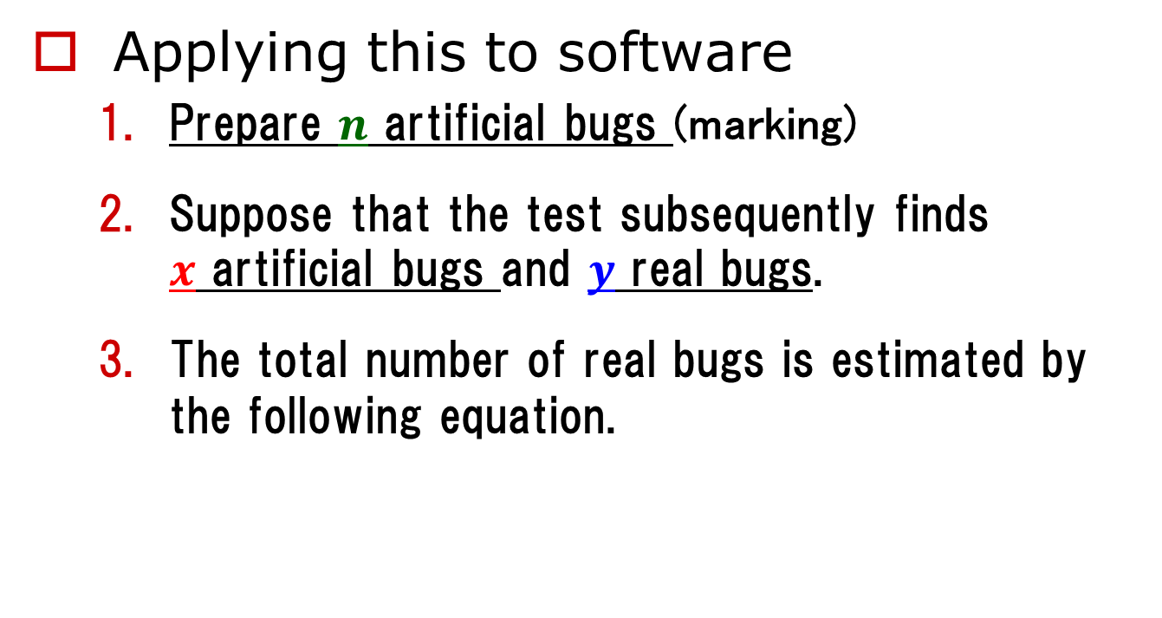

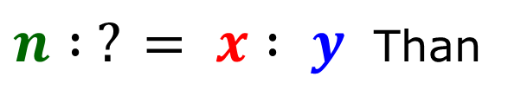
Bug number estimation method ① Capture/recapture method (4/4)
Applying this to software
Prepare $n$ artificial bugs (marking)
Suppose that the test subsequently finds $x$ artificial bugs and $y$ real bugs.
The total number of real bugs is estimated by the following equation.
$n : ? = x : y$ Than
$$\frac{ n y }{x}$$

Slide 10


Disadvantages of the capture / recapture method
It's hard to make realistic artificial bugs
Inevitably, it becomes a bug that seems to be intentional, and it is found immediately
The psychology of engineers is that there is resistance to "creating bugs" (voices in the field)
You end up releasing fish that are easy to catch, so the estimated number is lower than the actual number.
$$\frac{ n y }{x}$$
* $y$ is smaller and $x$ is larger than it should be.

Slide 11
Bug number estimation method (2) Two-step editing method (1/3)
Improved capture/recapture method without using artificial bugs
Prepare two test groups A, B
Group A tests and records the bugs found (keeping them secret to B)
Group B tests and estimates the number of remaining bugs based on how many of the bugs found are the same as A.

Slide 12
Bug number estimation method (2) Two-step editing method (2/3)
Think like a capture-recapture method
Group A found 10 bugs
2 out of 10 items found in group B included items found in group A
Estimation of percentage of total
10 : ? = 2 : 8
So there are 40 bugs that have not been found by A.
:
= 2 : 8

Slide 13

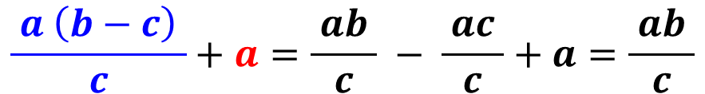

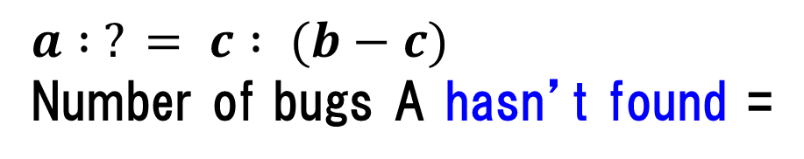
Bug number estimation method (2) Two-step editing method (3/3)
Number of bugs found by group A = $a$
Number of bugs found by group B = $b$
Number of bugs found in both = $c$
$$a : ? = c : (b−c)$$
Number of bugs A hasn’t found =
$$\frac{ a \left(b−c\right) }{c}$$
The total number of bugs (including those found) is:
$$\frac{ a \left(b−c\right) }{c}+a=\frac{ ab }{c} − \frac{ ac }{c}+a=\frac{ ab }{c}$$

Slide 14
Features of Two-step editing method
No need to prepare artificial bugs
(Estimation can be made using only real bugs)
Since the two teams need to test separately, which is more time consuming and costly
Estimates tend to be smaller than actual values

Slide 15
[Exercise 1]
① Find an estimate of the total number of bugs
Group A finds 10 bugs,
Group B finds 50 bugs.
However, 5 were found in both groups.
② Find an estimate of the number of remaining bugs (not found yet).
Group A finds 100 bugs,
Group B finds 80 bugs.
However, 20 were found in both groups.

Slide 16
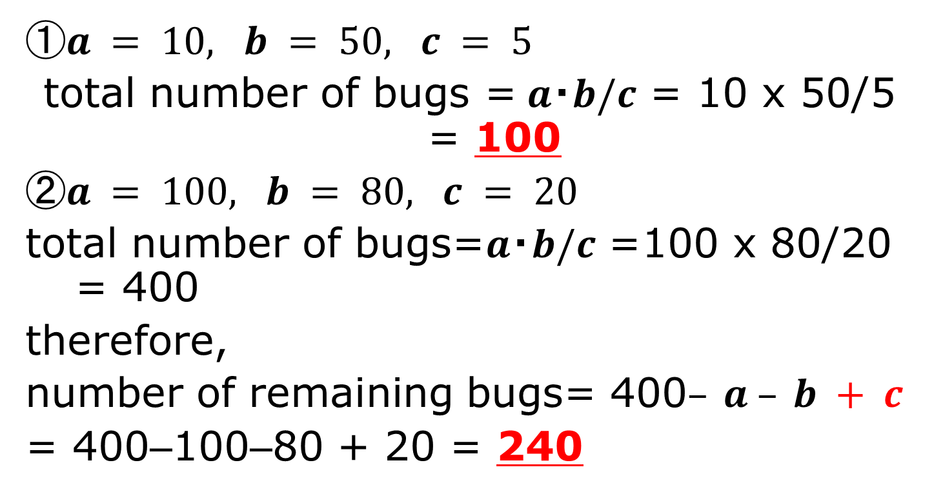
[Exercise 1] Answer
①$a = 10, b = 50, c = 5$
total number of bugs =$a・b/c$ = 10 x 50/5 = 100
②$a = 100, b = 80, c = 20$
total number of bugs=$a・b/c$ =100 x 80/20 = 400
therefore,
number of remaining bugs= 400$– a – b + c$
= 400–100–80 + 20 = 240
because what is found in both is double subtracted

Slide 17
Bug number estimation method (3) Gompertz curve model (1/4)
What is the Gompertz curve model?
A type of growth curve model that represents the process from the beginning of various events to growth and convergence.
Cumulative number of event occurrences
convergence
stage
Preparation
stage
growth
stage
elapsed time

Slide 18
Bug number estimation method (3) Gompertz curve model (2/4)
Used for growth model of cumulative number of bugs
Eventually you will find many things
Cumulative bugs
You won't be able to find it soon
Not often found right away
Preparation
stage
convergence
stage
growth
stage
test time

Slide 19

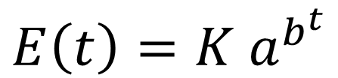



Bug number estimation method (3) Gompertz curve model (3/4)
Mathematically
$$E\left(t\right)=K a^{b^{t}}$$
$$a, b （<1）, K$$ is a parameter that determines the shape of the curve
$$E(t)$$
$$K$$
$$t$$
*This curve shows an empirical trend

Slide 20




Bug number estimation method (3) Gompertz curve model (4/4)
It is possible to estimate (predict) the test time required to obtain reliability at a specific point in time or target reliability.
$$E(t)$$
(Example)
95% of the final value K
the corresponding expected time
$$K$$
$$0.95K$$
$$t$$

Slide 21
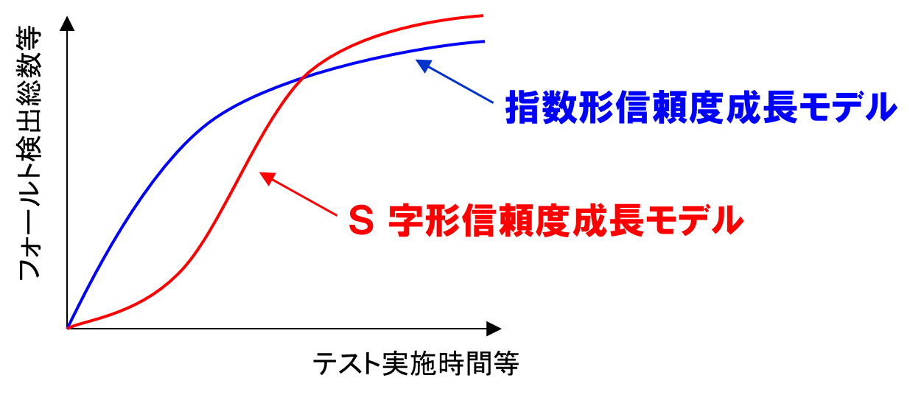

Bug number estimation method (3) Software reliability growth model
Exponential Software Reliability Growth Model
Delayed S-shaped SRGM
$$E\left(t\right)=a(1−e^{−bt})$$
Mathematical model expressing bug detection probabilistically
$$E\left(t\right)=a\left\{ 1−\left(1+bt\right)e^{−bt} \right\}$$

Slide 22
Bug number estimation method ④ Method based on past statistical data
Method using actual values ​​from past projects
For example, if the past bug density is 3.8 [bugs/KLOC] and the scale of this development is 100 [KLOC], then it is estimated that simply 3.8 x 100 = 380 bugs
Although it is a simple method, the prediction accuracy is not bad
*LOC = Lines Of Code : Number of code lines (excluding comments and blank lines) KLOC = 1000 LOCs

Slide 23
[Exercise 2] Predict the number of remaining bugs
When testing the deliverables of a project, we found a total of 38 bugs.
The bug density in a similar project in the past was 2.5 [bugs/KLOC].
The scale of this development is 20 [KLOC].
How many more bugs are expected to remain undetected?

Slide 24
[Exercise 2] Answer
First, based on past performance and the scale of this development,
2.5 x 20 = 50
Than, it is predicted that there will be a total of 50 bugs
At the moment, 38 bugs found (76% = 38/50), so the rest 12 bugs (24%).

Slide 25
Evaluation of the test (3) Evaluation based on operability
In system testing (imitating operations)
Average value of the time interval at which failures (malfunctions) occur
MTBF (Mean Time Between Failure)
Occurrence of failure
Average time interval = MTBF
restoration
operating
time

Slide 26
Evaluation by MTBF
MTBF length means high reliability
However, it is meaningless unless the system test environment is close to the actual operational environment.
Random testing according to appropriate stochastic models is important
(Of course, human testing is also important)

Slide 27
Summary
Test Evaluation:
coverage rate, bug resolution rate
Estimation of number of bugs →Two-step editing method，growth curve，bug density
Operability Evaluation: MTBF

Slide 28
Software reliability growth model (Theory Explained and R Exercises)
Download lecture08-materials.zip
(Includes data files srgm-data1.csv, srgm-data2.csv and R script Rscript08.R)

Slide 29
Growth curve
A curve that models how the target data changes over time and input of man-hours
Using cumulative number to catch its growth
Estimation using models is also performed
The software reliability growth model that models the number of detected failures is famous.
Failure cumulative number
Time or effort

Slide 30
Software reliability growth model: SRGM
Modeling the relationship between testing time and total number of bugs.
Exponential reliability growth model
Total number of bugs
S-shaped reliability growth model
Testing time or testing effort

Slide 31



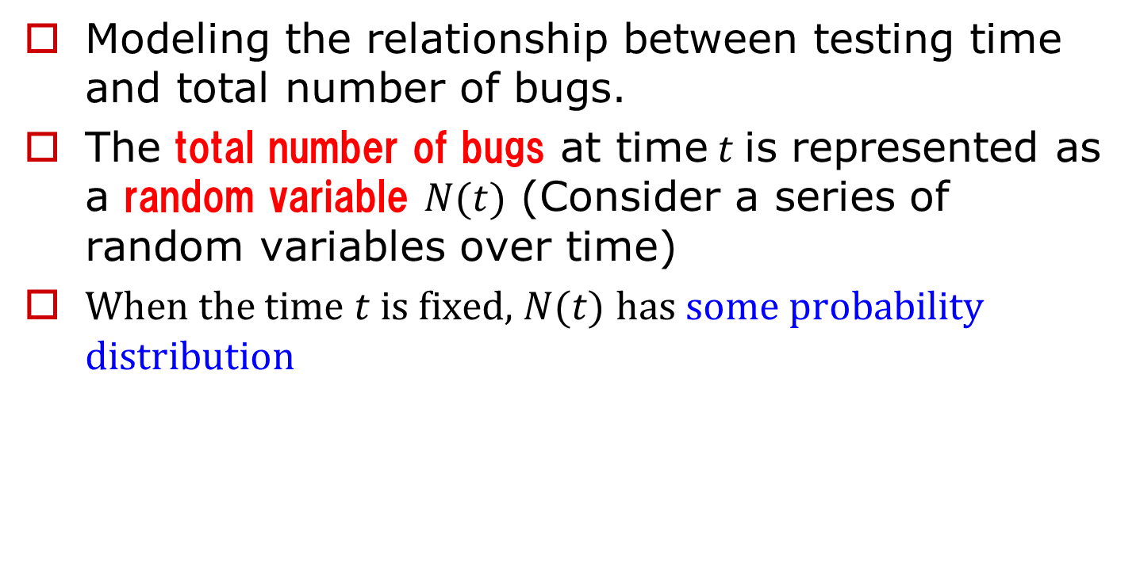
Stochastic process model for the number of bugs
Modeling the relationship between testing time and total number of bugs.
The total number of bugs at time$t$is represented as a random variable $N(t)$ (Consider a series of random variables over time)
W$hen the time t$is fixed,$N(t)$ has some probability distribution
（Example）
0
1
2
3
4
5
6
7
8
9
10 ・・・・・

Slide 32
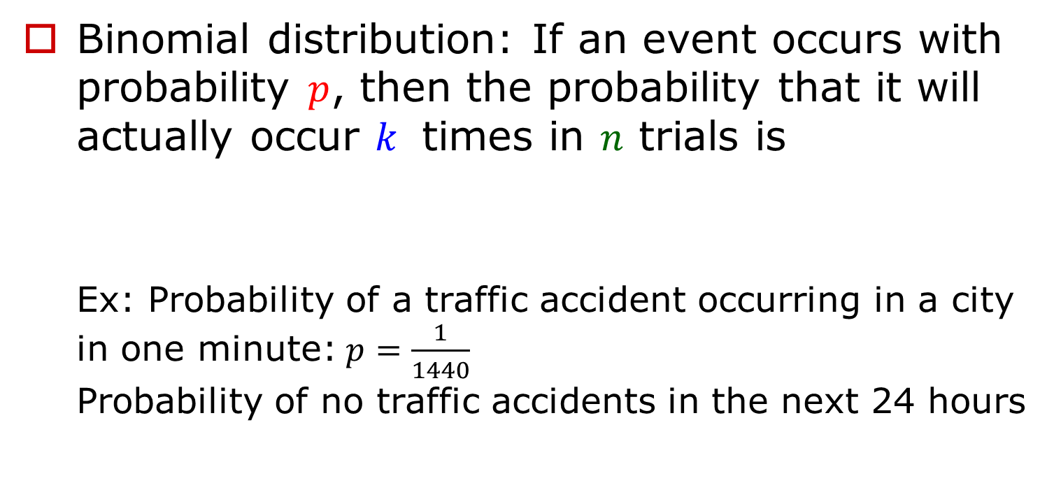
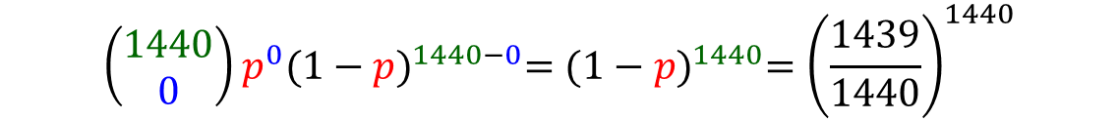
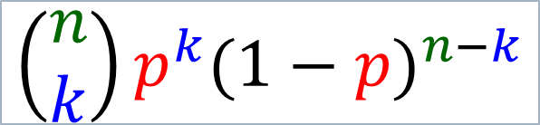
(Reference) Binomial and Poisson distribution (1/3)
*Taguri et al.: Easy introduction to statistics, Kodansha (2007)
Binomial distribution: If an event occurs with probability $p$, then the probability that it will actually occur $k$ times in $n$ trials is
Ex: Probability of a traffic accident occurring in a city in one minute:$p=\frac{1}{1440}$ Probability of no traffic accidents in the next 24 hours
$$\left(\begin{matrix}n \\ k\end{matrix}\right)p^{k}{(1−p)}^{n−k}$$
$$\left(\begin{matrix}1440 \\ 0\end{matrix}\right)p^{0}{(1−p)}^{1440−0}={(1−p)}^{1440}={\left(\frac{1439}{1440}\right)}^{1440}$$

Slide 33
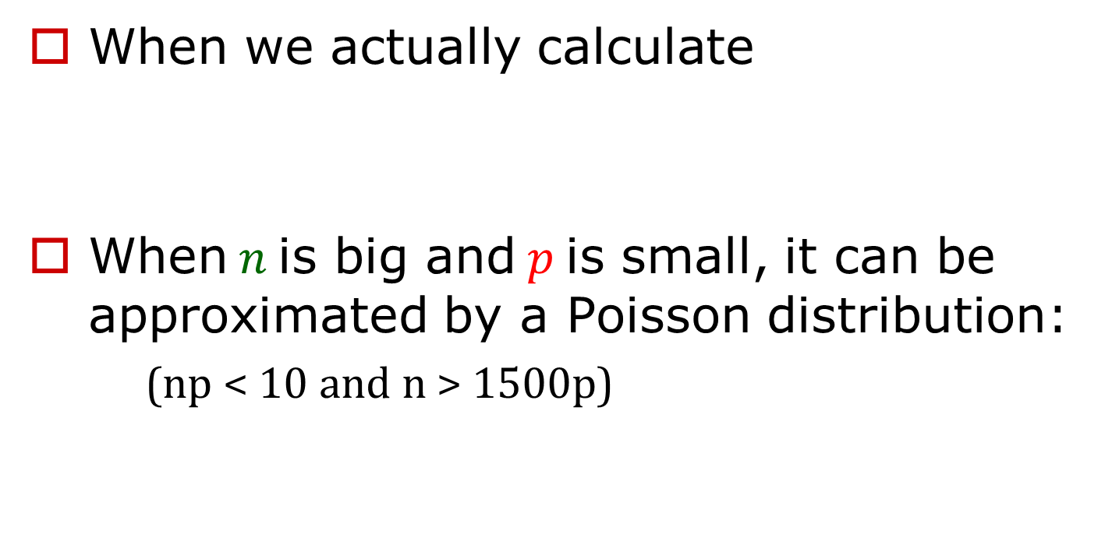
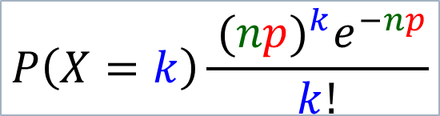


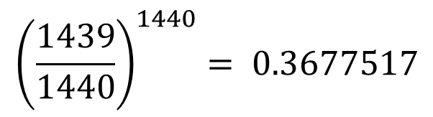
(Reference) Binomial and Poisson distribution (2/3)
When we actually calculate
$\text{When} n$is big and$p$is small, it can be approximated by a Poisson distribution:
(np < 10 and n > 1500p)
$${\left(\frac{1439}{1440}\right)}^{1440}= 0.3677517$$
$$P\left(X=k\right)\frac{{ (np)}^{k}e^{−np}}{k!}$$
$$(n=1440, p=\frac{1}{1440},k=0)$$
$$= e^{−1}=0.3678794$$

Slide 34
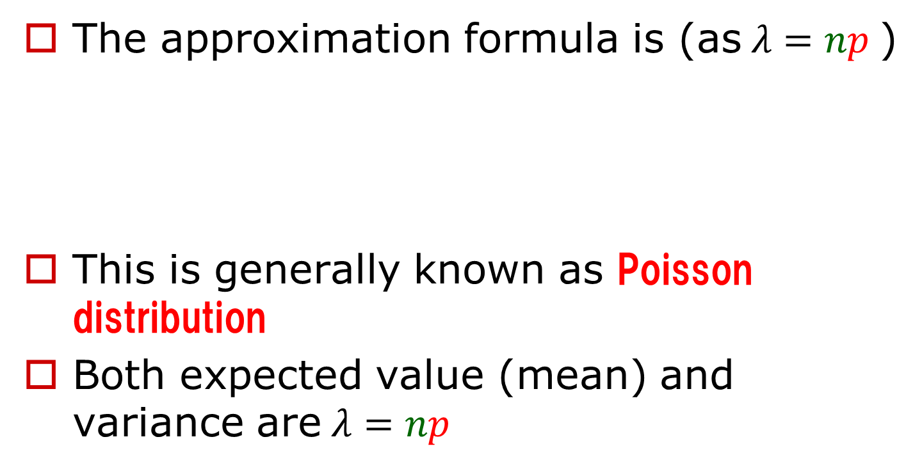
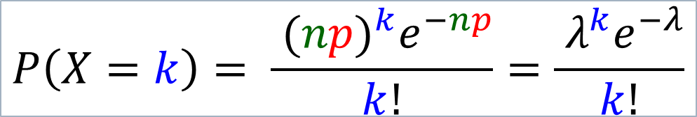
(Reference) Binomial and Poisson distribution (3/3)
The approximation formula is (as$λ=np$)
This is generally known as Poisson distribution
Both expected value (mean) and variance are$λ=np$
$$P\left(X=k\right)= \frac{{ (np)}^{k}e^{−np}}{k!}=\frac{{ λ}^{k}e^{−λ}}{k!}$$

Slide 35


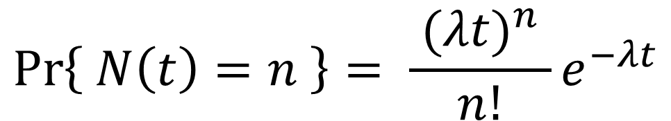
Poisson Process
If we find bugs at a rate of$λ$ per unit time$(λ>0)$
Expected number of total bugs at time t is $λt$
Its probability distribution follows the Poisson distribution
$$\operatorname{Pr}\left\{ N\left(t\right)=n \right\}= \frac{ {(λt)}^{n} }{n!}e^{−λt}$$
$$(n=0,1,2,…)$$
In other words, a series of random variables like this (following a Poisson distribution) is formed → Poisson process

Slide 36
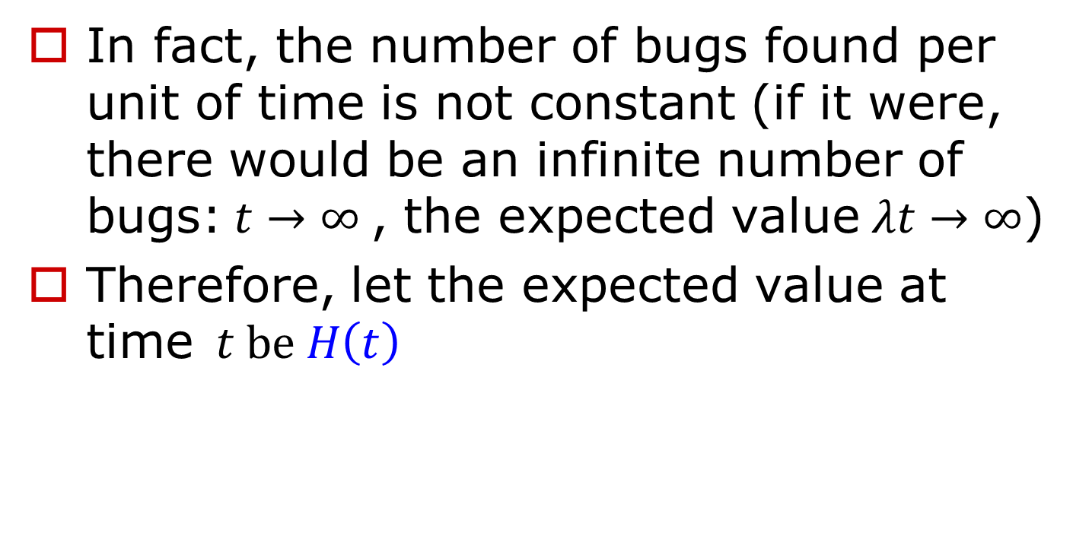

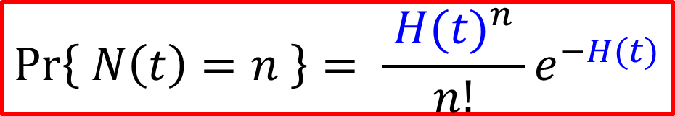
Expected number of bugs (1/3)
In fact, the number of bugs found per unit of time is not constant (if it were, there would be an infinite number of bugs:$t→∞$, the expected value$λt→∞$)
Therefore, let the expected value at time$t be H\left(t\right)$
$$\operatorname{Pr}\left\{ N\left(t\right)=n \right\}= \frac{ {H(t)}^{n} }{n!}e^{−H(t)}$$
$$(n=0,1,2,…)$$

Slide 37




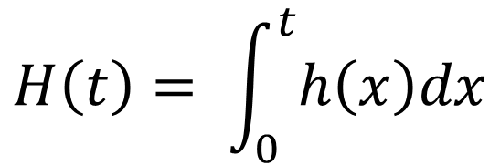
Expected number of bugs (2/3)
The expected number of bugs at time t H(t) is obtained from the bug detection rate h(t) at each time up to that point
$$H\left(t\right)= \int_{0}^{t}{h\left(x\right)dx}$$
for example, $h(3)$ is the bug detection rate at time $t=3$
and at that point, the probability of detecting ℎ(3) bugs per unit time is
$$h(x)$$
0
$$t$$
$$x$$

Slide 38


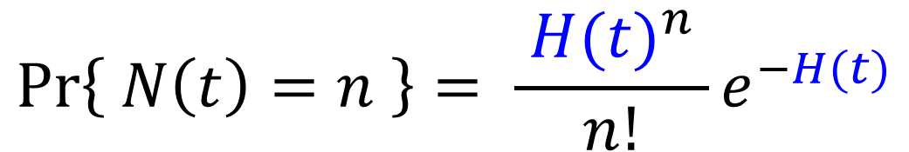
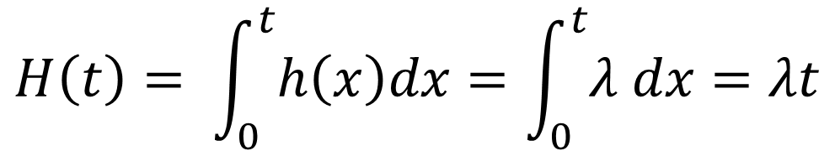
Expected number of bugs (3/3)
Of course, if the bug detection rate is always constant, $h\left(t\right)=λ$(constant)
$$H\left(t\right)= \int_{0}^{t}{h\left(x\right)dx}=\int_{0}^{t}{λ dx}=λt$$
$$\operatorname{Pr}\left\{ N\left(t\right)=n \right\}= \frac{ {H(t)}^{n} }{n!}e^{−H(t)}$$
$$= \frac{ {(λt)}^{n} }{n!}e^{−λt}$$

Slide 39

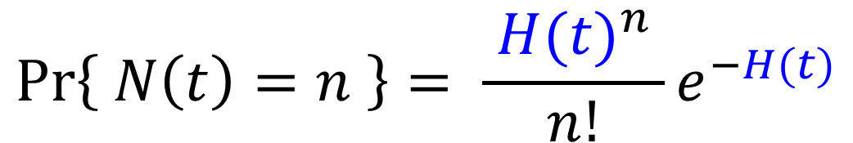
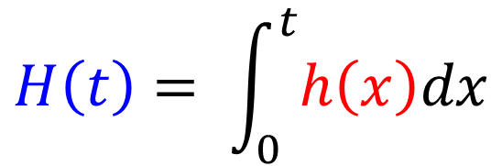

A typical bug detection count model: NonHomogeneous Poisson process model
Generalize bug detection rate as a function of time$h\left(t\right)$
The Poisson process considers expected value as $H\left(t\right)$ instead of $λt$is called NHPPs
$$\operatorname{Pr}\left\{ N\left(t\right)=n \right\}= \frac{ {H(t)}^{n} }{n!}e^{−H(t)}$$
$$(n=0,1,2,…)$$
$$H\left(t\right)= \int_{0}^{t}{h\left(x\right)dx}$$

Slide 40
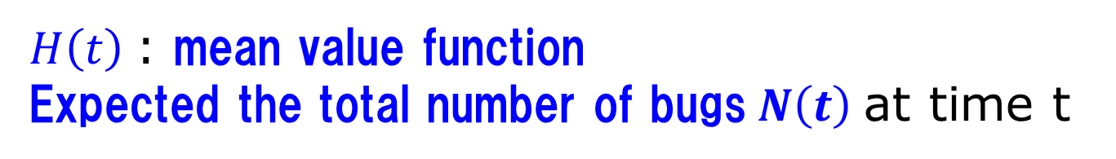
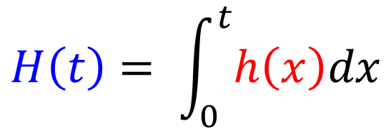


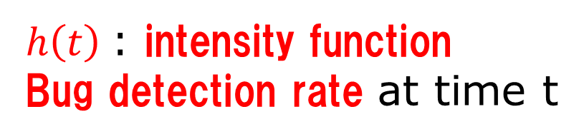
NHPPs mean value function and intensity function
$$\operatorname{Pr}\left\{ N\left(t\right)=n \right\}= \frac{ {H(t)}^{n} }{n!}e^{−H(t)}$$
$$(n=0,1,2,…)$$
$$H\left(t\right)= \int_{0}^{t}{h\left(x\right)dx}$$
$H\left(t\right)$: mean value function
Expected the total number of bugs$N\left(t\right)$at time t
$h\left(t\right)$: intensity function
Bug detection rate at time t
*Not a probability
The current estimate of how many faults are likely to be found in a unit of time.

Slide 41

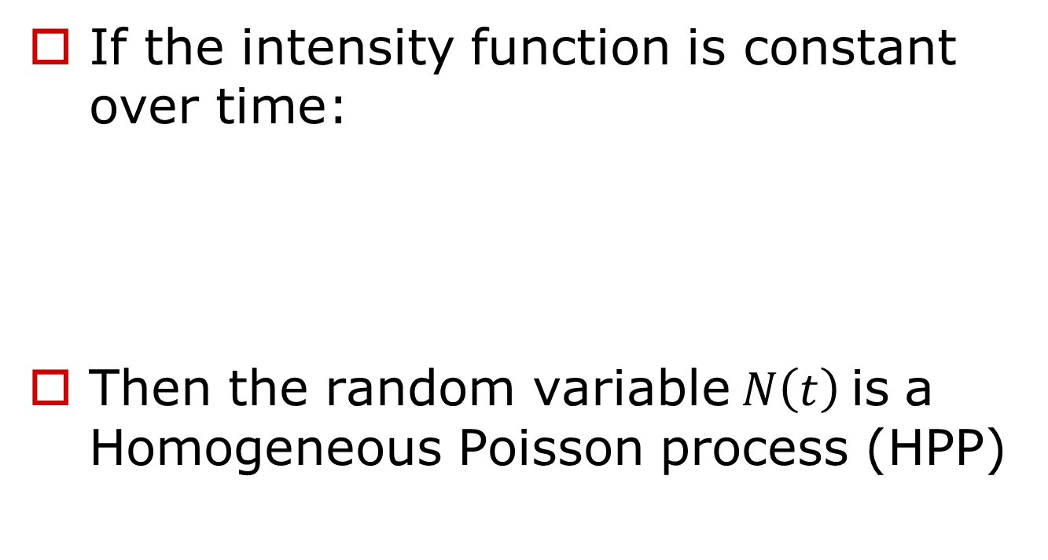

(Reference) Homogeneous Poisson process
If the intensity function is constant over time:
Then the random variable$N\left(t\right)$is a Homogeneous Poisson process (HPP)
$$(λ>0)$$

Slide 42



Typical NHPPs model
When actually evaluating and predicting reliability, it is necessary to specify the Mean Value Function under some assumption
Example
$$H(t)$$
Model name | Mean value function
Exponential
Delayed S-shaped
$$a(1−e^{−bt})$$
$$a\left\{1−(1+bt)e^{−bt}\right\}$$

Slide 43
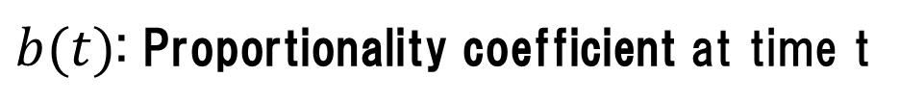



Assumptions set by many NHPP models
The number of bugs found per unit time is proportional to the number of remaining (undetected) bugs at that time
That is, the bug detection rate at time t is proportional to the number of remaining bugs at that time
$$a−H(t)$$
$$h(t)$$
$$h\left(t\right)=b\left(t\right)\left\{a−H(t)\right\}$$
$b(t)$: Proportionality coefficient at time t
(Discovery rate per bug)

Slide 44

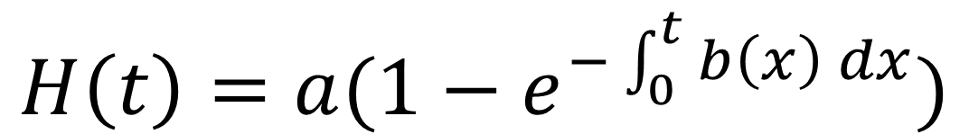

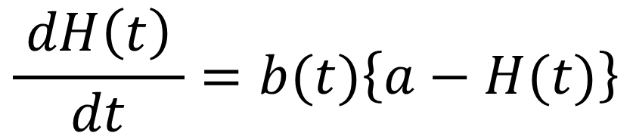
Assumptions set by many NHPP models
Again, if we write it using the mean value function$H\left(t\right)$
Solving this equation with the initial condition $H\left(0\right)=0$
$$\frac{ dH\left(t\right) }{dt}=b(t)\left\{a−H(t)\right\}$$
$$H\left(t\right)= \int_{0}^{t}{h\left(x\right)dx}$$
$$H\left(t\right)=a(1−e^{−\int_{0}^{t}{b\left(x\right) dx}})$$

Slide 45





(1) Exponential Software Reliability Growth Model (Exponential SRGM)
Assume that $b\left(t\right)$used for proportionality coefficient is constant over time
(example)
$$H\left(t\right)=a(1−e^{−\int_{0}^{t}{b\left(x\right) dx}})$$
$$b\left(t\right)=b$$
$$H\left(t\right)=a(1−e^{−bt})$$

Slide 46
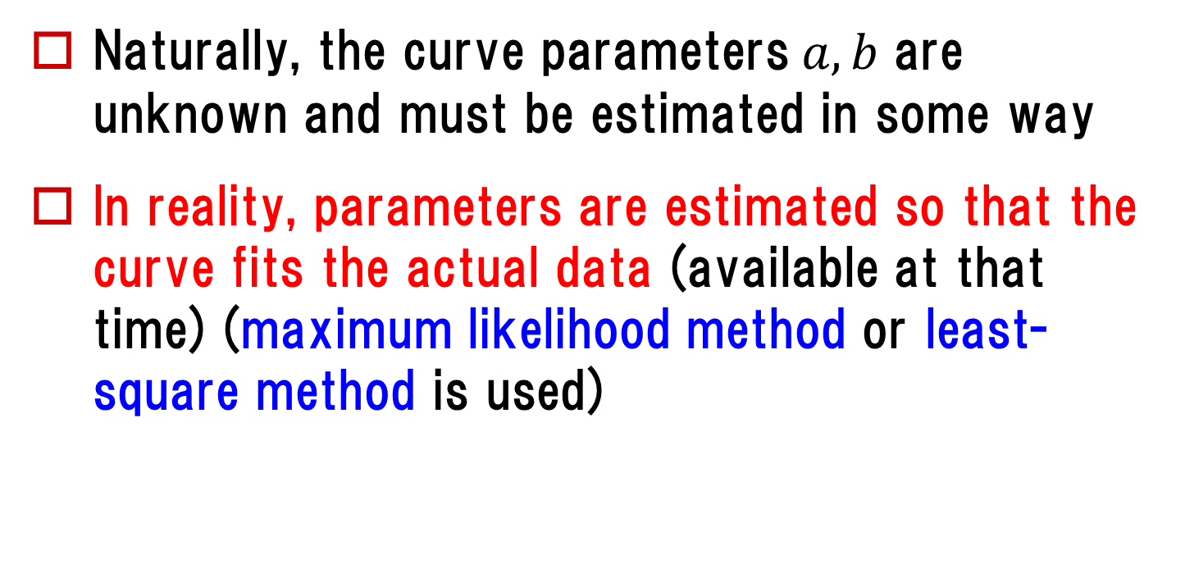
When actually using it
Naturally, the curve parameters$a, b$ are unknown and must be estimated in some way
In reality, parameters are estimated so that the curve fits the actual data (available at that time) (maximum likelihood method or least-square method is used)
It is said that stable estimates are obtained after approximately 50 to 60% of the tests are completed.

Slide 47
[R exercise] Numerical example
Fault detection data of the real-time command and control program (217 KLOC)
Read this as a dataframe d1
srgm-data1.csv
[Goel(1985)]
d1= read.csv( file.choose())
[Goel(1985)] Goel, AL : Software reliability models: Assumptions, limitations, and applicability,
IEEE Trans. Software Eng., vol.SE-11, no.12, pp.1411-1423, Dec. 1985.

Slide 48
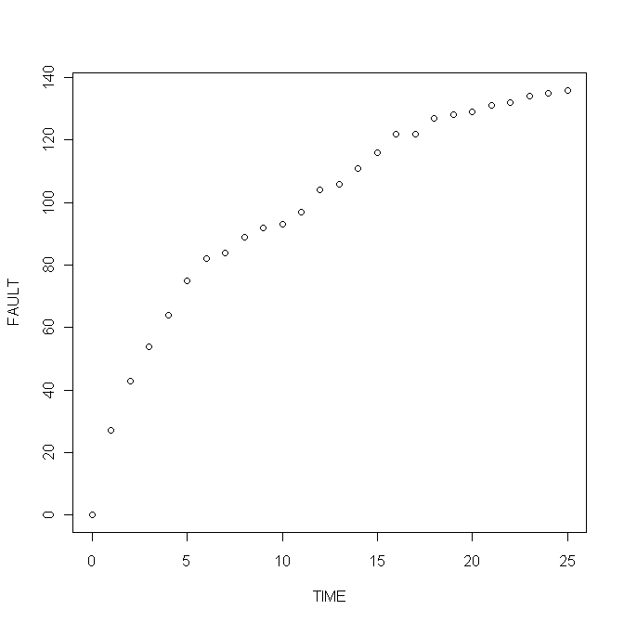
Numerical example : CSV Data Content
Elapsed time and accumulated number of bugs
> d1
TIME FAULT
1 0 0
2 1 27
3 2 43
・・・・・・・・・・・・・・・・
plot(FAULT ~ TIME, data=d1)
Time is the CPU time spent running the test (in hours)

Slide 49


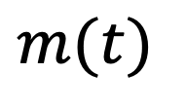


Growth curve fitting example
For example, when using an exponential growth model
$$m\left(t\right)=a(1−e^{−bt})$$
$$m(t)$$
: mean value function
(expected number of detected bugs at time t
$$a$$
: Expected total number of bugs ($t→∞$)
$$b$$
: bug detection rate
* This is a model in which bugs are detected with a constant detection rate (b).

Slide 50
Growth curve fitting example
Estimating model parameters (nonlinear model)
model.e= nls( FAULT ~a*(1-exp(-b*TIME)),
data=d1, start=list(a=200, b=0.2) )
After execution
Initial value for numerical calculation (adjustment required if calculation does not go well)
a=as.numeric(model.e$m$getPars()[1])
b=as.numeric(model.e$m$getPars()[2])
a
b
135.9744
0.1382574
Note that the results of parameter estimation using the maximum likelihood method are different from the results of approximation using the least squares method.

Slide 51

Prepare the growth curve as a function
Prepare the parameters of the exponential growth model, the mean value function as a function m
a.e = as.numeric(model.e$m$getPars()[1])
b.e = as.numeric(model.e$m$getPars()[2])
m = function(t){
a.e*(1-exp(-b.e*t))
}
$$m\left(t\right)=a(1−e^{−bt})$$

Slide 52
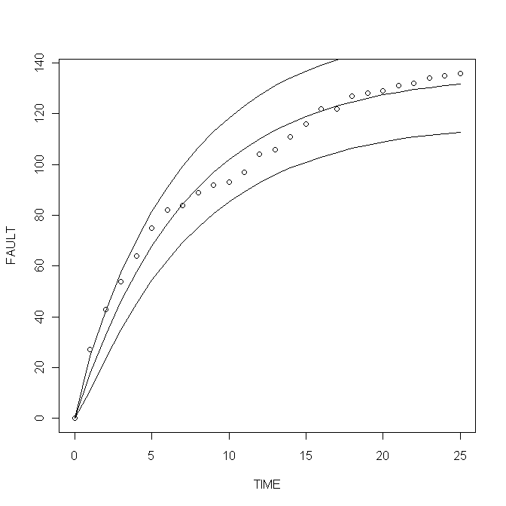

Growth curve fitting example (90% Confidence interval)
plot(FAULT ~ TIME, data=d1)
lines( m(TIME) ~ TIME, data=d1, col="red")
lines(m(TIME)+1.645*sqrt(m(TIME)) ~ TIME, data=d1)
lines(m(TIME)-1.645*sqrt(m(TIME)) ~ TIME, data=d1)
a.e+1.645*sqrt(a.e)
a.e-1.645*sqrt(a.e)
155.1564
116.7923
Total number of bugs is expected to be 117-155
Because$t=25$ and 136 faults found
About 19 have not been found yet (Reliability 90%)

Slide 53
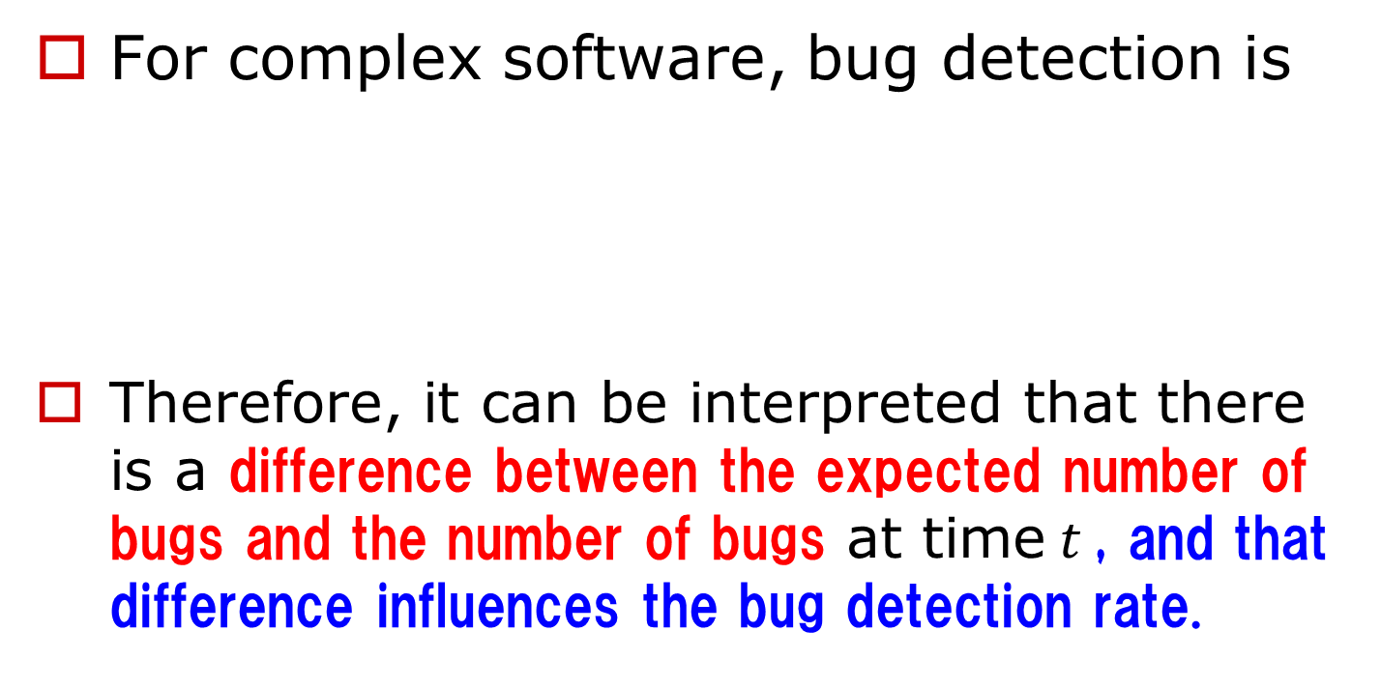
(2) Delayed S-shaped SRGM (1/4)
For complex software, bug detection is
Therefore, it can be interpreted that there is a difference between the expected number of bugs and the number of bugs at time$t$, and that difference influences the bug detection rate.
Defect discovery
→ Investigation of cause
→ Bug (fault) detection

Slide 54
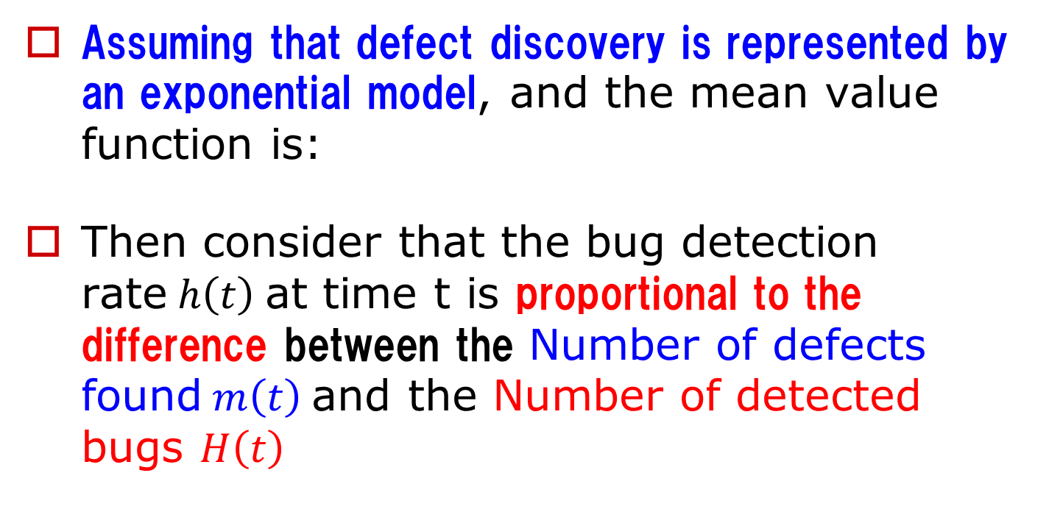


(2) Delayed S-shaped SRGM (2/4)
Assuming that defect discovery is represented by an exponential model, and the mean value function is:
Then consider that the bug detection rate$h\left(t\right)$at time t is proportional to the difference between the Number of defects found$m\left(t\right)$and the Number of detected bugs $H\left(t\right)$
$$m\left(t\right)=a(1−e^{−bt})$$
$$h\left(t\right)=b\left\{ m\left(t\right)−H\left(t\right) \right\}$$

Slide 55


(2) Delayed S-shaped SRGM (3/4)
In short,
Solving this differential equation gives
$$h\left(t\right)=\frac{ dH\left(t\right) }{dt}=b\left\{ m\left(t\right)−H\left(t\right) \right\}$$
$$m\left(t\right)=a(1−e^{−bt})$$
$$H\left(t\right)=a \{ 1 −\left(1+bt\right)e^{−bt} \}$$

Slide 56
(2) Delayed S-shaped SRGM (4/4)
Intuitively, the inclusion of two exponential models causes a "delay" in growth
$$H\left(t\right)=a \{ 1 −\left(1+bt\right)e^{−bt} \}$$
(example)

Slide 57
[R exercise] Numerical example
Bug detection data for the online data entry software package (40 KLOC) srgm-data2.csv
Read this as a dataframe d2
[Ohba(1984)]
d2 = read.csv( file.choose())
[Ohba(1984)] M. Ohba : Software reliability analysis models,
IBM J. Research and Development, vol.28, no.4, pp.428-443, July 1984.

Slide 58

Numerical example : CSV Data Content
Observation time and Cumulative number of bugs
plot(FAULT ~ TIME, data=d2)
> d2
TIME FAULT
1 0 0
2 1 2
3 2 3
・・・・・・・・・・・・・・・・
Time is the number of days spent on the test

Slide 59
Fitting a Delayed S-shaped
Estimation model parameters (nonlinear model)
model.d= nls(FAULT ~a*(1-(1+b*TIME)*exp(-b*TIME)),
data=d2, start=list(a=200,b=0.2) )
After execution
Initial value for numerical calculation (adjustment required if calculation does not go well)
a=as.numeric(model.d$m$getPars()[1])
b=as.numeric(model.d$m$getPars()[2])
a
b
78.69114
0.09493751

Slide 60
Prepare the growth curve as a function
Prepare a delay S-shaped long curve pattern, prepare the mean value function as H
a.d = as.numeric(model.d$m$getPars()[1])
b.d = as.numeric(model.d$m$getPars()[2])
H = function(t){
a.d*(1-(1+b.d*t)*exp(-b.d*t))
}
$$H\left(t\right)=a \{ 1 −\left(1+bt\right)e^{−bt} \}$$

Slide 61

Growth curve fitting example (90% confidence interval) (1/2)
plot(FAULT ~ TIME, data=d2)
lines( H(TIME) ~ TIME, data=d2, col="red")
lines( H(TIME)+1.645*sqrt(H(TIME)) ~ TIME, data=d2)
lines( H(TIME)-1.645*sqrt(H(TIME)) ~ TIME, data=d2)

Slide 62


Growth curve fitting example (90% confidence interval) (2/2)
a.d+ 1.645*sqrt(a.d)
a.d- 1.645*sqrt(a.d)
93.28361
64.09867
Total number of bugs is expected to be 64-93
Because$t=20$ and 46 faults found
About 18-47 have not been found yet (Reliability 90%)

Slide 63
Homework
Answer “[8] quiz”
by this Friday 23:59
(Note: Your quiz score will be a part of your final evaluation)

