Slide 1
ソフトウェアテスト [13] バグ予測とテスト計画
Software Testing
[13] Bug Prediction and Test Plan
あまん ひろひさ
阿萬 裕久（AMAN Hirohisa）
aman@ehime-u.ac.jp

Slide 2
Fault-Prone module analysis
Bug is often called fault in software engineering
A programmer's error introduces a fault into the program. As a result, faults, failures, defects occur during program execution.
Find features of modules likely to be faulted by metrics (Fault-Prone)

Slide 3
Significance of Fault-Prone module analysis
Activities required for software quality assurance:
Testing
Reviewing
Help plan these activities:
Identify where the fault is likely to be
*Intuitively, The idea is "Where is the intersection where accidents are likely to occur?"

Slide 4
Focus on the distribution of faults (bugs)
Faults (bugs) are made incorrectly by humans
Even if you focus only on each bug, the cause is different. Therefore, it is difficult to analyze it by itself.
A statistical approach is important to capture overall trends
Let's look at how faults (bugs) have been distributed so far.

Slide 5

(Reappears) Pareto principle
About 80% of bugs are present in about 20% of modules
concentrated in fewer parts
spread uniformly

Slide 6
Launch RStudio
Let's analyze the data using RStudio
Download Rscript13.R and data13.csv from Teams
Open Rscript13.R in RStudio

Slide 7
Use the same metric data as last time
First, use the same NASA-published data as last time
Data file name data13.csv
Load this content as a dataframe named data
data = read.csv( file.choose( ))

Slide 8
Start with a simple analysis
The module set is divided into two types, “non buggy” and "buggy”,
See the difference in cyclomatic numbers
Find the threshold for bug prediction (of cyclomatic number)
Non buggy
comparison
Buggy
14
3
8
20
8
5
11
12

Slide 9
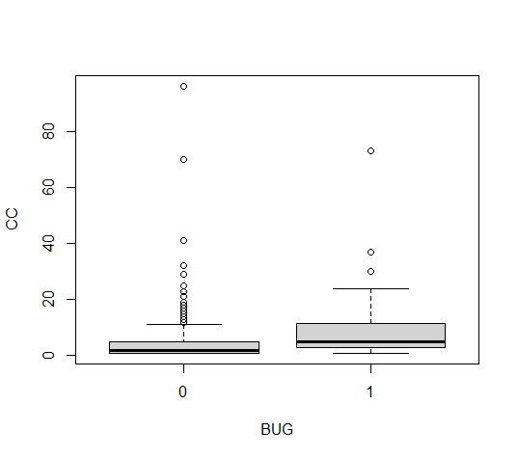
Box plot
Column name
Column name
DataFrame
boxplot(CC~BUG, data=data)
Although it is rough, you can see the difference in distribution
Vertical axis: cyclomatic number
Horizontal axis: presence or absence of bugs
(0 = none,1 = yes)

Slide 10
Compare by summary statistics
Separate the cyclomatic numbers with non buggy and buggy and check with the summary function
cc0 = data$CC[data$BUG==0]
cc1 = data$CC[data$BUG==1]
summary(cc0)
summary(cc1)
Min. 1st Qu. Median Mean 3rd Qu. Max.
1.000 1.000 2.000 4.705 5.000 96.000
Min. 1st Qu. Median Mean 3rd Qu. Max.
1.000 3.000 5.000 9.729 11.250 73.000

Slide 11
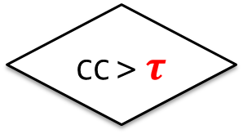
Consider Metric Thresholds
Looking at data, the cyclomatic number seems to be related to the presence or absence of bugs
A larger cyclomatic number is more suspicious
Therefore，if it is larger than a certain value, let's predict that there is a bug.
Yes
CC > $τ$
No
Buggy
Non buggy

Slide 12
Split dataset
Consider a simple predictive model
Training data is needed to build this predictive model
Furthermore, to evaluate the capabilities of the predictive model, test data is also required
So let's split the data into two and prepare them.

Slide 13
Random Distribution
First shuffle row number 1 ~ nrow (data): get a list of shuffled row numbers with the following function sample:
set.seed(1234)
idx = sample(nrow(data))

Slide 14
Split data after shuffling
training data (d.train): first 300
test data (d.test): remaining 205
d.train = data[idx[1:300], ]
d.test = data[idx[301:nrow(data)], ]

Slide 15
(Ex)When the threshold of the cyclomatic number is set to 10(1/6)
As a simple example, If the cyclomatic number(CC)exceeds 10, let's predict that there is a bug
Check the training data for bugs in this module
d.train$BUG[d.train$CC>10]
[1] 0 0 0 1 1 0 0 0 0 0 0 0 1 1 0 1 0 0 0 0 0 1 0 0 1 1 0 0 0 0 0 0 0 1 0 0 0 0 1 0 0

Slide 16
(Ex)When the threshold of the cyclomatic number is set to 10(2/6)
The result of "predicting that there is a bug" as the result
result = d.train$BUG[d.train$CC>10]
[1] 0 0 0 1 1 0 0 0 0 0 0 0 1 1 0 1 0 0 0 0 0 1 0 0 1 1 0 0 0 0 0 0 0 1 0 0 0 0 1 0 0
length(result)
sum(result)
Predicted number
Number of correct answers in the prediction
[1] 41
[1] 10

Slide 17
(Ex)When the threshold of the cyclomatic number is set to 10(3/6)
If you organize the results
length(result)
sum(result)
Predicted number
Number of correct answers in the prediction
[1] 41
[1] 10
Results of predictions using training data |  | Actual |  | total
 |  | Buggy | Non Buggy
Prediction | Buggy | 10 | 31 | 41
 | Non Buggy
total

Slide 18
(Ex)When the threshold of the cyclomatic number is set to 10(4/6)
The actual number of bugs was
sum(d.train$BUG)
Number of actual bugs
[1] 30
Results of predictions using training data |  | Actual |  | total
 |  | Buggy | Non Buggy
Prediction | Buggy | 10 | 31 | 41
 | Non Buggy | 20
total |  | 30

Slide 19
Recall and Precision
Actually buggy (correct answer set)
Actually buggy (correct answer set)
Recall
Prediction success
Prediction success
View by percentage
Prediction success
Buggy and predicted
Precision
Buggy and predicted

Slide 20
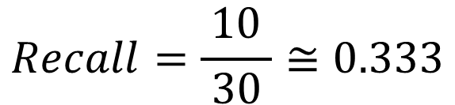
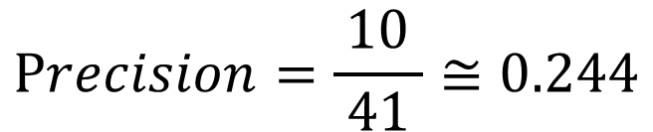
(Ex)When the threshold of the cyclomatic number is set to 10(5/6)
Results of predictions using training data |  | Actual |  | total
 |  | Buggy | Non Buggy
Prediction | Buggy | 10 |  | 41
 | Non Buggy
total |  | 30
$$Recall=\frac{10}{ 30 }≅0.333$$
$$Precision=\frac{10}{ 41 }≅0.244$$

Slide 21

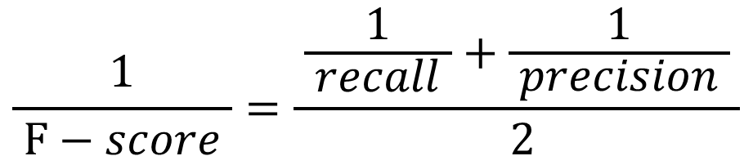
F-score
Harmonic mean of recall and precision
$$\frac{1}{ F−score }=\frac{ \frac{1}{ recall }+\frac{1}{ precision } }{ 2}$$
$$F−score=\frac{1}{ \frac{1}{ 2 }\left(\frac{1}{ recall }+\frac{1}{ precision }\right) }$$
$$=\frac{ 2・recall・precision }{recall+precision}$$

Slide 22



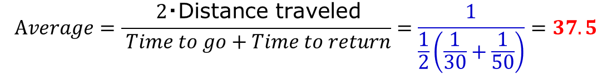

(Reference) Example of harmonic mean
Elementary school math problems
I drove back and forth between my house and the station. The travel speed was 30km/h for the way and 50km/h for the return. What is the average travel speed?
$$\frac{\text{Distance} \text{traveled}}{ Time to go}=30$$
$$Time to go=\frac{\text{Distance} \text{traveled}}{30}$$
$$\frac{\text{Distance} \text{traveled}}{ Time to return}=50$$
$$Time to return=\frac{\text{Distance} \text{traveled}}{50}$$
$$Average=\frac{ 2・\text{Distance} \text{traveled}}{ Time to go+Time to return}=\frac{1}{\frac{1}{2}\left(\frac{1}{30}+\frac{1}{50}\right)}=37.5$$

Slide 23
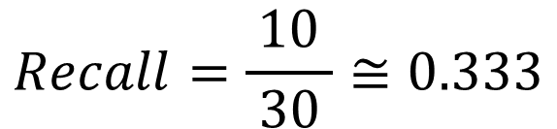
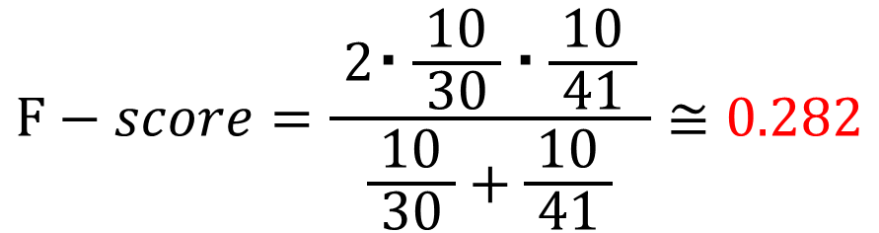
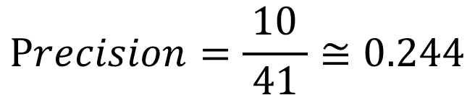
(Ex)When the threshold of the cyclomatic number is set to 10(6/6)
The F-score in this case is
$$Recall=\frac{10}{ 30 }≅0.333$$
$$Precision=\frac{10}{ 41 }≅0.244$$
$$F−score=\frac{ 2・\frac{10}{ 30 }・\frac{10}{ 41 } }{\frac{10}{ 30 }+\frac{10}{ 41 }}≅0.282$$

Slide 24
[Exercise 1]
[13] Exercise-1
(by tomorrow, 1pm)
Use LOC instead of cyclomatic number (CC) as a metric
For the training data, answer the recall, precision, and F-score when the LOC threshold is 30.
p15 -- p23

Slide 25
Function for calculating the F-score(1/5)
Create a function to calculate the F-score
First, calculate the Recall
$$recall=\frac{Number of correct answers predicted as buggy}{Number of actual bugs }$$
result = d.train$BUG[d.train$CC>10]
recall = sum(result)/sum(d.train$BUG)

Slide 26
Function for calculating the F-score(2/5)
Next, the precision is
$$precision=\frac{\text{Number} \text{of} \text{correct} \text{answers} \text{predicted} \text{as} \text{buggy} }{Number of bugs predicted to be }$$
result = d.train$BUG[d.train$CC>10]
recall = sum(result)/sum(d.train$BUG)
precision = sum(result)/sum(d.train$CC>10)

Slide 27
Function for calculating the F-score(3/5)
For simplicity, we will replace it with the following:
d.train$BUG
d.train$CC>10
bugs
target
result = bug[target]
recall = sum(result)/sum(bug)
precision = sum(result)/sum(target)

Slide 28
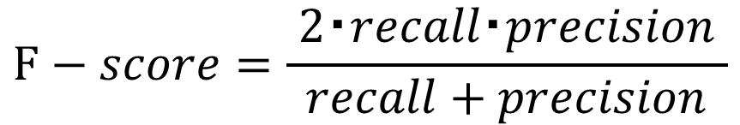
Function for calculating the F-score(4/5)
The F-score is obtained as follows
$$F−score=\frac{ 2・recall・precision }{recall+precision}$$
result = bug[target]
recall = sum(result)/sum(bug)
precision = sum(result)/sum(target)
2*recall*precision/(recall + precision)

Slide 29
Function for calculating the F-score(5/5)
Using the symbol replaced earlier as an argument, defining a function that can be used in R is as follows
f.value = function(bug, target){
result = bug[target]
recall = sum(result)/sum(bug)
precision = sum(result)/sum(target)
2*recall*precision/(recall + precision)
}

Slide 30
Use the function you created
If you call it like this, it will calculate the F-score.
Presence of bugs
Predict by metric value
f.value(d.train$BUG, d.train$CC>10)
[1] 0.2816901

Slide 31
Verification with test data
Not training data (d.train) Try to predict test data (d.test)
Evaluate by F-score
f.value(d.test$BUG, d.test$CC>10)
Because it is judged only by the cyclomatic numbers, the performance is low ...
[1] 0.2051282

Slide 32
10-minutes rest break

Slide 33
Test prioritization
Consider testing modules that may have bugs first
It's not perfect, but you can prioritize using metric values
Method of testing in descending order of metric values

Slide 34
Test in descending order of cyclomatic numbers
Arrange modules of test data (d.test) in descending order of cyclomatic number (d.test$CC)
Record the presence or absence of bugs in that order
order(d.test$CC, decreasing=T)
found.bugs =
d.test$BUG[order(d.test$CC, decreasing=T)]

Slide 35
Accumulate bug finds
The presence or absence of bugs (1 or 0) is recorded in order in the variable found.bugs
By accumulating (adding) this, Find out how many bugs have been found so far
0 0 0 0 1 0 1 0 0 0 0 0 0 ……
for ( i in 2:length(found.bugs) ){
found.bugs[i] = found.bugs[i-1] + found.bugs[i]
}

Slide 36
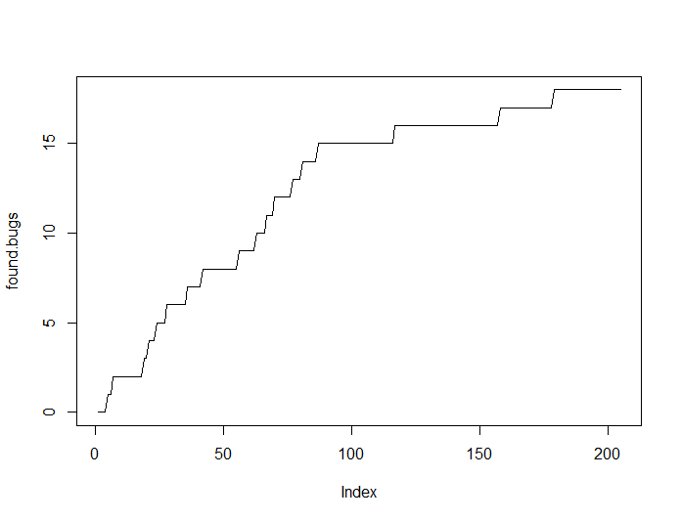
Graph cumulative bug finds
Graph the accumulated found.bugs
plot(found.bugs, type='l')
Total number of bugs found
Number of modules tested

Slide 37
How quickly did you find 80% of bugs?
How few tests were able to find 80% of the total bugs?
b80 = max(found.bugs)*0.8
sum(found.bugs<b80)/length(found.bugs)
max(found.bugs)
b80
sum(found.bugs<b80)
Smaller is more efficient testing
length(found.bugs)
[1] 0.4195122

Slide 38
[Exercise 2]
[13] Exercise-2
(by tomorrow, 1pm)
Suppose you use LOC as a metric and test in descending order. For test data, what percentage of tests are needed to find 80% of bugs? (For cyclomatic number, it was 0.4195122)
Also answer when you use CALL as a metric
p34 -- p37

Slide 39
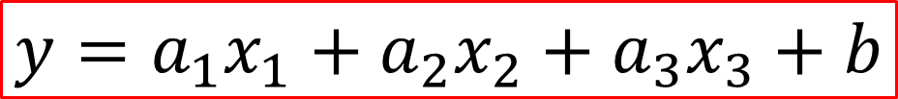

Forecasting with multiple metrics
Isn't it possible to make more accurate predictions by using multiple metrics than by predicting bugs with only a single metric?
Is it possible to use the following linear multiple regression model with each metric as an explanatory variable (prediction material)?
$$y=a_{1}x_{1}+a_{2}x_{2}+a_{3}x_{3}+b$$
CC
CALL
LOC
(where, $a_{1}, { a}_{2},a_{3},\text{b} \text{are} \text{all} \text{constants}$)

Slide 40
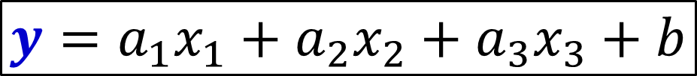
There is one problem...
If this continues, the domain of the objective variable y will be (−∞,+∞)
What we want to predict is the possibility of the presence or absence of bugs, and if we put this as p (as with probability), the value range of p must be [0, 1].
$$y=a_{1}x_{1}+a_{2}x_{2}+a_{3}x_{3}+b$$
Something appropriate conversion needs to be done between y and p

Slide 41
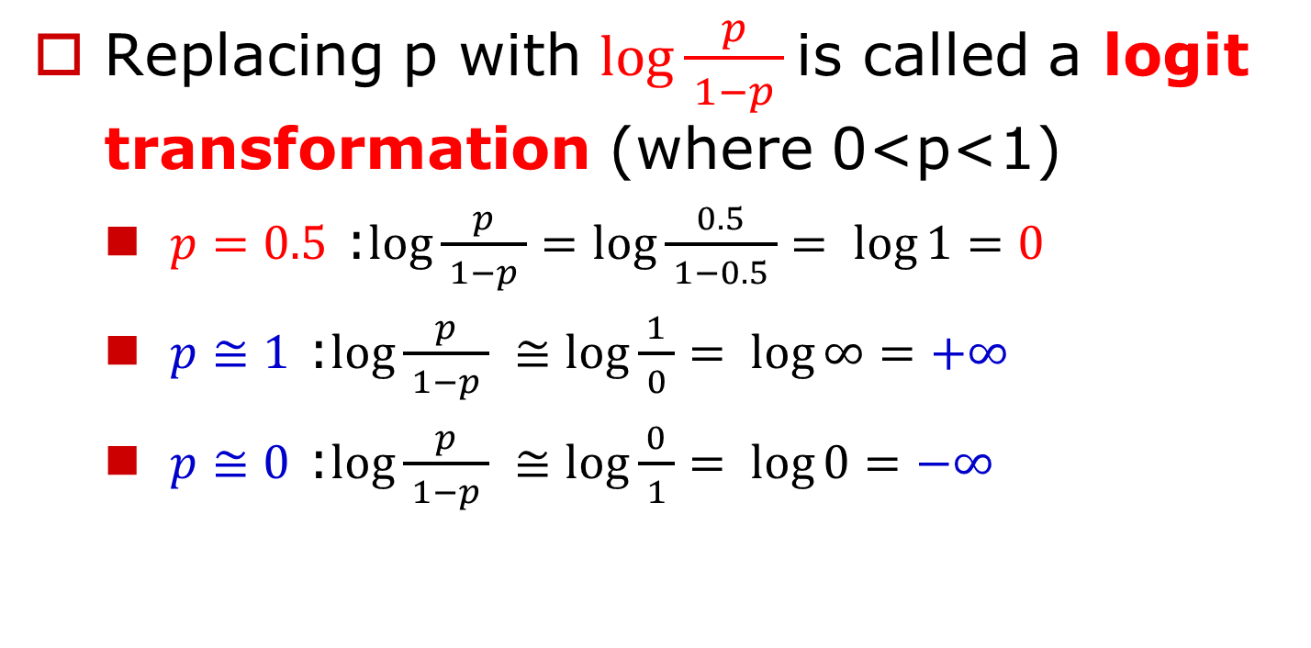
Logit Transformation
Replacing p with $\log{\frac{p}{ 1−p }}$is called a logit transformation (where 0<p<1)
$p=0.5$ :$\log{\frac{p}{ 1−p }}=log{\frac{0.5}{ 1−0.5 }= \log{1}=0}$
$p≅1$ :$\log{\frac{p}{ 1−p }} ≅log{\frac{1}{ 0 }= \log{∞}=+∞}$
$p≅0$ :$\log{\frac{p}{ 1−p }} ≅log{\frac{0}{ 1 }= \log{0}=−∞}$
When the probability 𝑝 is 50%, it becomes 0, above it is positive, and below it is negative. Moreover, the value range is (−∞,+∞).

Slide 42
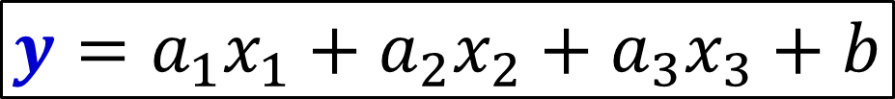
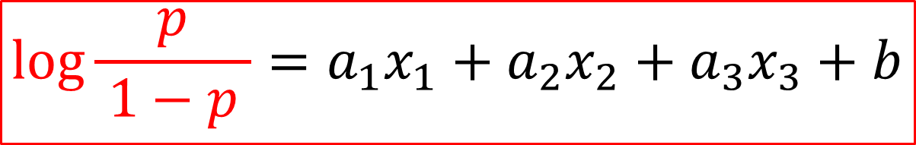
Transform the objective variable y into a logit transformation of p
This is called a logistic regression model.
$$y=a_{1}x_{1}+a_{2}x_{2}+a_{3}x_{3}+b$$
$$\log{\frac{p}{ 1−p }}=a_{1}x_{1}+a_{2}x_{2}+a_{3}x_{3}+b$$

Slide 43
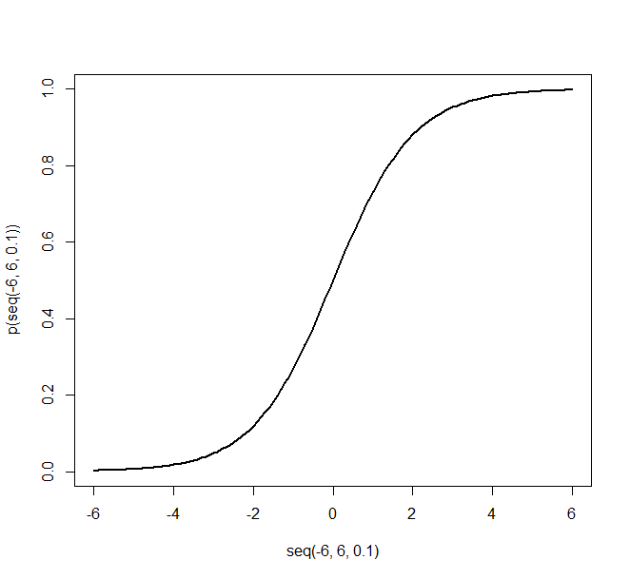






Alternative representations of logistic regression models
Transform the previous formula so that the left side is p
$$p=\frac{1}{1+e^{−y}}$$
$$y>0$$
$$p$$
50%
$$y=a_{1}x_{1}+a_{2}x_{2}+a_{3}x_{3}+b$$
Same as the sigmoid function often used in neural network activation functions
$$y<0$$
$$y$$

Slide 44
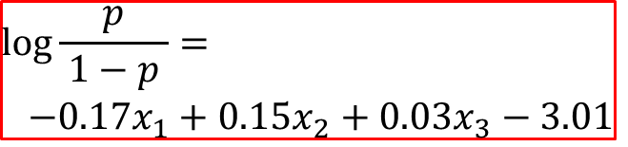
Create a logistic regression model in R
Using the glm function
model = glm(BUG ~ CC+CALL+LOC, d.train,
family="binomial")
summary(model)
Call:
glm(formula = BUG ~ CC + CALL + LOC, family = "binomial", data = d.train)
Deviance Residuals:
Min 1Q Median 3Q Max
-1.6280 -0.4119 -0.3388 -0.3103 2.4587
Coefficients:
Estimate Std. Error z value Pr(>|z|)
(Intercept) -3.00685 0.29626 -10.149 < 2e-16 ***
CC -0.17097 0.06649 -2.571 0.01013 *
CALL 0.14645 0.06581 2.225 0.02607 *
LOC 0.03375 0.01202 2.808 0.00499 **
---
Signif. codes: 0 ‘***’ 0.001 ‘**’ 0.01 ‘*’ 0.05 ‘.’ 0.1 ‘ ’ 1
(Dispersion parameter for binomial family taken to be 1)
Null deviance: 195.05 on 299 degrees of freedom
Residual deviance: 168.69 on 296 degrees of freedom
AIC: 176.69
Number of Fisher Scoring iterations: 5
$$\log{\frac{p}{ 1−p }}=$$
$$−0.17x_{1}+0.15x_{2}+0.03x_{3}−3.01$$

Slide 45
Get prediction results
Get predictions on test data
predict(model, type="response", d.test)
99 505 124 97 …………………
0.053450137 0.067460143 0.148106912 0.050136245 …………………
……………………………………………………………………………………………………………………………………………………
Extract only the output probability from this
result = predict(model, type="response", d.test)
result = as.vector(result)

Slide 46
Tests in order of highest probability
Test data (d.test) module Probability output of logistic regression model Arrange (result) in descending order
Record the presence or absence of bugs in that order
found.bugs =
d.test$BUG[order(result, decreasing=T)]

Slide 47
Accumulate bug finds
The presence or absence of bugs (1 or 0) is recorded in order in the variable found.bugs
By accumulating (adding) this, Find out how many bugs have been found so far
0 0 0 0 1 0 1 0 0 0 0 0 0 ……
for ( i in 2:length(found.bugs) ){
found.bugs[i] = found.bugs[i-1] + found.bugs[i]
}

Slide 48
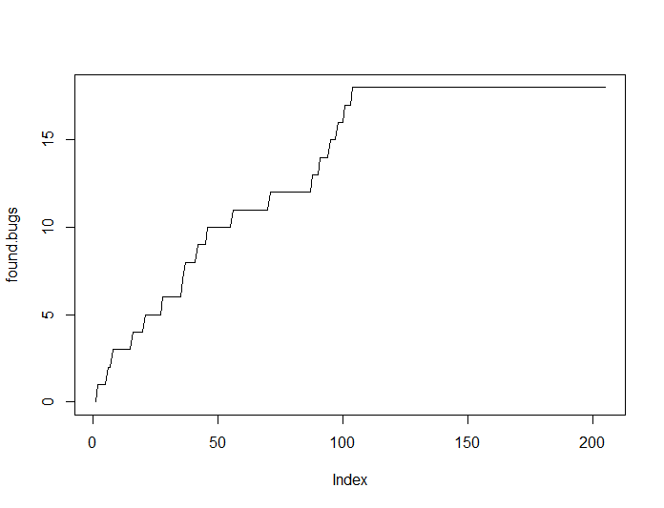
Graph cumulative bug finds
Graph the accumulated found.bugs
plot(found.bugs, type='l')
Total number of bugs found
Number of modules tested

Slide 49
How quickly did you find 80% of bugs?
How few tests were able to find 80% of the total bugs?
b80 = max(found.bugs)*0.8
sum(found.bugs<b80)/length(found.bugs)
Smaller is more efficient testing
[1] 0.4585366
For only the cyclomatic numbers
[1] 0.4195122

Slide 50
Why didn't the performance improve?
Affected by uneven number of buggy and non buggy samples.
Overwhelmingly non buggy samples
Since the parameters are adjusted so that the overall error is minimized, the result is a model that is easy to predict without bugs.
sum(d.train$BUG==1)
sum(d.train$BUG==0)
[1] 30
[1] 270

Slide 51
How to deal with it?
There are two main types of basic measures (1) Change the weight in training: make the error heavier for the smaller (buggy) sample; Or reduce the error for larger samples
(2) Give uniform training data: Make the number of buggy and non buggy samples in the training data roughly the same (50:50)
We will take the (2) approach here.

Slide 52
Undersampling and Oversampling
Undersampling Instead of using all the majority (non buggy), use only a partial sample obtained by random sampling
Oversampling
Use the minority (buggy) padding
If we simply undersample, the training data becomes extremely small
Note the method of padding: I doubt whether it is possible to learn by simply choosing the same sample repeatedly.

Slide 53
SMOTE algorithm
Synthetic Minority Over-sampling Technique
Oversampling by artificially creating minority samples (randomly using neighboring data)
At the same time, undersampling is also performed for the majority.

Slide 54
Prepare training data with SMOTE algorithm (1/3)
First, install the dedicated package
And, load it
install.packages("smotefamily")
library(smotefamily)

Slide 55
Prepare training data with SMOTE algorithm (2/3)
Create a dataset with the SMOTE algorithm (The seed of the random number is set here)
Specify only columns with metric values
set.seed(1234)
d.train.smote = SMOTE(d.train[,c(2,3,4)], d.train$BUG, K = 10)$data
Objective variable
(bug or not)
Number of neighbors to use in synthesis

Slide 56
Prepare training data with SMOTE algorithm (3/3)
The format of the data produced by the SMOTE algorithm is slightly different from that used in the logistic regression model, so adjust
names(d.train.smote)[4] = "BUG"
d.train.smote$BUG = as.numeric(d.train.smote$BUG)

Slide 57
Rebuild model with training data by SMOTE algorithm
Rebuild the logistic regression model and make predictions on the test data
model = glm(BUG ~ CC+CALL+LOC,
d.train.smote, family="binomial")
result = predict(model, type="response", d.test)
result = as.vector(result)

Slide 58
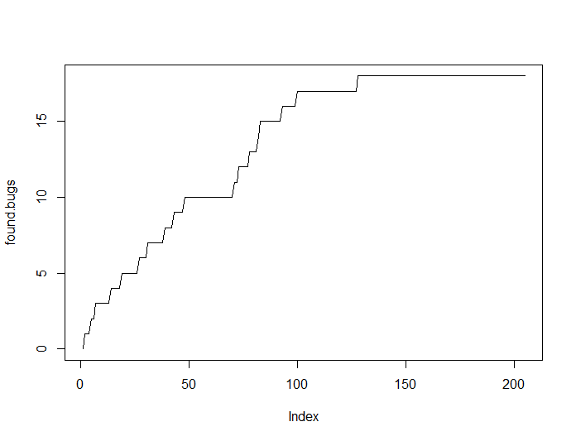
Evaluate test efficiency
Evaluate test efficiency again
found.bugs = d.test$BUG[order(result, decreasing = T)]
for ( i in 2:length(found.bugs) ){
found.bugs[i] = found.bugs[i-1] + found.bugs[i]
}
plot(found.bugs, type='l')
b80 = max(found.bugs)*0.8
sum(found.bugs<b80)/length(found.bugs)
Slightly improved results
[1] 0.4

Slide 59
There are many other predictive models
The logistic regression model is a basic model, but not necessarily the best model
There are many other machine learning models, so there is a possibility that testing can be made more efficient by using other models.

Slide 60
[Exercise 3]
[13] Exercise-3
(by tomorrow, 1pm)
Reset the random number seed to 9876 and redo the split into training and test data
Then, for the training data, answer the recall, precision, and F value when the cyclomatic number threshold is 10.
set.seed(9876)
p13 -- p23

Slide 61
[Exercise 4]
[13] Exercise-4
(by tomorrow, 1pm)
As a continuation of exercise 3, create a logistic regression model using the SMOTE algorithm (specify in the R script on p54 as well)
And answer the efficiency of the test for the test data
set.seed(9876)
p54 -- p58

