Slide 1
ソフトウェアテスト [9] プログラミング技術
Software Testing
[9] Programming Tips and Techniques
あまん ひろひさ
阿萬 裕久（AMAN Hirohisa）
aman@ehime-u.ac.jp

Slide 2
Position of programming
The role of programming is to realize “program specifications” on a computer
Program specification
program
Make something like this
programming
Formal execution instructions
The key is how correctly it can be described
human world
computer world
The computer faithfully executes the contents of the program

Slide 3
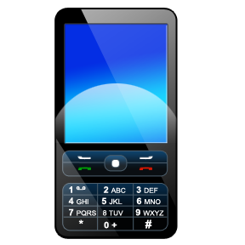
Software development ≠ Programming
People tend to think that “Programming is software development”
In the case of small-scale development, requirements analysis & design are done only in the developer’s mind, and programming is suddenly started.
However, this is not enough for Large-scale development
Programming skills are important
Don't underestimate design and management
For example, OS for smartphones: millions of lines or more
When printed → more than 100,000 sheets of A4 paper (over 10m in height)

Slide 4
Important things in programming
Writing programs that correctly reflect the specifications (error-free)
Be careful not to make the mistake of creating bugs (errors)
Write easy to understand programs
Idea: “I just need to know myself” ➔ Is not good
Maintenance is impossible unless the program is understood by others
(Even the person who wrote it may not be able to understand it after 6 months)

Slide 5
How to write and make a program
Easy to read and understand
Prevent mistakes
Simple structure
Be environment independent
Write comments appropriately
Make it easy to change

Slide 6

(1) Easy to read and understand
Add indentation to visually tell where the block starts and ends.
Intentionally insert blank lines to emphasize the change in execution content
To prevent forgetting something, write “}” whenever you write “{” and insert the code in between.
sum = 0;
for ( i = 0; i < n; i++ ){
if ( a[i] > 0 ){
sum += a[i];
}
}
printf("%d$∖$n", sum);

Slide 7
Make variable names meaningful
A name that explains what the variables represent is desirable
When asking Yes/No, the interrogative form is also used
A program with few lines and easily understandable content can be handled without excessive worry, like the variable i on the previous page.
index, position, count
or idx, pos, cnt for short
is_empty, hasNext
To separate words, use underscore (_)
or use capital letters
Example: If the set is empty → 1, Otherwise 0
Example: In the list, the following node is 1 if present, otherwise 0

Slide 8
Variable name, function name snake case and camel case
snake case
Use underscore (_) to connect words
Ex: file_name, get_file_size
camel case
use capital letters for word breaks
Ex: fileName, getFileSize
For C language,
snake case
is often used

Slide 9
Be aware of function and return value in function names
Use a name that makes it easy to understand what the function does and what the return value is.
(Example)
int get_length (char str[ ]){
・・・文字列の長さを調べる
}
void move_to (int x, int y){
・・・(x,y) へ移動
}
void sort (int array[ ], int length){
・・・ array をソーティング
}
To separate words, use underscore (_)
or use capital letters

Slide 10
[Exercise 1] Think of a function name
get help
leap year
Copy the contents of an array to another array
void ( )
int (int year)
void (int src[], int dest[], int length)
Original
Copy to
length

Slide 11
[Exercise 1] Think of a function name (Example answer)
get help
leap year
Copy the contents of an array to another array
(Another solution)
printHelp
isLeapYear
copyArray
void ( )
print_help
int (int year)
is_leap_year
Or array_copy
copy_array
void (int src[], int dest[], int length)
Original
Copy to
length

Slide 12
(2) Prevent mistakes
Write curly braces even in a single statement
Avoid reuse of variables
if ( x > 0 )
foo(x);
if ( x > 0 )
printf("%d",x);
foo(x);
if ( x > 0 ) {
printf("%d",x);
foo(x);
}
A little mistake
Someone asked me if there is some relationship between the variable x above and below. It is misunderstood.
int x = 0;
・・・(use x)
x = 5;
・・・(x used for another purpose)

Slide 13
(3) Simple structure
Do not use goto
I feel like the goto statement is convenient because it allows you to jump to any position you want, but it only happens while you're creating it, and it just becomes more complicated in the end.
This kind of program is called
"spaghetti program”

Slide 14
Avoid too many conditional branches
The more if, for, while statements, the more difficult to understand and the more mistakes
A better program (same movement)
sum = 0;
scanf("%d", &x);
do{
if ( x > 0 ){
sum += x;
scanf("%d", &x);
}
} while( x > 0 );
sum = 0;
scanf("%d", &x);
while( x > 0 ){
sum += x;
scanf("%d", &x);
}
After trial and error, the program may have been like the one on the left, but it has become more complicated than necessary

Slide 15
Cyclomatic number
Number of independent loops in the flow chart
It is known as a measure to evaluate the complexity of program structure.
There is a research report that says that maintainability is quite poor when this number exceeds 10.

Slide 16
(4) Be environment independent
Avoid the influence of differences in computer environments
In the C language, the number of bytes allocated to a variable may vary depending on the processing system (for example, an int type may be 2 bytes or 4 bytes).
If the OS is different, the header (library) read by #include may also be different.
That is why we write size of(int)
A little technical, but switching using #ifdef etc.

Slide 17
(5) Write comments appropriately
Functional description should be included as a comment for each meaningful chunk
However, it is not enough to simply write a program
A program that cannot be understood without writing comments is also a problem
In many cases, it is sufficient to keep the program's structure simple by making the function and variable names easy to understand.

Slide 18
(6) Make it easy to change
Stop hard coding
Writing numbers and strings as they are in the source code is called hard coding.
Should be defined or read with symbols first (Ex) Number of data and file name
for ( i = 0; i < 256; i++ ){
for ( j = 0; j < 256; j++ ){
・・・・・・
FILE* fp = fopen(“foo.txt”, “r”);
Read the file name at runtime or specify it with a macro
Replace with a macro such as SIZE

Slide 19
[Exercise 2] About hard coding
For example, it is recommended to give the length of an array and the name of a data file with macros like
Consider the benefits of doing this
#define SIZE 256
#define DATA_FILE "foo.txt"

Slide 20
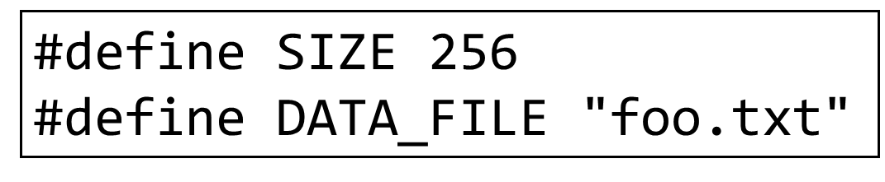
[Exercise 2] About hard coding (Sample answer)
① Resistant to change
If you want to change the length of the array, you can just rewrite 256 (replacing it every time will lead to mistakes).
② Easy to understand the meaning
In some cases, the meaning of a number or string alone may be misunderstood (the same "256" can also mean "there and here are different meanings")
③ Easy to manage configurations
Unique configurations can be gathered in one place (at the beginning of the program), making it easy to change and check.
If "255" was written to mean "SIZE-1", the change would have been omitted.

Slide 21
Conventions for using macros
When defining macros in the C language, it is common to have their names in all uppercase letters.
On the other hand, keep all Variable names lowercase
That way, even if the two are mixed, you can immediately see whether they are variables or macros.
#define SIZE 256
int size;

Slide 22
Refactoring
Refactoring is the process of modifying source code to improve its readability and maintainability without changing its functionality or meaning.
Also includes improvements in performance (execution speed, memory usage)
There are various refactoring patterns, so those who are interested should look into them.

Slide 23
XP (eXtreme Programming)
A development style suitable for short-term development with a small number of people
Changes in the modern IT industry are dizzying (the so-called “dog year”)
Especially in the case of small-scale development, development must be completed in a few months at most.
Small-scale development requires agile development in a different style from large-scale development.
*Dog Year: A dog's lifespan is a fraction of that of a human, and time passes several times faster.

Slide 24
XP Practices
Planning game
Small release
Metaphor
Simple design
Testing
Refactoring
Pair programming
Collective ownership
Continuous integration
40 hours work week
On-site customer
Coding standards

Slide 25
① Planning game ② Small release
Planning game
Coordinate plans with customers/clients
Planning is not a one-time occurrence at the beginning but is ongoing during development as the situation change.
Small release
We will release every few months and develop & improve the necessary functions in order by getting feedback from customers.
*Release: Delivering or disclosing software to customers/users.
*Feedback: Reflecting opinions and bug reports on the development site.
(Repeat development in a short span and adjust the plan)

Slide 26
③ Metaphor ④ Simple design
Metaphor
Metaphor means “simile” or “illustration”
Comparing the structure and functions of the system to something and sharing the image with related parties
Such examples are called metaphors, and sharing metaphor leads to improved development efficiency.
Simple design
XP keep the design to a minimum necessary
Eliminate extra complexity
Don't think about future extensibility from the beginning
(No coding that may be used in the future)

Slide 27
⑤ Testing
Test continuously
Test-first
Create a test program first, then write the program
"A test program is a specification"
Programmers should at least have unit tests (and run them every time they are rewritten)

Slide 28
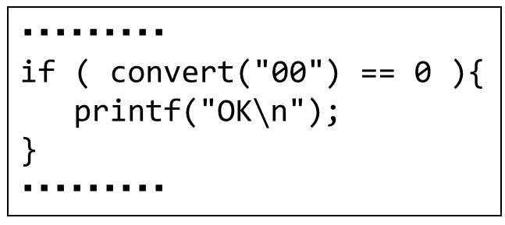
Test-first example
Create a convert function to convert a specified 1-byte hexadecimal number to a decimal number
convert("01") == 1
convert("ff") == 255
convert("FF") == 255
convert("A0") == 160
・・・・・・
Create a test program first
・・・・・・・・・
if ( convert("00") == 0 ){
printf("OK$∖$n");
}
・・・・・・・・・
convert("000") == ERROR
convert("fff") == ERROR
convert("-1") == ERROR
convert(NULL) == ERROR
convert("xyz") == ERROR
・・・・・・・

Slide 29
⑥ Refactoring
Exercise in Week 10
Change the program to make it better while keeping its functionality and meaning (Refinement)
In specialized refactoring books, “suspicious” code that should be rewritten is called “code smell”

Slide 30
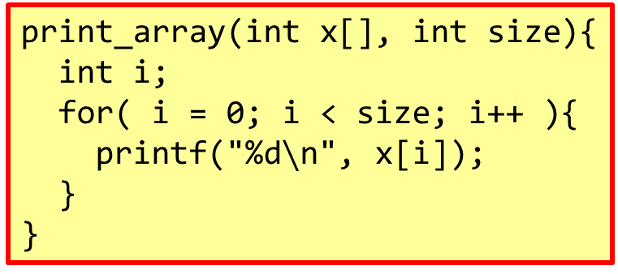

Example of code smell
"Duplicated code"
If you see similar code in two or more places, consider consolidating it into one place.
print_array(int x[], int size){
int i;
for( i = 0; i < size; i++ ){
printf("%d$∖$n", x[i]);
}
}
…
for( i = 0; i < 10; i++ ){
printf("%d$∖$n", a[i]);
}
…
for( j = 0; j < 100; j++ ){
printf("%d$∖$n", b[j]);
}
…
print_array(a, 10);
…
print_array(b, 100);

Slide 31
[Exercise 3] Think about refactoring
A 4-bit binary number was stored in a 4-length array bin, and a program was written to convert it to decimal
②
x = 0;
for ( i = 0; i < 4; i++ ){
if ( i == 0 ) p = 1;
if ( i == 1 ) p = 2;
if ( i == 2 ) p = 4;
if ( i == 3 ) p = 8;
x += bin[i] ＊ p;
}
① was not good, so I tried ②, but could it be better?
①
x = bin[3]＊8 + bin[2]＊4
+ bin[1]＊2 + bin[0]＊1;

Slide 32
[Exercise 3] Think about refactoring (Sample answer)
x = 0;
for ( i = 0; i < 4; i++ ){
if ( i == 0 ) p = 1;
if ( i == 1 ) p = 2;
if ( i == 2 ) p = 4;
if ( i == 3 ) p = 8;
x += bin[i] ＊ p;
}
x = 0;
p = 1;
for ( i = 0; i < 4; i++ ){
x += bin[i] ＊ p;
p ＊= 2;
}
p=1 is used as the initial value for the first time, and then double p

Slide 33
⑦ Pair programming
Programming in pairs
(Note: two people use one computer)
Simple mistakes are reduced
Even if you meet an obstacle, one person can code another part; the other person can think and research in the meantime.
Reviews (evaluations/checks) are performed at the same time
Although it seems inefficient
As a result, it helps to maintain high code quality.
It is also important to change the partners in efficient pairs.

Slide 34
⑧ Collective ownership ⑨ Continuous integration
Collective ownership
Allow all members to freely view and modify all code
Quick improvements are possible because everyone understands the code and can modify it.
Continuous integration
Do integration testing immediately after completing code creation/modification and unit testing for each pair.
Perform integration multiple times a day at different timings.
A system that centrally manages source code in one place is effective (e.g. version control system)

Slide 35
⑩ 40 hours work week ⑪ On-site customer
40 hours work week
Set a "target" of working hours of 8 hours a day x 5 days.
Productivity does not increase if you are tired or work overtime.
On-site customer
Include customer representatives on the development team or keep them nearby at all times
In agile development , frequent meetings with customers are important
Fatigue of one person leads to the collapse of pair programming.

Slide 36
⑫ Coding standards
The style of writing source code varies from person to person
My own style of writing is difficult for others to understand.
Set rules in your organization
how to name variables
how to write comments
how to put brackets
how to indent
while ( x > 0 ) {
・・・・
while( x > 0 )
{
・・・・
Which one to choose?

Slide 37
(Test + Programming) Test driven development
Exercise in Week 11
A method of repeating “first create a test case, then write a program that passes it”
A new test should fail the first time (because it hasn't been implemented yet).
① Test case creation
Review
②Testing
③ Programming
Success
Failure
Refactoring
(If necessary)
④ Testing
Success
Failure

Slide 38
Features of test driven development
Clarify goals
You will write a program so that it works correctly for the prepared test cases
A test case plays the role of a concrete specification
Avoid overlooking bugs
Since programming progresses while repeating the tests many times So it is easy to notice even if bugs are introduced midway through

Slide 39
Summary
Programming etiquette: Easy to understand is important
Fundamentals of agile development
Test-first
Refactoring
Pair programming
Coding standards
Even when it comes to programming, it is better to approach it as a team play rather than an individual play.

Slide 40
Homework
Answer “[9] quiz”
by this Friday 23:59
(Note: Your quiz score will be a part of your final evaluation)

