Slide 1

Reducing Electricity Costs in Romania: Predictive and Reinforcement Learning for Solar Battery Optimization
Authawich N.
Image Source: https://auroraer.com/insight/exploring-the-new-wave-of-subsidy-support-in-romania-and-hungary/

Slide 2

Introduction
Romania relies heavily on diverse energy sources like nuclear, wind, hydroelectric, oil and gas, solar, and biomass.
The three primary sources of electricity in Romania are hydro electric, producing 2,035 MW/h, oil and gas, generating 1,605 MW/h, and nuclear, contributing 1,378 MW/h.
Solar power is not a main source of electricity, producing around 150 Megawatts per hour and is only available during daylight hours, typically between 7AM and 6PM.

Slide 3
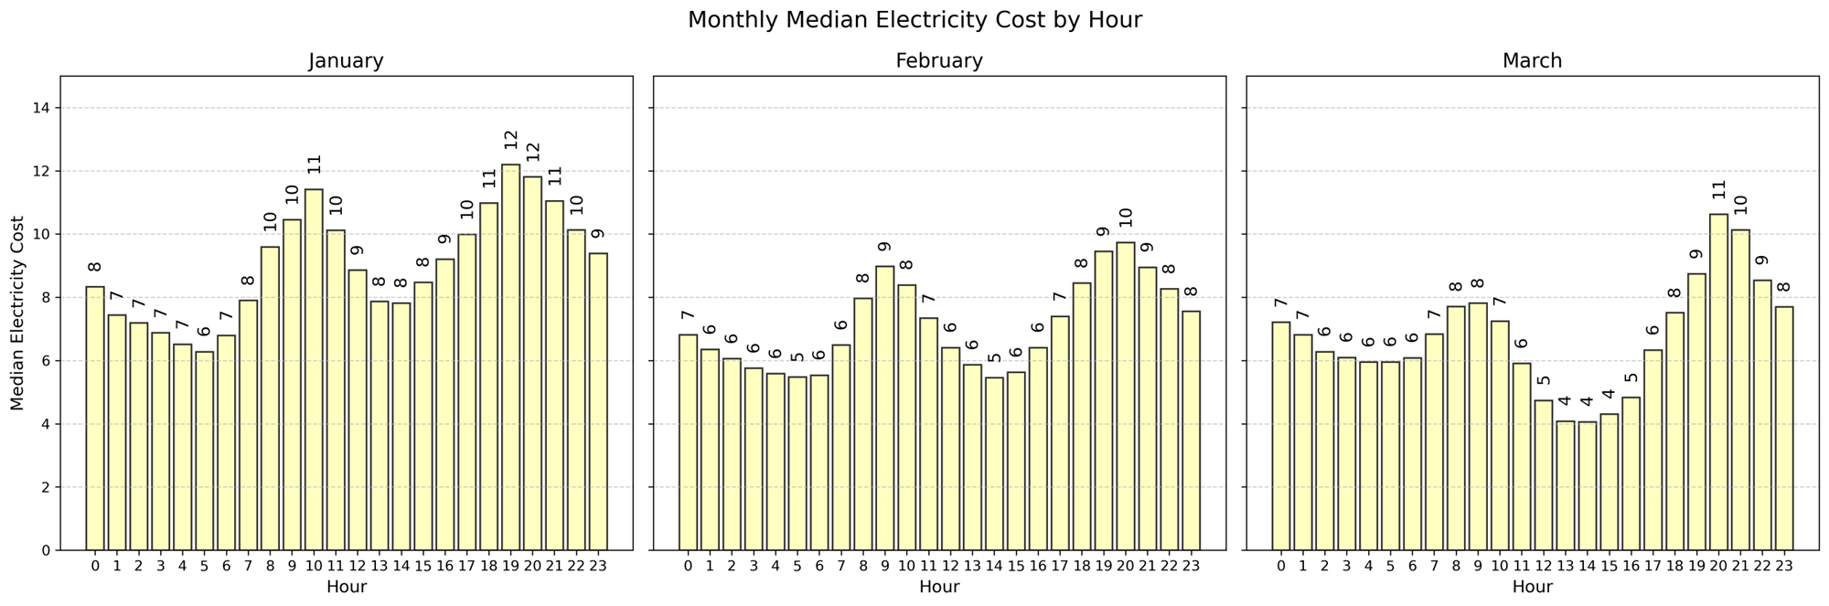
Introduction – Electricity Cost
The hourly electricity cost fluctuates between peak (9-11 AM, 5-7 PM) and off-peak hours, forming a multimodal distribution with two distinct peaks.

Slide 4

Problem Statement
Households with solar panels face the challenge of reducing electricity costs by effectively analyzing hourly solar generation and electricity prices to determine the optimal timing for battery charging and discharging.
Why it is hard?
Solar energy production varies throughout the day due to uneven sunlight intensity.
Electricity costs fluctuate between peak and off-peak hours.

Slide 5
Agenda
Exploratory Data Analysis
Insight from Predictive Models
Introduction to Reinforcement Learning
Solar Battery Optimization

Slide 6
Data sources
The data was extracted from 3 sources
Weather in Bucharest, Romania: Visual Crossing's weather data services
Electricity Cost per Hour: Thingler, by interpreting the bar charts and making personal notes
Electricity Production per Hour: Kaggle
All three datasets cover the period from January 2024 to March 2024 on hourly basis. The data for March 31, 2024 was intentionally removed due to missing one hour because of daylight saving adjustments.

Slide 7
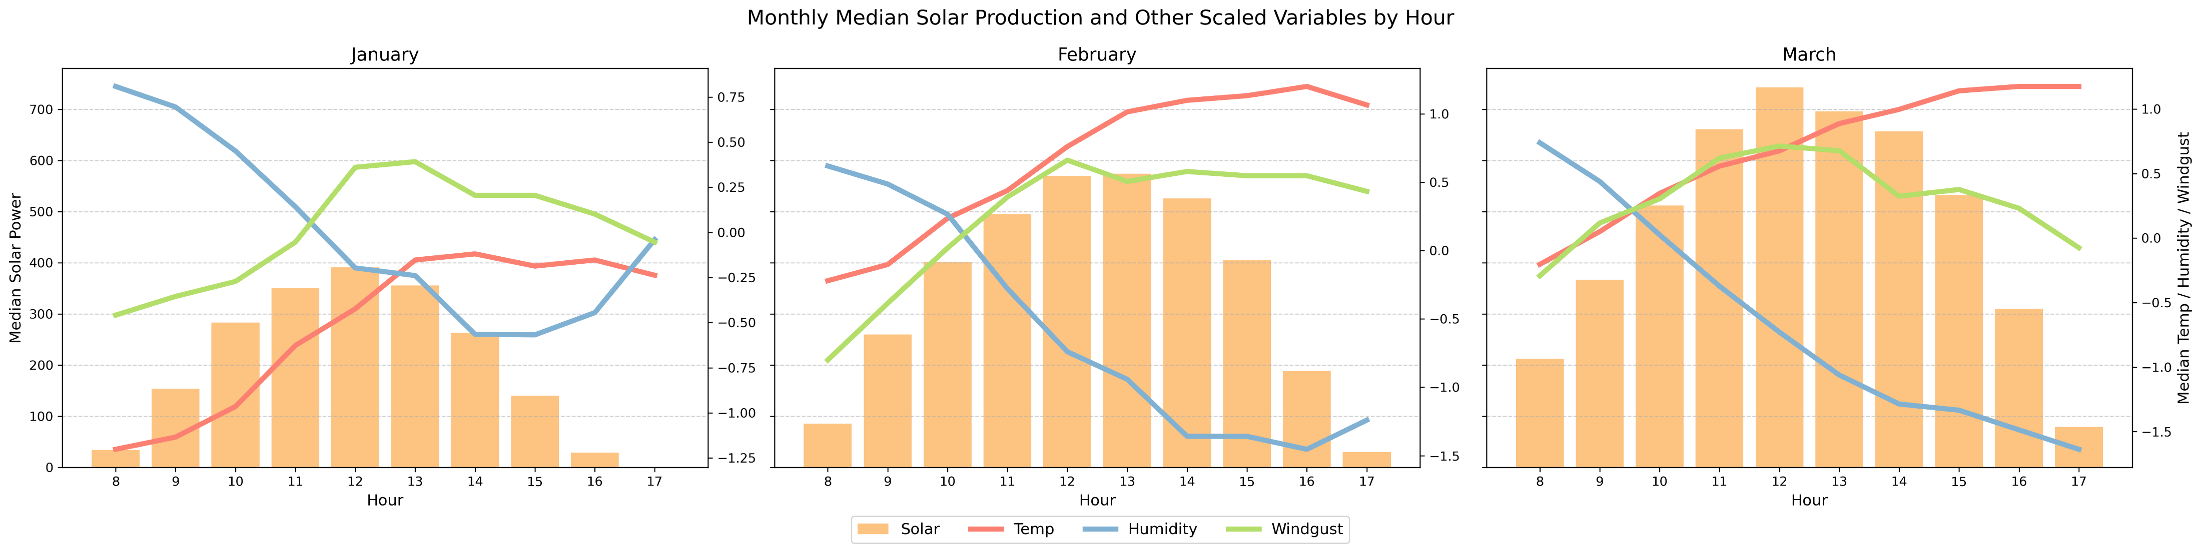
Exploratory Data Analysis
Relationship between Weather and Solar Energy
Temperature and Wind show positive relationship with solar power.
Humidity shows a negative relationship.

Slide 8
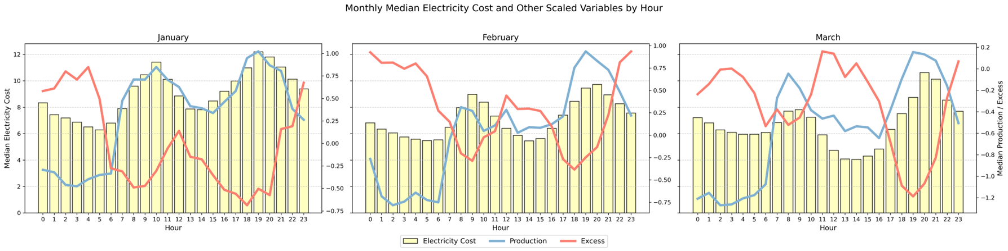
Exploratory Data Analysis
Relationship between Electricity Production and Electricity Cost per Hour
Electricity costs are positively related to energy production.
However, when there is excess production, electricity costs decrease, showing a negative relationship.

Slide 9
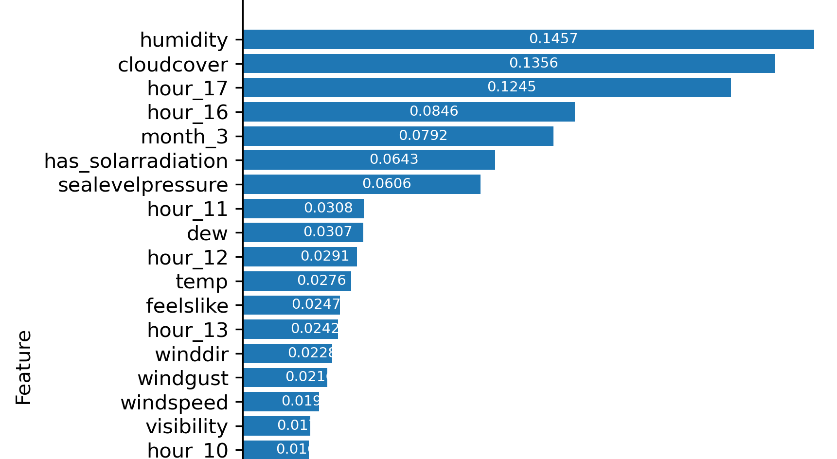
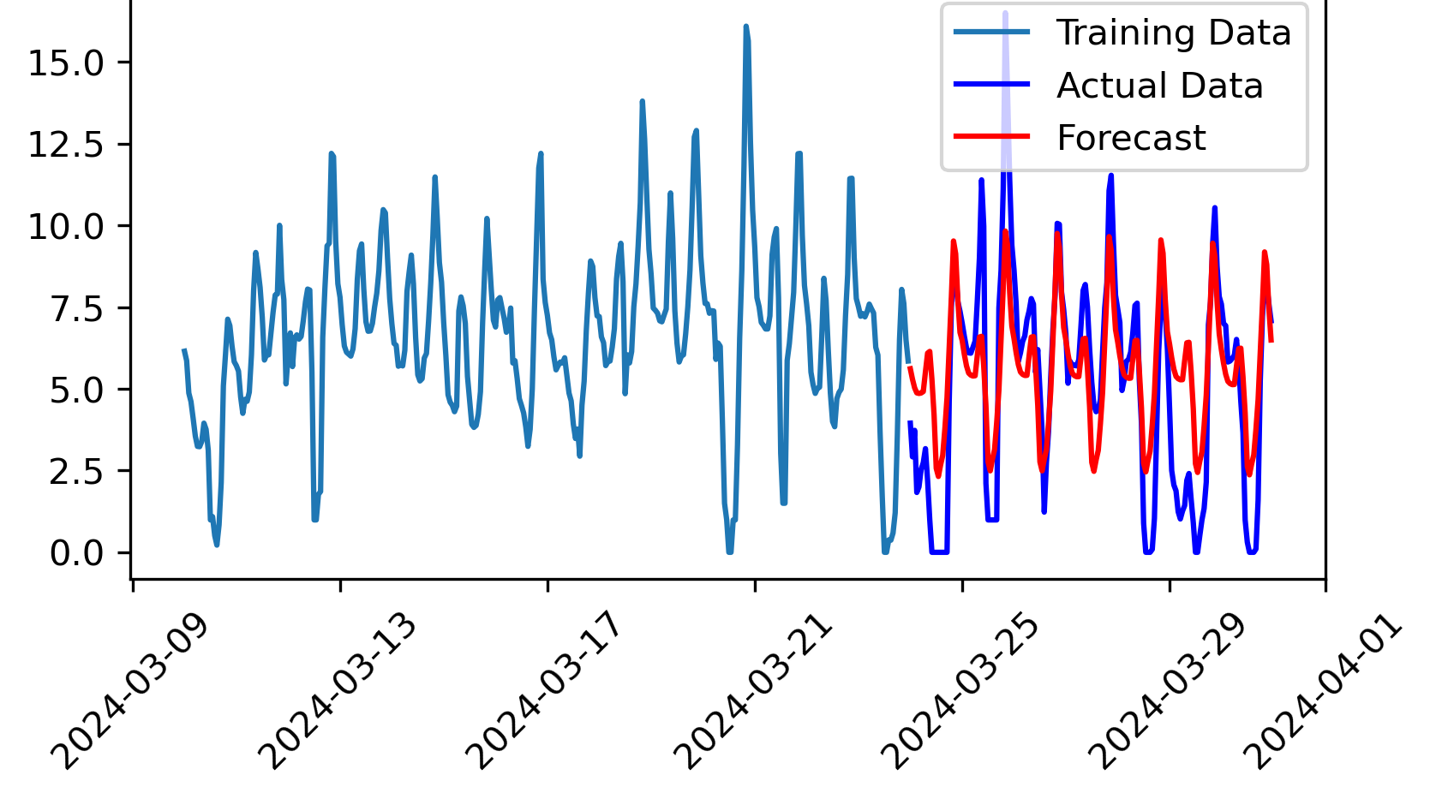
Insight from Predictive Models
Solar Energy Prediction Models
The gradient boosting model achieved R² of 0.90
Top three weather-related features are humidity, cloud cover, solar radiation availability.
Electricity Cost Prediction Models
The data is stationary and exhibits a 24-hour seasonality. The time series analysis was conducted using SARIMAX, achieved a root mean squared error of 2.22 cents per kilowatt as the difference between the actual and forecasted values over the last 168 hours of data.
Solar Energy Prediction Models: Feature Importance from Gradient Boosting Model
Electricity Cost Prediction Models: The SARIMAX with 24-hour seasonality

Slide 10
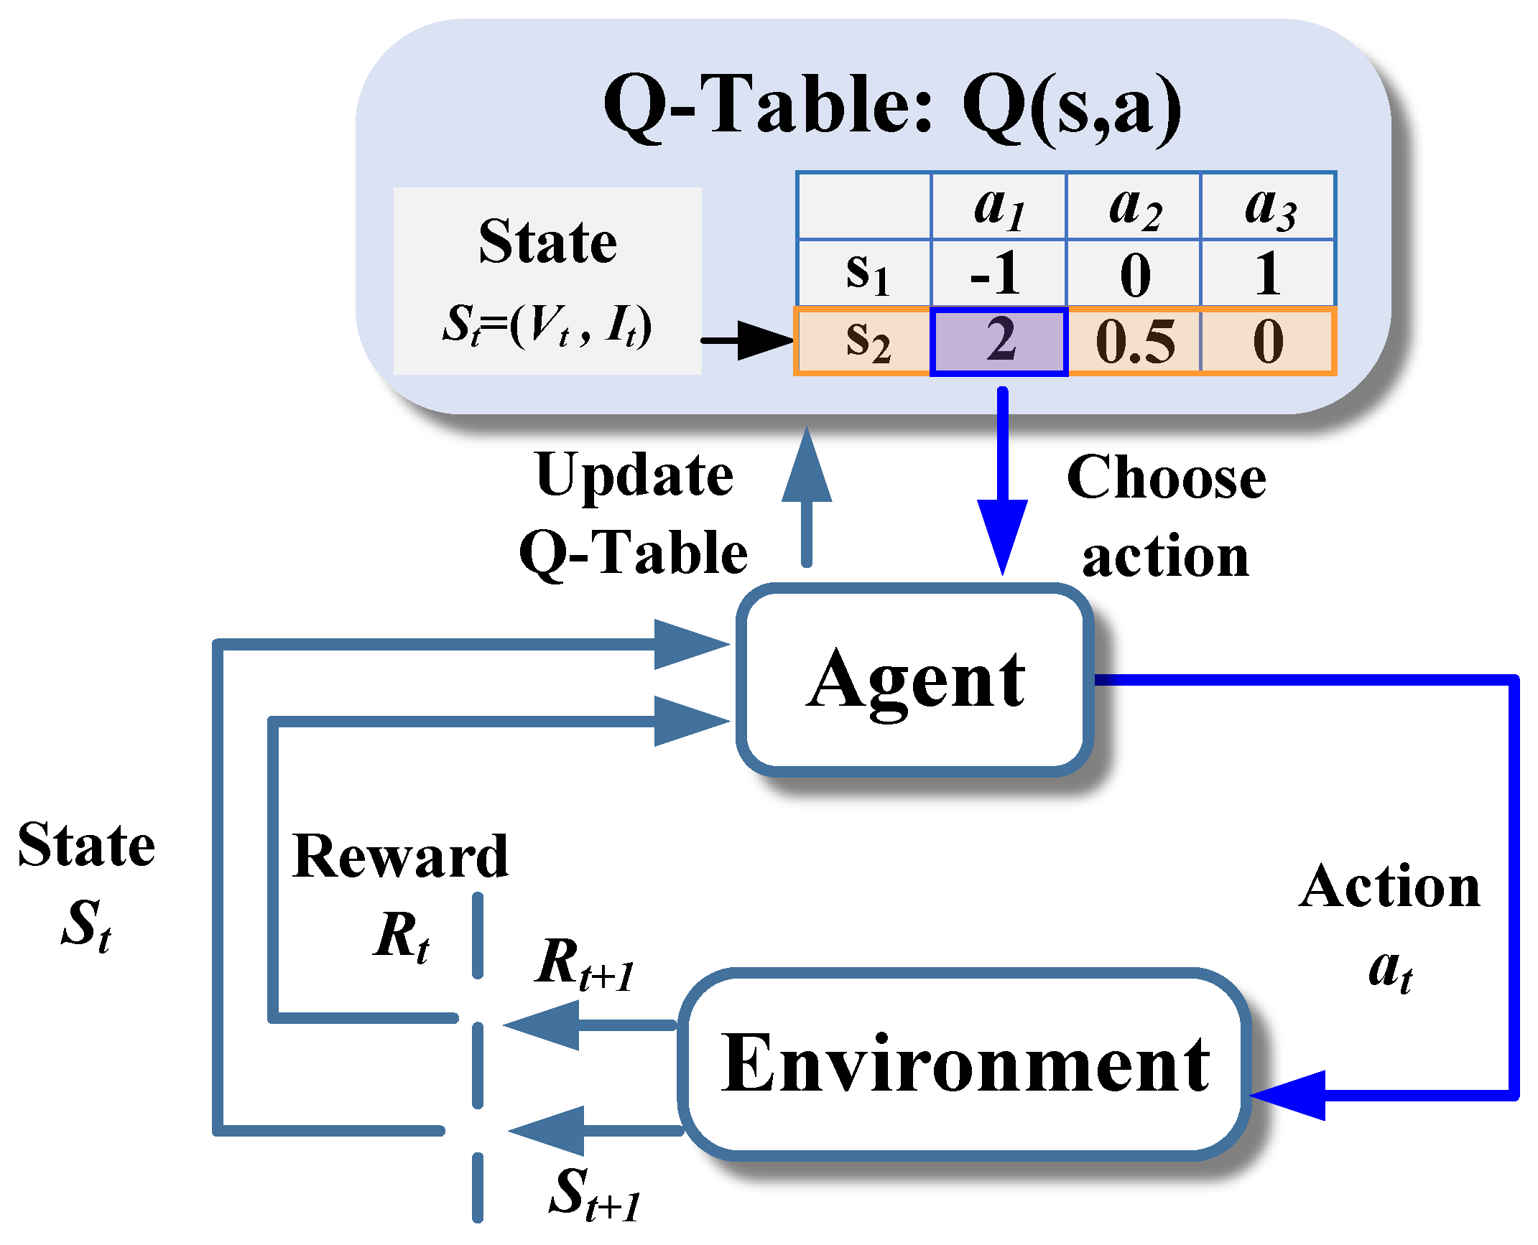
Introduction to Reinforcement Learning
Reinforcement Learning (RL) is a branch of machine learning where an agent learns to make decisions by interacting with an environment to maximize cumulative rewards.
The agent observes the state of environment, takes actions, and receives feedback in the form of rewards. Overtime, the agent learns a policy, a mapping from states to actions, that maximizes the expected cumulative rewards.
One of the foundational methods in reinforcement learning is Q-learning.

