Slide 1
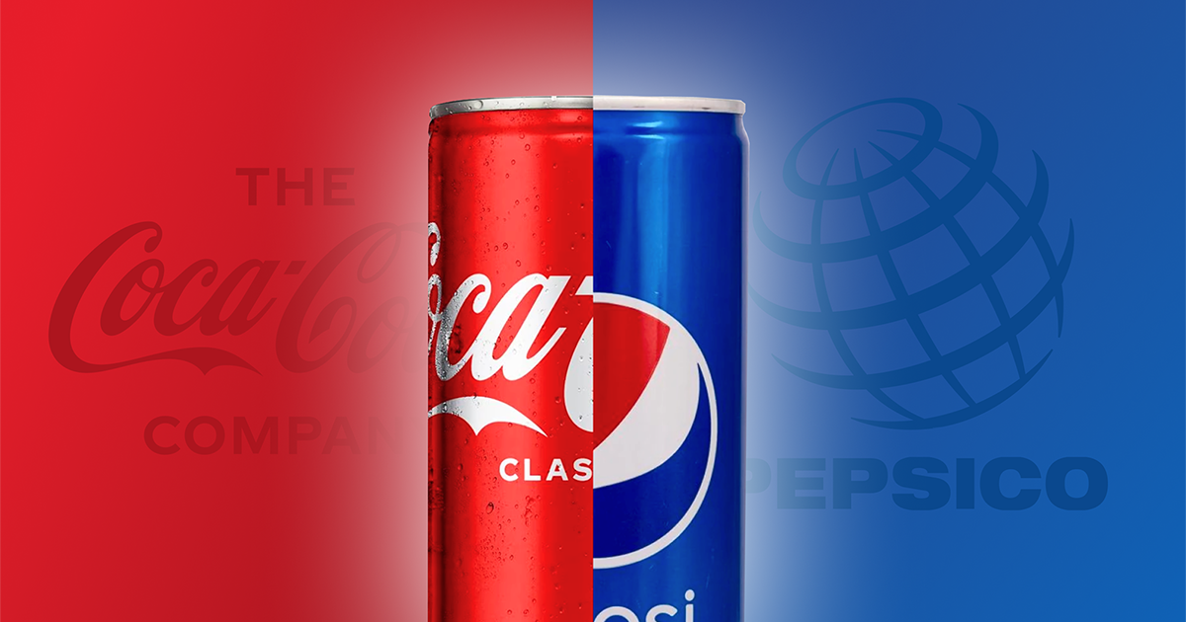

Understanding Pepsi and Coca-Cola
Trends, Sentiment, and Brand Fit 2024-11-21

Slide 2
Problem Statements
What People Are Talking About:
Find the common words and sentiment in discussions about Pepsi and Coca-Cola to see what people are interested in.
Matching Brand Identity:
Use an NLP model to predict if a message is about Pepsi or Coca-Cola and check if it matches each brand's mission.

Slide 3
Study Process
Extract Subreddit Posts from r/Pepsi and r/cocacola
Preparing Data
Exploratory Data Analysis
Sentiment Analysis
Vectorizer and Tokenizer
Model Tuning
Application

Slide 4
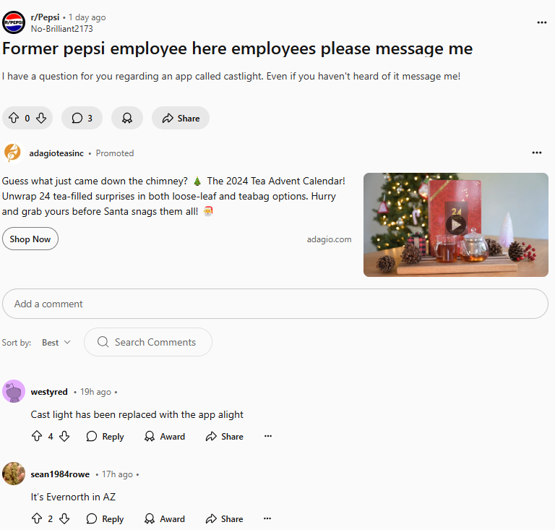
is_pepsi = 1
Title
Preparing Data
Body
Concatenate Title and Body
Create column is_pepsi
Lower text and remove related words; pepsi, pepsico, coca, cola, coke
Pepsi
995
Posts
Coca-Cola
963
Post

Slide 5
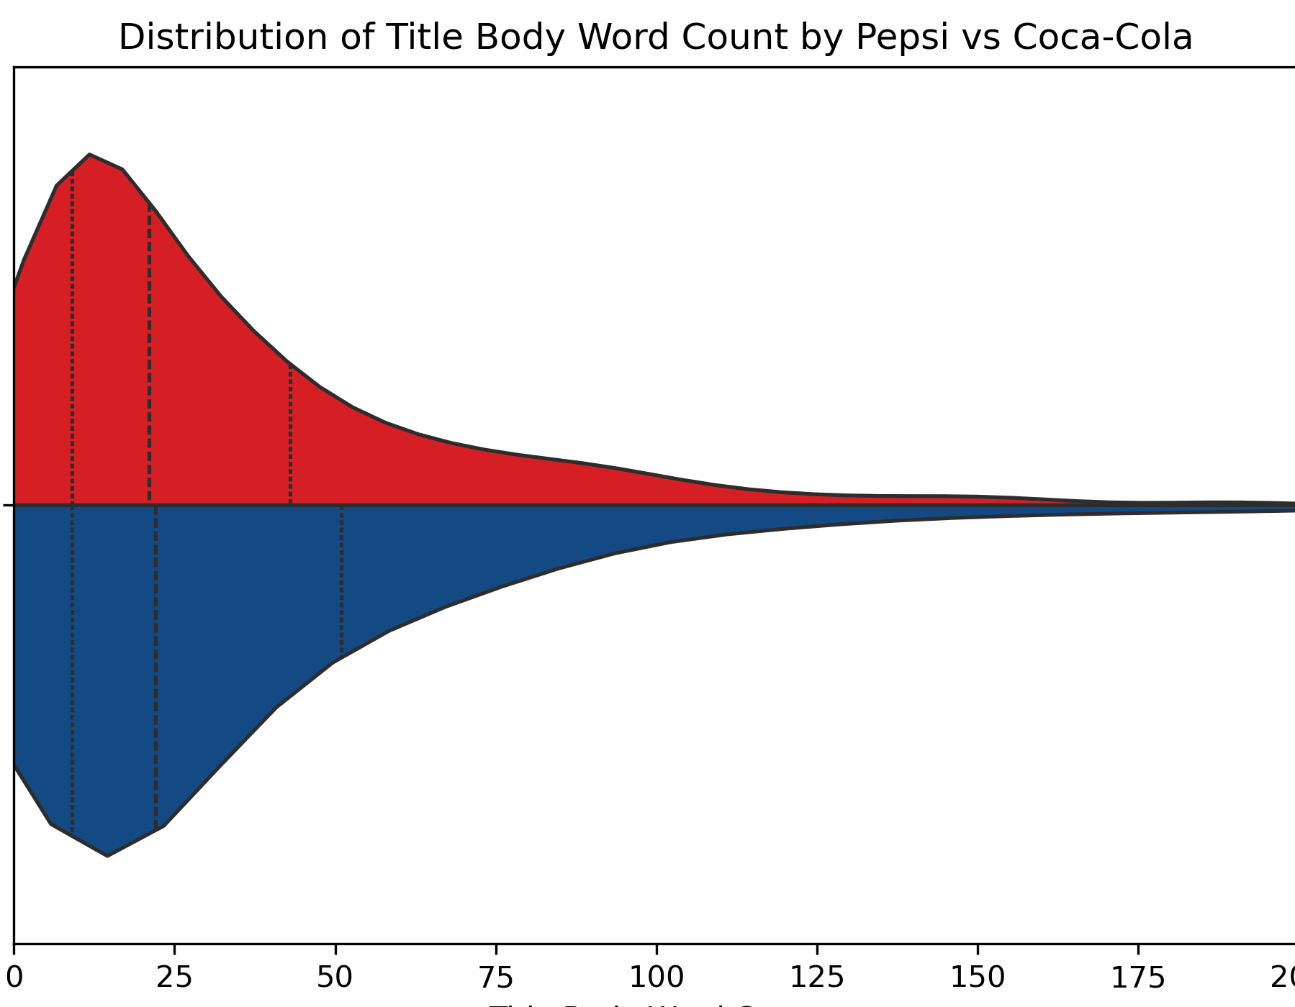
Exploratory Data Analysis
Q3 – 43 words
Word Counts
Similarities in Lower Quartiles
Differences in Higher Quartiles
Pepsi have more word counts than Coca-Cola
Coca-Cola
Pepsi
Q3 – 51 words

Slide 6
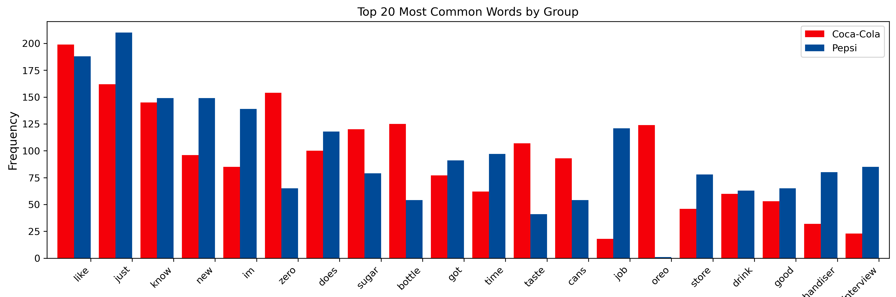
Exploratory Data Analysis
Common Words
Words that frequently show across all documents
Stopwords: like, just, know, new, im (I’m), does
Keywords: zero, sugar, bottle

Slide 7
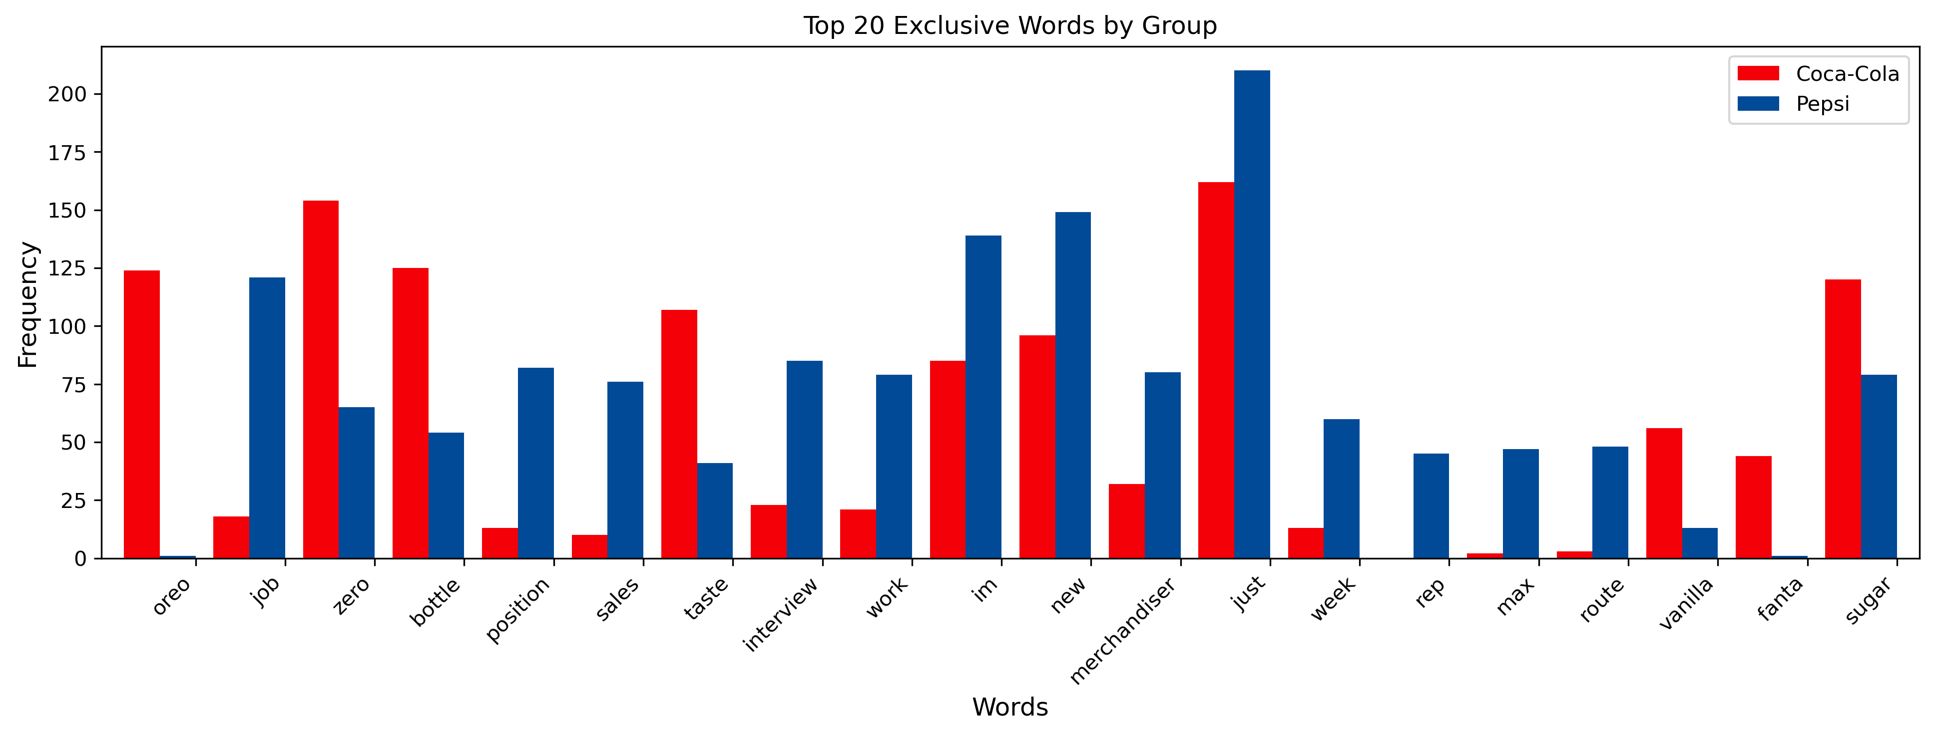
Exploratory Data Analysis
Exclusive Words
Words that mostly show either in Pepsi or Coca-Cola
Find the difference in the count of occurrences between Pepsi and Coca-Cola

Slide 8
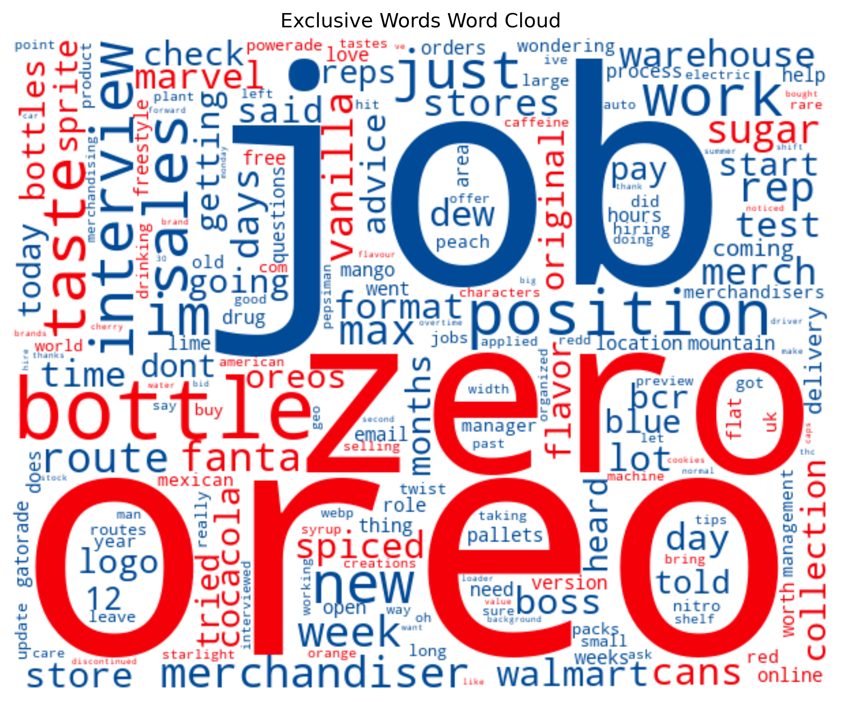
PepsiCo is closing 4 bottling plants and cutting nearly 400 jobs as it streamlines operations
#pepsi
Exploratory Data Analysis
Word Cloud
This word cloud displays words in red for Coca-Cola and in blue for Pepsi, with word size reflecting the difference in occurrences between the two brands
Never seen this kinda Coke bottle. Pretty fun IMO.
Does anyone have any info about this Coca-Cola Hip Hop bottle?

Slide 9
Pepsi
Coca-Cola
Sentiment Analysis
995
Posts
963
Post
454
Positive
477
Compound Score
Focus overall Sentiment
Sensitive to modifiers, negations, and emphasis
NPS Net Promoter Score
is a metric used to gauge customer satisfaction, range between -1 and 1
Score > 0.05
354
Neutral
323
- 0.05 <= Score <= 0.05
187
Negative
163
Score < 0.05
27%
NPS
33%
Positive - Negative
Total Posts

Slide 11
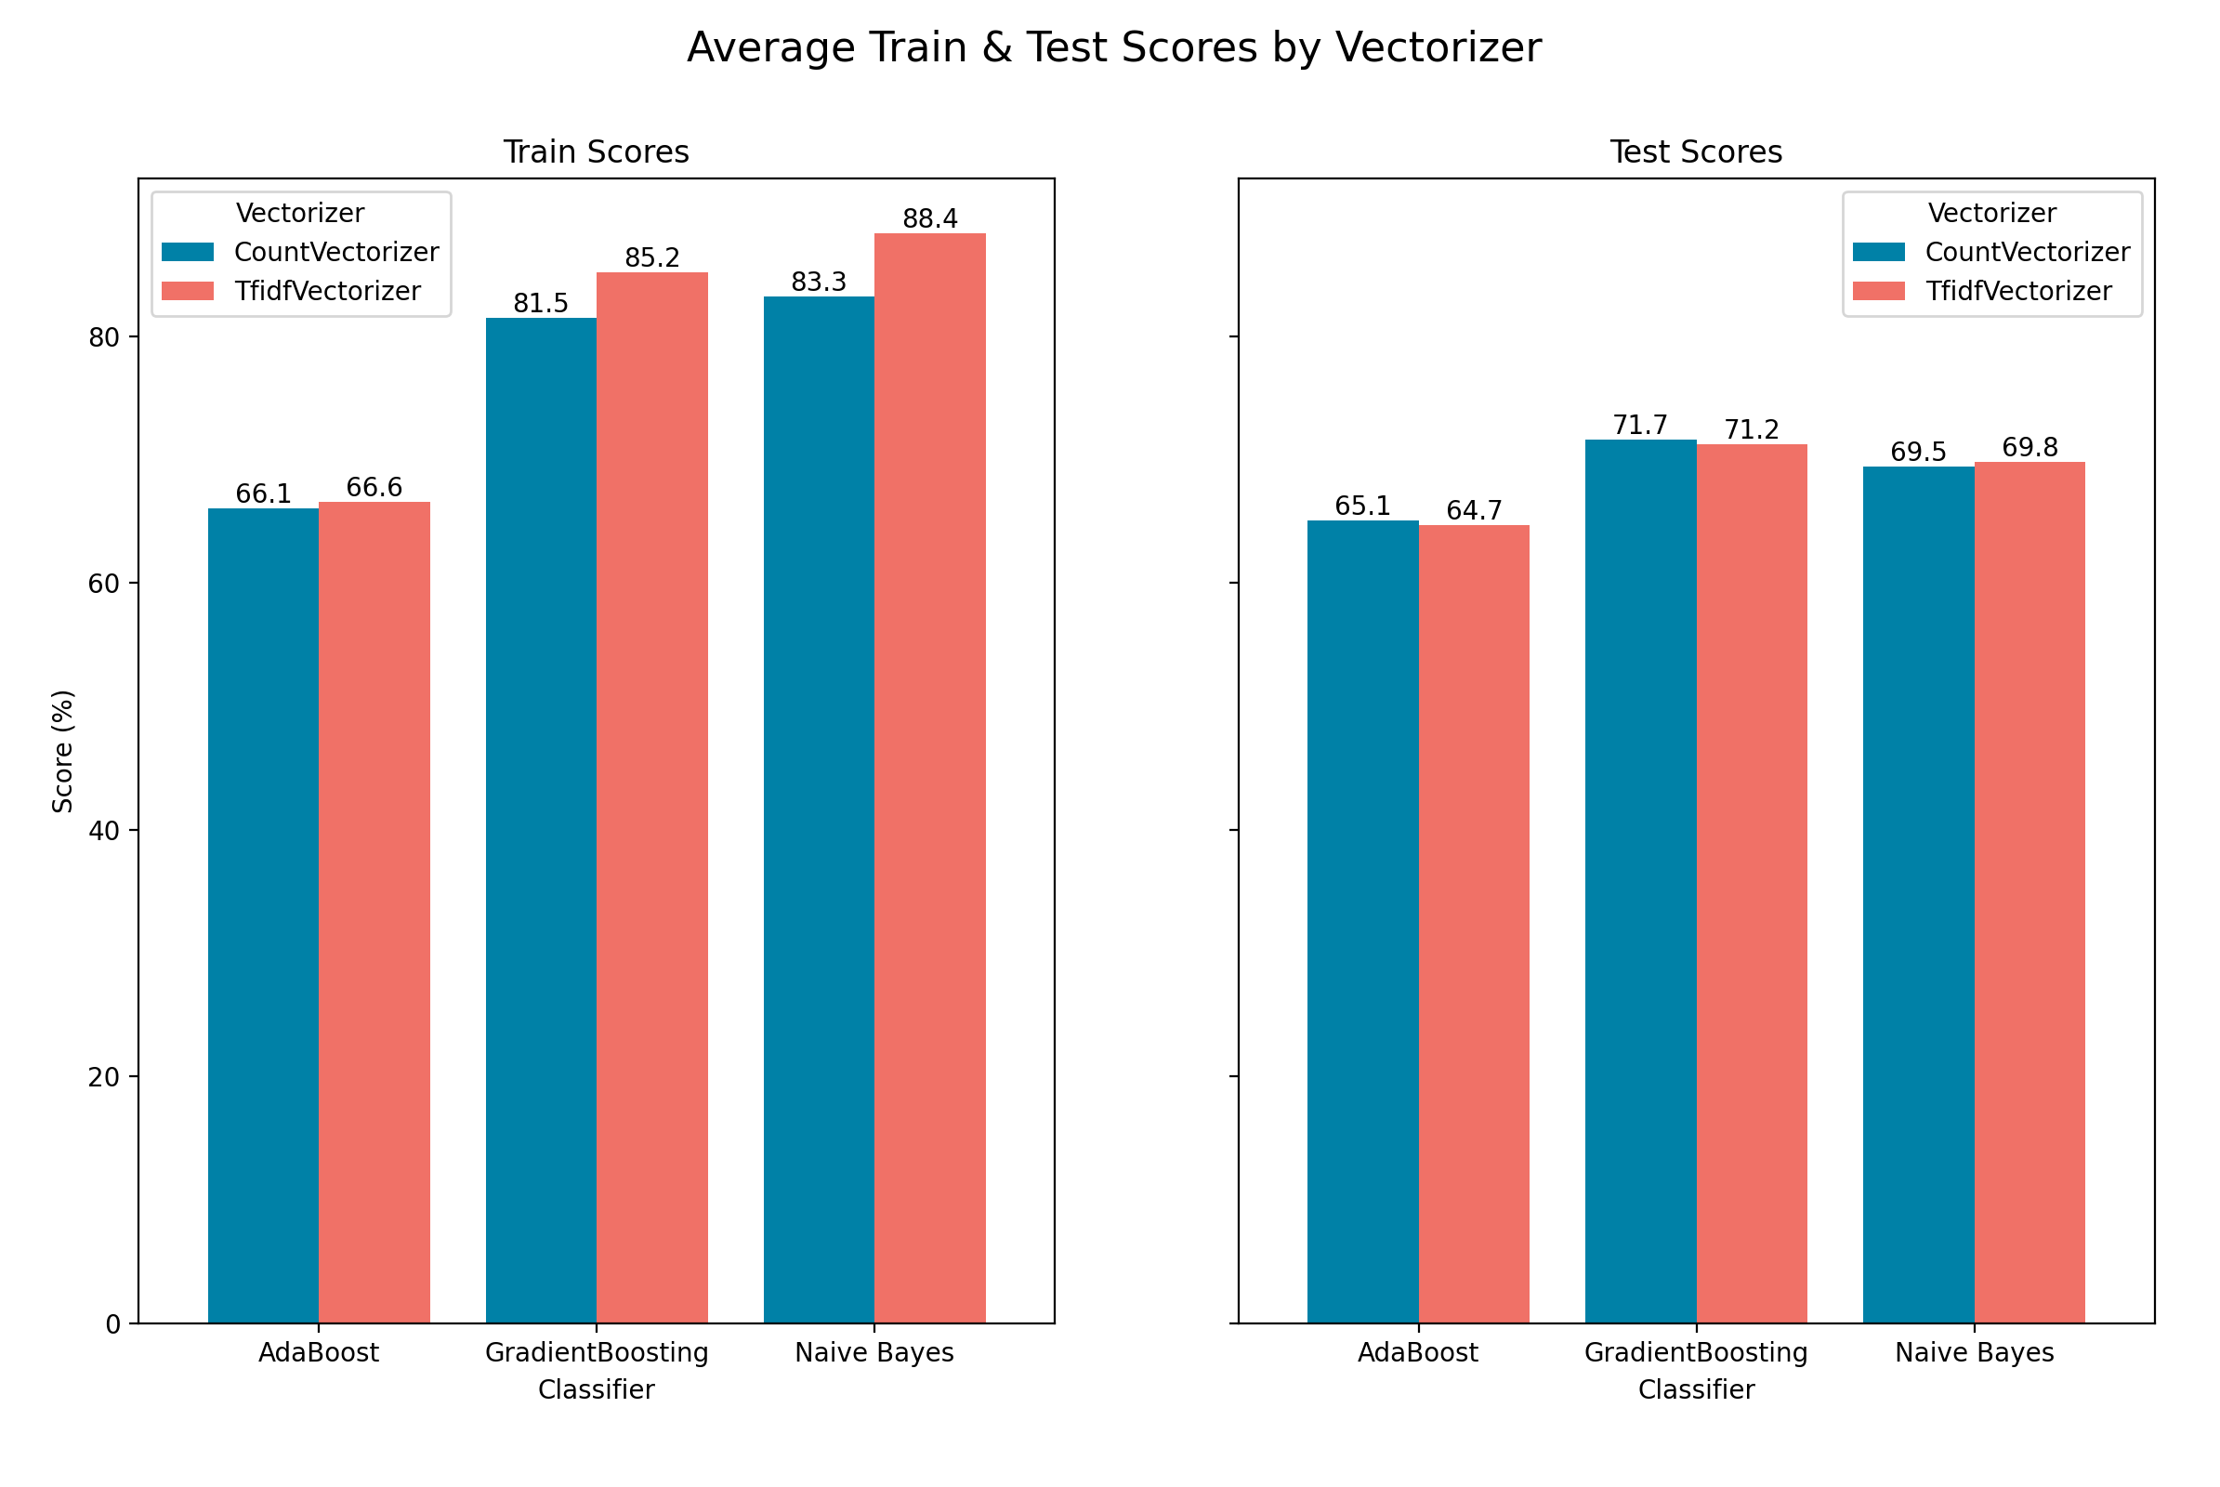
Vectorizer
TF-IDF vectorizer
Count vectorizer
The Train score increased
when using the TF-IDF vectorizer.
But not affect with Test Score

Slide 12
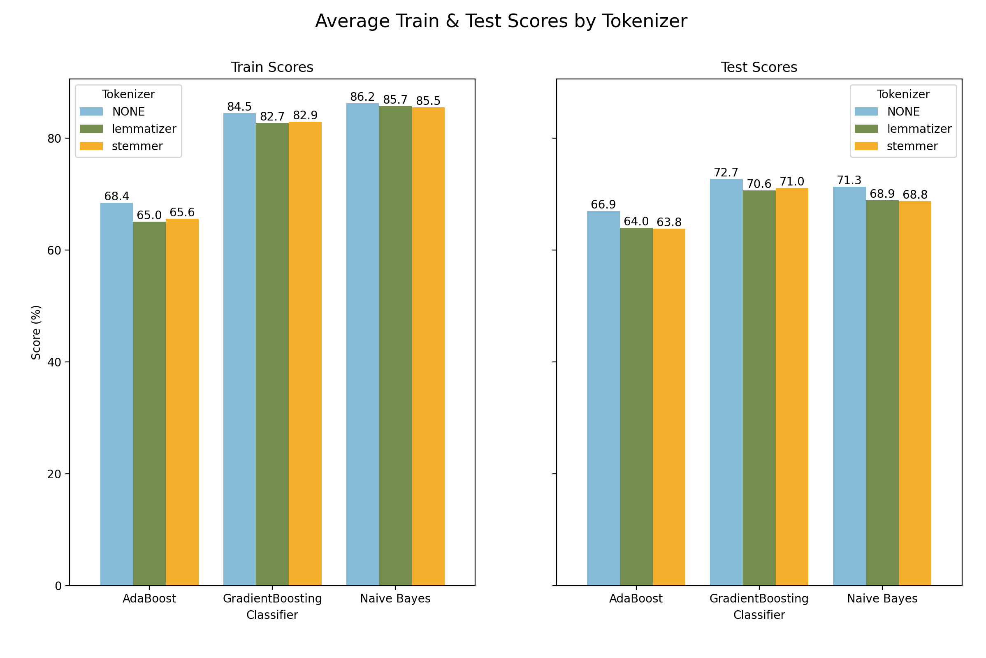
Tokenizer
None
Lemmatizer
Stemmer
The highest train score : Naïve Bayes
The highest test score : GredientBoosting
The least overfitting : AdaBoost

Slide 13
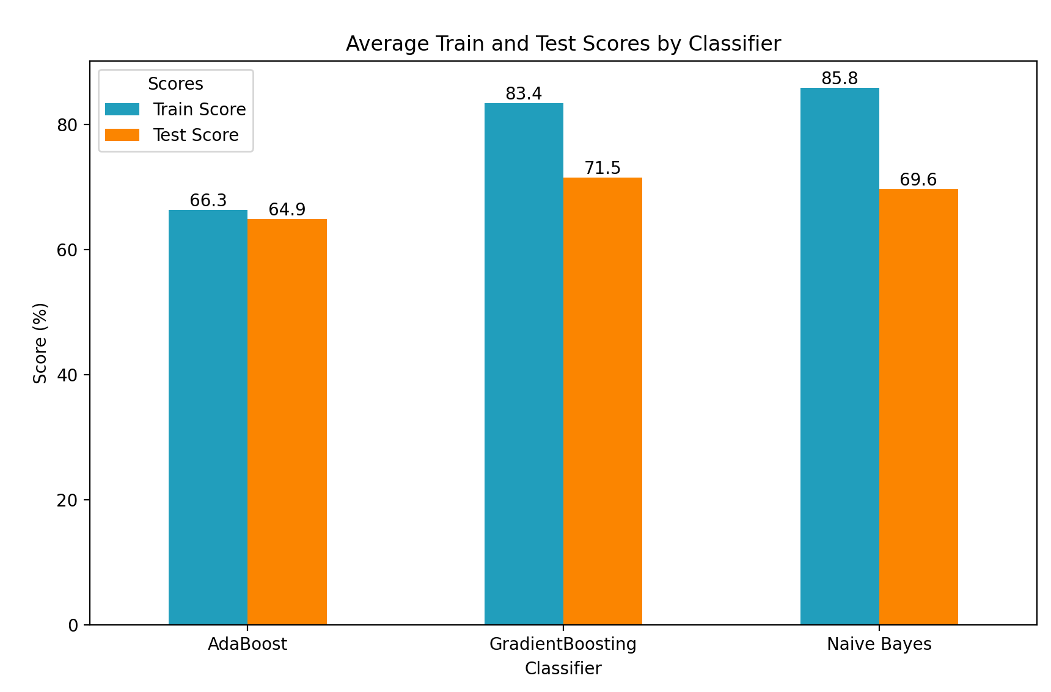
Classifier
AdaBoost
GredientBoosting
Naïve Bayes
The highest train score : Naïve Bayes
The highest test score : GredientBoosting
The least overfitting : AdaBoost

Slide 14
Best vectorizer params for Naïve Bayes
ngrams
(1,2) better than (1,1)
min_df
Least min_df More Accurate Score

Slide 15
Best Parameters for tuning
Gradient
Boosting
learning_rate = 0.3
max_depth = 4
min_samples_leaf = 2
n_estimators = 50

Slide 16
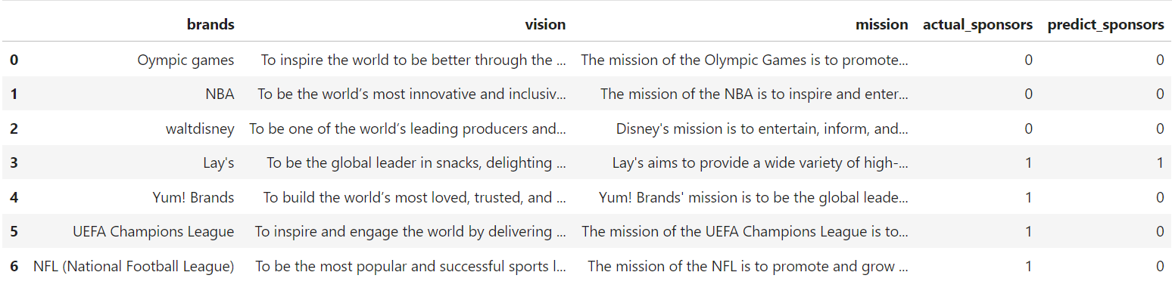
Application
Accuracy = 57%
Precision = 25%
Tp/(tp+fp)
Recall = 100%
Tp / (tp+fn)
Specificity = 50%
tn / (tn+fp)
f1 = 40%

Slide 17
Key Findings
What People Are Talking About:
Pepsi: Jobs
Coca-Cola: Oreo, zero, bottles
Sentiment: Pepsi < Coca-Cola
Matching Brand Identity:

